Slide 1
2025-26 NFHS Soccer PowerPoint

Slide 2


Slide 3
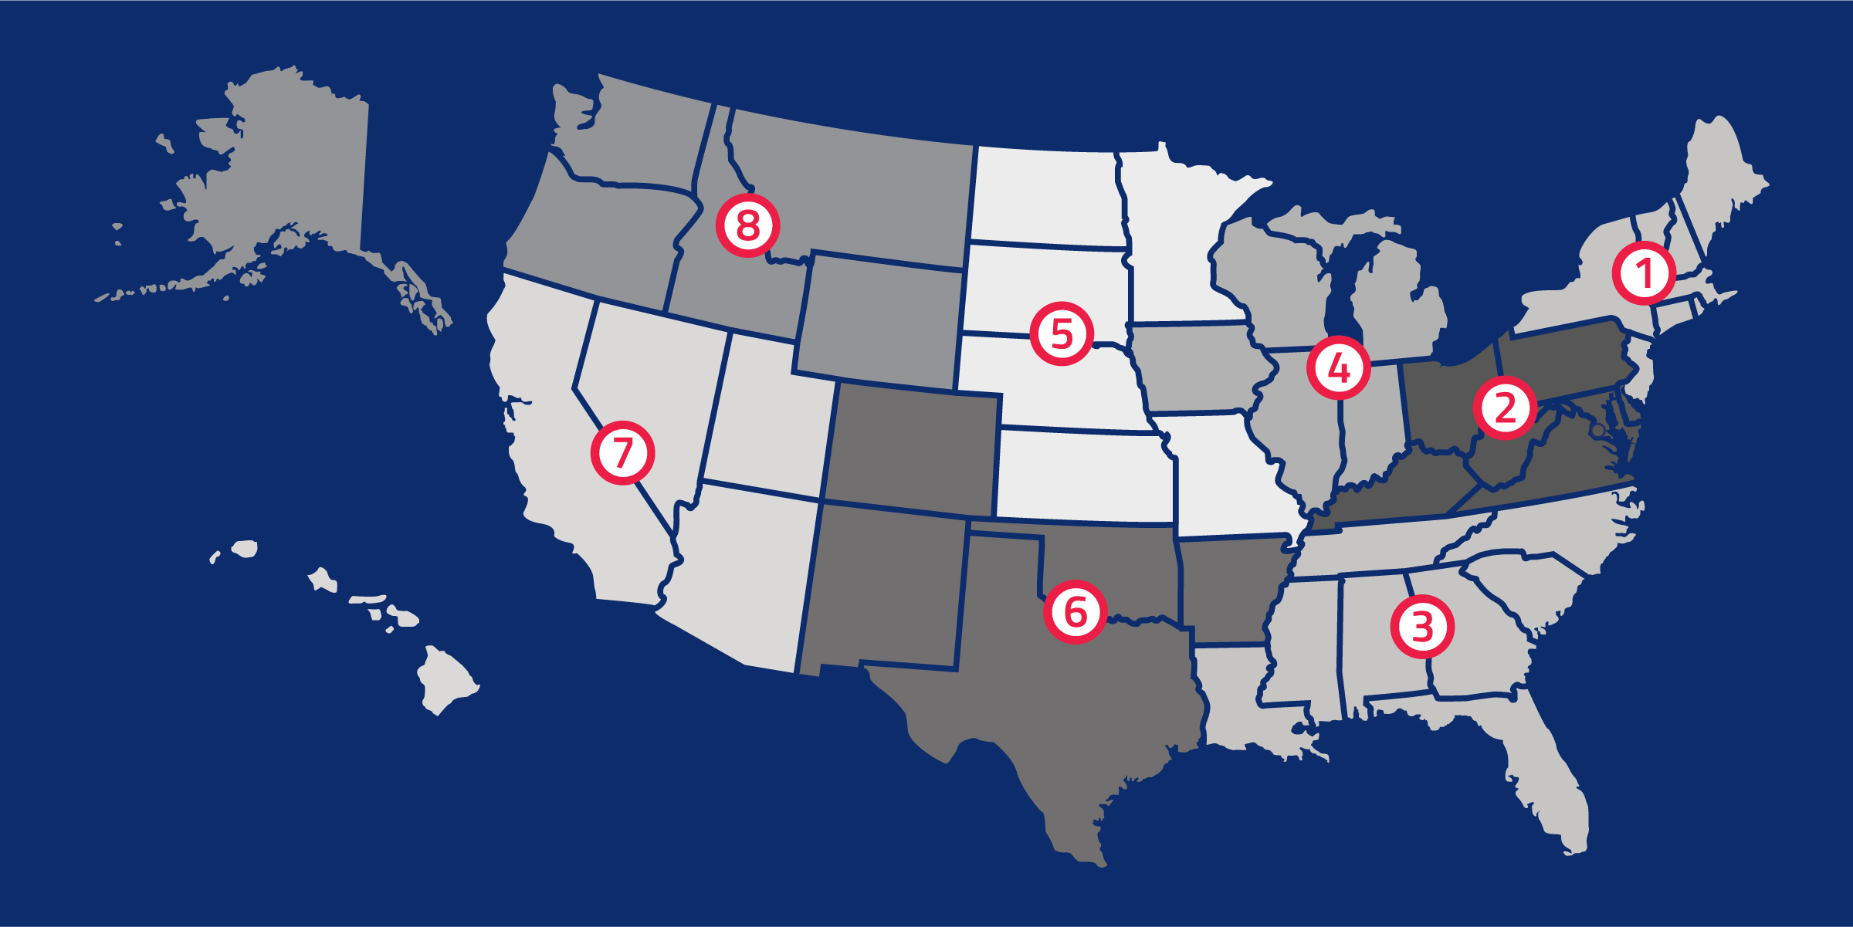
National Federation of State
High School Associations
NFHS (located in Indianapolis, IN – Est. 1920):
  National leader and advocate for high school
  athletics and performing arts programs.
  Serves 51 state associations, 19,800 high
  schools and 12 million student participants.
  Writes playing rules for 18 high school
  sports for boys and girls.
  Offers online education courses for high
  school coaches, officials, parents, students and others.
  Ensures that students have opportunity to enjoy healthy participation, achievement and good sportsmanship in education-based activities.
Notes:
The NFHS is the national leader and advocate for high school athletics and performing arts programs. Services of the NFHS reach more than 19,500 high schools and 12 million participants throughout the eight NFHS sections across the U.S.
A significant responsibility of the NFHS is the commitment to writing quality playing rules for 17 high school sports for boys and girls, in addition to providing educational resources for high school coaches, officials, parents and students.
It is the vision of the NFHS to help prepare tomorrow’s leaders for the next level of life through the many program offerings in education-based athletics and activities.

Slide 4









NFHS Rules Review Committee
The NFHS Rules Review Committee is chaired by the chief operating officer and composed of all rules editors. After each committee concludes its deliberations and has adopted its recommended changes for the subsequent year, such revisions will be evaluated
by the Rules Review Committee.
Davis Whitfield
Chief Operating Officer
Lindsey Atkinson
Boys & Girls Lacrosse and Volleyball
Julie Cochran
Cross Country, Soccer and Track & Field
Bob Colgate
Flag Football, Football and Sports
Medicine
Elliot Hopkins
Baseball and Wrestling
Monica Maxwell
Basketball, Field Hockey and Girls Gymnastics
Dan Schuster
Ice Hockey
Sandy Searcy
Softball, Swimming & Diving and Water Polo
James Weaver
Spirit
Notes:
The rules writing process is multi-tiered. Each year, specific committee meets to deliberate rules proposals submitted by state associations and committee members. After each committee concludes its deliberations and has adopted its recommended changes for the subsequent year, proposals are sent to the Rules Review Committee, who then evaluates the proposals and then forwards the to the NFHS Board of Directors for their consideration. The NFHS Rules Review Committee is chaired by the chief operating officer and consists of all NFHS rules editors

Slide 5




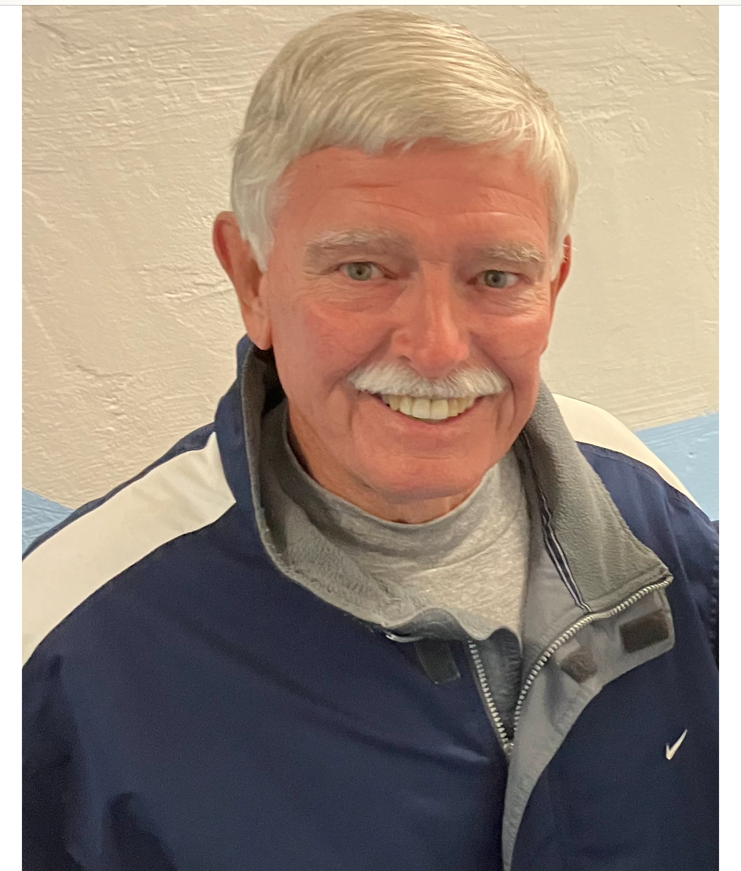



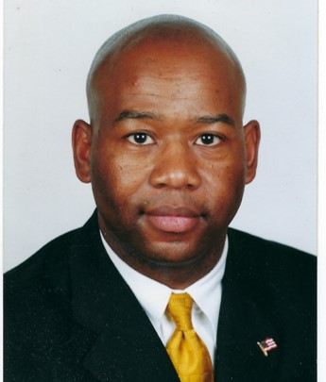



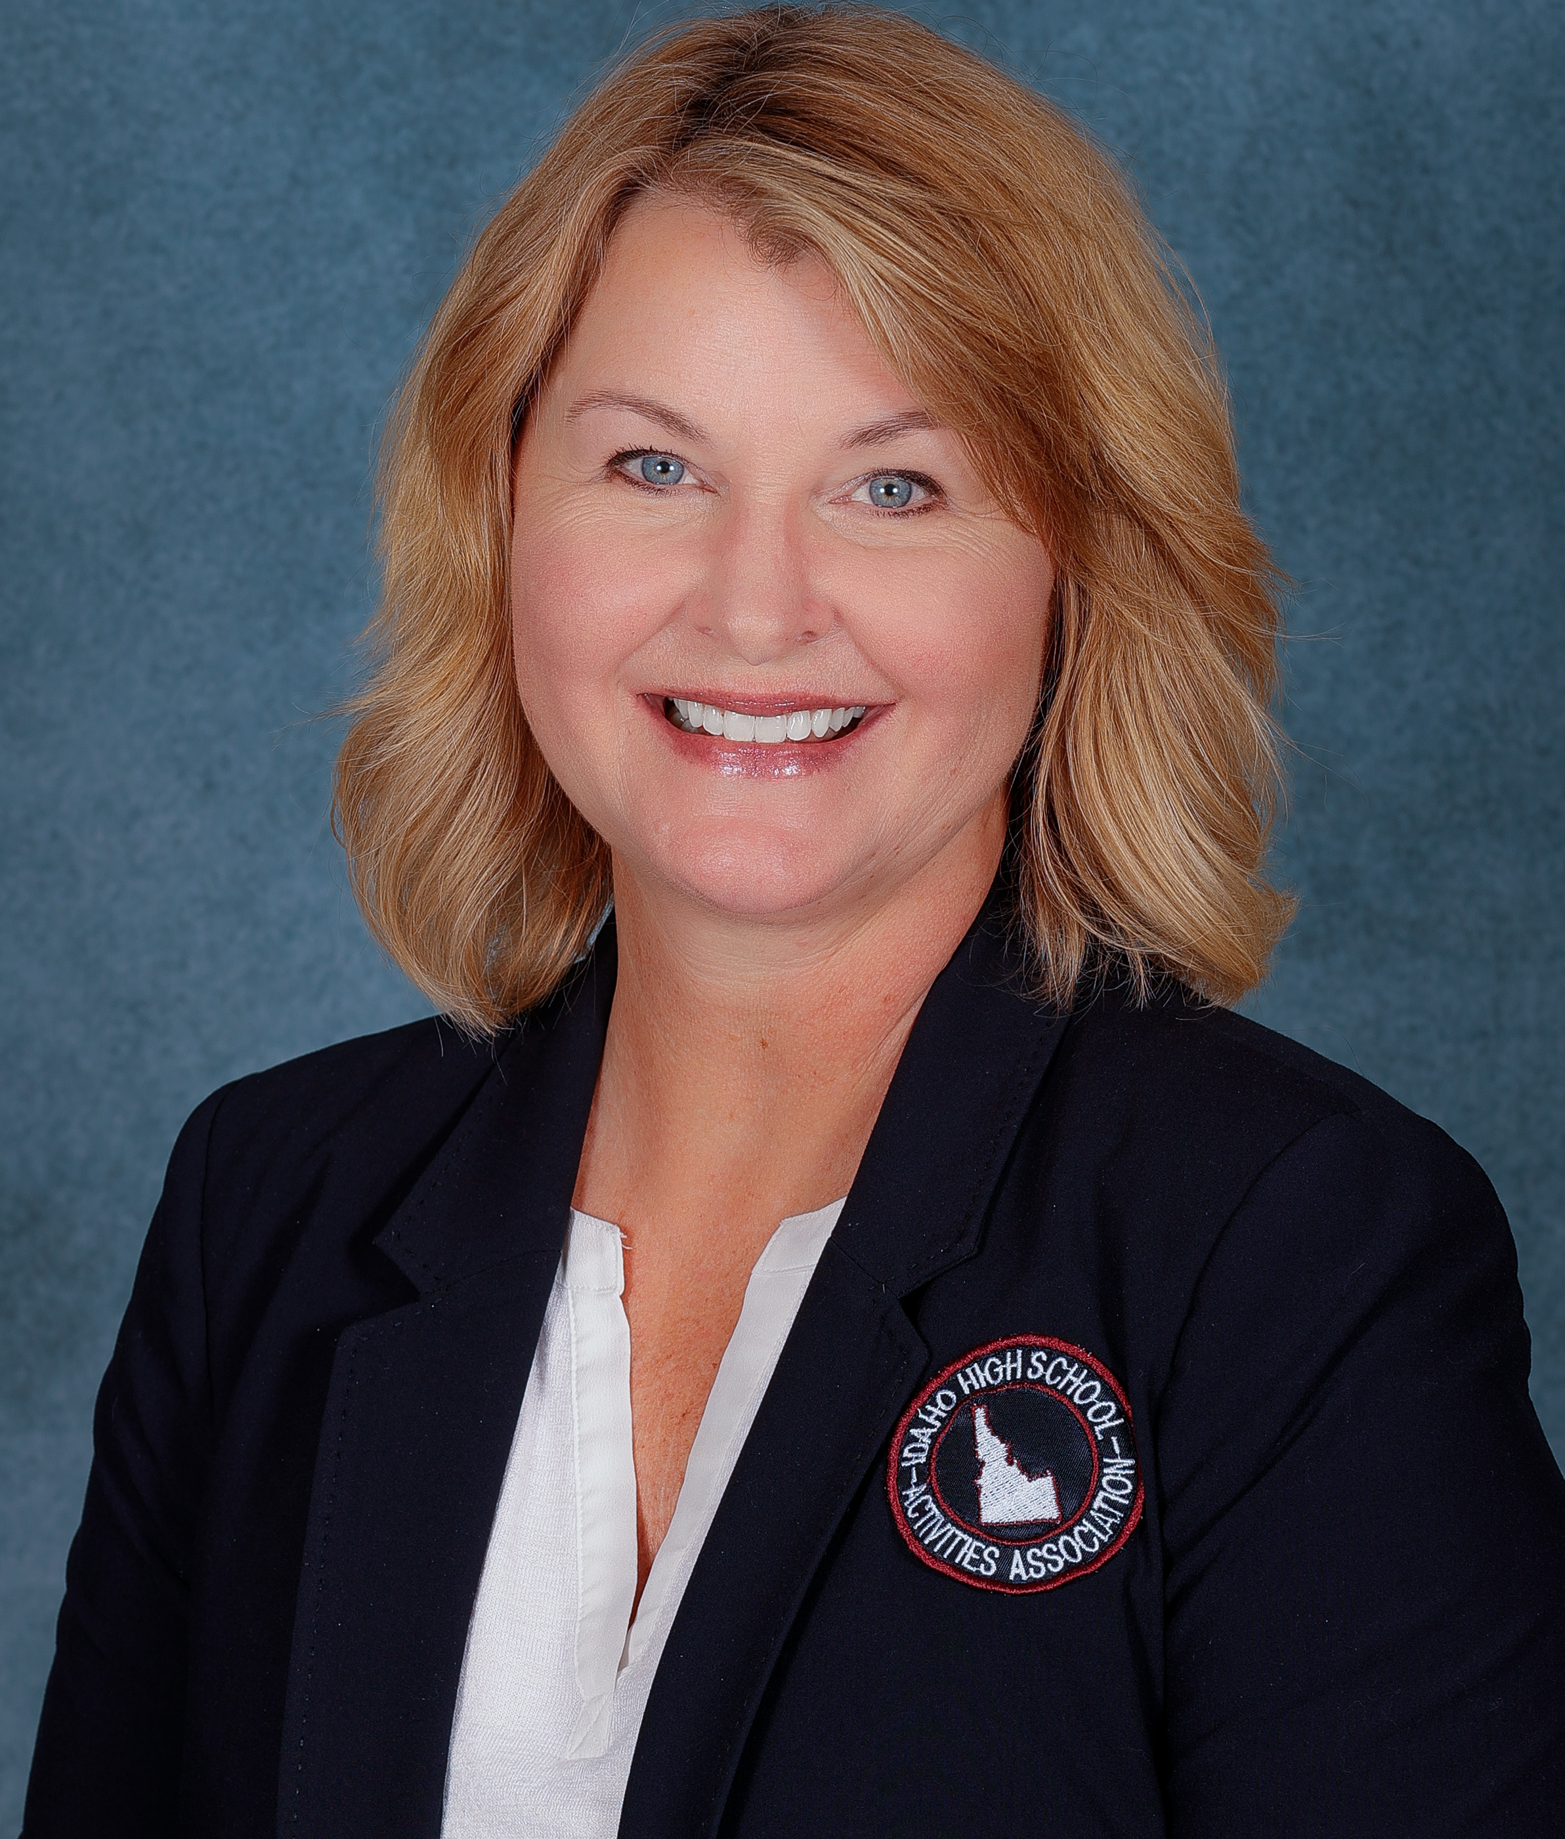
NFHS Rules Committee
Dr. Karissa Niehoff
NFHS
Publisher
Julie Cochran
NFHS
Editor
Gibby Reynolds
OR
Chair
Brianna Hines
VA
Coaches. - 2026
Teri Connor
NJ
Officials - 2027
Bob Cavanagh
RI
Section 1 - 2028
Marianne Shultz
MD
Section 2 - 2026
Mohan Telfer
MD
Section 2 - 2028
Brad Alford
NC
Section 3 - 2025
Roger Morton
NC
Section 3 - 2027
Beth Sauser
IL
Section 4 - 2026
Saul Hernandez
KS
Section 5 - 2025
Zac Stevenson
NM
Section 6 - 2028
Joe Oberndorfer
NV
Section 7 - 2027
Julie Hammons
ID
Section 8 - 2025
Notes:
The 2024-2025 Soccer Rules committee members. Representation of eight sections, the NFHS Officials Association, the NFHS Coaches Association, and Rules Committee Chair. The Committee is chaired by Gibby Reynolds from the Oregon High School Activities Association.

Slide 6


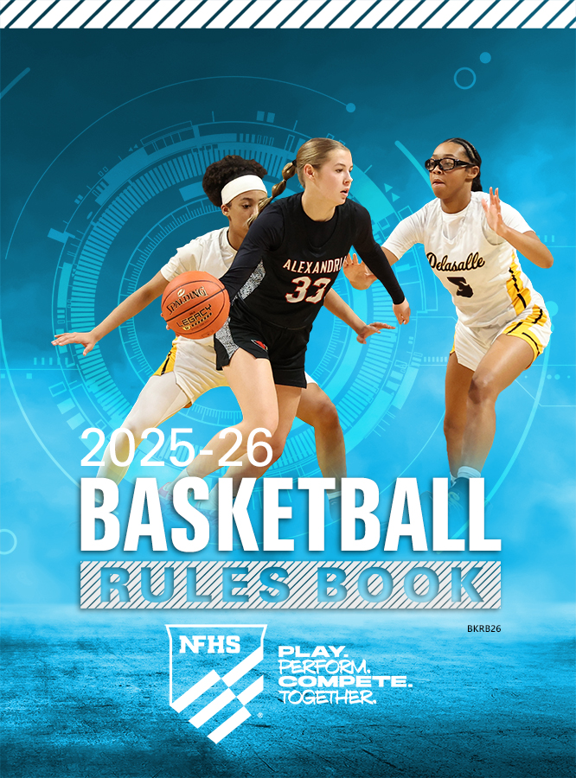
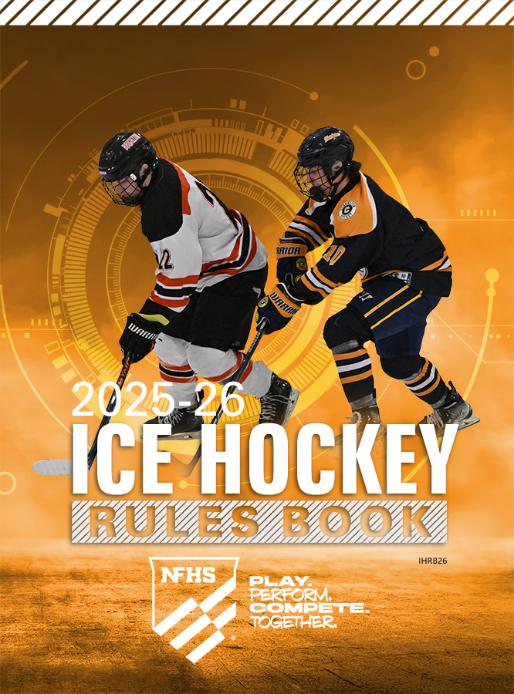
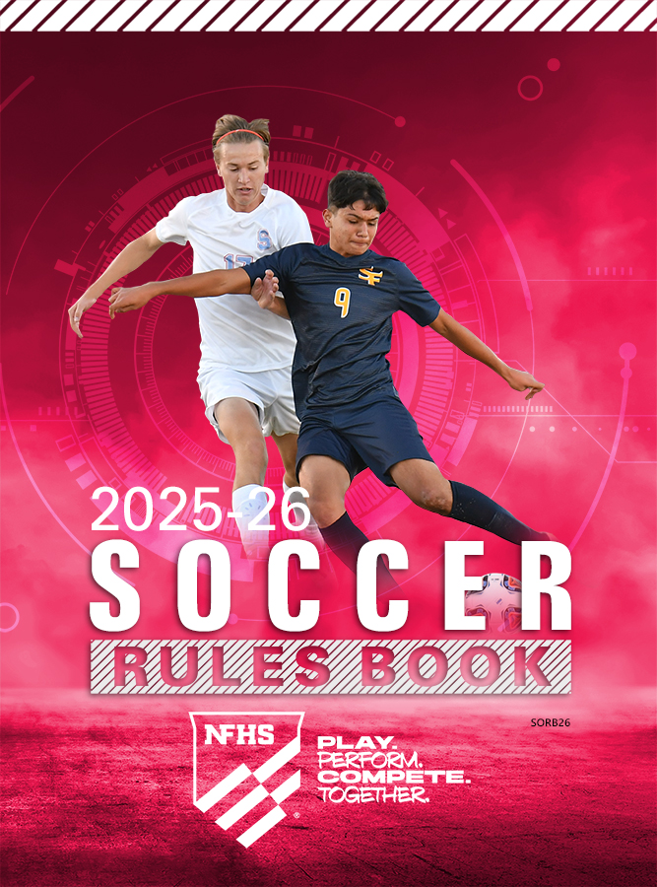



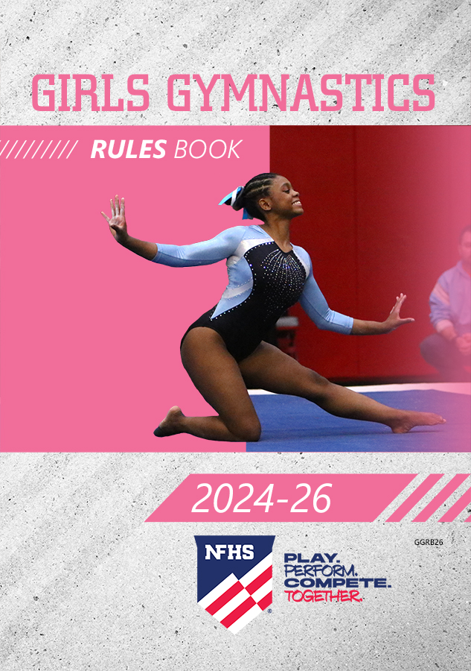
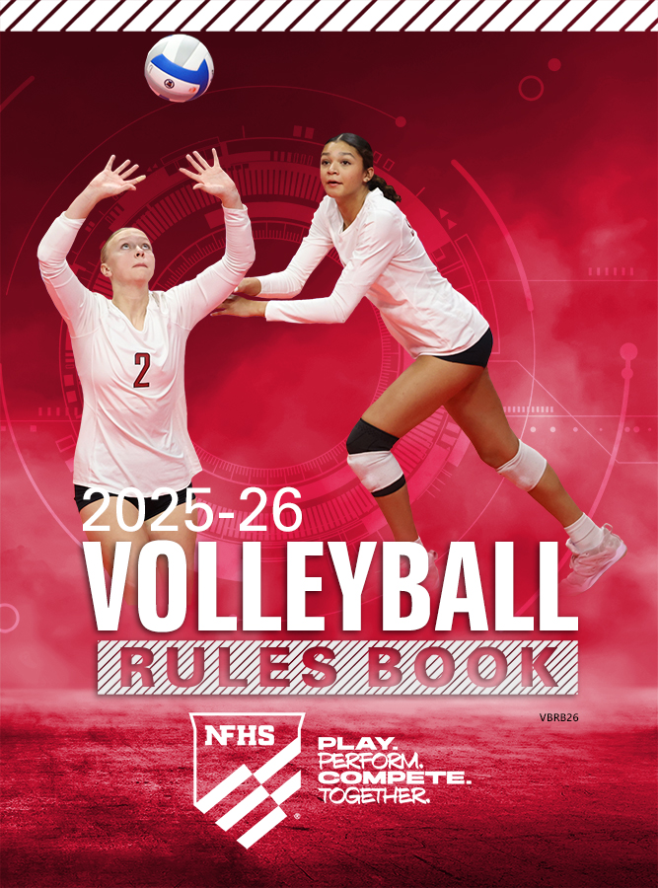


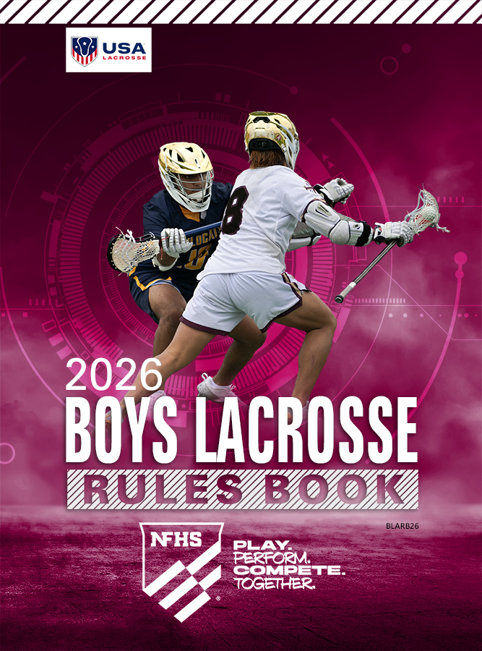



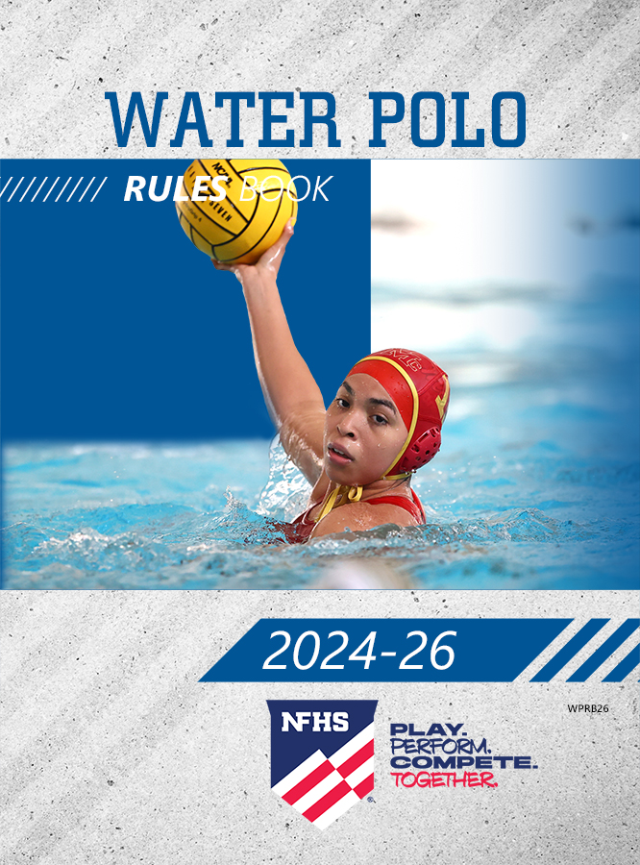
NFHS Publications
The NFHS writes playing rules for 18 sports
for boys and girls at the high school level.
  Publishes 2 million pieces of materials annually.
Notes:
The NFHS writes playing rules for 18 sports for boys and girls at the high school level and publishes 4 million pieces of materials annually. Flag Football is the newest addition to this group.

Slide 7


NFHS Digital
NFHS Digital is the New Publications Platform that includes:
  Rules Books
  Case Books
  Officials Manuals
  Policy Debate Quarterly
  Other NFHS Publications
Visit nfhs.org/NFHSDigital

Slide 8
NFHS Digital – Mobile App
Access via Mobile App:
  View available publications for sale
  View publications assigned to you
  Create comments and save notes
  Highlight important content to review later
  Available on App Store and Google Play

Slide 9
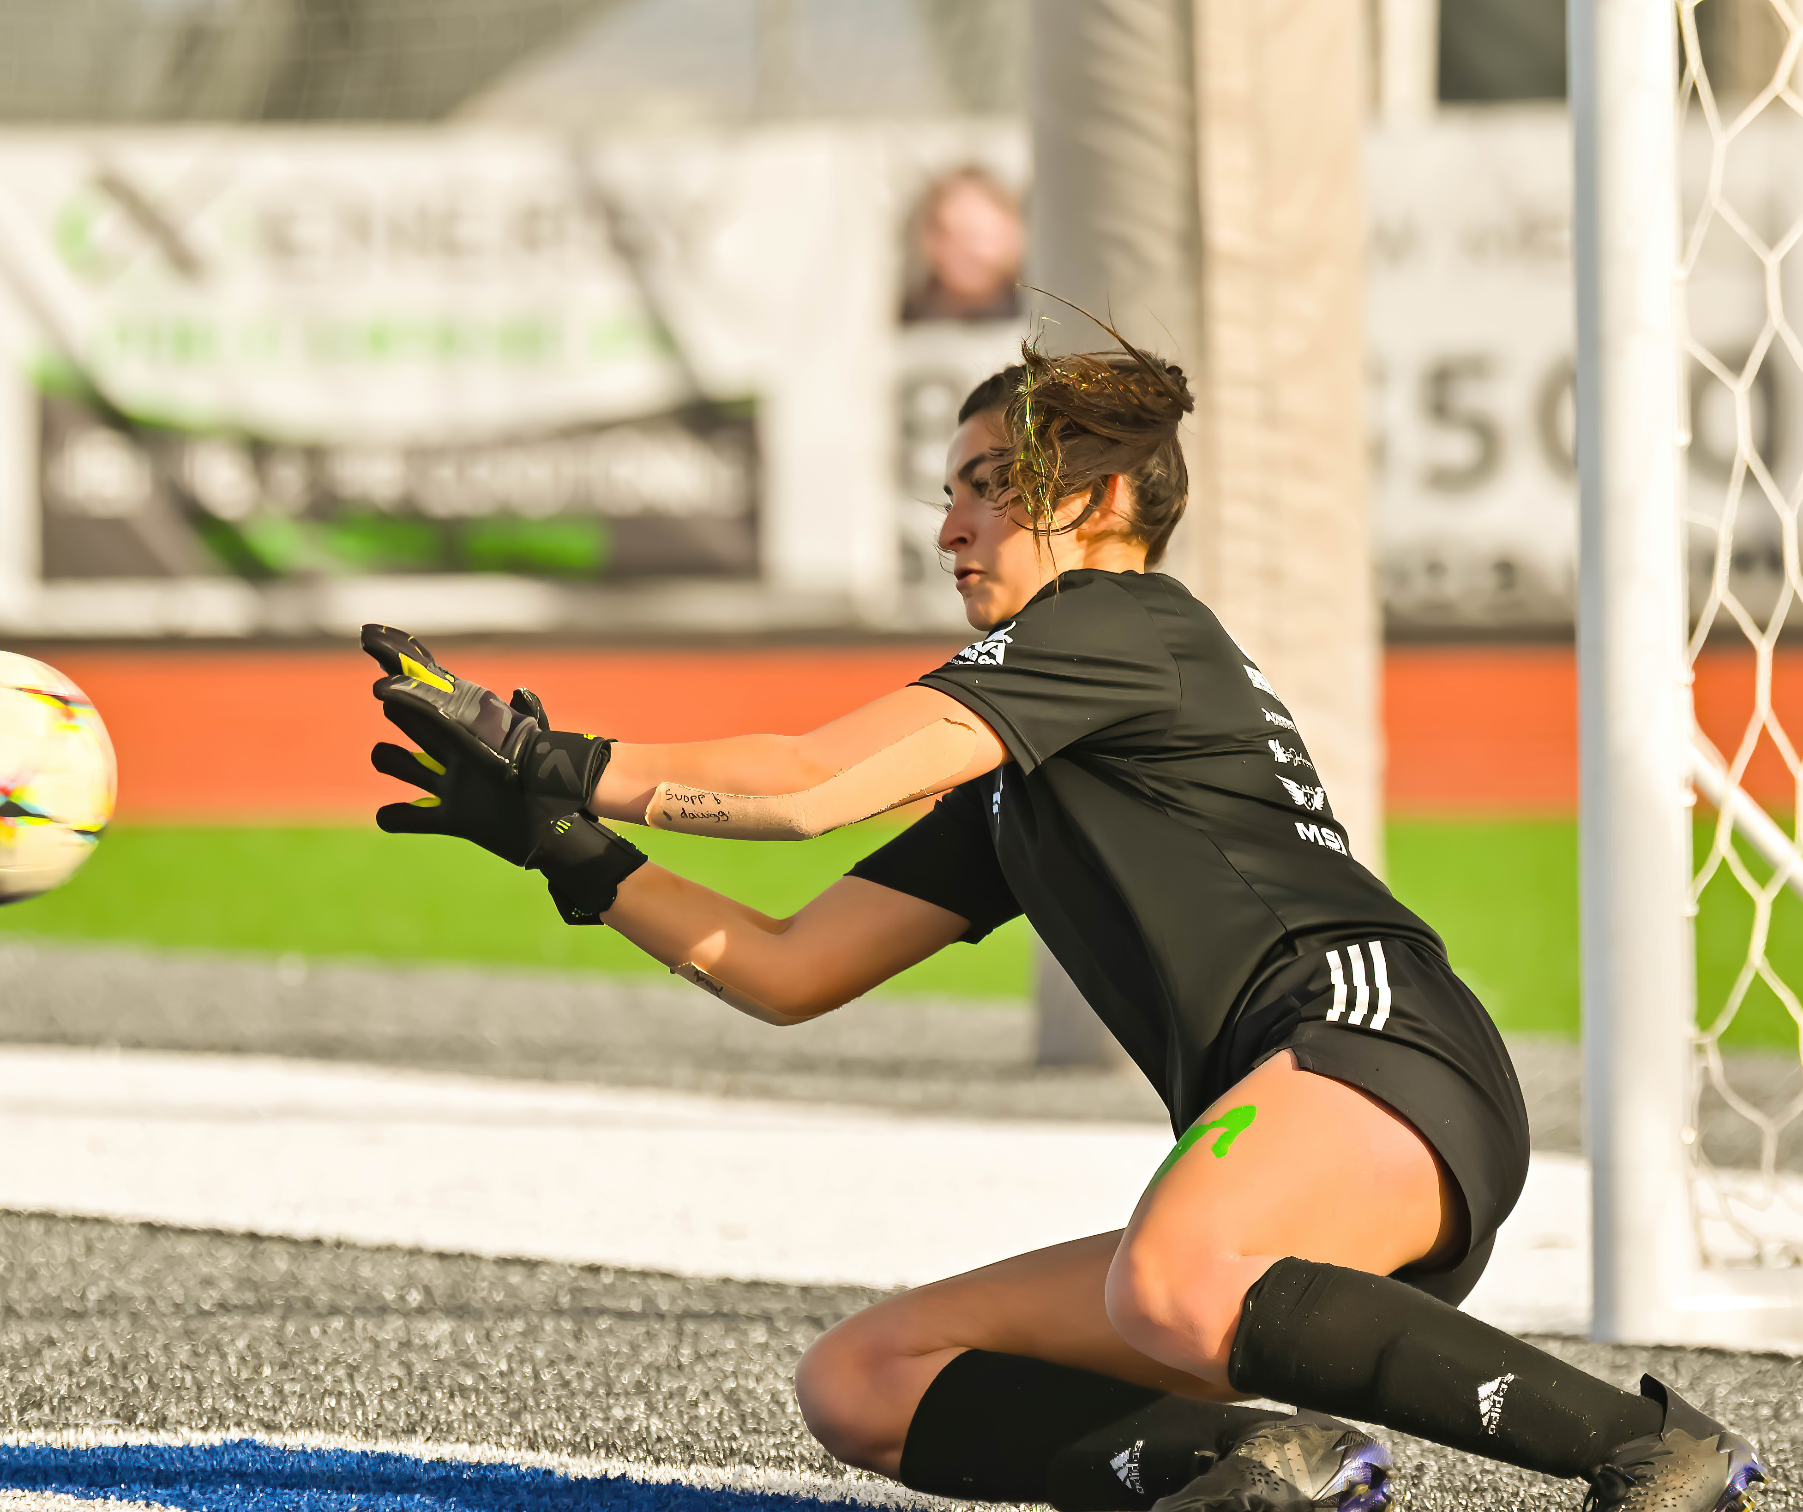
2025-26 NFHS Soccer Rules Changes

Slide 10
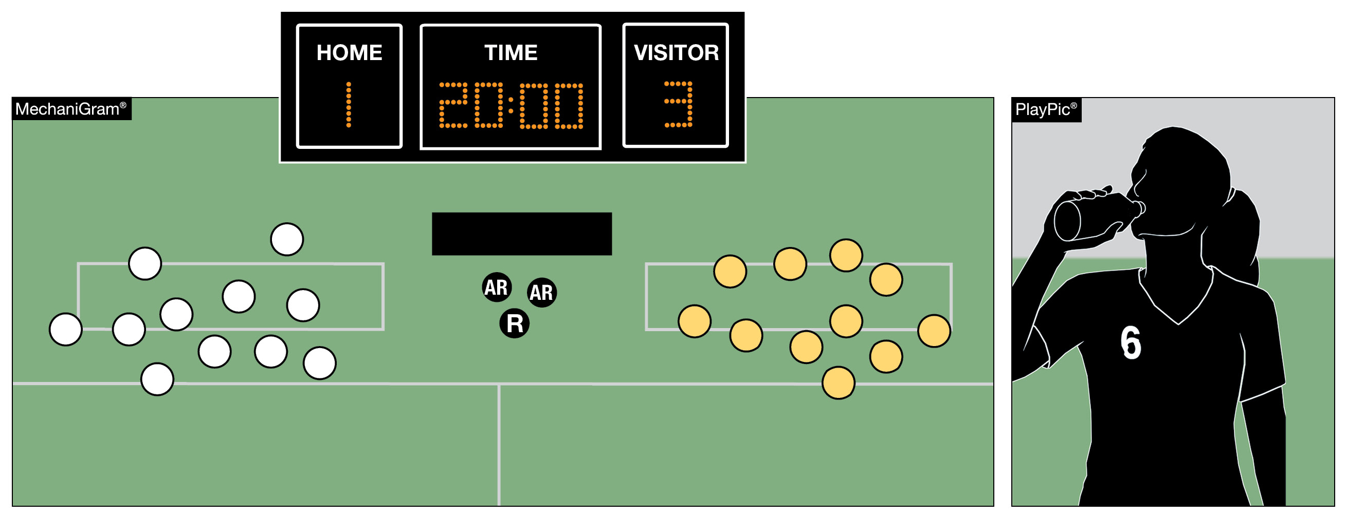
SUBSTITUTIONS
RULE 3-3-2c
In addition to being able to substitute players after a goal is scored or when a player is injured, teams may substitute players when a game is temporarily suspended.
Notes:
Rationale: The rule change eliminates redundant language and allows substitutions during a temporarily suspended game. In hot weather, state associations often authorize stoppages within a half for water breaks. Under this change, teams would now be permitted to make substitutions during these stoppages.

Slide 11
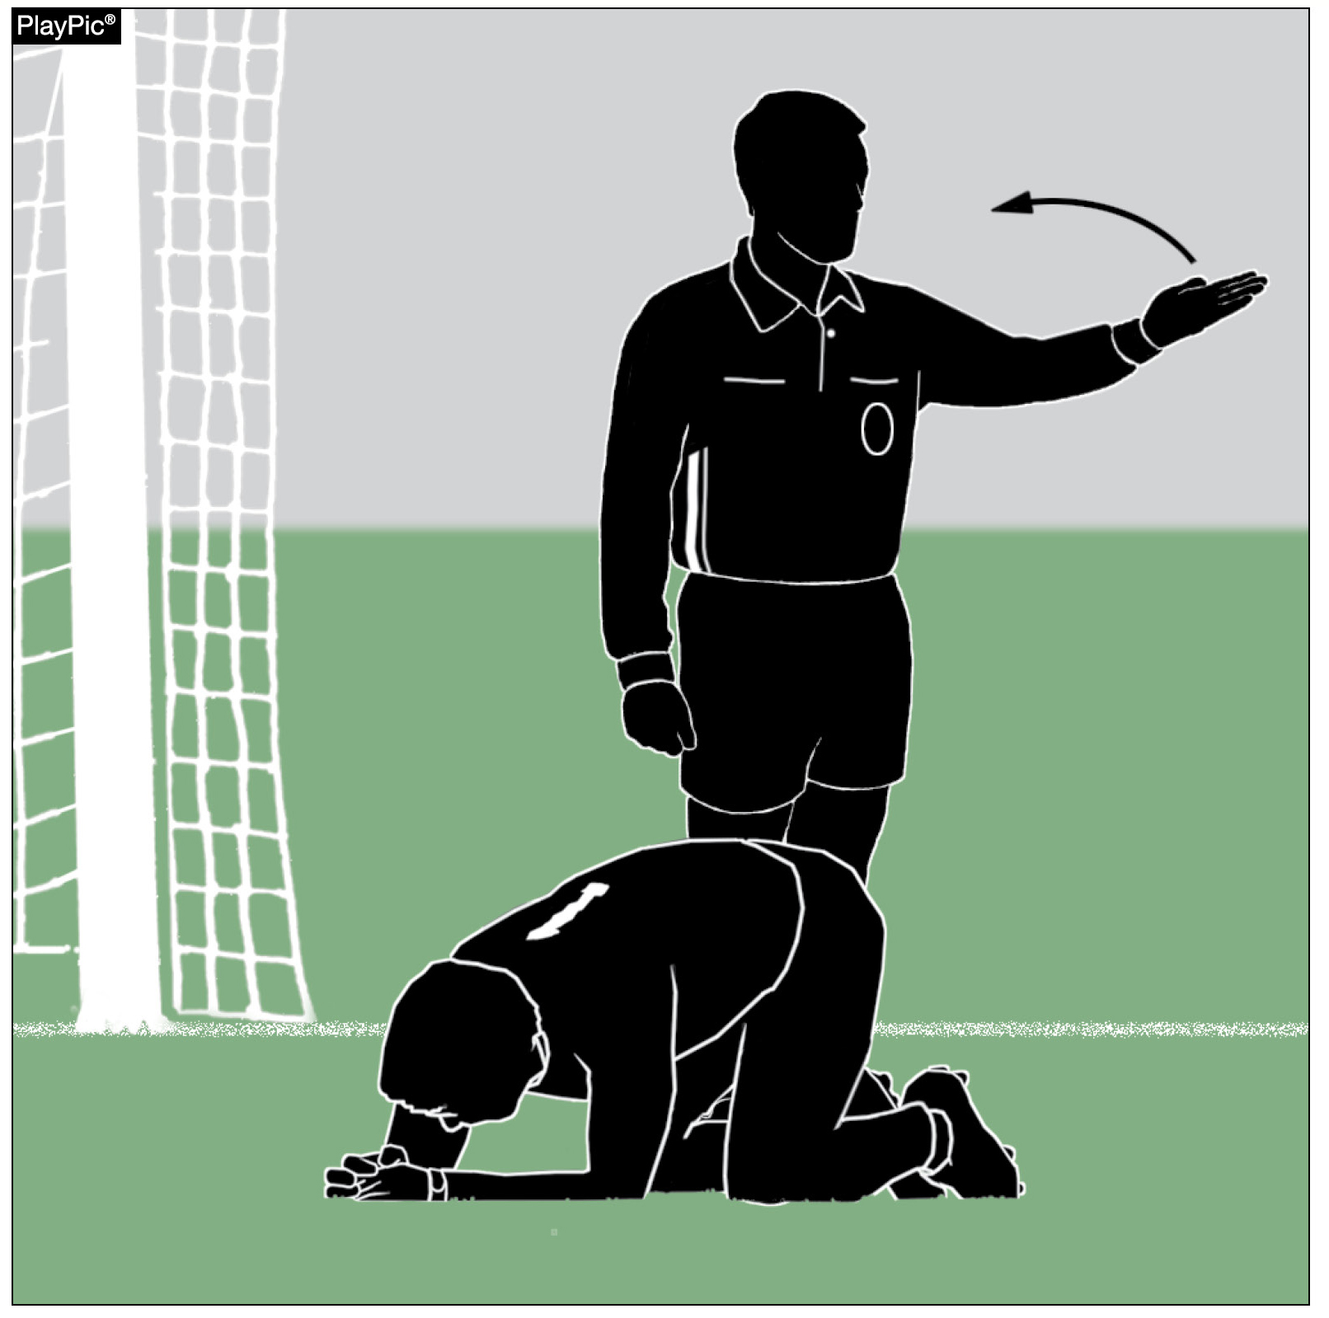
SUBSTITUTIONS
RULE 3-3-2b2
Amended language clearly states that once the appropriate health care official is beckoned by the referee, an injured player (including a goalkeeper) must leave the game.
Notes:
Rationale: The rules change clarifies that if an official beckons a coach or appropriate health-care provider for any injured player, including the goalkeeper, that player must leave the field regardless of the reason the clock is stopped.
The coach may play shorthanded or substitute for the player. If the team elects to play shorthanded and it is deemed the player who came off the field, can play, then that player may re-enter at the next dead ball.
If the goalkeeper comes off the team must have a goalkeeper on the field. They can play shorthanded, but a member of the team must put on the goalkeeper jersey or there can be a substitute made.

Slide 12

REQUIRED UNIFORM
RULE 4-1-2
Amended language clarifies a player’s number may be placed on the front of the jersey and/or shorts in addition to the back of the jersey.
Notes:
Rationale: This language supports the rule prior to the reorganization of Rule 4 and adds clarification to the overall interpretation that a number is required on the front of the uniform which may be on the jersey and/or the shorts.

Slide 13
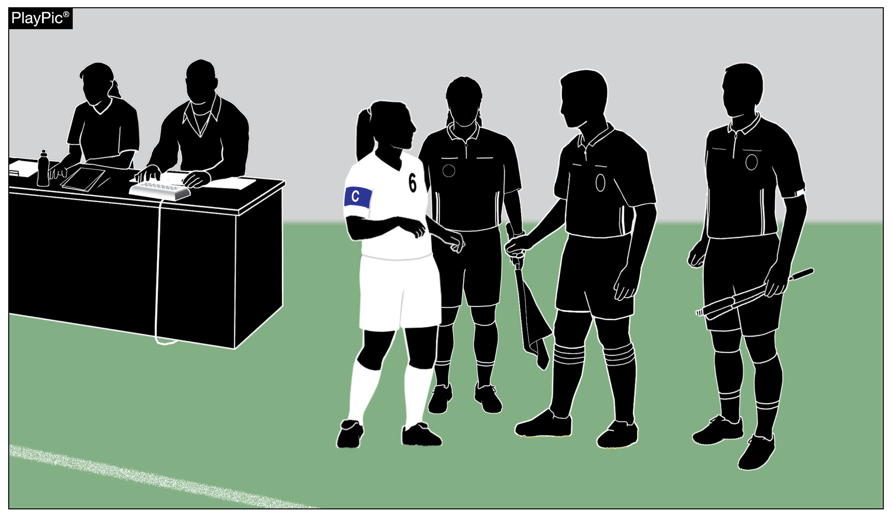
INTERVALS BETWEEN PERIODS
RULE 7-2-4
This time is for officials to talk amongst themselves and for coaches to work with their players.
No coach, player, substitute or other team personnel other than the team captain shall approach or speak to the officials during an interval between periods, unless beckoned by an official.
Notes:
Rationale: The time between periods of play is designated for rest for all participants, not for engaging with officials. This rule change introduces specific language and penalties for coaches or players who confront officials during these intervals, aiming to reduce unnecessary disputes and maintain a respectful game environment.

Slide 14
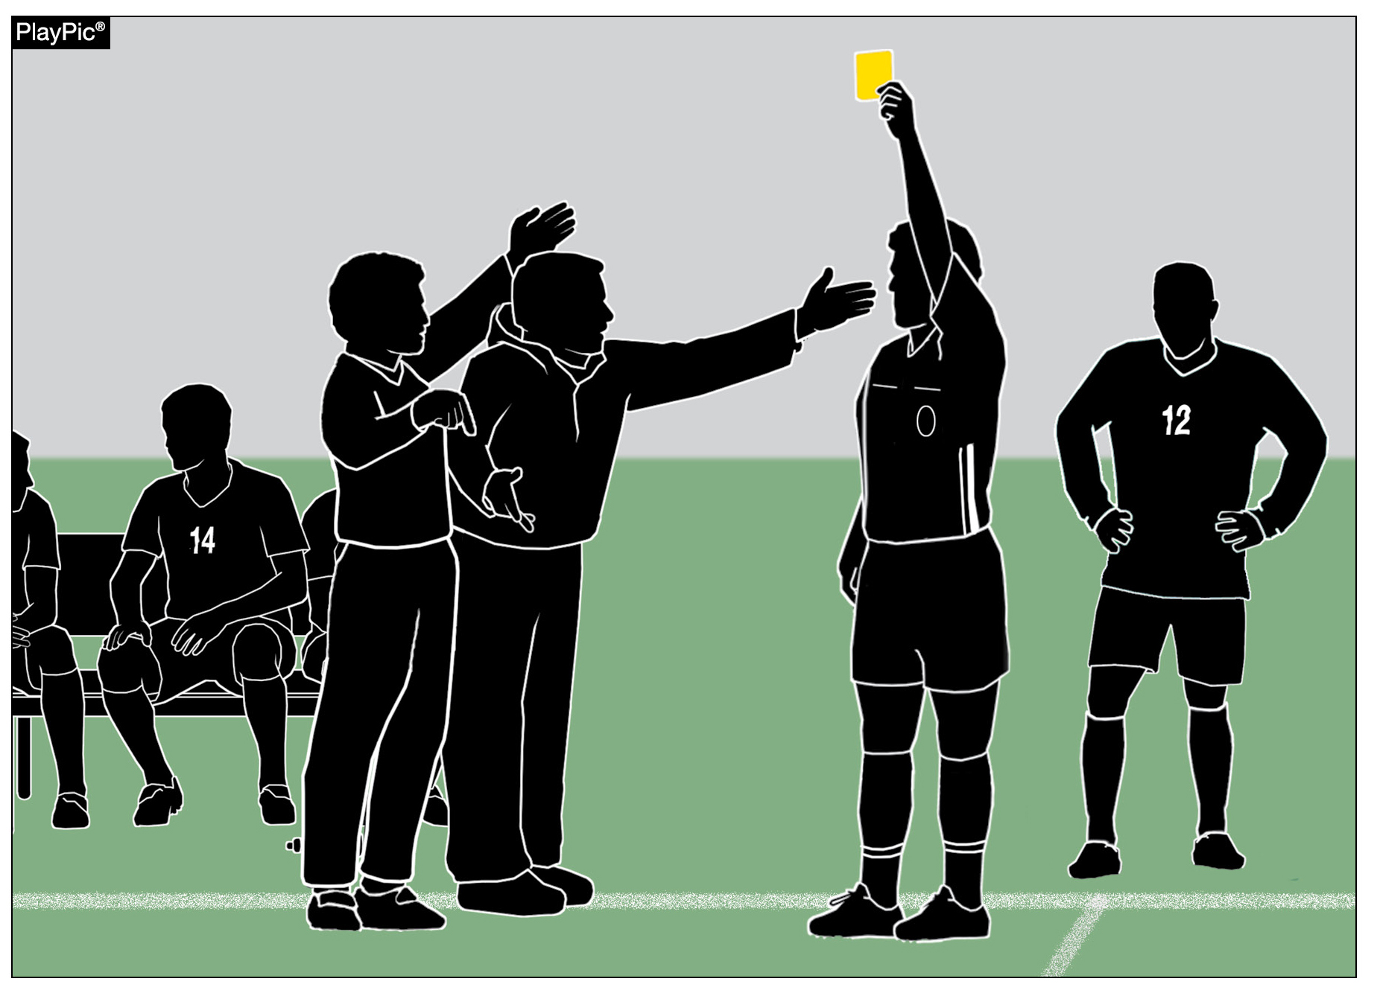
MISCONDUCT
RULE 12-4-4b
The head coach is responsible for conduct of their team, inclusive of all bench personnel in the team area. The head coach may be warned, cautioned or ejected for misconduct committed by bench personnel.
Notes:
Rationale: To encourage and support sporting and positive bench decorum, the rule change reinforces the head coach’s responsibility for the conduct of their team and bench personnel within the team area. It provides officials with additional tools, allowing them to warn, caution, or eject the head coach if any bench personnel engage in misconduct.

Slide 15
DEFINITIONS
RULE 18
Rule 18, which previously contained the rulebook’s definitions, has been eliminated. The terms and definitions have been relocated to their respective rules sections within the rulebook. They also remain accessible via the index for quick reference. This change aims to reduce redundancy.
Notes:
Rationale: This change relocates definitions into their corresponding rules, streamlining the rules book by reducing redundancies and contradictions. The expanded index at the back of the book continues to serve as a helpful quick reference tool, while definitions were updated and aligned in context with appropriate rules

Slide 16
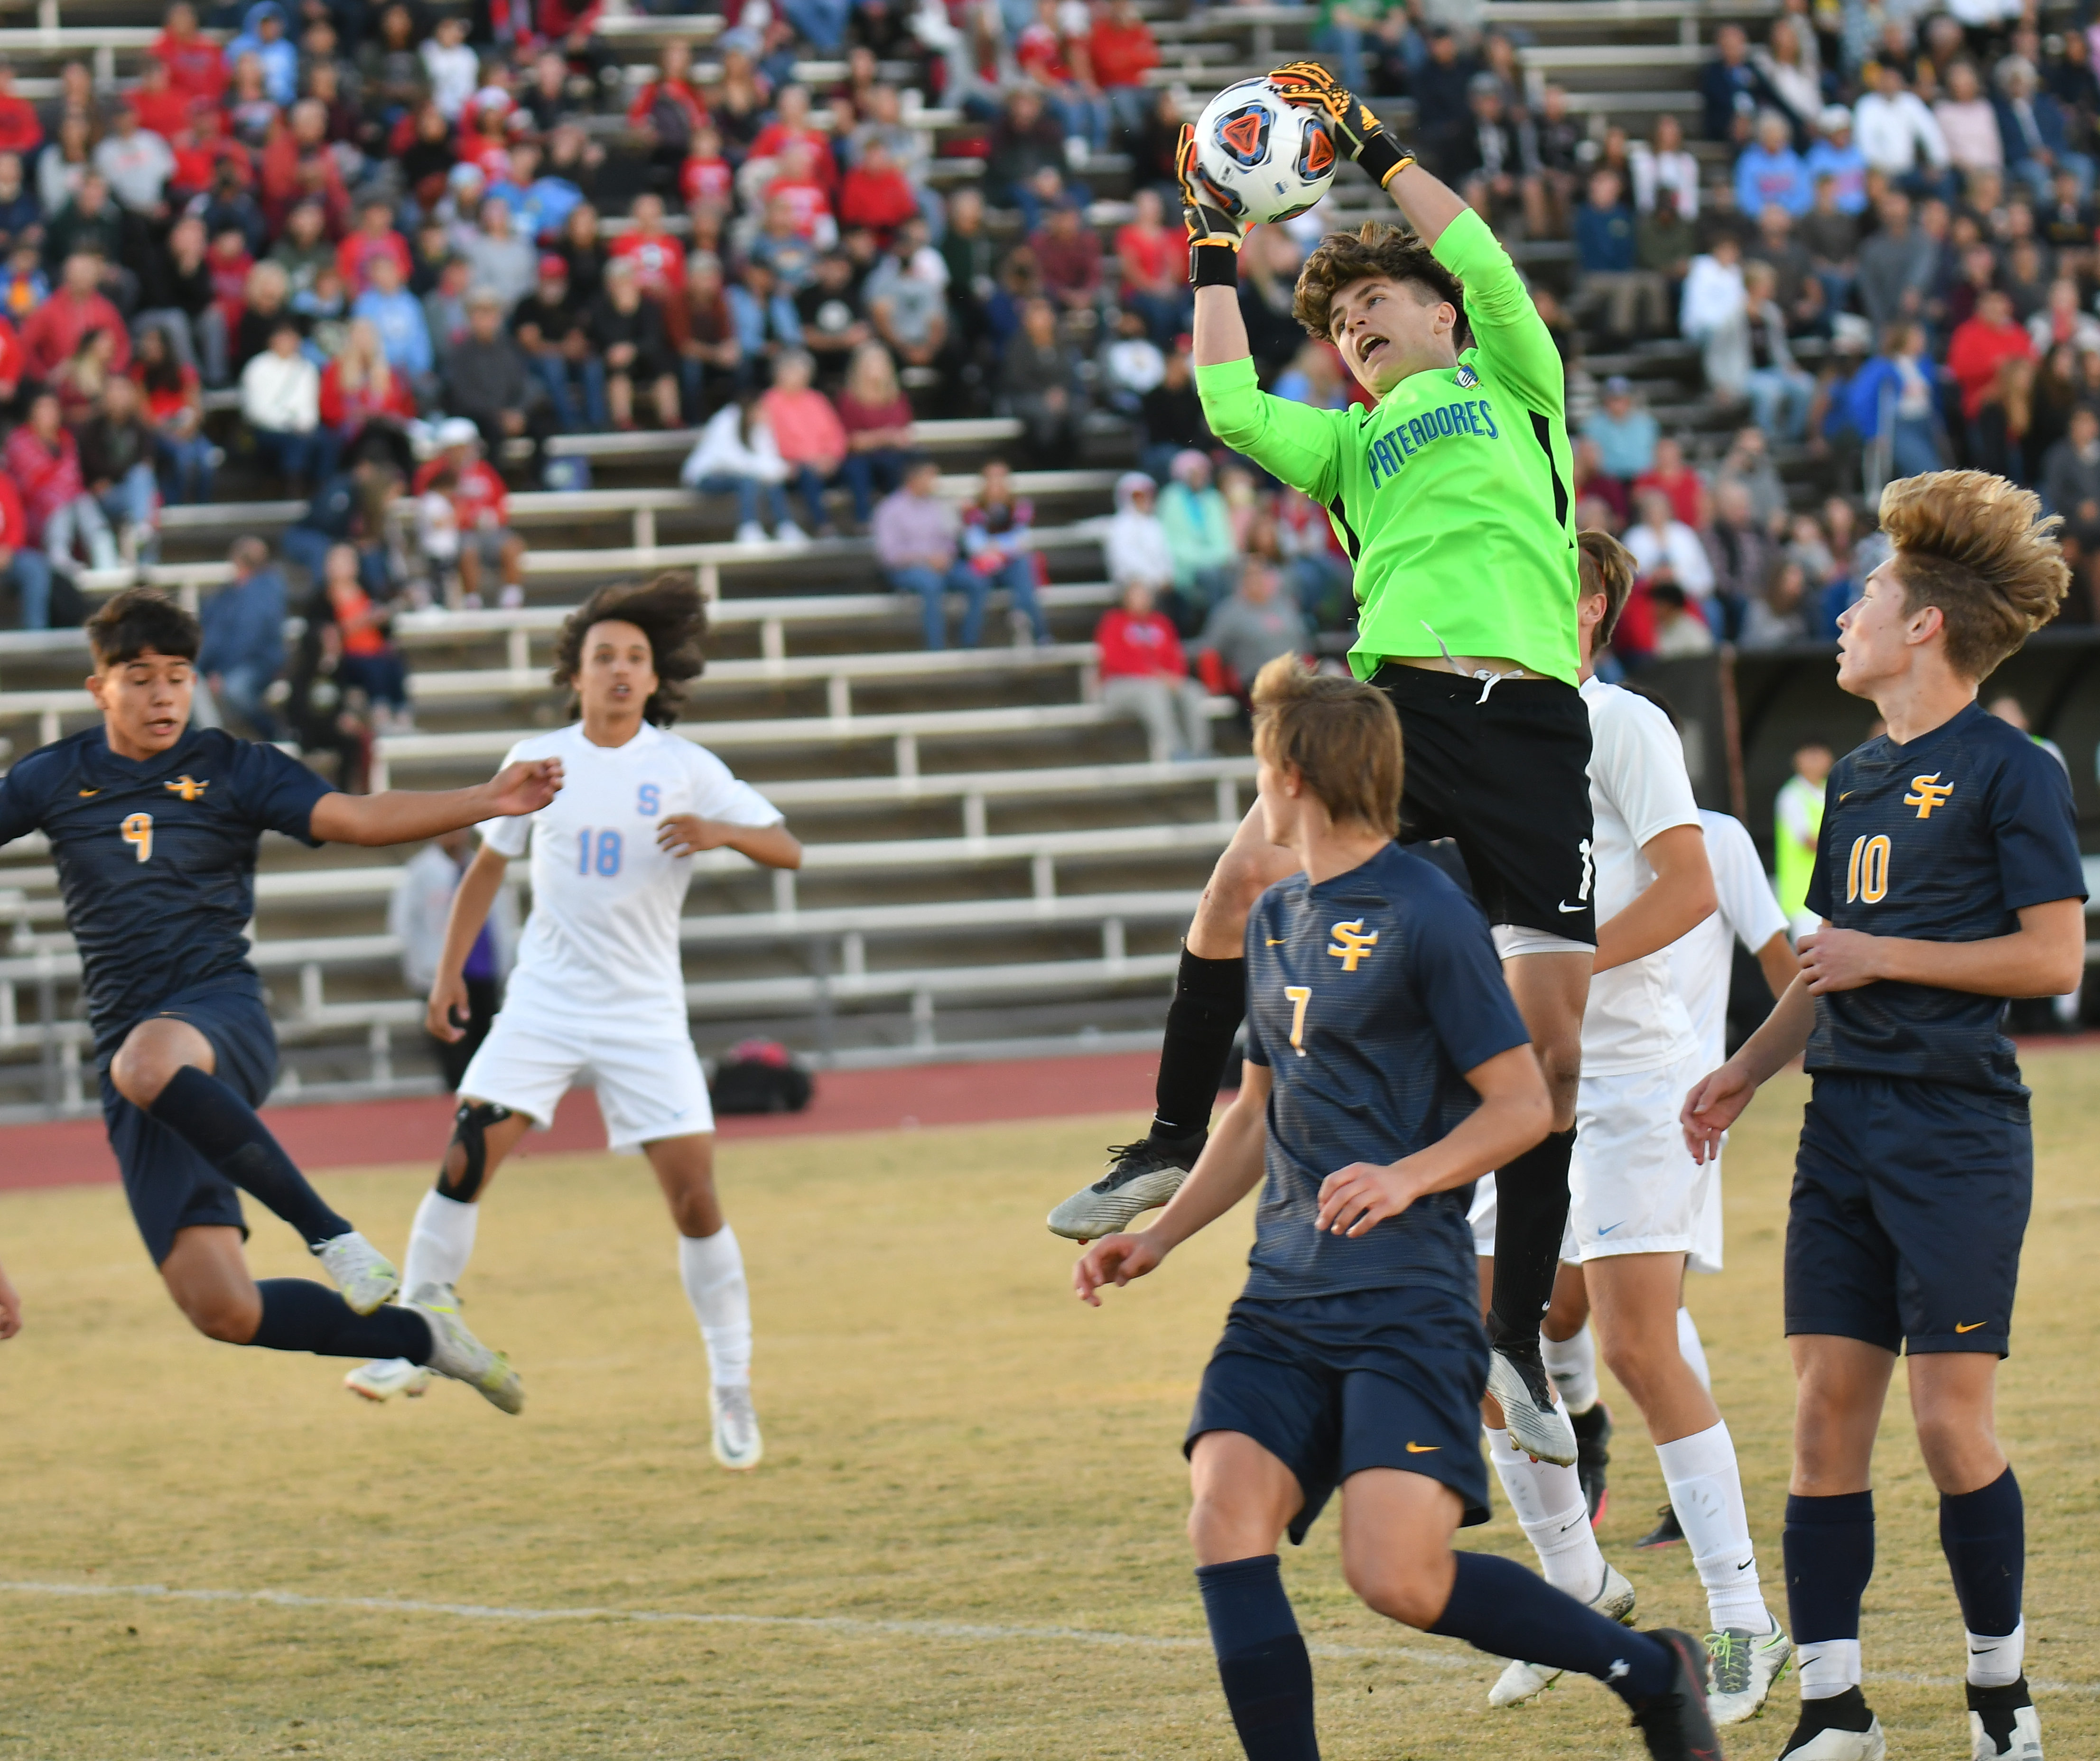
2025-26 EDITORIAL CHANGES

Slide 17
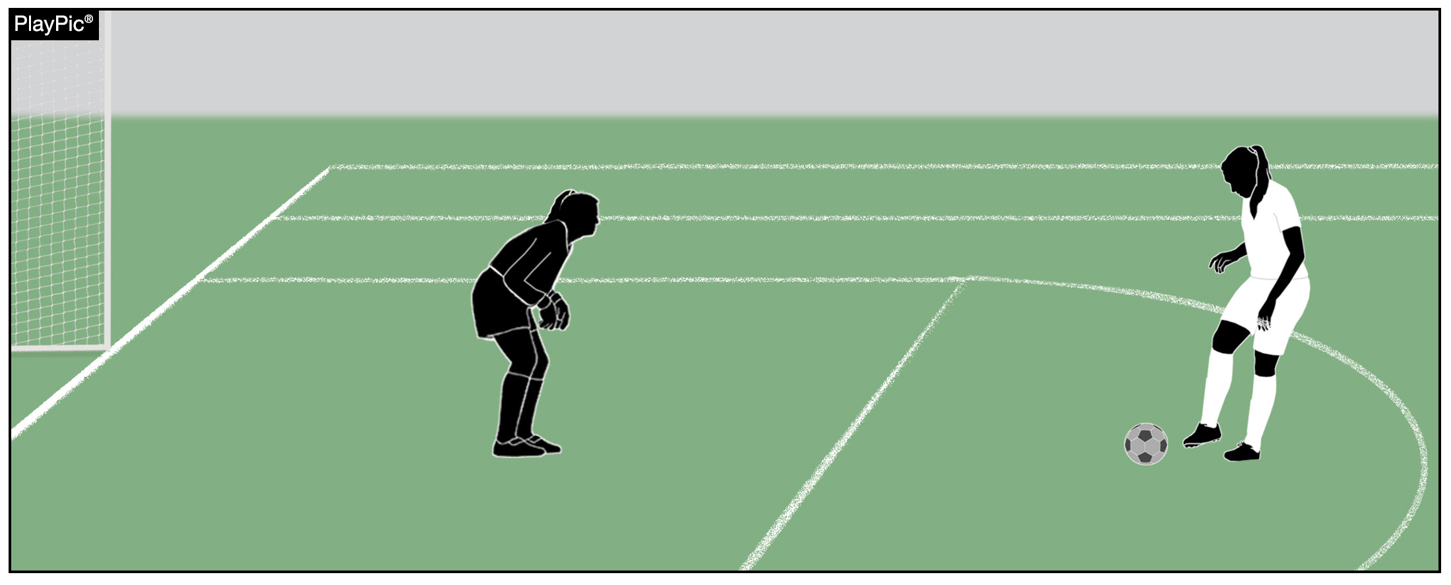
3-3-7 Substitutions
If a player is being replaced during a penalty kick situation, the substitute may not take the penalty kick.
Notes:
Rationale: Similar language was duplicated in four articles that outline the same restriction on a substitute's ineligibility to take the penalty kick if they entered the game before a penalty kick situation. All those provisions were moved and combined into a single article. Additionally, an exception in Rule 13 was also updated to be more generic as this principle applies to any substitute entering the game during a penalty kick situation.

Slide 18

REQUIRED UNIFORM
RULE 4-1-1c
A school’s nickname and/or mascot are permitted on a uniform, in addition to the school’s name, logo and/or player’s name.
Notes:
Rationale: This language aligns all NFHS rules books language as to what may appear on a players uniform.

Slide 19
5-1-2 Officials
SECTION 1 GENERAL
ART. 2 . . . The jurisdiction of the officials shall begin on arrival at the field of play and its immediate surroundings (to begin official responsibilities), which shall be no later than 15 minutes prior to the start of the game and end with the officials leaving the field of play and its immediate surroundings.
a. The officials shall enforce the rules, and their decisions on points of fact are final.
b. The officials can only correct a decision so long as the game has not been restarted.
c. The officials retain clerical authority over the contest through the completion of any reports, including those imposing ejections, that are responsive to actions occurring while the referees had jurisdiction.
d. State associations may intercede in the event of unusual incidents that occur before, during or after the officials' jurisdiction has ended or in the event that a contest is terminated prior to the conclusion of regulation play.
e. Protests of NFHS rules are not recognized.
f. The officials shall not use any form of alcohol, tobacco, or controlled or illicit substance(s) for non-medicinal purposes beginning with arrival at the competition site until departure following the completion of the contest.
Notes:
Rationale:
Breaks up the large paragraph of officials' duties and jurisdiction into bite size bits.

Slide 20
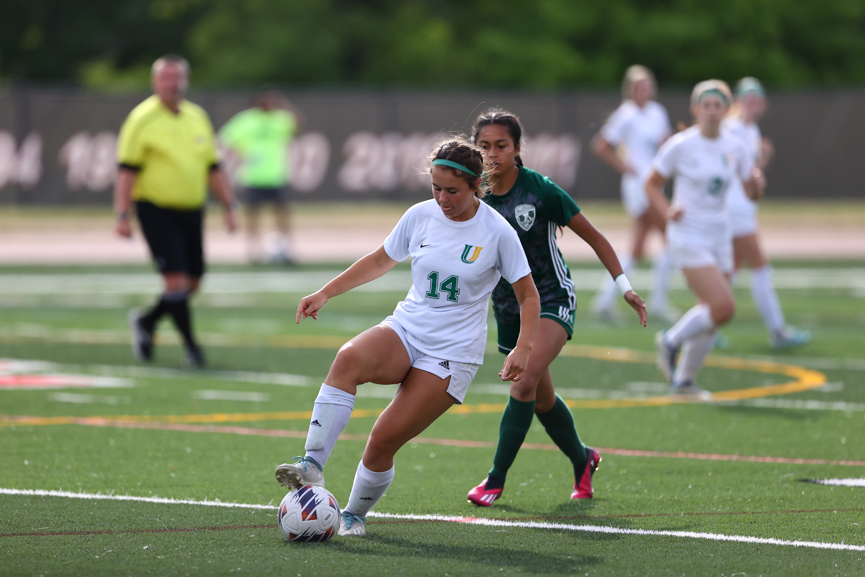
2025-26 POINTS OF EMPHASIS

Slide 21
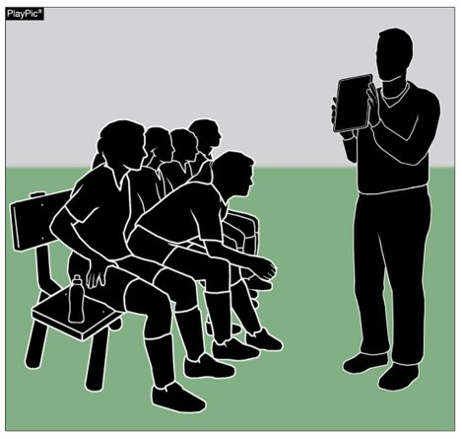
HIGH SCHOOL ATHLETICS
ARE EDUCATION-BASED​
High school athletics play a vital role in the overall growth of student-athletes, providing opportunities to develop physically, mentally, and emotionally.
Soccer serves as a platform for building essential life skills such as teamwork, discipline, leadership, and resilience.
Coaching priorities focus on fundamental skills, strategic gameplay, and decision-making while instilling respect for opponents, officials, and teammates.
As the game evolves, a strong understanding and application of the rules are essential to maintaining fair and safe competition, making rule education a key responsibility for players, coaches, and officials.
Notes:
High school athletics play a vital role in the overall growth of student-athletes, providing opportunities to develop physically, mentally, and emotionally. Soccer serves as a platform for building essential life skills such as teamwork, discipline, leadership, and resilience. Coaching priorities focus on fundamental skills, strategic gameplay, and decision-making while instilling respect for opponents, officials, and teammates. As the game evolves, a strong understanding and application of the rules are essential to maintaining fair and safe competition, making rule education a key responsibility for players, coaches, and officials.

Slide 22
HIGH SCHOOL ATHLETICS
ARE EDUCATION-BASED​
A well-rounded high school soccer program should emphasize both athletic and academic development, reinforcing the importance of discipline, time management, and perseverance.
Education-based athletics prepare students not only for success in sports but also for their future endeavors by teaching valuable life lessons through competition.
Schools, coaches, and administrators must work together to ensure that high school soccer fosters growth, responsibility, and leadership, creating a positive experience that supports student success both on and off the field.
Notes:
A well-rounded high school soccer program should emphasize both athletic and academic development, reinforcing the importance of discipline, time management, and perseverance.
Education-based athletics prepare students not only for success in sports but also for their future endeavors by teaching valuable life lessons through competition.
Schools, coaches, and administrators must work together to ensure that high school soccer fosters growth, responsibility, and leadership, creating a positive experience that supports student success both on and off the field.

Slide 23
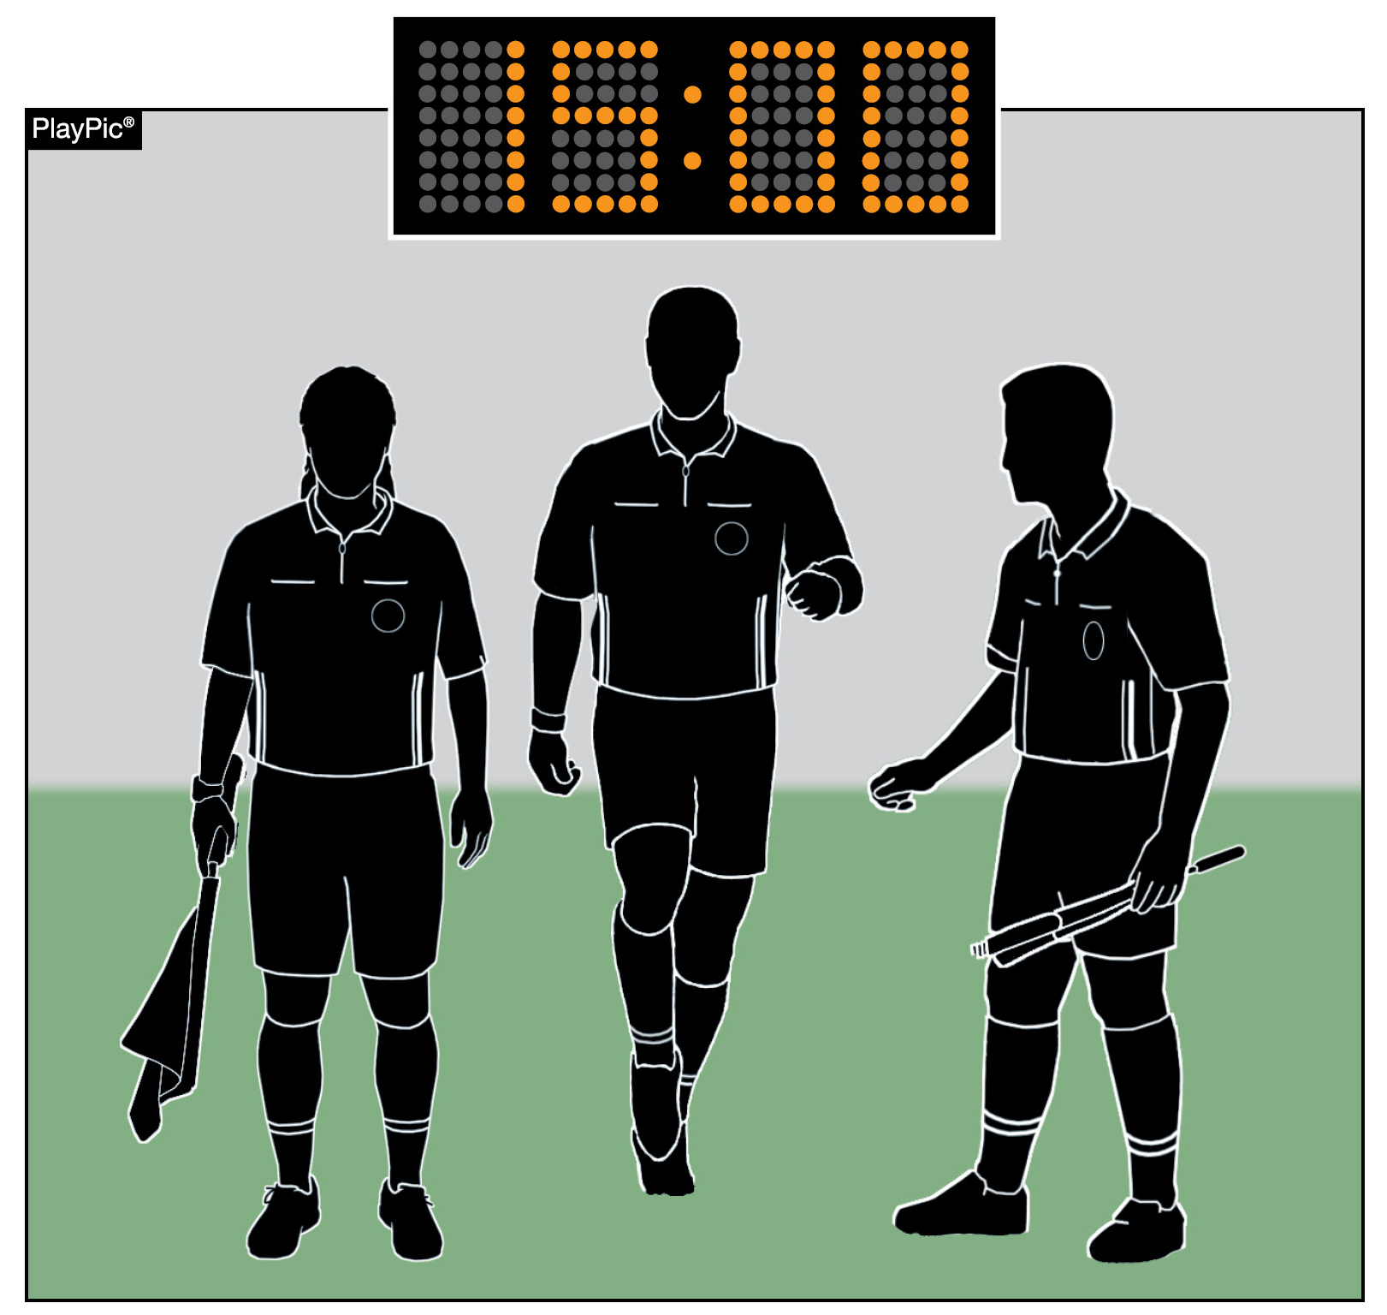
COURAGE, CHARACTER
AND CONSISTENCY
It is important for contest officials to conduct themselves in a professional manner that upholds the dignity of the position. This includes arriving on time, conducting the proper pregame, knowing and applying the NFHS rules properly, speaking to players and coaches in a professional manner, and completing any necessary postgame reports.
Notes:
These qualities encourage the game to be managed fairly, effectively, and with integrity.
Officials must have the courage to make difficult decisions, calling fouls equally for both teams without fear of backlash from players, coaches, or spectators. This courage extends to maintaining authority on the field, recognizing and firmly addressing any attempts to challenge their control or interfere with the game.
Character is reflected in professionalism and the official’s personality they incorporate into their management philosophy, fostering cooperation and mutual support within the officiating team. By maintaining composure and a focused attitude, officials uphold the integrity of the game, ensuring their decisions are based on the rules within the spirit of the game, rather than external pressures or emotions.
Consistency ties these attributes together, ensuring officials apply the rules uniformly and fairly throughout the game. Players and coaches expect predictability from officials in decision-making, which reinforces trust in the official’s authority. An official who applies the rules consistently, while managing interactions with confidence and conviction, fosters a controlled and respectful environment. An official who successfully combines these attributes bolsters acceptance when managing dissent and conflicts, while emphasizing calmness, direct communication, and resolution without unnecessary escalation.
Ultimately, courage, character, and consistency define an official’s ability to manage the game effectively, uphold fairness, and maintain order, ensuring a positive experience for all participants.

Slide 24
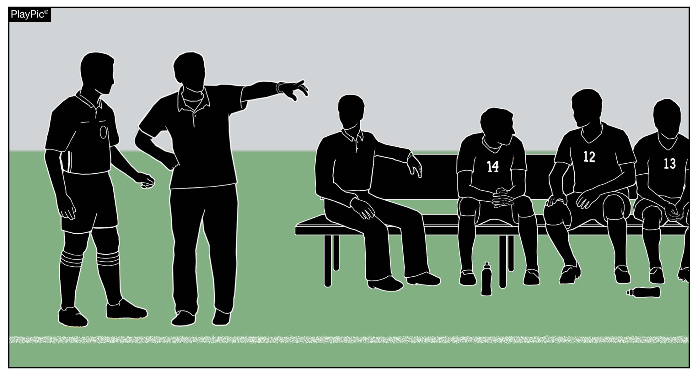
TEAM AREAS AND
BENCH DECORUM
Effective communication and game management are essential. Recognizing and addressing dissent early is crucial — public, provocative and/or persistent complaints must be dealt with decisively.
The official's role is to keep the game safe and fair.
Coaches set the tone for their teams. Adult leaders must be champions of character.
Notes:
Effective communication is essential for officials in maintaining control over the match, particularly when dealing with bench decorum and sportsmanship. An official’s role is to keep the game safe, fair, and fun, which requires adapting to the level of play and responding to game situations as they develop.
High school soccer is an extension of the classroom, meaning officials must uphold the highest standards of professionalism, composure, and integrity. By setting a respectful tone, referees can prevent escalation and unnecessary conflict. Recognizing and addressing dissent early is crucial—while emotional reactions can be ignored, public, provocative, or persistent complaints must be dealt with decisively.
Coaches and bench personnel set the tone for their teams, and poor behavior can spread if not managed properly. In education-based athletics, adult leaders must be champions of character. Bench decorum must be actively monitored, as unchecked misconduct from the team area can quickly influence players and spectators. The head coach has an obligation to manage their team’s behavior. A firm but fair approach ensures that the game remains under control while demonstrating respect for all participants. Officials have tools to warn coaches and must take action to sanction misconduct when it occurs. Ultimately, head coaches are responsible for their team area, including assistant coaches and substitutes, and must be held accountable for any misconduct occurring within it.

Slide 25
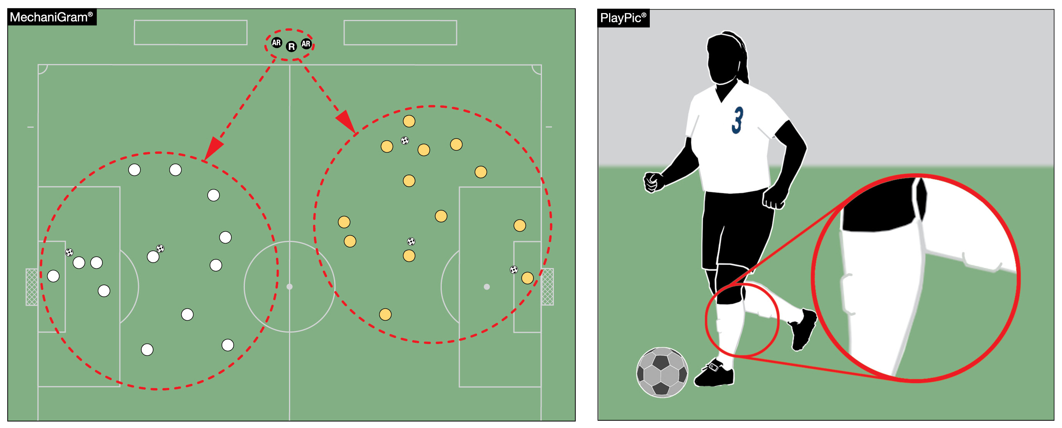
UNIFORM/EQUIPMENT REQUIREMENTS
Student-athlete safety is a priority, and that starts with players wearing proper uniforms and equipment. Specifically, players are required to wear shinguards suitable for their age and size. This is a non-negotiable item in the NFHS, not a player’s or coach’s decision.
Notes:
Ensuring student-athlete safety is a top priority, and proper equipment plays a key role in maintaining a safe and fair playing environment. NFHS Rule 4 provides clear guidelines on required player equipment, including shinguards, which are essential for protecting athletes during competition. Given that high school players are still in their developmental stages, shinguards must be age- and size-appropriate, meeting NOCSAE safety standards. Each shinguard must display the NOCSAE seal, permanently marked on the front, indicating the approved height range for that model.

Slide 26
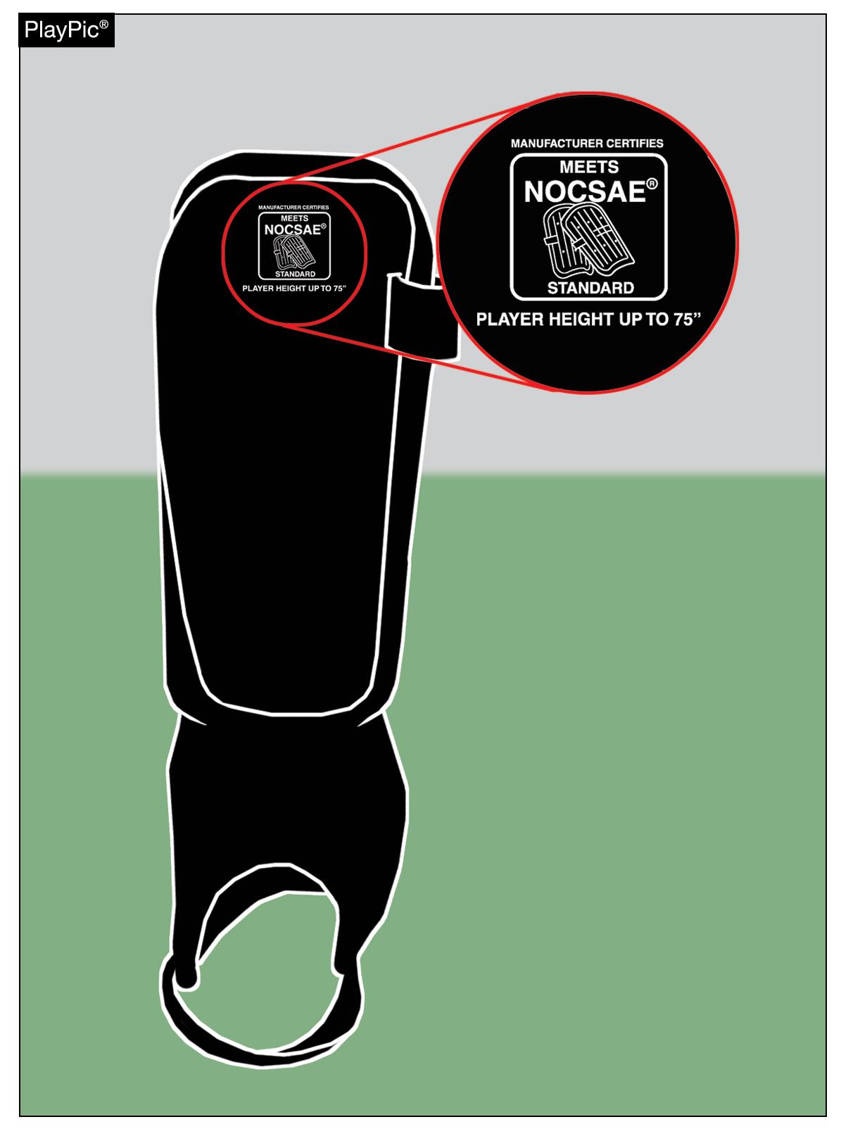
UNIFORM/EQUIPMENT REQUIREMENTS
Shinguards must have a NOCSAE seal and information about height requirement. The coach is responsible for ensuring their players adhere to this and referees must enforce the rule. Referees should inspect and, if needed, correct the issue in a professional manner. Officials should also be on the lookout for players with micro guards. No one is to play at the NFHS level with illegal or improper shinguards.
Notes:
While coaches are responsible for ensuring their players are properly equipped before the game, officials take a proactive approach by observing warm-ups to identify any potential concerns. Rather than conducting formal equipment checks, referees use preventive officiating by maintaining awareness during pregame activities and addressing any noticeable issues. If a player's shinguards appear inadequately sized, officials should engage with the coach in a professional and approachable manner to confirm compliance.
By prioritizing communication and proactive observation, officials help reinforce safety standards while allowing players to focus on the game. A consistent and safety-conscious approach ensures that every student-athlete competes with the necessary protective equipment, contributing to a positive and well-regulated match experience.

Slide 27
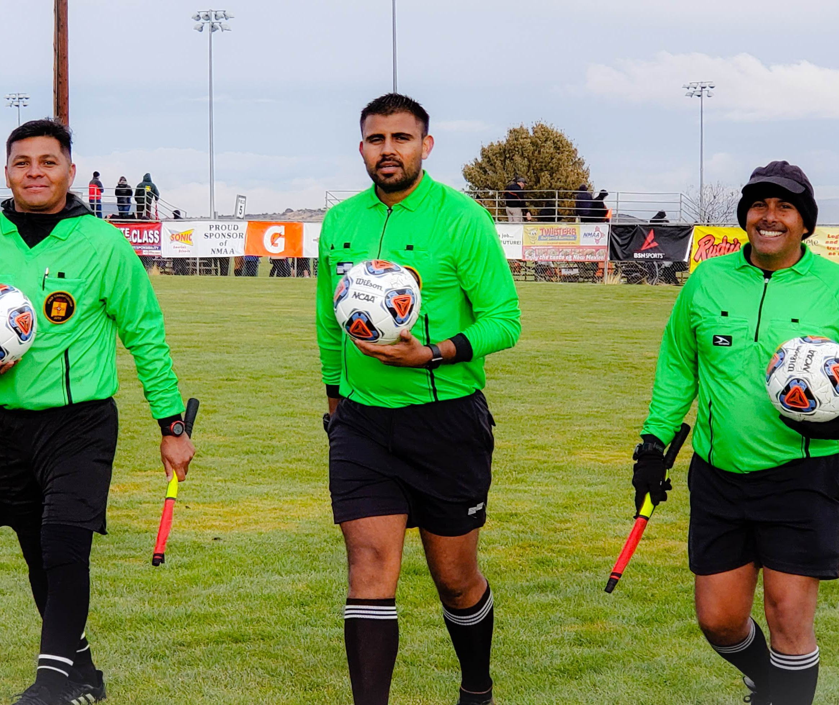
NFHS Officials Education
Notes:
The next few slides offer a look at the resources that are available to your officials:

Slide 28

All Things Officiating in One Place!
The all-in-one, cloud-based NFHS Center for Officials Services (COS) connects everyone associated with officiating. The COS handles registration, assignments, testing, payments, and a host of other features and integrations that consolidate all officiating needs into a single, modern solution. Free to all NFHS state associations, local associations, and assigner groups.
20+
Member States
300,000+
Officials
7,000+
Schools
Notes:
The all-in-one, cloud-based NFHS Center for Officials Services (COS) connects everyone associated with officiating. The COS handles registration, assignments, testing, payments, and a host of other features and integrations that consolidate all officiating needs into a single, modern solution. Free to all NFHS state associations, local associations, and assigner groups.

Slide 29
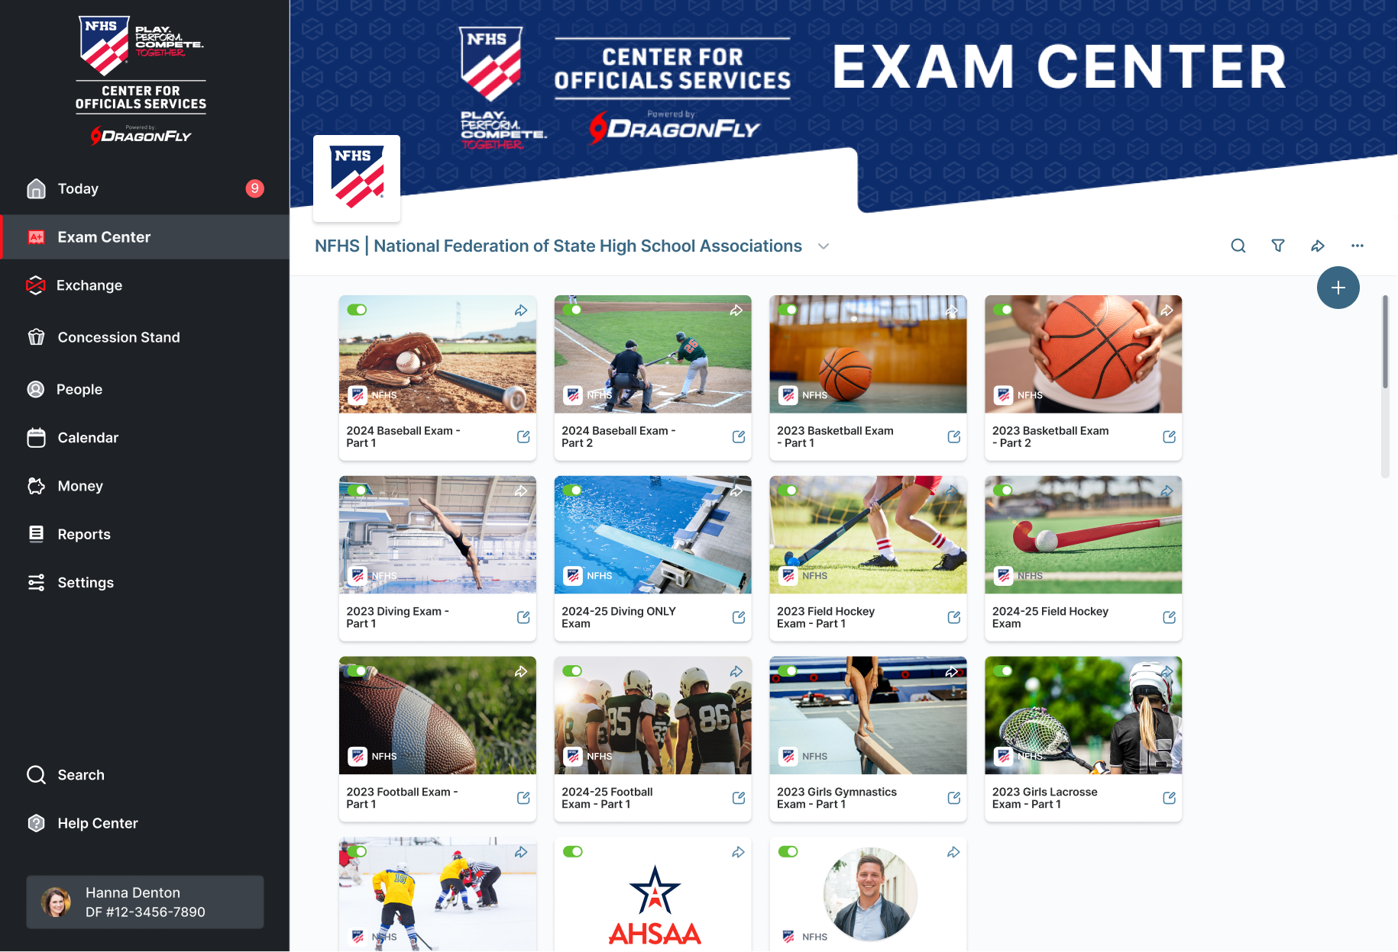
Improved Exam Center

Slide 30
NFHS Digital Slide

Slide 31
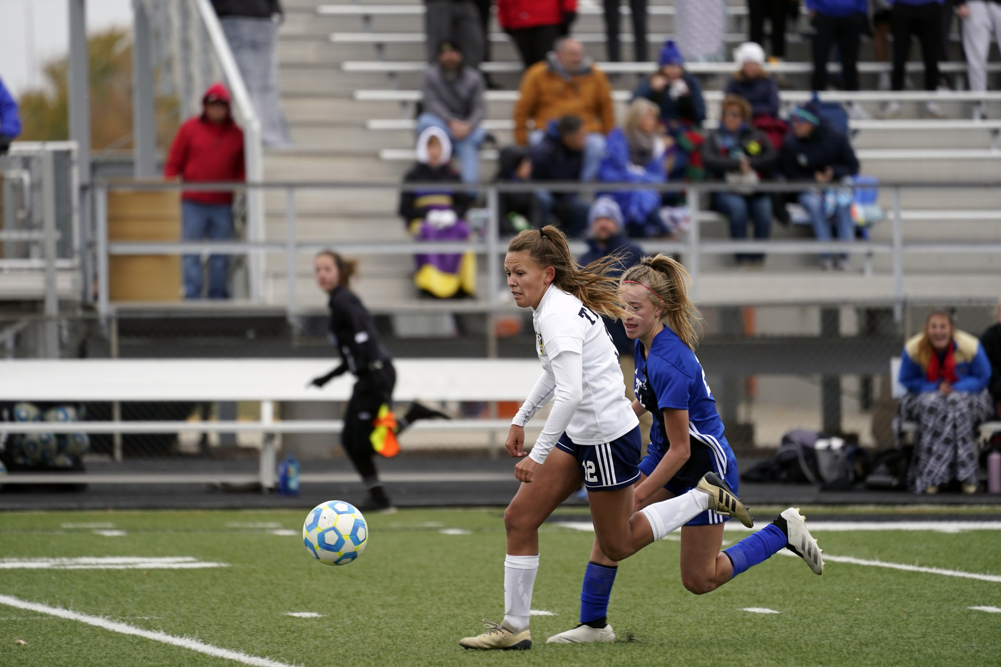
NFHS Learning Center
Notes:
The next few slides offer a look at the resources that are available to your coaches, parents and students:

Slide 32

Notes:
The NFHS Learning Center is the home to more than 90 online professional development courses for everyone within the interscholastic community - coaches, students, officials, parents, administrators, and individuals within performing arts programs. More than 60 courses are available for free.
The NFHS is an Accredited Institution and has delivered more than 15 million courses on its NFHS Learning Center platform since its inception in 2007. In receiving national accreditation by Cognia, the NFHS has upheld itself to rigorous standards that focus on productive learning environments, equitable resource allocation that meet the needs of learners, and effective leadership.
The NFHS Learning Center features its flagship coaching course, “Fundamentals of Coaching,” as well as several health and safety courses that have been completed by millions of individuals, such as “Concussion in Sports,” “Heat Illness Prevention,” “Sudden Cardiac Arrest” and “Protecting Students from Abuse.” The NFHS Learning Center offers several national credentials that can be earned by individuals who complete specific NFHS courses. Through the School Honor Roll Program, schools can earn a physical banner to hang in their school.
To learn more and start your professional development journey, please visit the NFHS Learning Center at NFHSLearn.com.

Slide 33

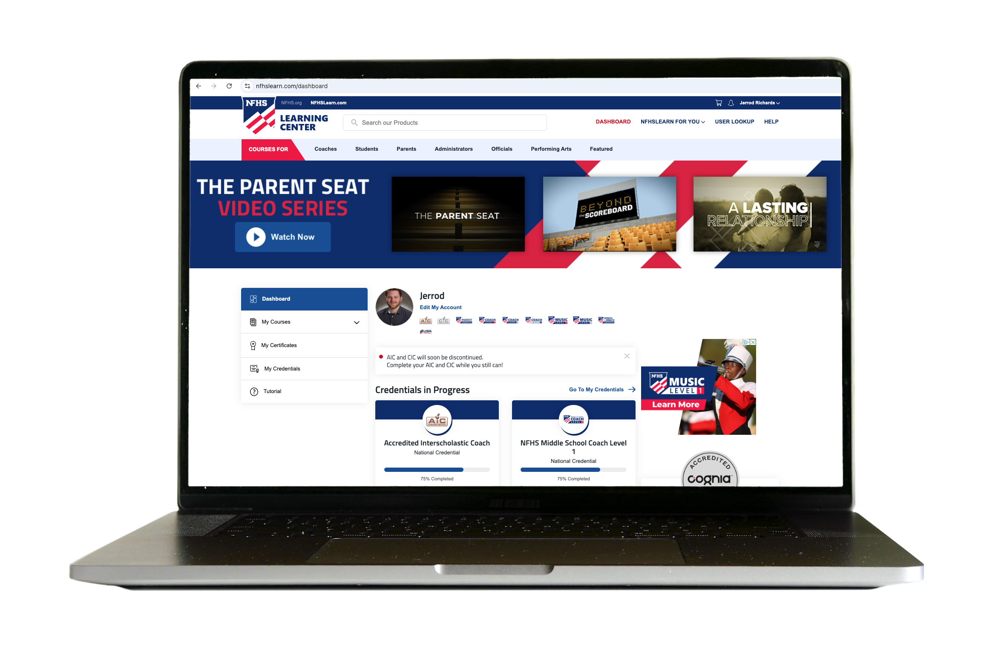
Over 21 Million Courses Delivered!
Concussion in Sports – 8.4M+
Heat Illness Prevention – 3M+
Sudden Cardiac Arrest – 3.3M+
Concussion for Students – 1.8M+
The Collapsed Student (2020) – 89,550+
CPR & AED Training (2023) – 28,500+
Sportsmanship – 1.3M+
Fundamentals of Coaching – 1,000,000+
First Aid, Health and Safety – 470,000+
Bullying, Hazing and Inappropriate Behaviors – 561,000+
Student Mental Health and Suicide Prevention – 376,000+
Protecting Students from Abuse – 400,000+
Implicit Bias (2021) – 145,000+

Slide 34

NFHS Network

Slide 35
NFHS Network
27 Different Sports and Activities.
By 2028, every high school event
in America will be streamed live.
The NFHS Network will be
THE DESTINATION for fans.
OUR NETWORK
www.NFHSnetwork.com
Notes:
The NFHS Network is the leader in streaming Live and On Demand high school sports.

Slide 36

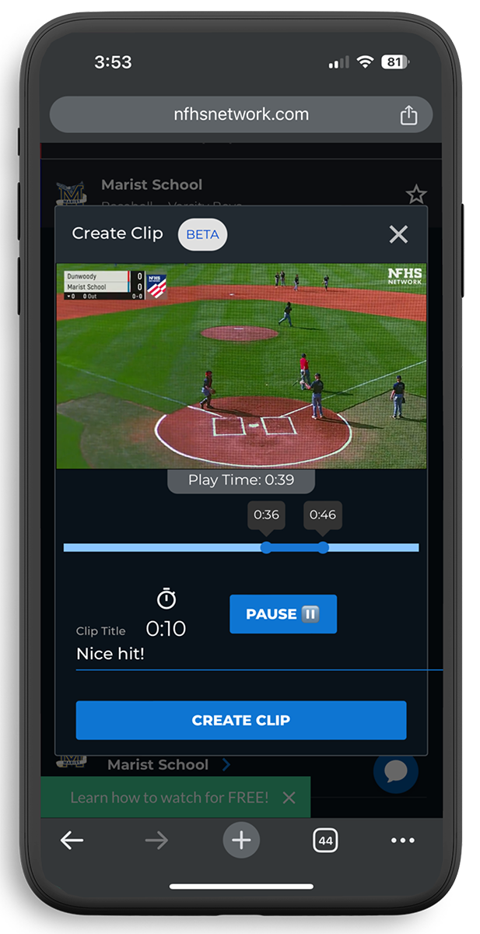
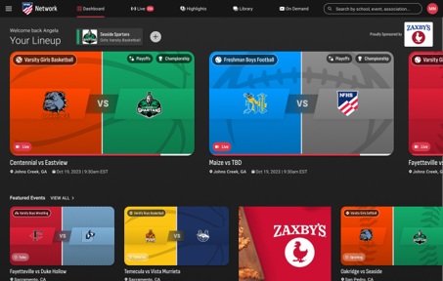
Capture Your Memories –
Clip and Share
Allowing fans to capture and share their favorite moments
Notes:
The NFHS Network will broadcast over 150,000 live events this year. If your school is not a member of the NFHS Network School Broadcast Program, please contact us at Mark.Koski@NFHSnetwork.com

Slide 37





Slide 38



NFHS Authenticating Mark Update
Specifications
Do not use the NFHS Authenticating Mark without prior written approval from the NFHS
This mark is for use of licensees only.
Minimum size
  Inflatable Balls - 2 ½“ in length (Basketball, Football, Soccer, Volleyball, and Water Polo)
  Non-Inflatable Balls - 1 ¼" in length (Baseball, Field Hockey, Ice Hockey Puck, Lacrosse, and Softball)
  On a ball or puck, the NFHS mark may be smaller than manufacturer’s logo, but should be placed in proximity to the manufacturer’s name for easy identification. Allow enough space around the mark so it can be easily recognized as distinct and separate.
  Reproduce the mark only from the vector artwork provided on Direct Licensing Hub. Do not copy, scan art electronically or use as a template to redraw the symbol.
Note: If sizing or specifications do not work well in your particular design situation, contactK12 Licensing.
Old Logos
Current Logo

Slide 39



Soccer
A current list of NFHS authenticated products can be found at www.nfhs.org, Resources, Authenticating Mark.
Old Size
Current Size
1.25”
2.5”
circumference = 27.5”
circumference = 27.5”

Slide 40
Thank You
NFHS.org Phone # 317-972-6900 jcochran@nfhs.org

