Slide 1
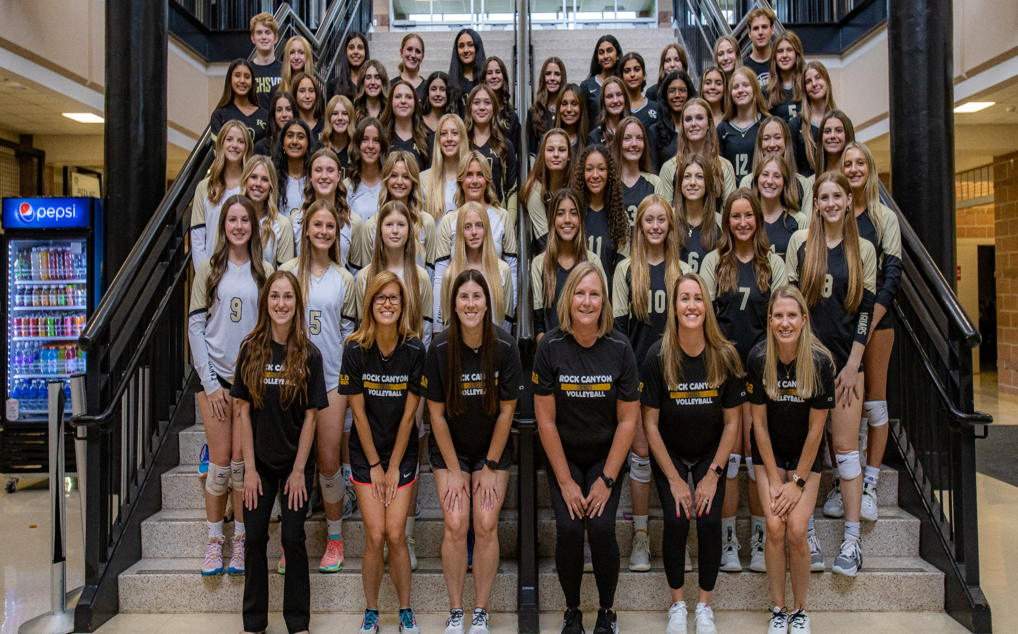

RCHS Volleyball 2025

Slide 2
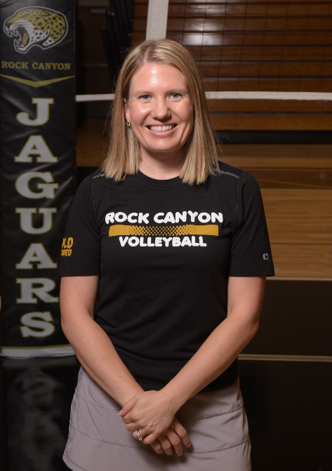
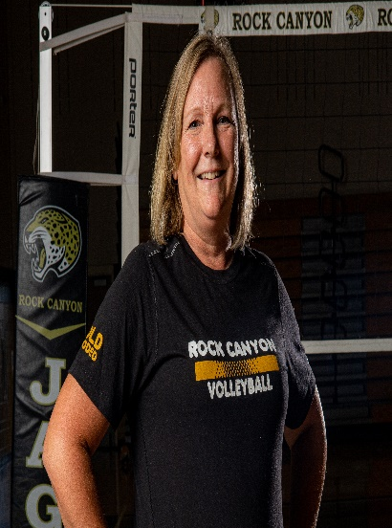
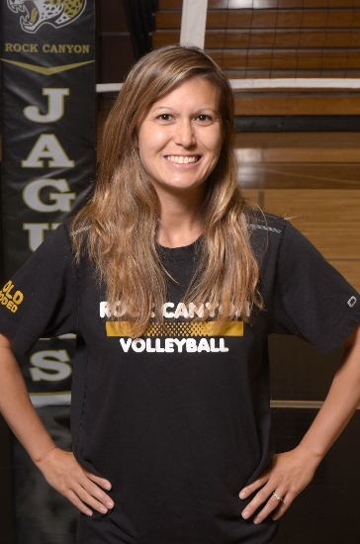
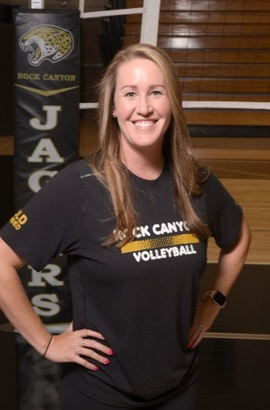
Coaching Staff
Angela Nylund-Hanson – Varsity
Tiffany Albert – Assistant Varsity
Shauna Barker – Assistant Varsity
TBD – Junior Varsity
Mallory Elfstrom – Sophomore
Keke Stickney – Freshman

Slide 3
Summer Schedule
Open Gyms: May-June
Free to attend, no sign up needed
Check website calendar for dates/times
Strength & Conditioning
Elite Speed @ RCHS
June 2 - Aug 1 (except July 4, 18, and 25)
MWF 9:30-10:45

Slide 4
Summer Schedule
UNC Team Camp July 24th – 26th
Invite Only (must attend at least 2 open gyms to be considered)
JV and Varsity level teams selected in June
RCHS Skills Camp: August 5th – 7th
Incoming Freshman: 3:00pm – 5:00pm
Upperclassmen: 5:00pm – 7:00pm
Middle School Skills Camp: June 24th – 26th
4:00-6:00 PM

Slide 5
Try-Outs
August 11th- 13th
Will be evaluated on:
Strength, Agility, & Athleticism
Technical Volleyball Skills
Court Awareness
Coachability & Attitude
Must complete before try-outs:
Register and turn in physical online
Teams will be announced on August 13th
Varsity, JV, Sophomore, Freshman (10-12 girls/team)
Mandatory Parent/Player meeting
Date- Shortly after tryouts, RCHS Commons
Potluck Dinner

Slide 6
Season Info/Key Dates
Regular Season: Aug 11th- Oct 24th
Varsity Post Season: Through Nov 15th
Practice
Every day after school (skills, conditioning, training), typically not Friday’s
Will have practices over Fall Break, usually second half of break
Scrimmage – August 16th
Games
Busses- only to games a long distance away
Team meals
Tuesdays & Thursdays mostly

Slide 7
Season Info/Key Dates
Tournaments
Varsity @ Chap Showcase, Aug 29th-3oth &
Cheyenne Mtn, Oct 31-Nov 1
JV @ Chap Showcase, Aug 29th-3oth
Sophomore @ Heritage, Sept 20th
Freshman @ Cherry Creek, Aug 23rd

Slide 8
Program Info
Program Unity
Team Support During Matches
Team/Program Bonding Activities
Lock In
Program Dinners
Big Sister-Little Sister
Community Service Projects
Increase Game Attendance
Home Game Themes

Slide 9
Program Info
RCHS Volleyball Website
www.rchsjags.com -Athletics-Fall Sports-Volleyball Girls
Social Media
Facebook- Rock Canyon Volleyball
Twitter- @RockCanyonVB
Instagram- rockcanyonvb
Spirit Wear
End of Season Banquet
Will be held sometime in November after State

Slide 10
Athletic Fee
$200/Athlete
$100 to Volleyball Program
$100 to General School Athletic Fund/District
$100 portion goes towards:
Additional Coaches
Program Events- bonding activities, banquet, etc.
Officials
Game Workers- scorebook, announcer, etc.
Program Shirts
Equipment
Busses

Slide 11
Booster Club
Grow the Program
Fundraising
Spirit Wear
Increase Game Attendance
Increase Player/Parent Involvement
Booster Club Donation
Jerseys & Warm ups
Equipment (e.g., balls, carts)
Program Events
Banquet Costs for Athletes
Game Night Meals

Slide 12
Booster Club
Bylaws (on website under Booster Club)
Fundraising
King Soopers
Concessions
Restaurant Nights
Booster Club Direct Donation

Slide 13
Booster Club
Officer Positions
President
Vice President
Secretary
Treasurer
Booster Club Meeting – TBD
Volunteer interest
Q&A

Slide 14
Booster Club
Committee Chair Volunteer Positions
Banquet
Senior Night
Dig Pink
Home Game Promotions
Homecoming Float
Program Meals
Lock In
Home Game Concessions
Restaurant Nights

Slide 15
Questions?
Contact Coach Nylund
angela.hanson@dcsdk12.org
720-428-1231
Please email me if you haven’t received an email from me yet so I can add you to my list.
Please email me or join us for a booster club meeting if you are interested in volunteering.

