Slide 1
Eligibility
and Compliance

Slide 2
Topics
01
Changes to Bylaws/Policies
05
Forms/Eligibility Resources
02
Summer Athletics
06
Allegations/Self-Reports
03
Non-School Teams
07
Policies 36/37
04
Transfers/EL 6
08
Due Process

Slide 3
01
Changes to
BYLAWS & POLICIES

Slide 4
Eligibility & Compliance Impacts
Policy 17
Removes restrictions on students who possess a B1/B2 Visa or who are here under the Visa Waiver Program.
Separates registration procedures for youth exchange students from other international and immigrant students.
Removes requirement for other international and immigrant students to provide a copy of their USCIS documentation.
BYLAWS AND POLICIES
Changes to
Policy 22
Prohibits presentations, promotions, or advertisements for non-school teams from school-based team social media accounts.

Slide 5
Eligibility & Compliance Impacts
Public school students whose school does not offer a sport may participate in that sport for another public school within the same district OR a private school.
Charter School students and FLVS Full-Time Public Program students may participate for a private school.
The enrollment cap for non-member private school students will increase from 125 students or fewer to 200 students or fewer.
Transfer students may continue participating in a sport at their previous school when the student began participating in the sport prior to transferring.
BYLAWS AND POLICIES
Legislative Changes

Slide 6
02
Policy 20
SUMMER ATHLETICS

Slide 7
Policy 20: Summer
"Summer" is defined as the period of time outside of the FHSAA sports year. This period for each member school is defined as beginning the day following the school's last day of classes for the spring semester OR the day following the school's last day of spring athletic activities, whichever is later, OR June 1st for schools whose last day of classes for the spring semester occurs on May 31st or thereafter, and concluding with the Saturday prior to fall sports beginning, as established in the FHSAA Planning Calendar.
The FHSAA does not regulate the athletic activities of member schools held with their own students during the the summer, with the exception of football.
NOTE: Florida Statute 1006.165 requires all member schools to follow the provisions of FHSAA Policies regarding Concussions (Policy 40), Exertional Heat Illness (Policy 41), Sudden Cardiac Arrest (Policy 42), and Emergency Action Plan and Student-Athlete Sports Safety for Parent(s)/Guardians(s) (Policy 43).

Slide 8
03
Policy 22
NON-SCHOOL TEAMS

Slide 9
Policy 22: Non-School Teams
How to stay compliant
Must be registered with a third party
Must have a published competition schedule
Must provide their own uniforms
Must collect or pay fees and assessments through outside agency
Must not make participation required
Must have a completed facility usage agreement
Must not use school-based team social media platforms
Common Policy 22 Violations
Livestreaming a non-school team’s contest from the school-based team social media page
Making participation mandatory to join school team
Wearing portions of the school uniform and/or school apparel
Practicing with no competition schedule
No facility usage agreement
Student-Athlete(s) is not registered with the 3rd party organization

Slide 10
04
Transfers/EL 6

Slide 11
Transfer
Transfer vs.
A transfer occurs when a student makes any change in schools after he/she established residency, as defined in Bylaw 9.2.1, at a school each year.
CHANGE OF SCHOOLS
Change of Schools
A change of school occurs when a student makes any change of school after the conclusion of the school year, prior to establishing residency for the subsequent year.

Slide 12
El 6 Form
The EL6 Form is mandatory and must be completed for any student who transfers or changes schools over the summer.
Changes
The EL6 Form is initiated by the receiving school and sent via Home Campus to the previous school. The previous school should complete their portion of the form within five (5) business days of being initiated by the receiving school.
Auto Expire: The form will expire after five (5) business days if the previous school has not completed their portion.

Slide 13
El 6 Changes

Slide 14
EL 6:
NOTICE OF TRANSFER
Unfavorable Response
• Improper Contact/Recruiting
• Academic Eligibility
• Disciplinary Action
• Transfer After Starting a Sport
• Eligible if still enrolled at
previous school

Slide 15
Spring
FOOTBALL
Policy 18.2.1
Spring Football is a continuation of the regular fall football season. Consequently, a student who transfers schools must meet the provisions in Bylaw 9.3.2.
Bylaw 9.3.2: The student must meet one of the following criteria (§ 1006.15(9)(b), F.S.):
Dependent children of active-duty military personnel whose move resulted from military orders.
Children who have been relocated due to a foster care placement in a different school zone.
Children who move due to a court-ordered change in custody due to separation or divorce, or the serious illness or death of a custodial parent.
Authorized for good cause in district, private or charter school board policy.

Slide 16
05
Forms/
ELIGIBILITY RESOURCES

Slide 17
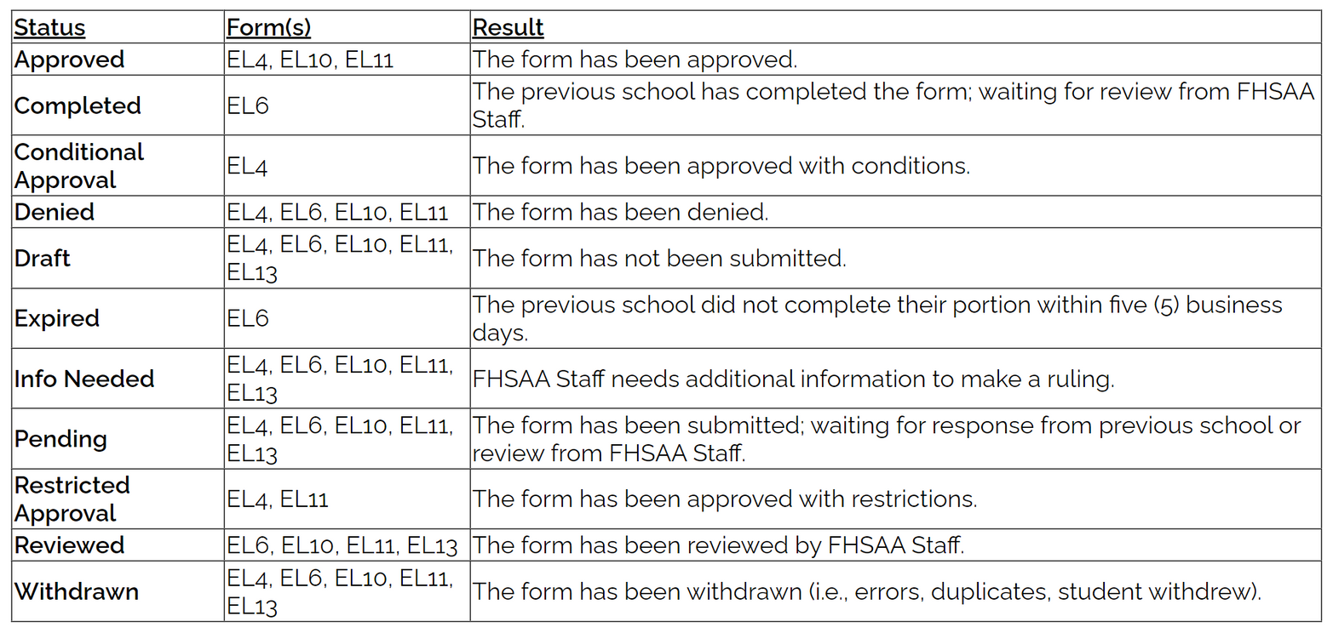
Eligibility
STATUS KEY

Slide 18
Policy 16.11.1
01
Allowing students to participate (see Bylaw 9.2.1.2) without a completed EL2 form (Pre-Participation Physical Evaluation, see Bylaw 9.7) will subject the school to a monetary penalty of a minimum of $500 per student and/or other sanctions.
Eligibility Form
VIOLATIONS
Policy 16.11.2
02
Allowing students to participate (see Bylaw 9.2.1.2) without a completed EL3 form (Consent and Release from Liability Certificate, see Bylaw 9.8) will subject the school to a monetary penalty of a minimum of $500 per student and/or other sanctions.

Slide 19
Policy 16.11.4
03
Allowing students to participate (see Bylaw 9.2.1.2) without properly registering a non-traditional student (see Policy 16.7.3) may subject the school to a monetary penalty of a minimum $100 per student and/or other sanctions.
Eligibility Form
VIOLATIONS
Policy 17.4.4
04
Allowing students to participate (see Bylaw 9.2.1.2) without a completed and approved EL4 form (Registration of Youth Exchange, Other International or Immigrant Student, see Policy 17) may subject the school to a monetary penalty of a minimum of $100 per student and/or other sanctions.

Slide 20
Eligibility
Resources
File Library > Eligibility Resources

Slide 21
06
Allegations and
SELF-REPORTS

Slide 22
FACTS
225 allegations have resulted in sanctions
Allegation
Other
5.3%
STATISTICS
Ineligible Students
23.1%
About 395 allegations received this year
Policy 36/37
71.6%

Slide 23
07
Policies 36/37

Slide 24
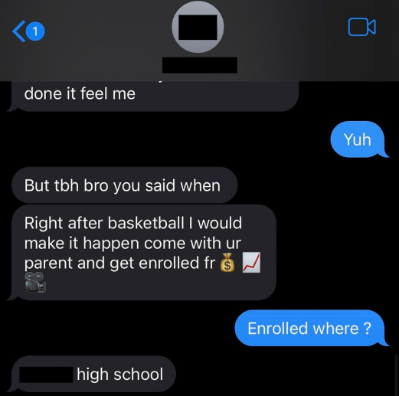
Common Violation
Using social media as an effort to pressure, urge or entice the student to attend a different school for the purpose of participating in interscholastic athletics.

Slide 25
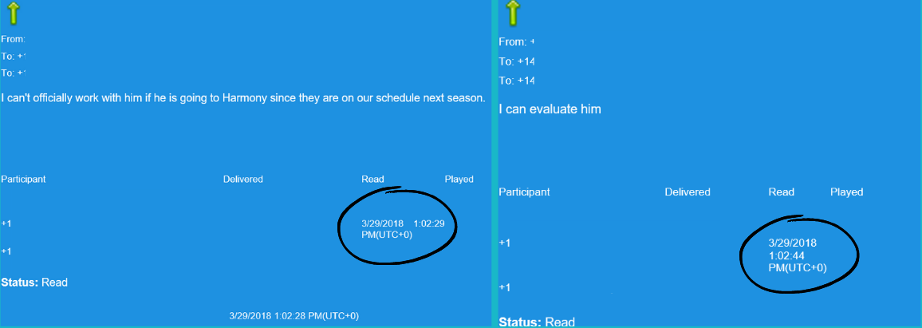
Common Violation
Evaluating or training a prospective student athlete when not compliant with policy 24.1.2.

Slide 26
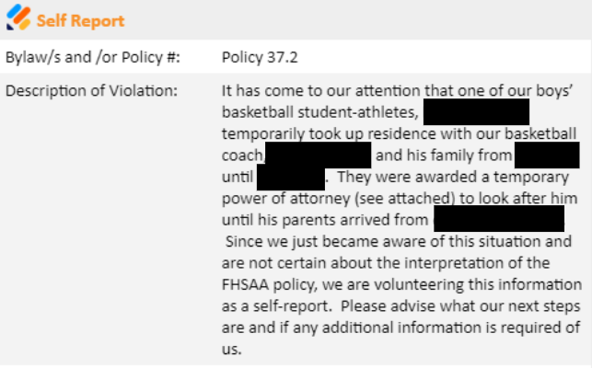
Common Violation
Living with a school representative (Policy 37.2.2.7)
Representative of a school’s athletic interest defined in Bylaw 1.4.18

Slide 27
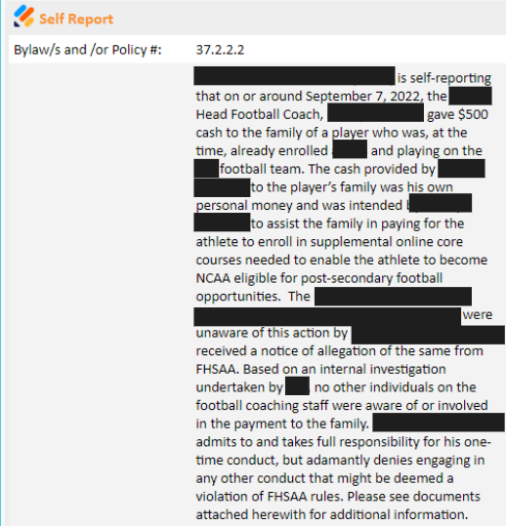
Common Violation
Cash or like items, such as credit cards, debit cards, gift cards, gift certificates, coupons, or vouchers.

Slide 28
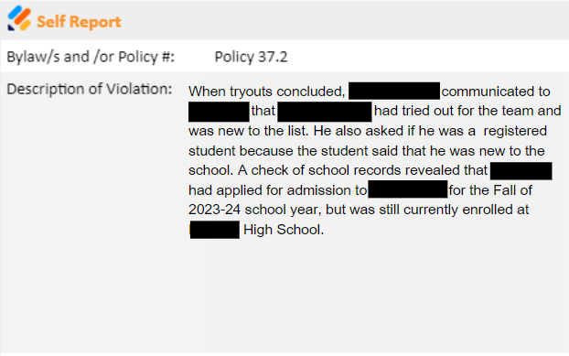
Common Violation
Any other form of arrangement, assistance, discount, or benefit that is not generally available to other students in the school or their families or that is based in any way on athletic ability.

Slide 29
08
Due Process

Slide 30
Letter
from
Principal
Other Documents
(to support the case)
Letter from
Parent/
Guardian
DOCUMENTATION
Mandatory
EL 11
Official
Transcript
(8th – current)
Discipline
Record

Slide 31
Letter from Principal
01
State the specific request
State the issue that is causing the ineligibility
State the hardship
Explain any issues with discipline, transcripts, etc
EXAMPLES
Medical Hardship
Documentation
Letter from health care provider
Avoid diagnosis and other specific health information
Document missed school time based on health issue
Example: John’s health required him to miss school for 3 months
02
Repeating a grade level
03
Letter from the school administration making the decision to repeat or retain
Transcripts showing retention

Slide 32
Due Process
OPTIONS
Sectional Appeals
Infractions Appeals
Mediation
Board of Directors

Slide 33
Justin Harrison
jharrision@fhsaa.org
Ext. 240
Jordanne Stark
jstark@fhsaa.org
Ext. 230
Ashton Moseley
amoseley@fhsaa.org
Ext. 380
Amanda Corral
acorral@fhsaa.org
Ext. 250
Ashton Moseley
Ashton Moseley
Becky Torino
btorino@fhsaa.org
Ext. 340

Slide 34
Thank you!
DO YOU HAVE ANY QUESTIONS?

