Slide 1
TIME MANAGEMENT & ORGANIZATIONAL TIPS FOR THE MODERN AD
EVANITTA OMENSETTER
ASSISTANT PRINCIPAL FOR ADMINISTRATION/ATHLETIC DIRECTOR
ALONSO HIGH SCHOOL

Slide 2
organizational skills – what is it?
Organizational skills are skills that allow you to use your resources efficiently and effectively. Being organized means you manage your time, energy and workspace well and can accomplish all your assigned tasks successfully.
Organizational skills can take different forms depending on your particular workplace and job title, but they typically involve maintaining an orderly workspace, meeting deadlines and communicating well with your team.
Possessing organizational skills enables you to get back control of your tasks when you’re feeling overwhelmed and perform better at work. They can make you more productive, more efficient, and of course, more organized.

Slide 3
organizational skills:
skills:
TIME MANAGEMENT
Make lists - Don’t rely on your memory
Working under pressure
Self motivation
Analytical thinking
Communication
Active listening
Method of communication:
One on one
Email
Feedback
responsiveness

Slide 4
organizational skills:
Skills continued:
Planning/setting goals
Calendars paper vs online
Delegating
You can’t do it by yourself
Surround yourself with good help
Prioritizing
Detail oriented
Keep a schedule
What do you use to organize all the practice times/games and field
USE TECHNOLOGY TO YOUR ADVANTAGE
CREATE FORMS
EXPORT DATA

Slide 5
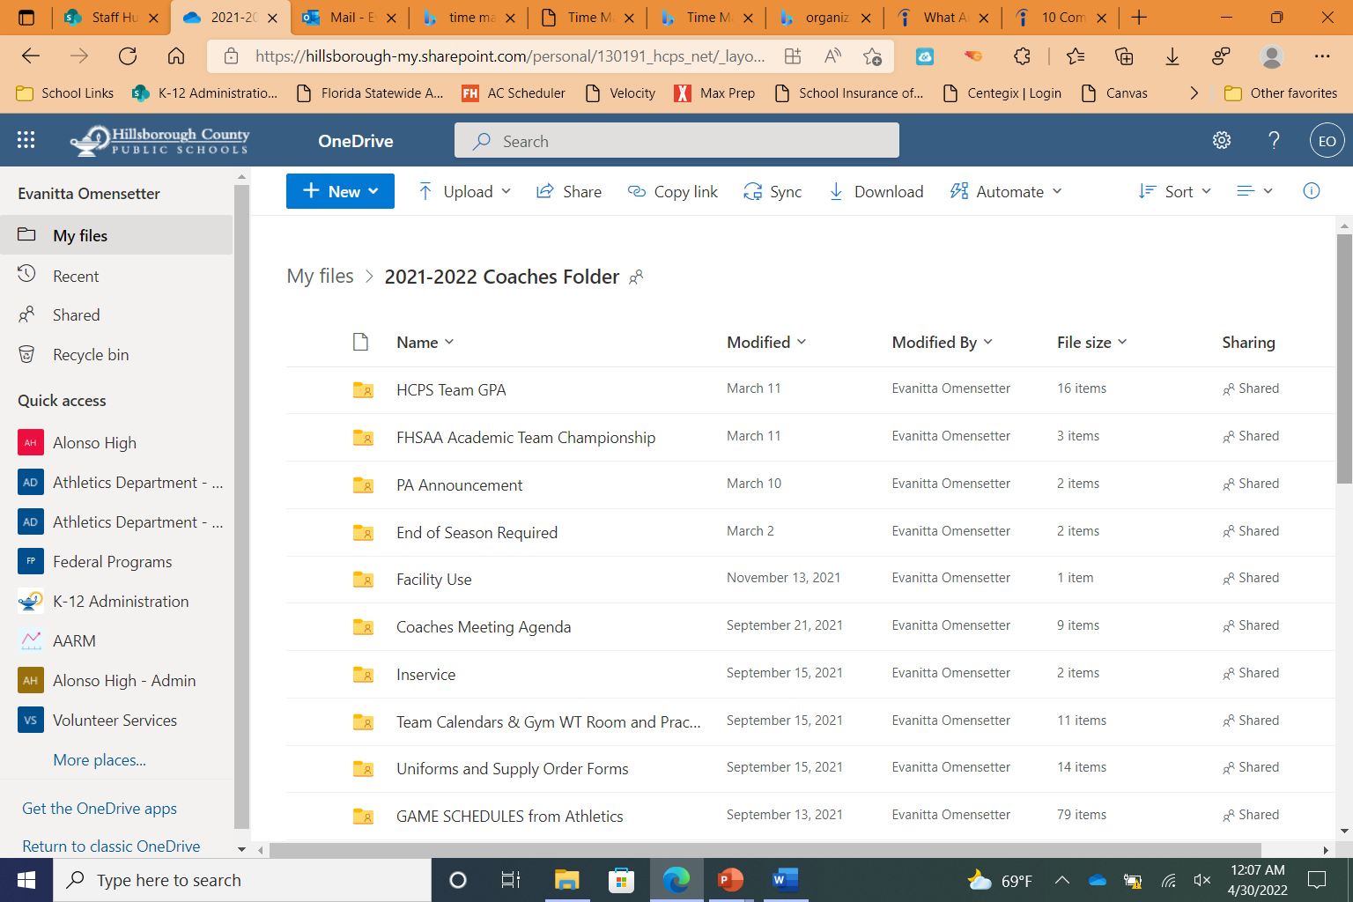
organizational skills:

Slide 6
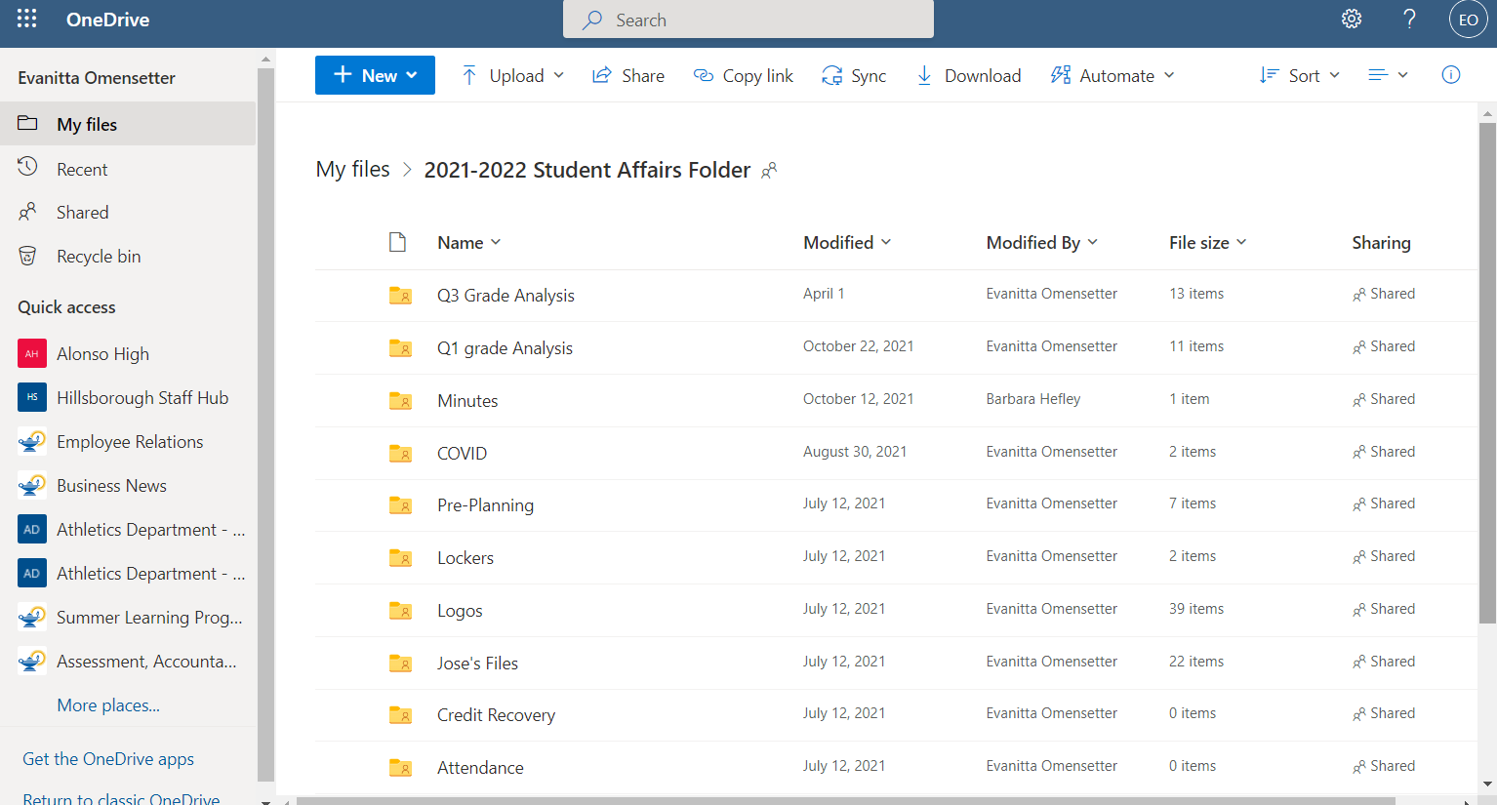

Slide 7
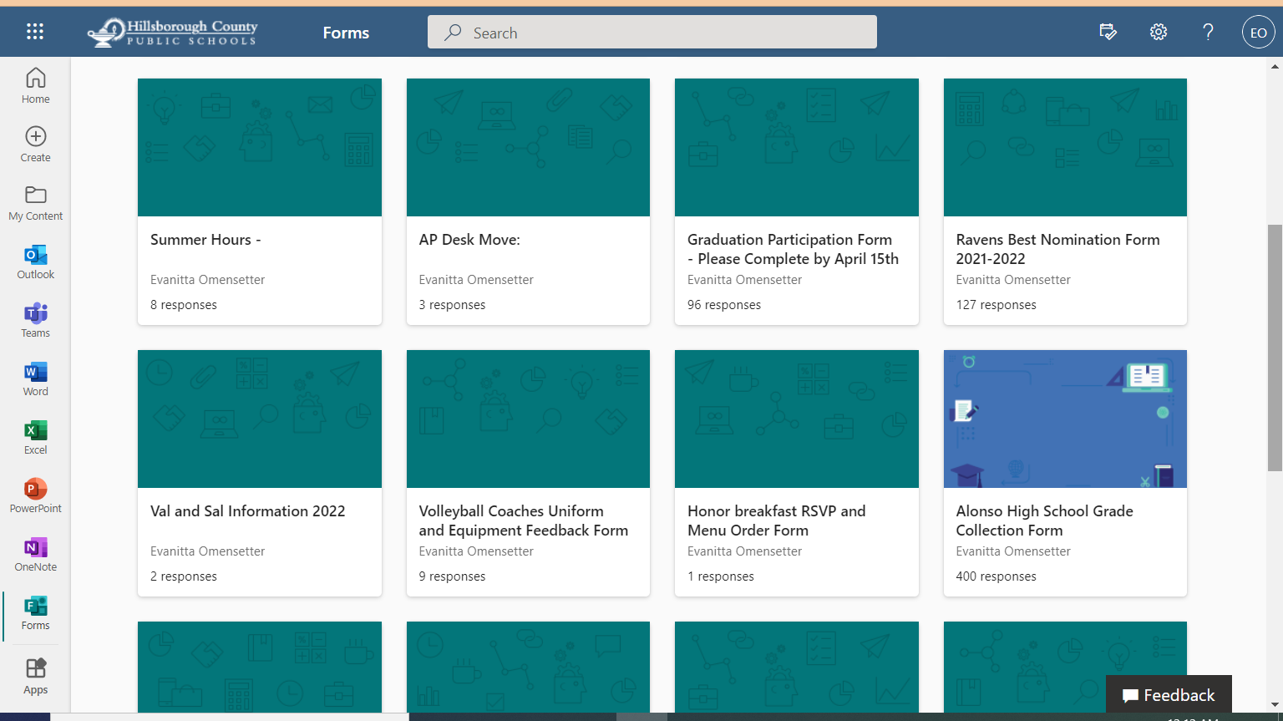

Slide 8
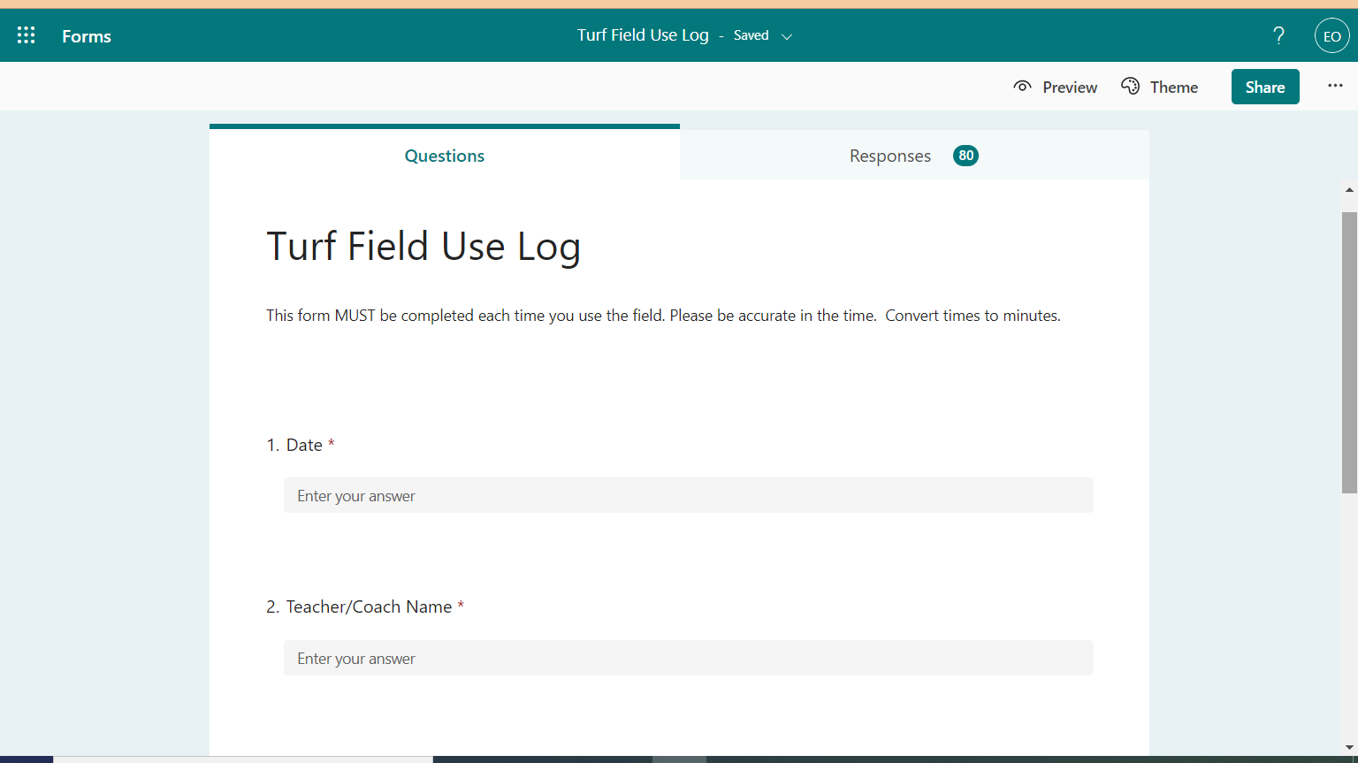
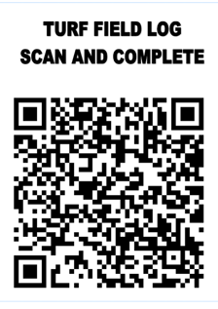

Slide 9
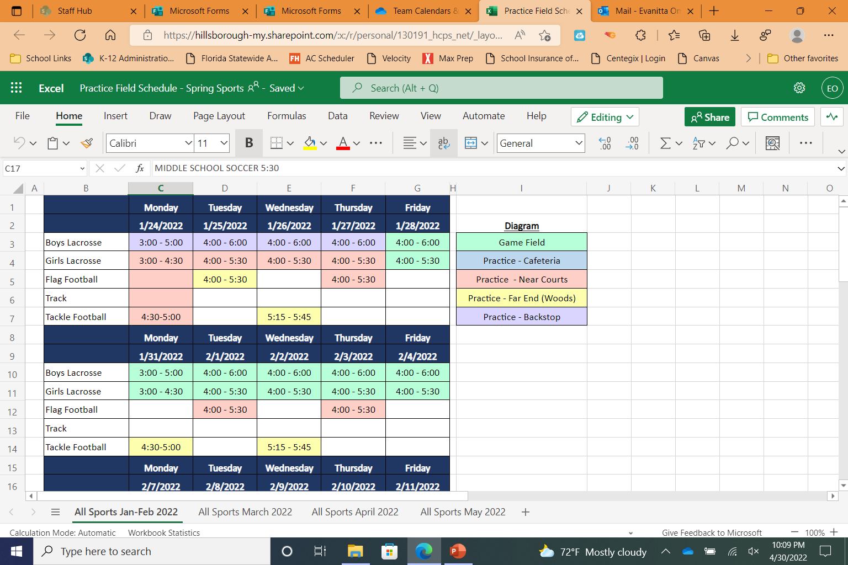

Slide 10
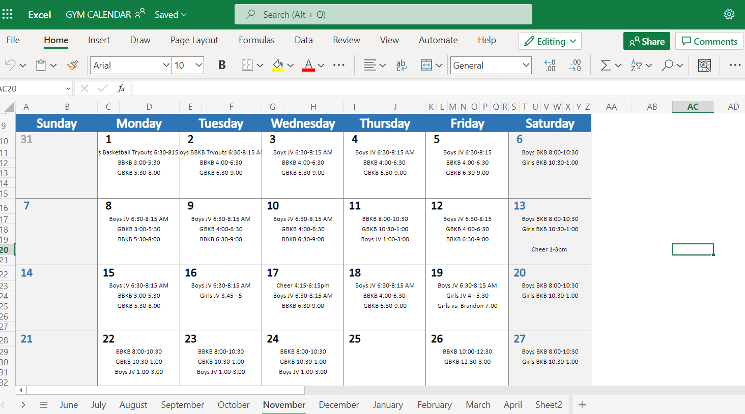

Slide 11
Time management
Schedule your time:
Doesn’t have to be the whole day
Things that need to get completed
Schedule breaks if necessary
Time Management Skills
Organizing
Mental Organization
Physical Organization
Prioritizing
Urgent vs Important
ABC Method
A Status – Must DO
B Status – should do
C Status – nice to do
Goal Setting
Communication & Collaboration
Task Management
DELEGATE
Workload Manager
Stress Management
Prioritizing:
What MUsT be done first?
What’s due now? Tomorrow? Later?
Importance of completion
Notes:
Time

Slide 12
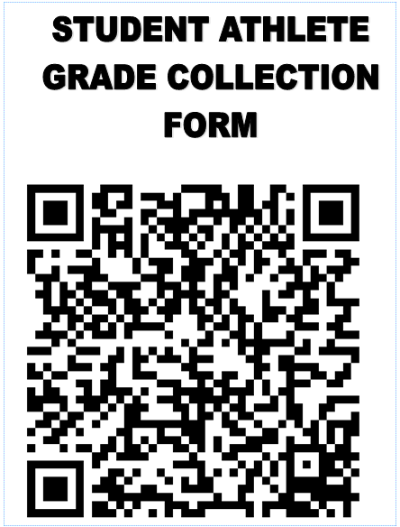
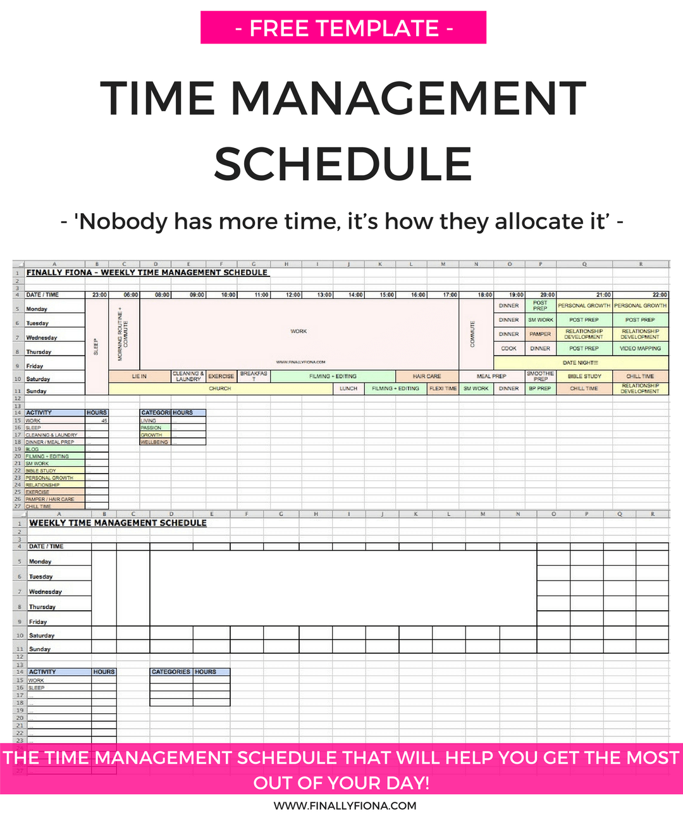
Time management
Why time management?
Saves time
Improves Efficiency
Greater reliability and less stress
Better work quality
Leaves a good impression
ONLINE CALENDARS

Slide 13
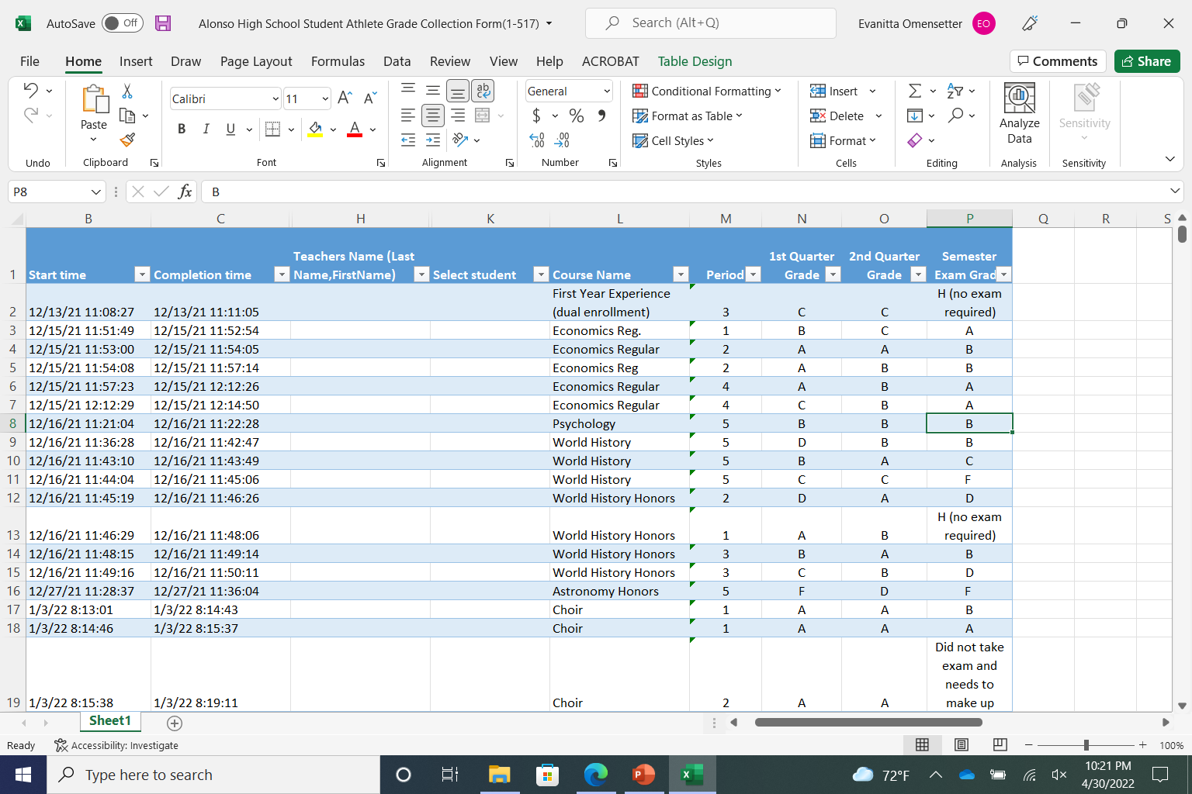

Slide 14
TIME MANAGEMENT
Time management tools:
Planners
Calendars
Phone apps
Wall charts
Index cards
Pocket diaries
Time management tools:
When using apps and tools – always record it on the tool itself – try not to transfer information as you will forget
Keep a List of priorities
Don’t forget to synchronize your app
Keep a back up system

Slide 15
“GOOD TEACHERS COPY. GREAT TEACHERS STEAL! TEACHERS WHO BEG , BORROW AND STEAL GOOD TECHNIQUES ARE TEACHERS WHO ARE EFFECTIVE AND WHOSE STUDENTS WILL ACHIEVE.” (HARRY WONG)

Slide 16
FOOD FOR THOUGHT:
7 habits of highly effective people (Franklin Covey)
Be proactive
Begin with the end in mind
Put first things first
Think win-win
Seek First to understand then to be understood
Synergize
Sharpen the saw

Slide 17
EVANITTA OMENSETTER
ASSISTANT PRINCIPAL FOR ADMINISTRATION/ATHLETIC DIRECTOR
ALONSO HIGH SCHOOL
EMAIL: EVANITTA.OMENSETTER@HCPS.NET
813.356.1525

