Slide 1
Current Trends - MS
Current Trends in Middle School Athletics
FIAAA – May 5th, 2018

Slide 2
Current Trends - MS
Bret Bystricky, CIC, CAA
Middle School Director of Athletics Saint Stephen's Episcopal School Bradenton, Florida

Slide 3
Current Trends - MS
Current Trends in Middle School Athletics
Why do kids play sports?
Ask an AD or Coach to make a list of answers to this question and you'll get a bunch of answers, but one answer consistently shows up at the top...it's fun!

Slide 4
Current Trends - MS
Current Trends in Middle School Athletics
Sport specialization
Pay-to-Play: Who's being eliminated
To Cut or Not to Cut
Coach/Parent & Coach/Student Athlete Communication
Bleacher Creatures
Budget Concerns: Are MS sports in jeopardy?
Growth of Lacrosse
Football Participation Numbers

Slide 5
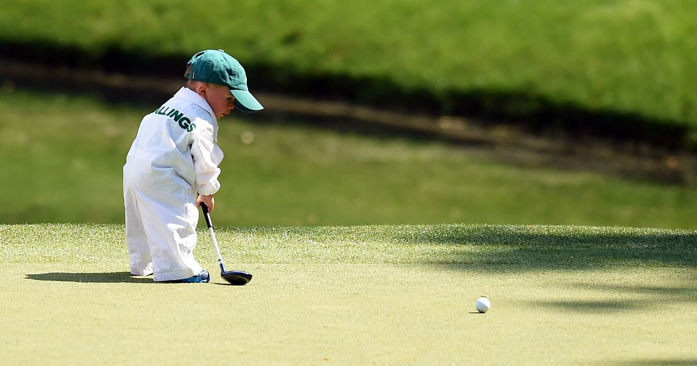
Current Trends - MS
Current Trends in Middle School Athletics
SPORT SPECIALIZATION
1) How are you promoting multi-sport athletes in your school? Are there special awards or recognition for those student-athletes? (Group share) 2) It's an issue that's not going to go away so how are we going to make it work for us as coaches, AD's, and schools?

Slide 6
Current Trends - MS
Current Trends in Middle School Athletics
We love to point to the NFL Draft as proof that multi-sport athletes are what high level coaches want, but football generally isn't played year-round like the other sports. It prevents specialization & lends itself to multi-sport participation unlike most other team sports. So what are we doing to promote multi-sport athletes in the other team sports?

Slide 7
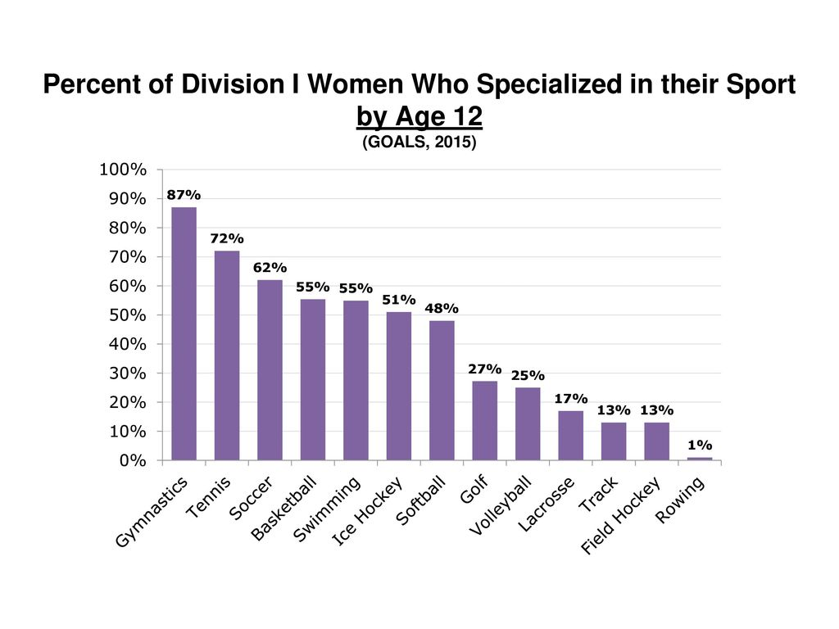
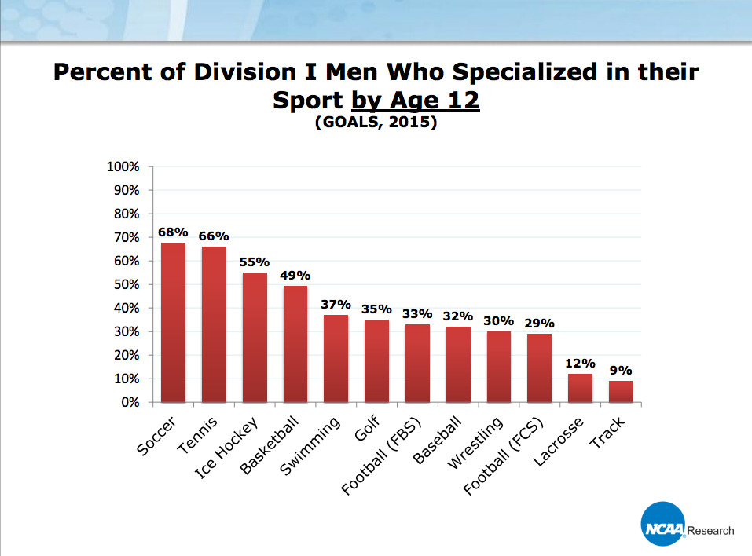
Current Trends - MS
Current Trends in Middle School Athletics
Almost all Athletic Director's believe in the benefits of multi-sport participation. So what is our counterargument to specialization and these types of statistics? http://usatodayhss.com/2017/a-few-surprises-in-the-data-behind-single-sport-and-multisport-athletes

Slide 8
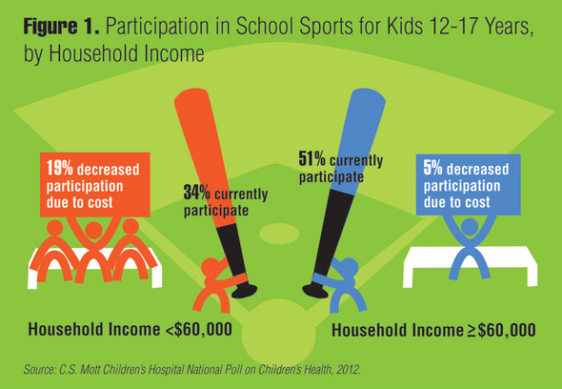
Current Trends - MS
Current Trends in Middle School Athletics
PAY-TO-PLAY: WHO'S BEING ELIMINATED

Slide 9
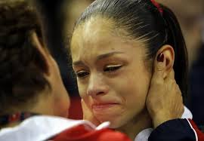
Current Trends - MS
Current Trends in Middle School Athletics
TO CUT OR NOT TO CUT
How often do you review your cut policy as a Department? Have you weighted the pros & cons of each? If you have the
funding, and the facilities, or volunteers then a "No-Cut" policy at the middle school level is a great way to jump start your programs. Try thinking outside the box. Be flexible. Do all of your teams need practice 5 days per week at this level? Country club sports vs. Team sports. Can you partner with AAU programs to help develop your players?

Slide 10
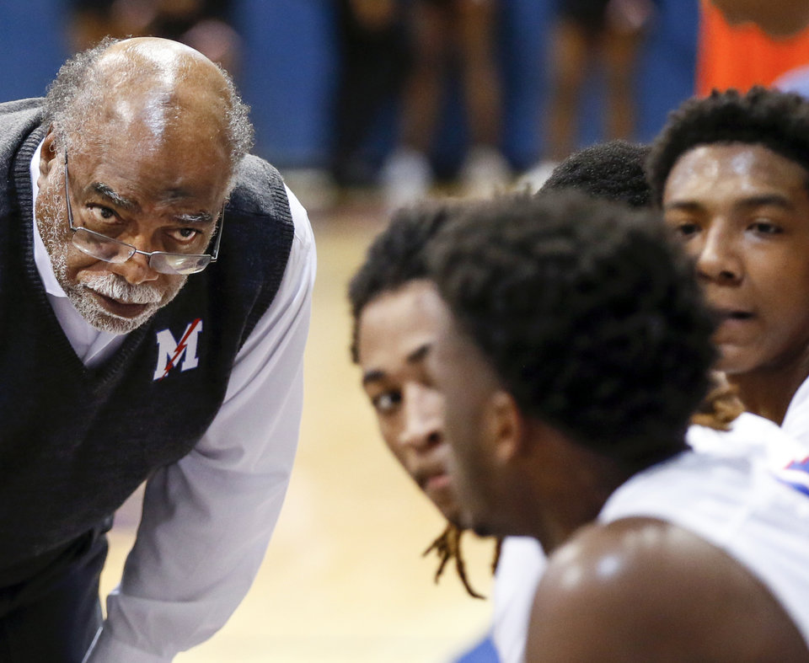
Current Trends - MS
Current Trends in Middle School Athletics
COACHING & COMMUNICATION
Our modes of communication have changed over the years? There's less face-to-face dialogue, more e-mail, text, and social media usage. The issues that come with that are extensive. Encourage your coaches to be willing to have difficult conversations & communicate...BUILD RELATIONSHIPS!

Slide 11
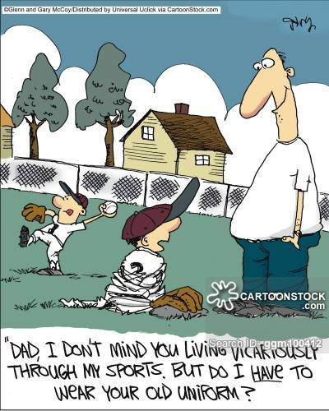
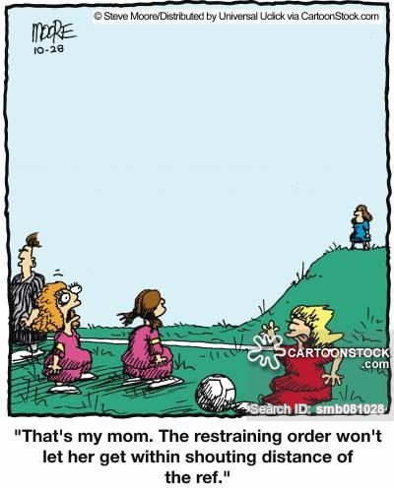
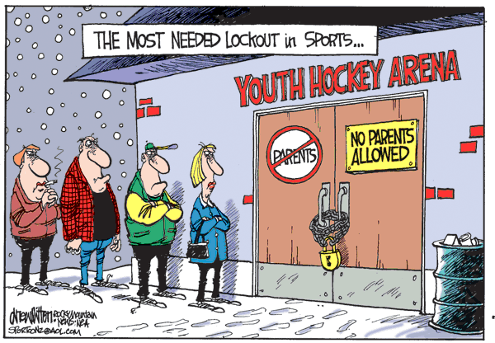
Current Trends - MS
Current Trends in Middle School Athletics
BLEACHER CREATURES

Slide 12
Current Trends - MS
Current Trends in Middle School Athletics
BUDGET CONCERNS: ARE MS SPORTS IN JEOPARDY? What are you doing to advocate for athletics at your school or district? As the AD, you're in the sales business every single day. We need to sell the value & importance of what we do.

Slide 13
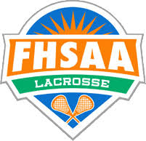
Current Trends - MS
Current Trends in Middle School Athletics
GROWTH OF LACROSSE
1. What has the impact been on your other spring sports?
2. Has it impacted your girls spring sports more than the boys?
3. While lacrosse is exploding, so is girls' flag football. What impact has that / will that have on your facilities and rosters?

Slide 14
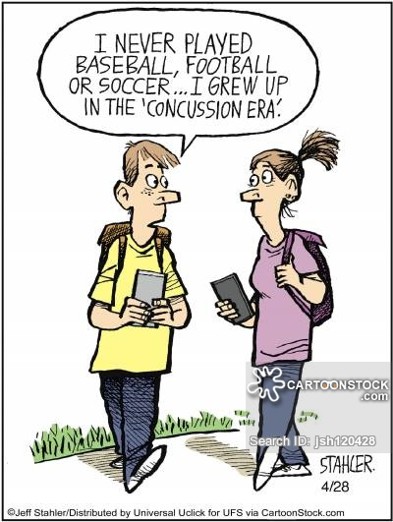
Current Trends - MS
Current Trends in Middle School Athletics
FOOTBALL PARTICIPATION NUMBERS A Boston University study in Sep. '17, said that "athletes that began playing tackle football before the age of 12 had more behavioral & cognitive problems later in life than those who started playing after they turned 12." https://www.nytimes.com/2017/09/19/sports/football/tackle-football-brain-youth.html

