Slide 1
Technology
Work Smarter, Not Harder…How Technology
Can Work for You
FIAAA – May 5th, 2018
Notes:
I would like to welcome everyone to the breakout session "Work Smarter, Not Harder...How Technology Can Work For You"
We will cover a variety of computer applications that can be useful in the world of athletics

Slide 2
Technology
Dylan Mobley
Director of Athletics Ronald W. Reagan/Doral High School Doral, Florida
Notes:
I am...

Slide 3
Technology
Work Smarter Not Harder…How Technology Can Work for You
Download a QR Code Reader
Notes:
Before we get started, by a show of hands who has a QR Code Reader on their Smartphone?
If you don't have a QR reader please take a moment and download one from your app store.
You will need a QR Reader to access a the resources I will give you at the end of the presentation.
Give a couple minutes for download and hit on why

Slide 4
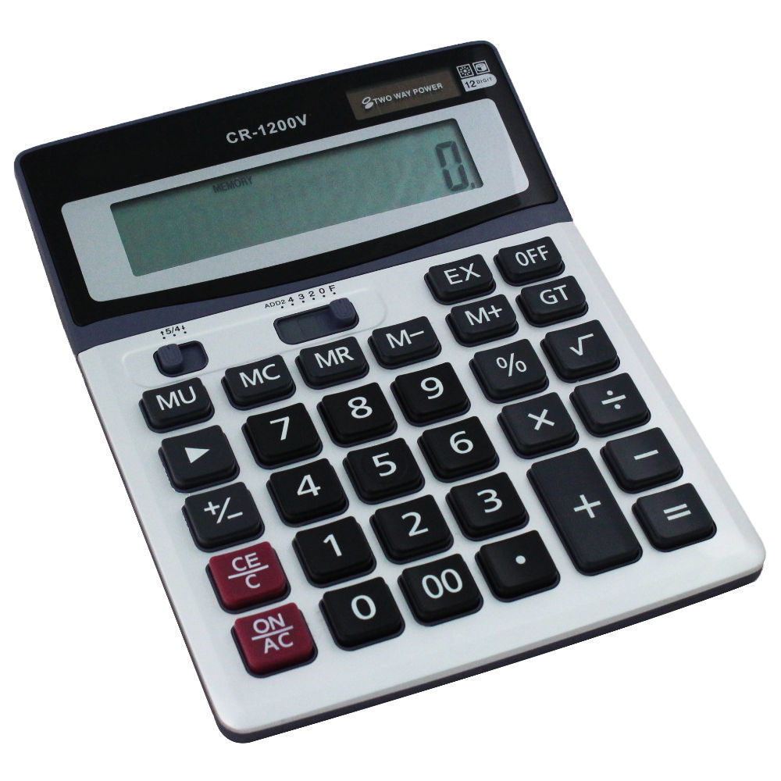
Technology
Work Smarter Not Harder…How Technology Can Work for You
Old Technology Versus New Technology...
Notes:
Mention how technology has evolved
Abacus is displayed 1st, ask who can Identify then fly in calculator

Slide 5
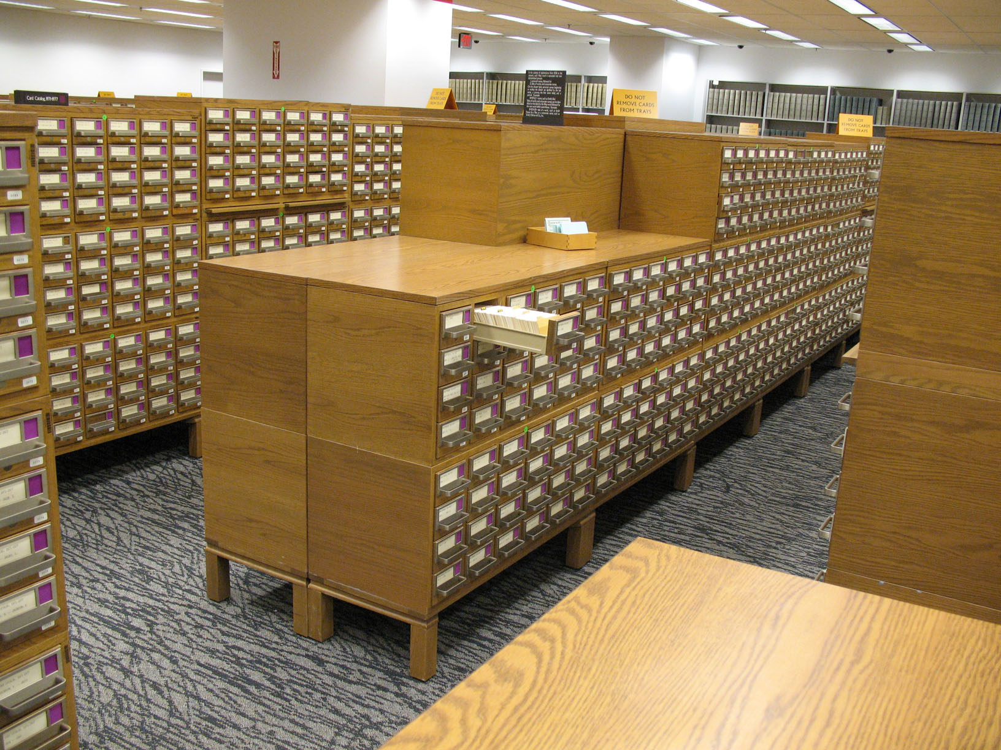
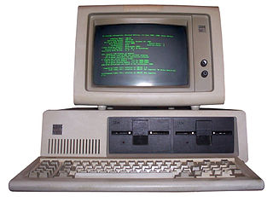
Technology
Work Smarter Not Harder…How Technology Can Work for You
Library Technology...
Notes:
Who remembers a Card Catalog?
What replaced the Card Catalog?
Is there a need for a Library or Media Center?

Slide 6
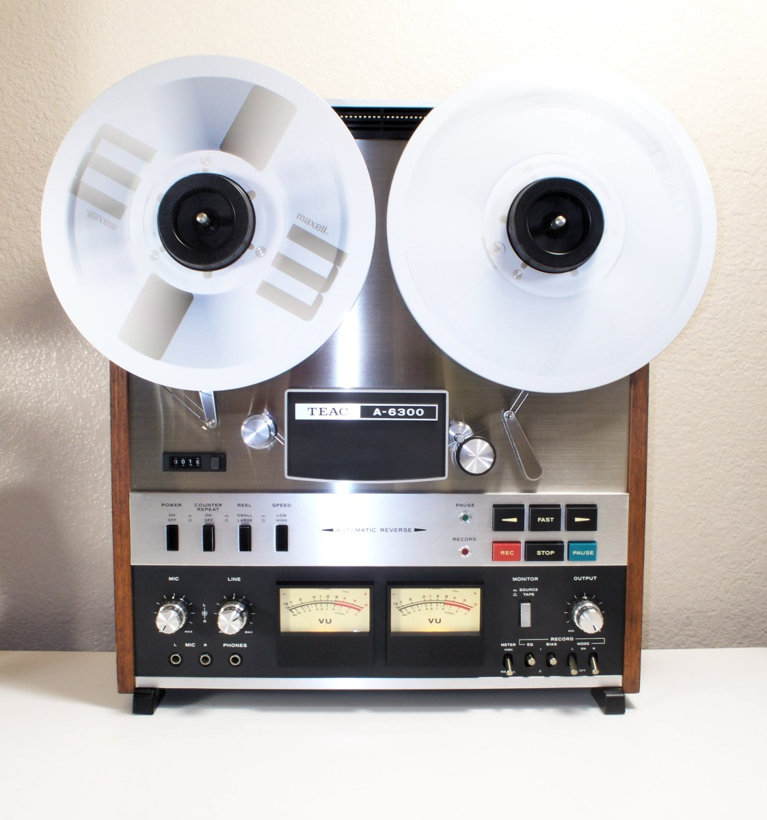
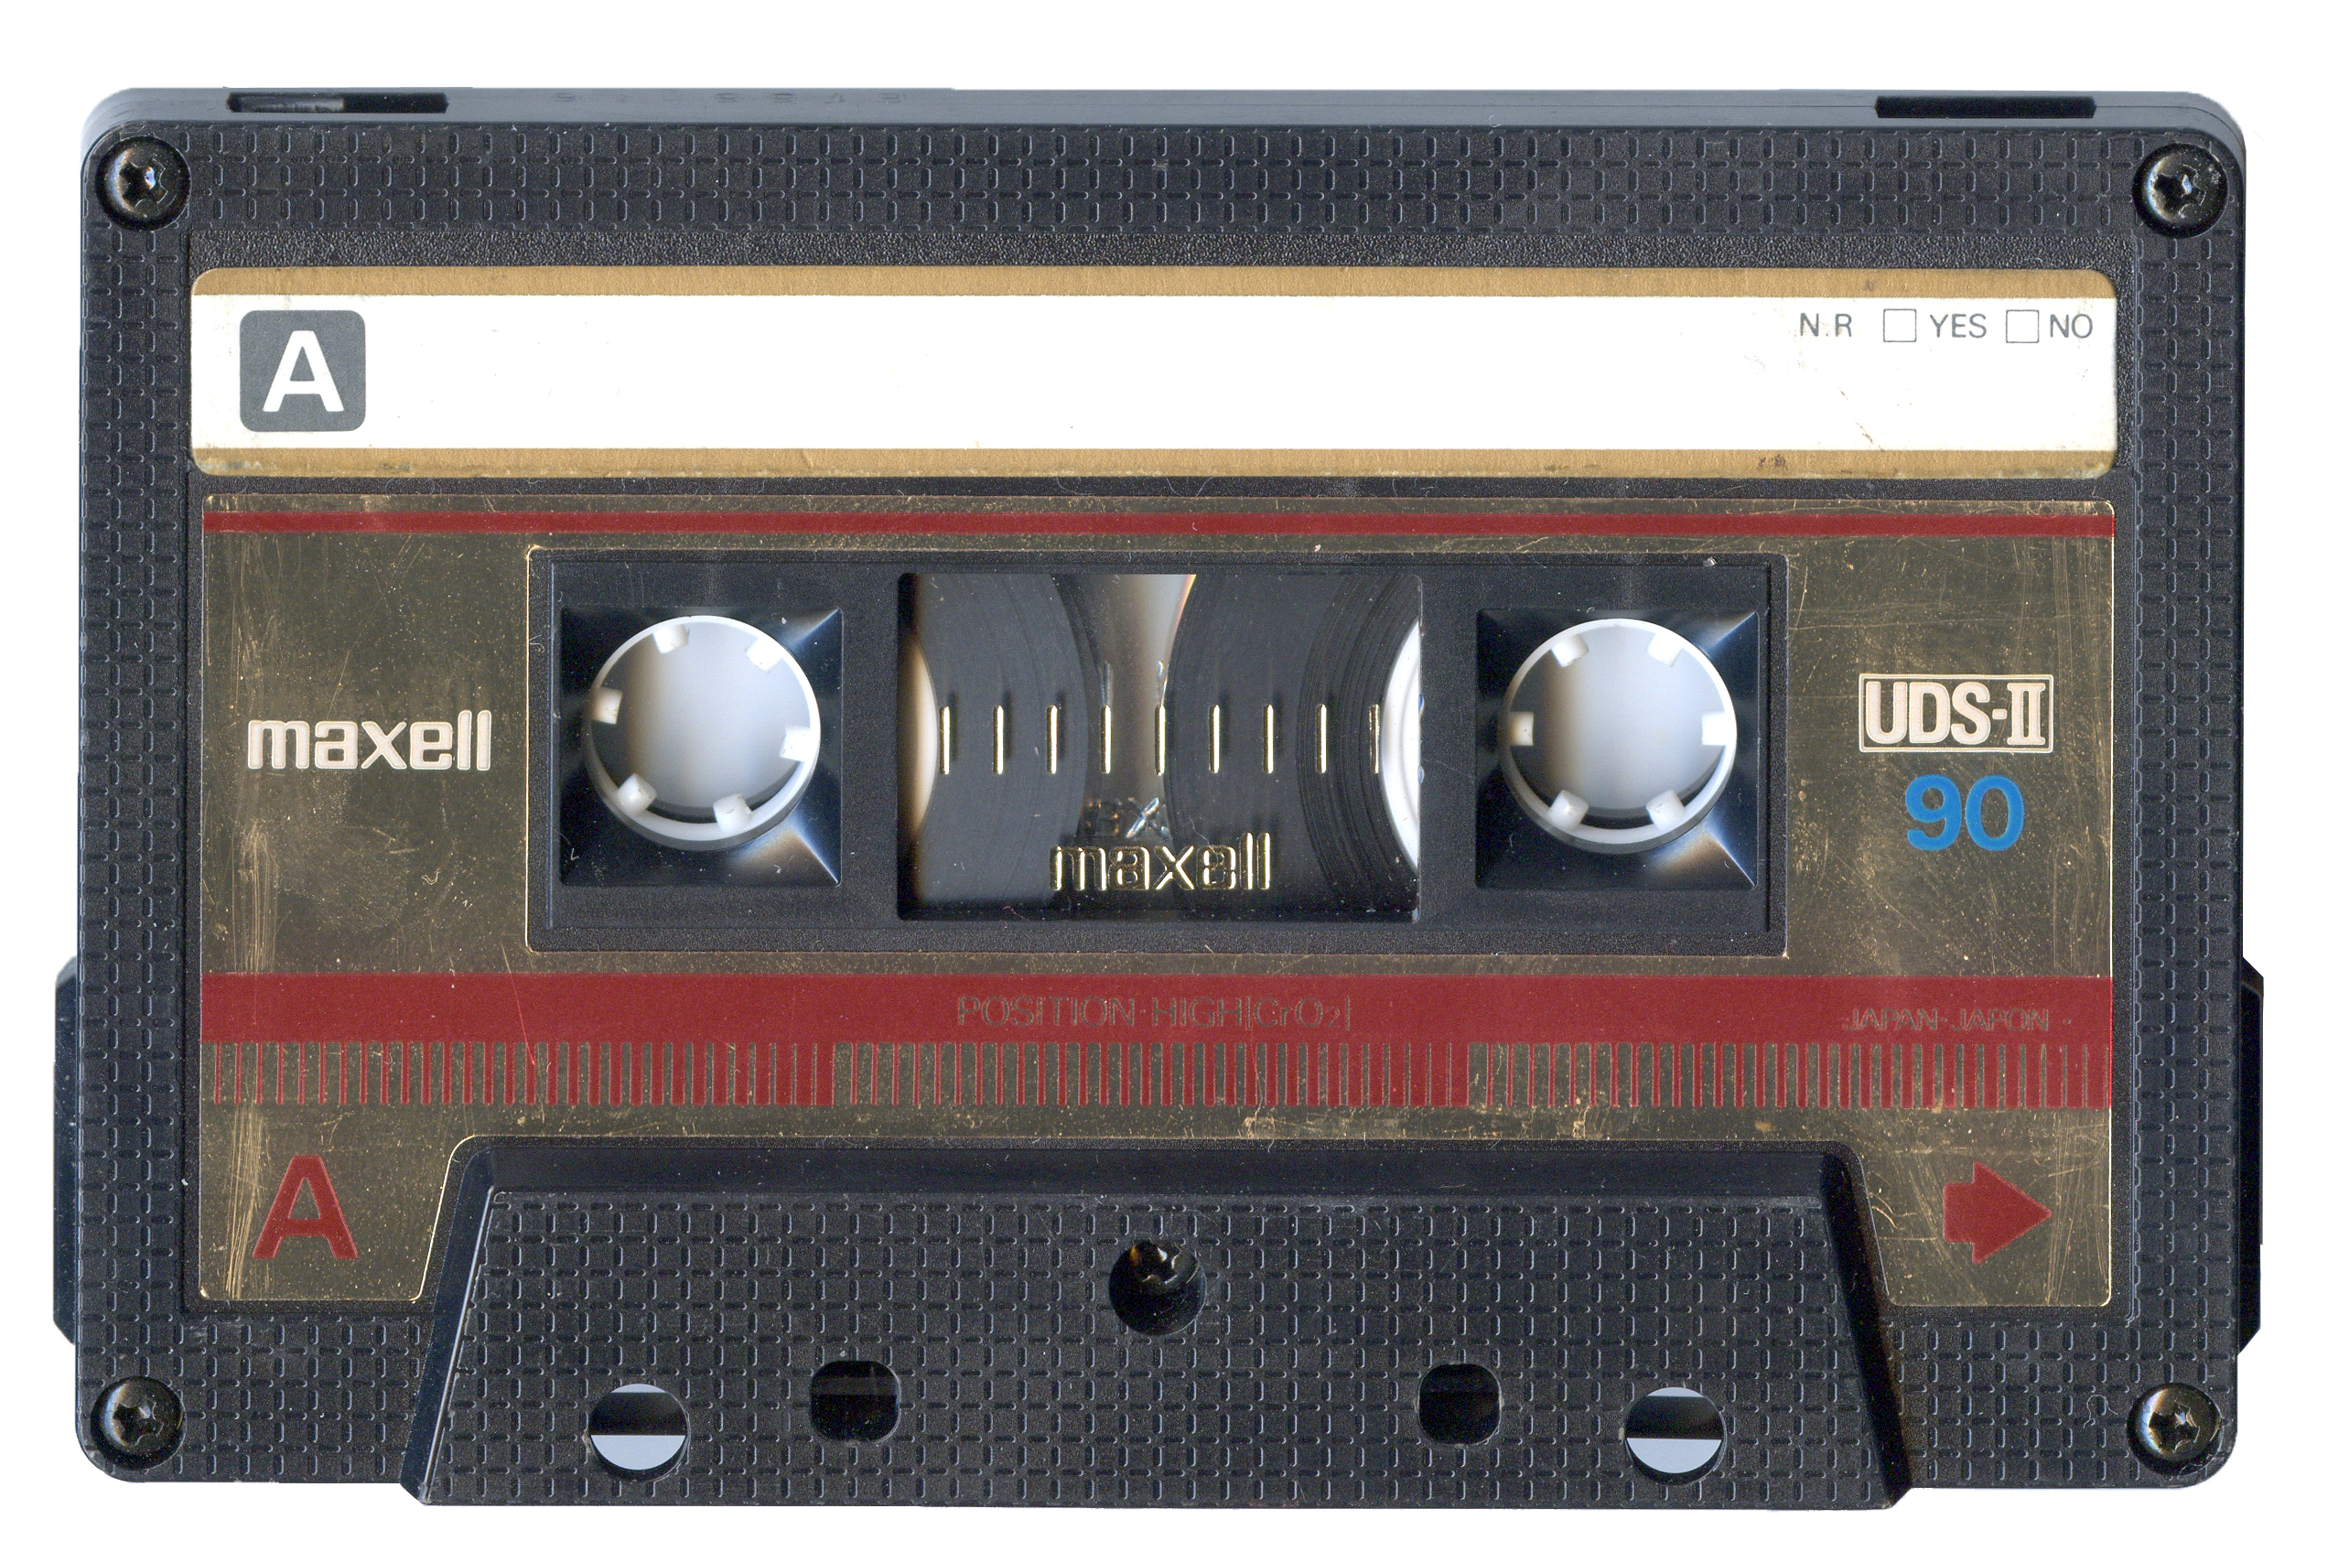
Technology
Work Smarter Not Harder…How Technology Can Work for You
Music Technology...
Notes:
Are there any music lovers in the house?
This is where I mention losing my Bose Bluetooth speaker at the airport (tell the story)
After story fly out items

Slide 7
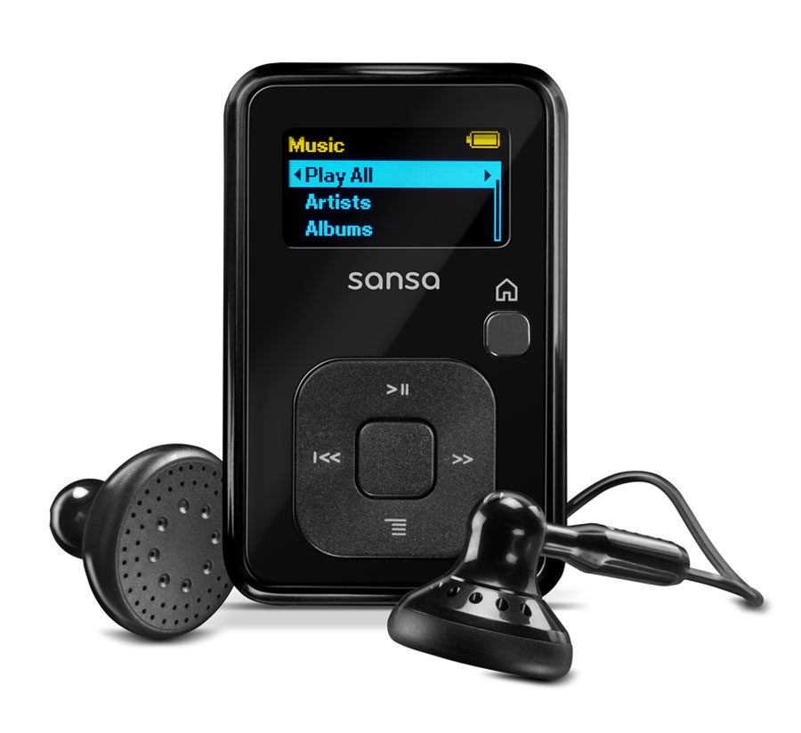
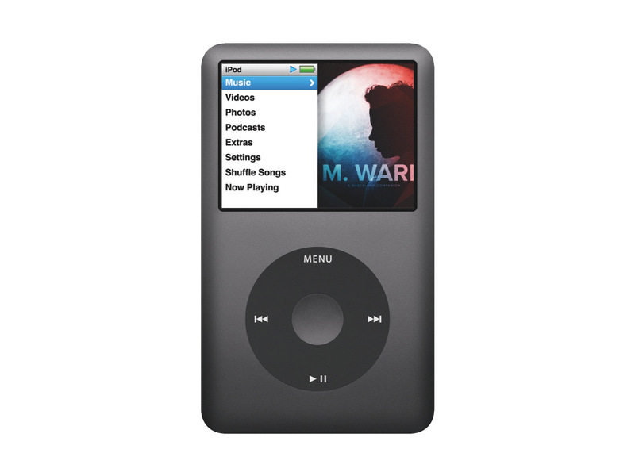
Technology
Work Smarter Not Harder…How Technology Can Work for You
Music Technology...
Notes:
Continue to fly out and discuss music technology
Ask who can Identify music technology I missed

Slide 8
Technology
Work Smarter Not Harder…How Technology Can Work for You
New Music Technology...
Notes:
Expound on music streaming

Slide 9
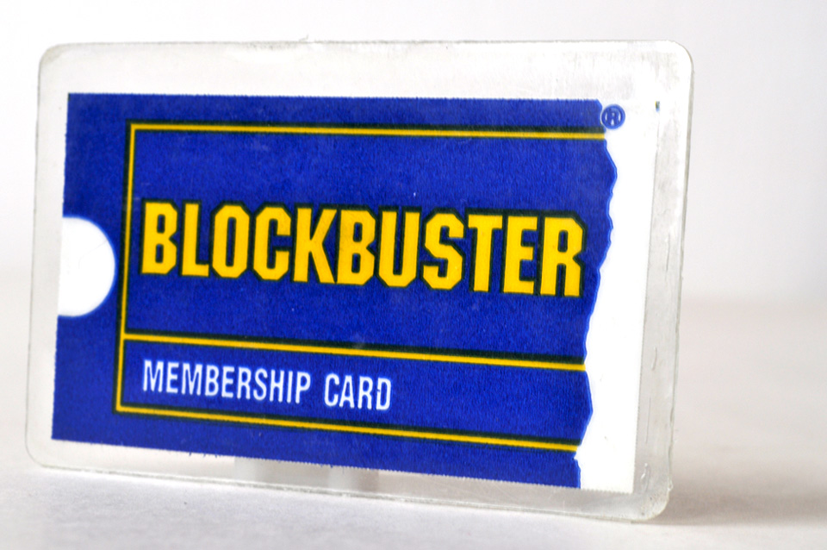
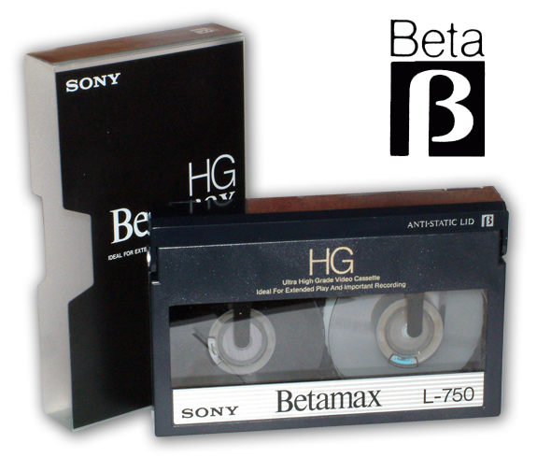
Technology
Work Smarter Not Harder…How Technology Can Work for You
Movie Technology...
Notes:
Who remembers Block Buster Video?
What new technology cannibalized the video giant? I would guess Netflix

Slide 10
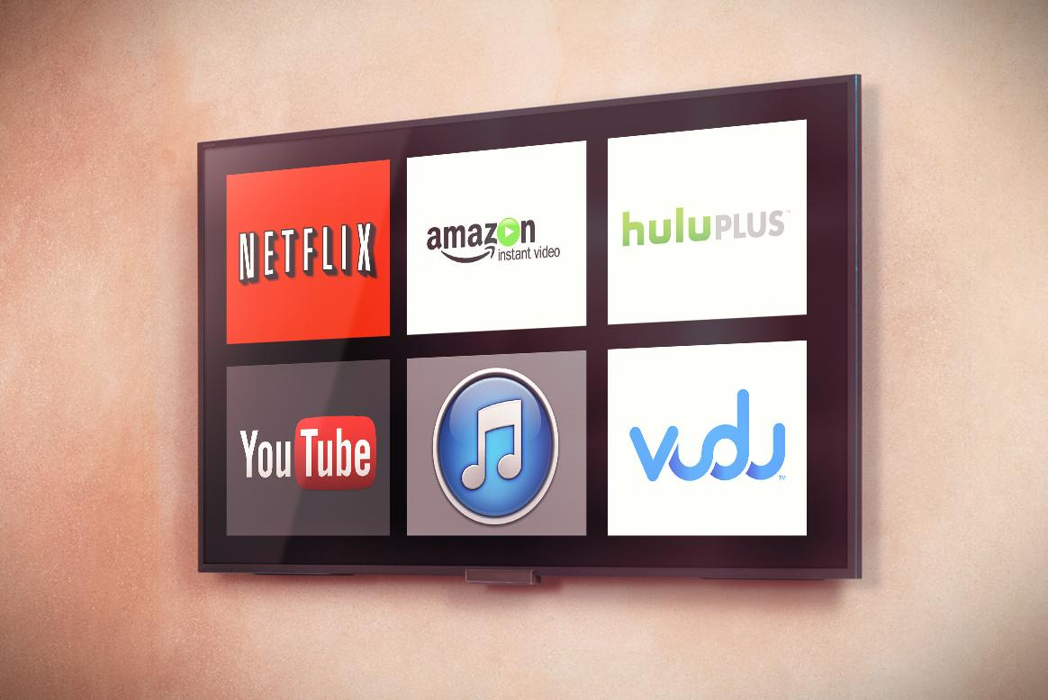
Technology
Work Smarter Not Harder…How Technology Can Work for You
Movie Technology...
Notes:
Blu-ray
Streaming & Netflix

Slide 11
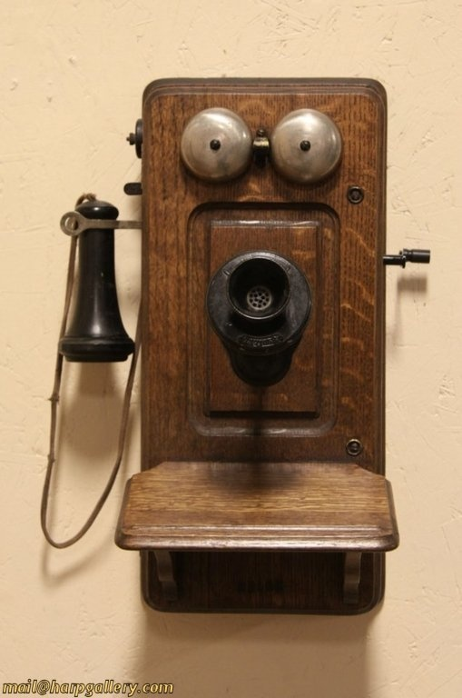
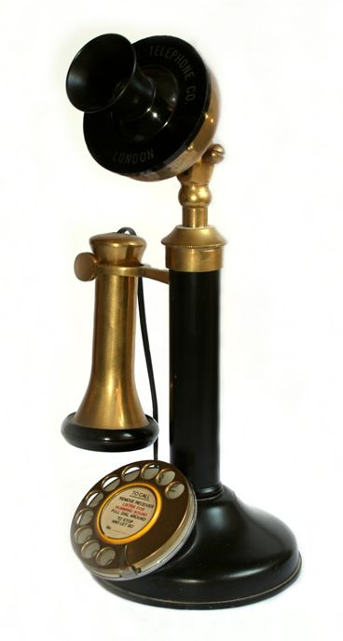
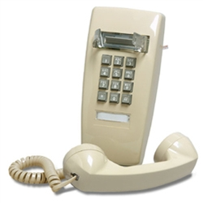
Technology
Work Smarter Not Harder…How Technology Can Work for You
Telephone Technology...
Notes:
Ask who had that one phone in the kitchen that had a long cord on it?

Slide 12
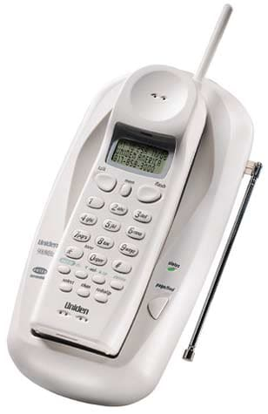
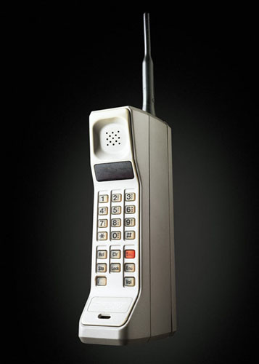
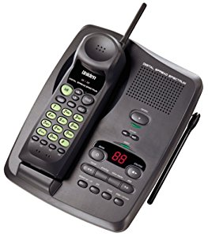
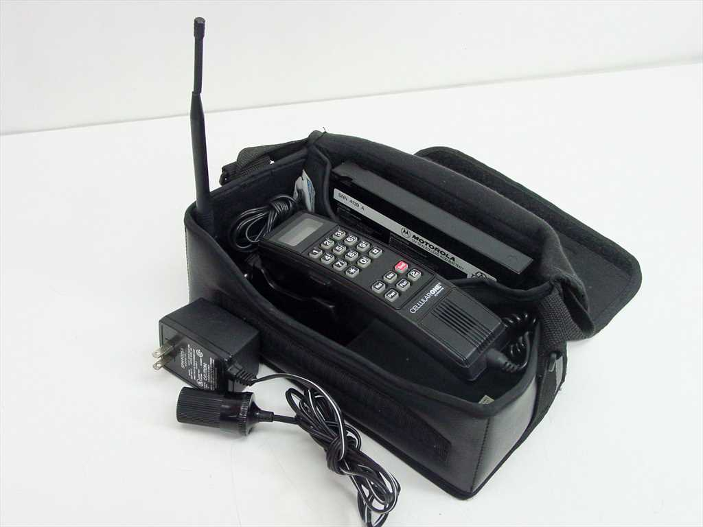
Technology
Work Smarter Not Harder…How Technology Can Work for You
Telephone Technology...

Slide 13
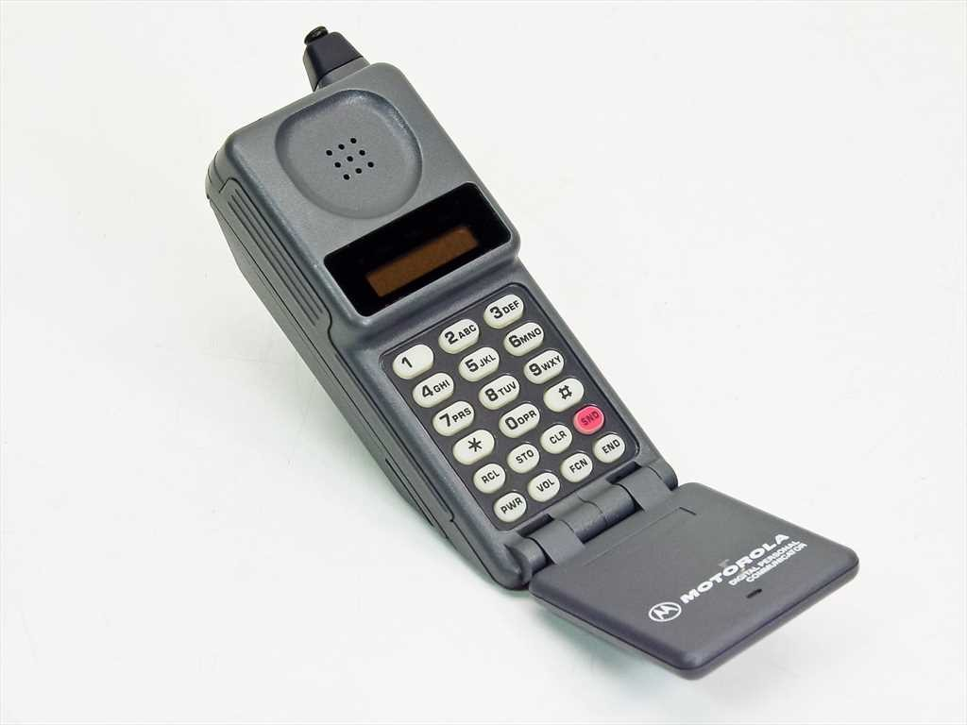
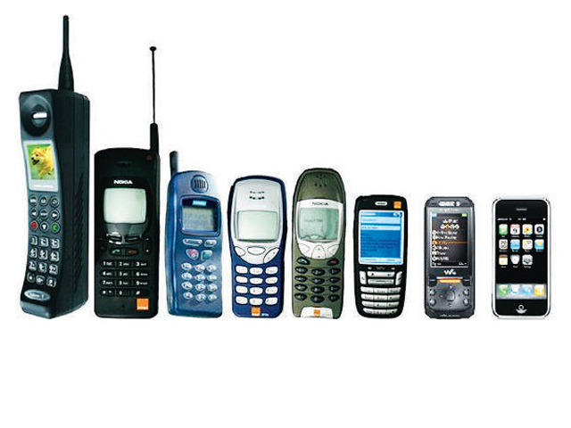
Technology
Work Smarter Not Harder…How Technology Can Work for You
Telephone Technology...

Slide 14
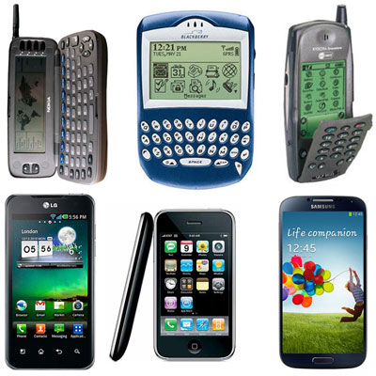
Technology
Work Smarter Not Harder…How Technology Can Work for You
The Smartphone...
Notes:
This is where you will show YouTube video of man running out of hospital

Slide 15
Technology
Work Smarter Not Harder…How Technology Can Work for You
Has this ever happened to you?
https://www.youtube.com/watch?v=3NwwmDD2tSc
Notes:
Has this ever happened to you?

Slide 16
Technology
Work Smarter Not Harder…How Technology Can Work for You
Situations Athletic Administrators Face Everyday
Schedule Management
Facilities Usage
Coordinate Transportation
Coordinate Officials
Contracts
Roster Management
Student Eligibility
Statistics
Print Awards
Games Results
Activities Management
Financial Tracking
User Management
Group Email Features
Manage Email Alerts
Notes:
Ask for best practices for each situation

Slide 17
Technology
Work Smarter Not Harder…How Technology Can Work for You
Peripherals Needed to Be Effective As An AD
Desktop Computer
Laptop
Tablet
Scanner
Color Laser Printer
Jump Drive
Dual Monitors (or more)
Smartphone
Smartwatch
Headphones
iCloud Storage
Potable Charger
Charging Cables
Bookbag
Notes:
Ask for best practices for each situation

Slide 18
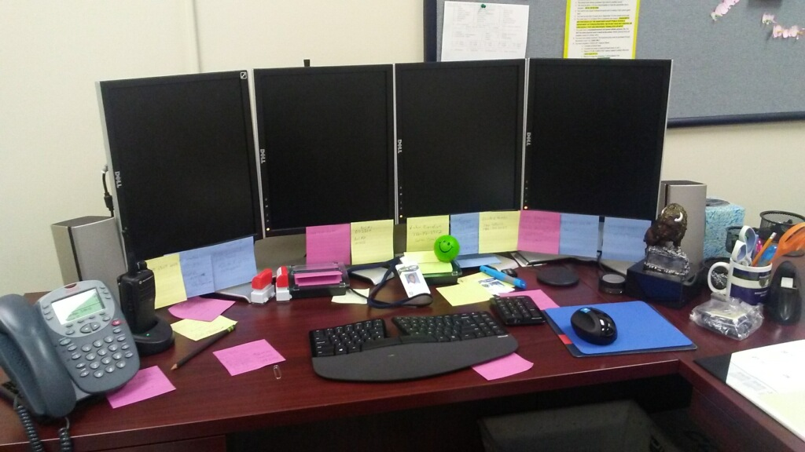
Technology
Work Smarter Not Harder…How Technology Can Work for You
What does this picture say to you?
Notes:
Why four monitors?
Comfortable mouse
Ergonomic keyboard
Post-it Notes at the ready

Slide 19
Technology
Work Smarter Not Harder…How Technology Can Work for You
Essentials Applications for Athletic Directors

Slide 20
Technology
Work Smarter Not Harder…How Technology Can Work for You
How would you rank the following?
Outlook
Excel
Access
Word
OneNote
OneDrive
Forms
Notes:
How would you rank?
Then show my ranking

Slide 21
Technology
Work Smarter Not Harder…How Technology Can Work for You
How I use Outlook?
Outlook
Email
Calendar
Meeting Request
Task Managment
Contacts
Notes:
How would you rank?
Then show my ranking

Slide 22
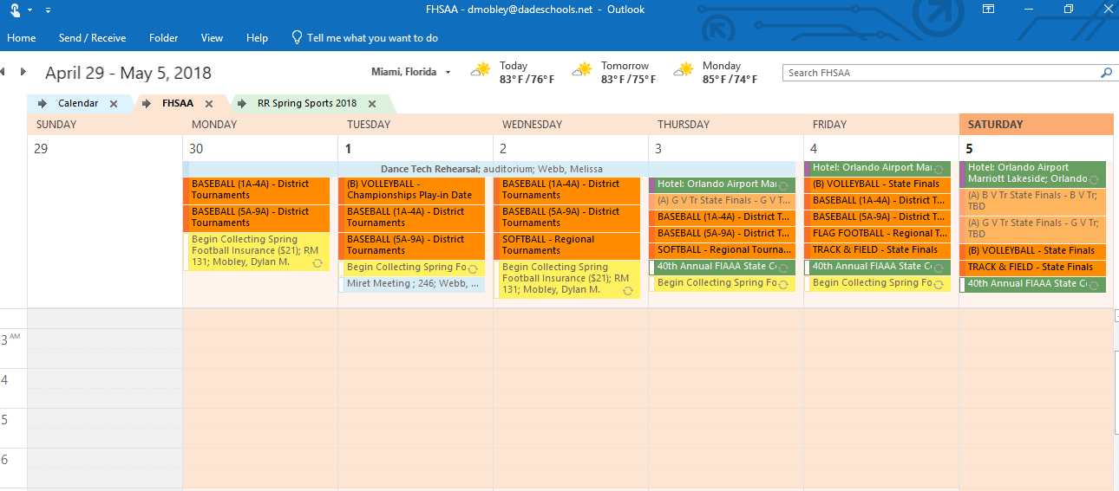
Technology
Work Smarter Not Harder…How Technology Can Work for You
My Outlook Calendar
Notes:
How would you rank?
Then show my ranking

Slide 23
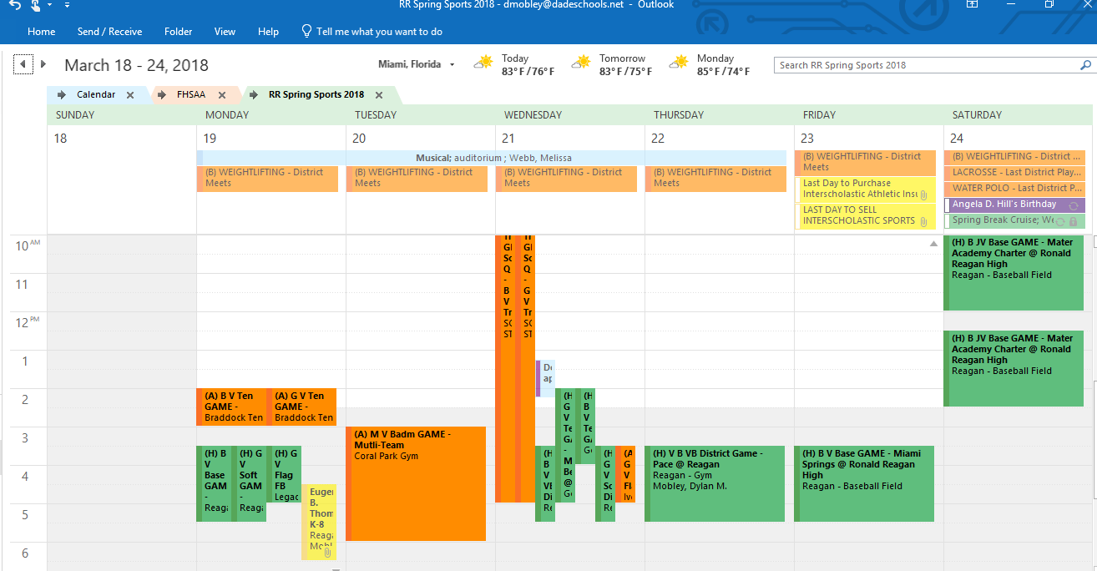
Technology
Work Smarter Not Harder…How Technology Can Work for You
My Outlook Calendar
Notes:
How would you rank?
Then show my ranking

Slide 24
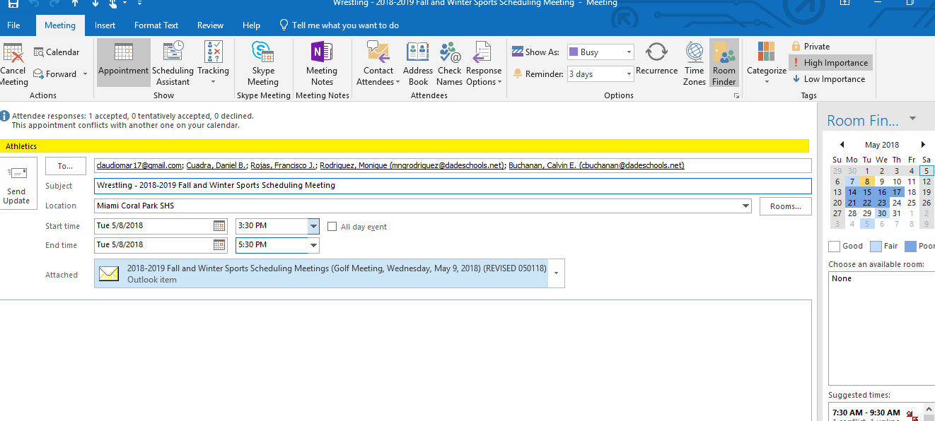
Technology
Work Smarter Not Harder…How Technology Can Work for You
Outlook Meeting Request
Notes:
Discuss the importance of a meeting request

Slide 25
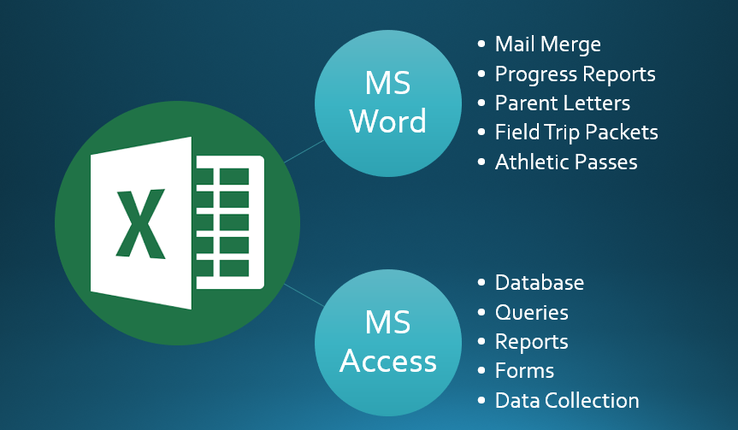
Technology
Work Smarter Not Harder…How Technology Can Work for You
How I use Excel...
Notes:
Discuss the importance of a meeting request

Slide 26
Technology
Work Smarter Not Harder…How Technology Can Work for You
How I use Excel...
•ID#
•Last Name
•First Name
•Last, First (full name)
•Grade
•Title
•Gender
•Ethnicity
•Cohort Year
•GPA
•Conduct GPA
•ESE
•ESOL
•Physical Date
•Insurance Date
•Impact Test
•Address
•Phone
•Parent Name
•Sport(s) Played
•Student Schedule
•Current Age
•# of Absences
•# of Tardies
•# of Suspensions
Notes:
Discuss the importance of a meeting request

