Slide 1
Sportsmanship Programs
Creating a Sportsmanship Program for Your School
FIAAA – May 5th, 2018

Slide 2
Sportsmanship Programs
Dwan Riggins
Assistant Director of Athletics The Maclay School Tallahassee, Florida

Slide 3
Sportsmanship Programs

Slide 4
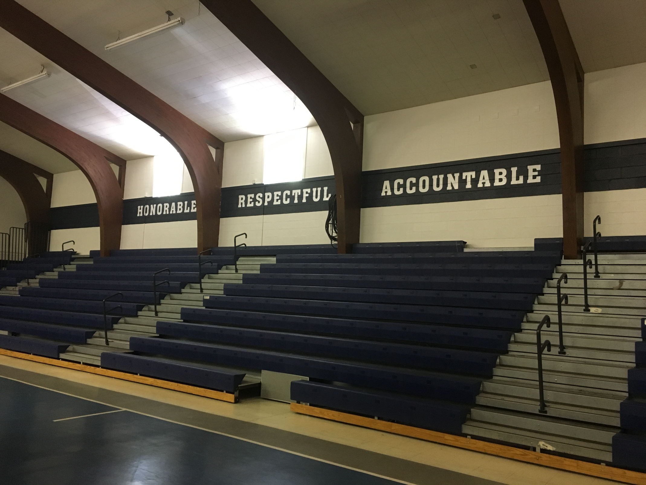
Sportsmanship Programs
Creating a Sportsmanship Program for Your School
SPORTSMANSHIP: BUILDING CULTURE
PRACTICE
PROMOTION
MANAGEMENT

Slide 5
Sportsmanship Programs
WHAT IS SPORTSMANSHIP?
Sportsmanship is a demonstration of generosity and genuine concern for others. It is a concrete measure of the understanding and commitment to fair play, ethical behavior and integrity.
2006-2007 FHSAA Sportsmanship Manual
(FHSAA, 2006, p. 1)​

Slide 6
Sportsmanship Programs
Creating a Sportsmanship Program for Your School
THE STANDARD: 2017-2018 FHSAA Handbook
Operational Bylaw, Article 7
- Sportsmanship Requirement
Players, coaches, administrators, spectators, contest officials
Practice and promote the highest standard (sportsmanship/ethics)
- Principal's Duty
Exercise control over all individuals to ensure safety and fair play
Adherence with the highest standard
(FHSAA, 2016, p. 20)​

Slide 7
Sportsmanship Programs
Creating a Sportsmanship Program for Your School
"Unsportsmanlike Conduct" Defined. Malicious or hateful acts towards a contest official, opponent, or any person attending an athletic contest. Acts may include:
Profanity
Striking or threatening
Physical contact with opponent beyond the normal scope of competition
Spitting on or directing gender, racial, or ethnic slurs towards contest participants
Use of illegal drugs as outlined in the 2017-2018 FHSAA Handbook
UNACCEPTABLE CONDUCT = PENALTIES
2017-2018 FHSAA Handbook​
(FHSAA, 2016, p. 20)

Slide 8
Sportsmanship Programs
Creating a Sportsmanship Program for Your School
MISCONDUCT is a societal issue of character that, unfortunately, has grown more commonplace in sports. Rather than accept the behavior as normal, Athletic Administrators must be willing to uphold the standards and integrity of: kindness towards humanity, our governing bodies (FIAAA, FHSAA, FACA, etc.), and our local schools.
THE CHARGE: If the culture does not embody good sportsmanship, change it!

Slide 9
Sportsmanship Programs
Creating a Sportsmanship Program for Your School
SPORTSMANSHIP: BUILDING CULTURE
PRACTICE (Documentation)
Review your school's charge/mission statement
Review current Athletics' policies/procedures
Review school's code of conduct
Consider player/parent/coaching agreements

Slide 10
Sportsmanship Programs
Creating a Sportsmanship Program for Your School
SPORTSMANSHIP: BUILDING CULTURE
PRACTICE
Honor Code: Honorable, Respectful, Accountable
Expectation/Uphold Standard: Students, Faculty, Staff
Start early: PE classes (LS, MS, US)
Discuss a good attitude, fair play, respecting "the call"
Humility after winning, honor after loosing
Compete hard, respect opponents

Slide 11
Sportsmanship Programs
Creating a Sportsmanship Program for Your School
SPORTSMANSHIP: BUILDING CULTURE
PRACTICE
Hold all parties involved accountable (keep the standard high): "It's either coached or allowed."
Important: Adults must teach and model proper behavior
Keep proper perspective: "These are student-athletes and they're playing a game"

Slide 12
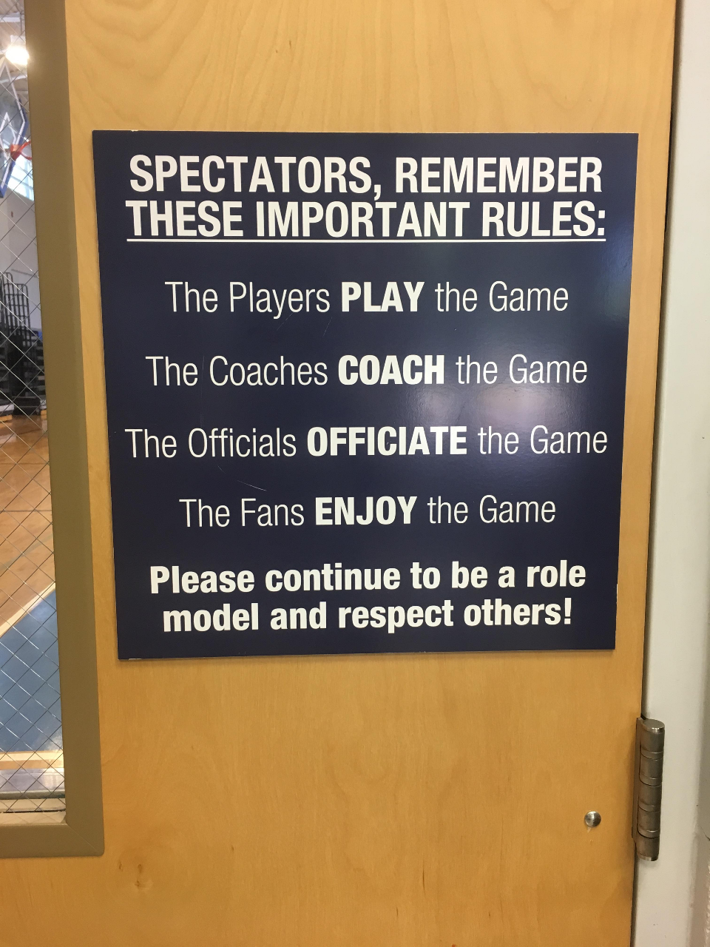
Sportsmanship Programs
Creating a Sportsmanship Program for Your School
SPORTSMANSHIP: BUILDING CULTURE
PROMOTION
Signage, Social Media
PA Announcements (ex. FHSAA PA scripts: www.fhsaa.org)
Sports practice/Sports events/PE class
Acknowledge good sportsmanship (ex. FIAAA/FHSAA Sportsmanship Award)
SAAC (Student-Athlete Advisory Committee)

Slide 13
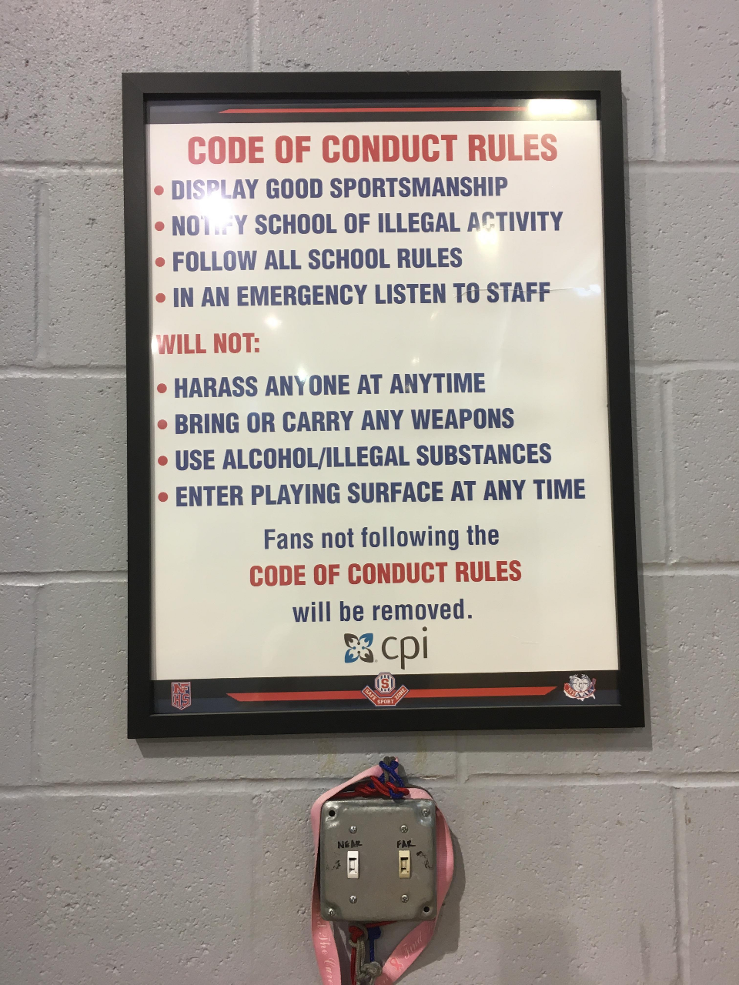
Sportsmanship Programs
Creating a Sportsmanship Program for Your School
SPORTSMANSHIP: BUILDING CULTURE
MANAGEMENT
Signage, monitor Social Media
PA Announcements (ex. FHSAA PA scripts: www.fhsaa.org)
Law Enforcement Officers
Communicate well
Be proactive

Slide 14
Sportsmanship Programs
Creating a Sportsmanship Program for Your School
SPORTSMANSHIP: BUILDING CULTURE
PRACTICAL APPLICATIONS (be PROactive)
Meetings: Student-athletes/Coaches
SAAC
Discuss logistics with Administrators, Managers, and Law Enforcement
Be visible: greet visiting teams, coaches, spectators

Slide 15
Sportsmanship Programs
Creating a Sportsmanship Program for Your School
SPORTSMANSHIP: BUILDING CULTURE
PRACTICAL APPLICATIONS (be PROactive)
Greet officials (i.e. discuss game plan)
Pregame PA (welcome/closing, sportsmanship message)
"Ear to the ground" - get a "feel" of the event as it progresses
Serve well with a great attitude
Half-time marketing events that involve home/away teams

Slide 16
Sportsmanship Programs
Creating a Sportsmanship Program for Your School
SPORTSMANSHIP: BUILDING CULTURE
PRACTICAL APPLICATIONS (be PROactive)
Address poor behavior
Don't negotiate, establish the standard
Utilize law enforcement or other administrators
Be assertive but professional and respectful

Slide 17
Sportsmanship Programs
Creating a Sportsmanship Program for Your School
SPORTSMANSHIP: BUILDING CULTURE
PRACTICAL APPLICATIONS (be PROactive)
Address poor behavior
Be visible
Respond rather than react
Emotions are high (don’t take things personally)
Repair order quickly
PA announcement, separate/remove uncoorperative participant/s

Slide 18
Sportsmanship Programs
Creating a Sportsmanship Program for Your School
SPORTSMANSHIP: BUILDING CULTURE
PRACTICE
PROMOTION
MANAGEMENT

Slide 19
Sportsmanship Programs
Creating a Sportsmanship Program for Your School
THE CHARGE: If the culture does not embody good sportsmanship, change it!
THANK YOU!

