Slide 1
High School Sports
Keeping High School Sports Significant
Greg Winkler CAA
Author: Coaching a Season of Significance
Saturday
FIAAA – May 5th, 2018
5:10pm Capri Room

Slide 2
High School Sports
Greg Winkler, CAA
Author Coaching a Season of Significance

Slide 3
High School Sports
Keeping High School Sports Significant
The Top 10 Issues in Athletic Administration:
*Finding Qualified Coaches *Reduced school funding *Athlete specialization,
*Added responsibilities *Finding parent/staff volunteers *Problems with parents
*Legal issues *participation declining *HR issues with staff
*Communication with constituents *Competition with clubs

Slide 4
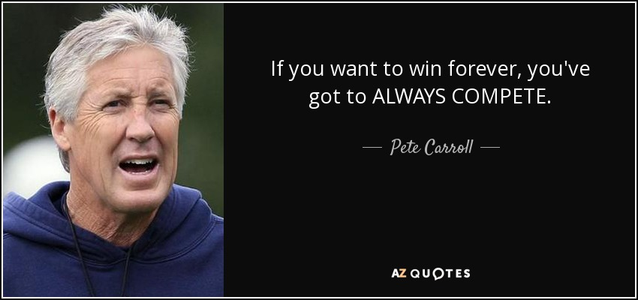
High School Sports
Keeping High School Sports Significant
Philosophy
“MAKE A DIFFERENCE” (Greg Winkler)
“ALWAYS COMPETE” (Pete Carroll)
“COMPETE WITH CLASS”
“NEVER QUIT”
“Don’t do anything that’s detrimental to yourself” Coach K on Rules
Do you know your Coaches philosophy?
Do you have a program philosophy?
Do you have a personal philosophy?

Slide 5
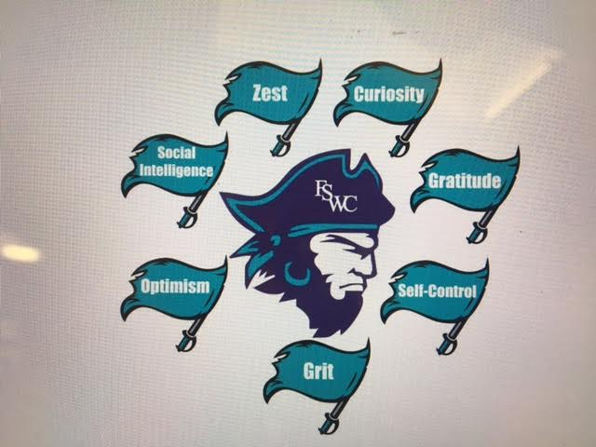
High School Sports
Keeping High School Sports Significant
BRAND – VALUES
What does your program stand for?
Do others know?
Do your coaches model the Brand?

Slide 6
High School Sports
Keeping High School Sports Significant
Building Relationships
Staff, Peers, Asst AD? Media, Students, Parents?
Coffee w/the AD (Coaches in Season)
Press Releases
Monthly Coaches Meeting (breakfast)
Free 2 Play (Students)
Athletic Supporters (Students)
Pre-Season Meetings (Parents)
Post-Season Social (Coaches)

Slide 7
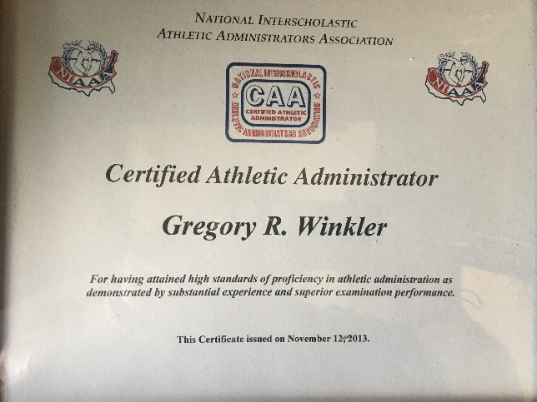
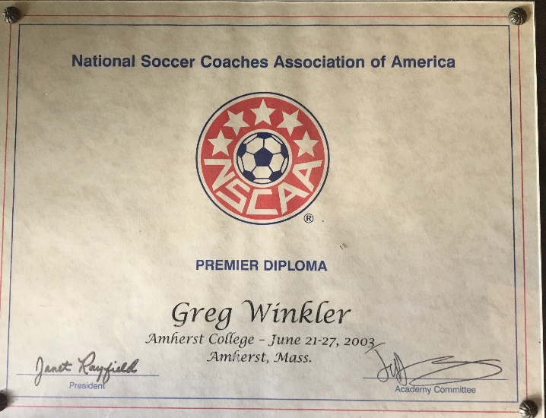
High School Sports
Keeping High School Sports Significant
Accountability
CAA
Coaching Certifications
Clinics
Promotion of Coaching Education

Slide 8
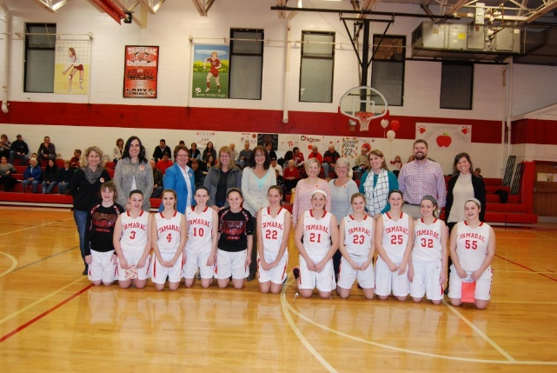
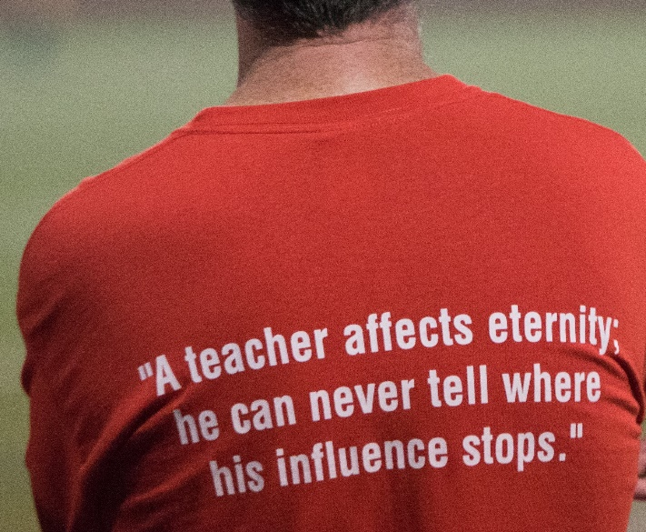
High School Sports
Keeping High School Sports Significant
Promotions
Twitter – Facebook – Instagram
Events

Slide 9
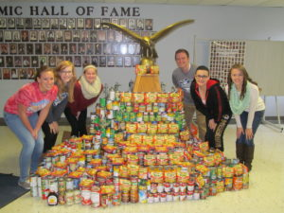
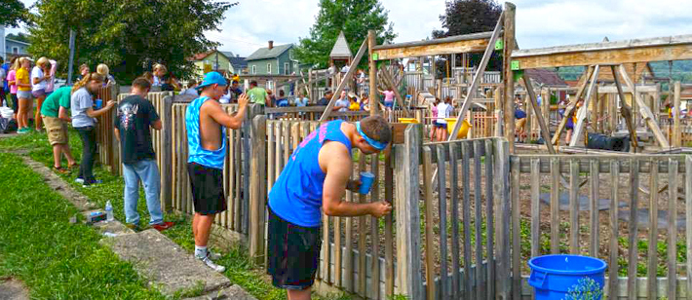
High School Sports
Keeping High School Sports Significant
Service

Slide 10
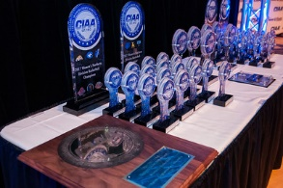
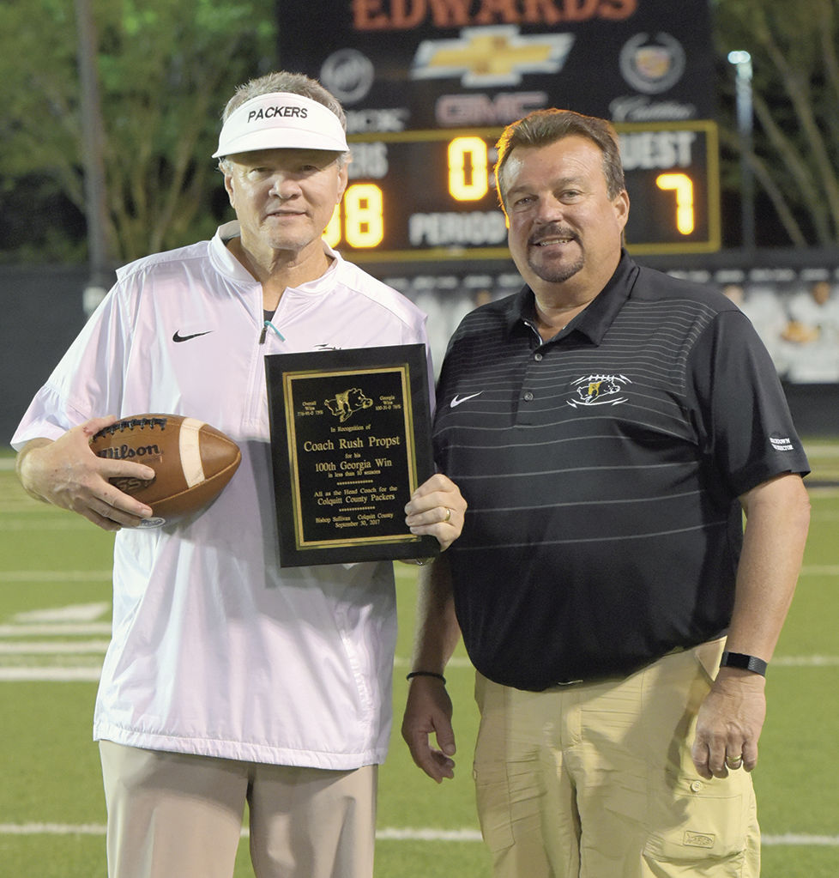
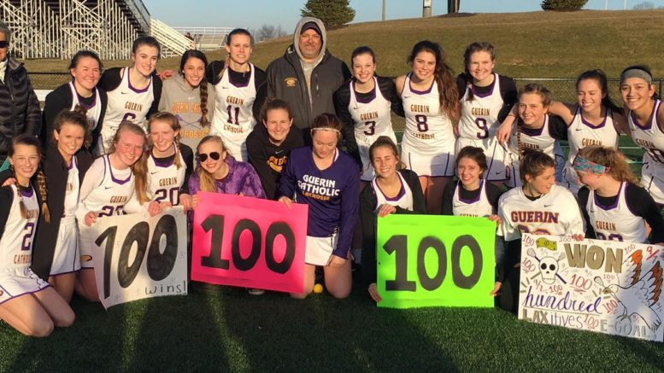
High School Sports
Keeping High School Sports Significant
Team Building
&
Awards

Slide 11
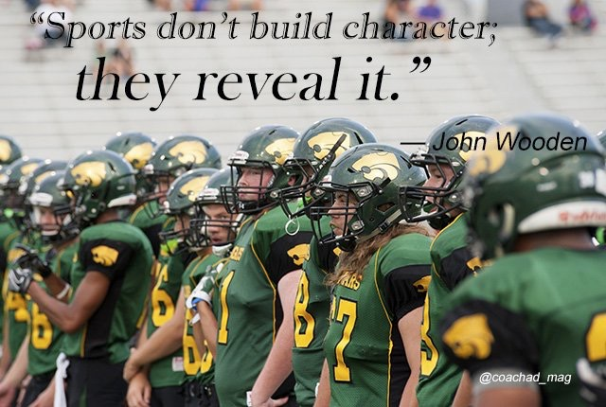
High School Sports
Keeping High School Sports Significant
Questions

