Slide 1
Personnel Procedures
Personnel Procedures from A to Z
FIAAA – May 5th, 2018

Slide 2
Personnel Procedures
Matthew Wicks, M.Ed.
Director of Athletics Pasco County Schools Land O Lakes, Florida

Slide 3
Personnel Procedures
Personnel Procedures from A to Z: Interviewing, Orienting, Assisting, Evaluating,
Encouraging and Moving Along

Slide 4
Personnel Procedures
Interviewing
Determine what type of coach you want to hire.
In-house candidate
Outside candidate
“Rebuilding” style candidate
“Reloading” style candidate
“I just need to fill this position asap” style candidate

Slide 5
Personnel Procedures
Interviewing
Things to think about when conducting interviews
Who is in the room?
What type of questions are you going to ask?
Hiring Rubric
Who is asking what questions?
Keep the interview on pace
Phone Interviews (when?)
Second Interviews – Top 3

Slide 6
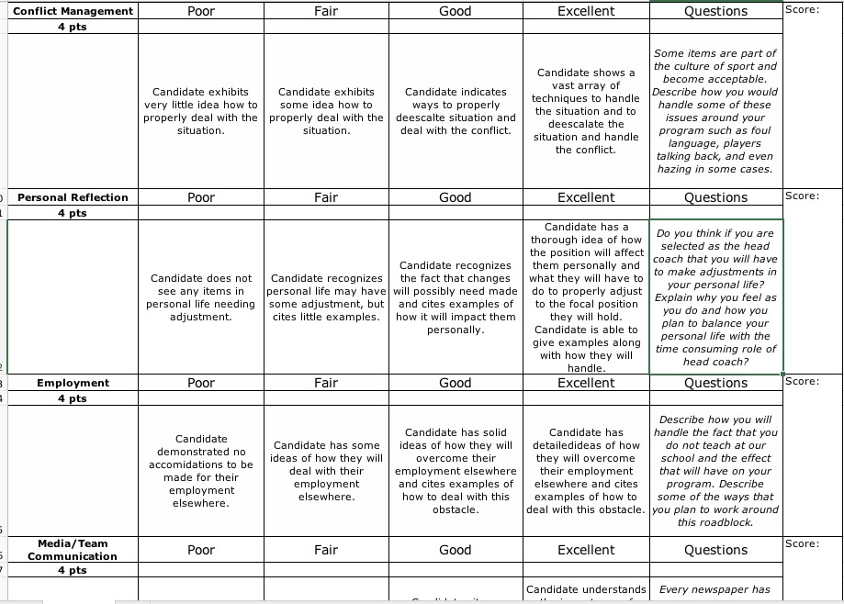
Personnel Procedures
Interviewing – Hiring Rubrics

Slide 7
Personnel Procedures
Hiring the right coach...

Slide 8
Personnel Procedures
Orienting & Assisting
Setting a new coach up for success
Establish a line of communication
Setting expectations (Off-season, In-season)
Organization (Practice, Fundraising, Travel, etc.)
School & County Procedures (Handbook)

Slide 9
Personnel Procedures
Orienting & Assisting
Communication
Have an open door policy.
Questions are fine, answers are better!
Establish the chain of command.
Social media policy...
Parents (address concerns, take ownership)...

Slide 10
Personnel Procedures
Orienting & Assisting
Communication – Social Media Policy
Good news/What's happening at your school/site
Picture of the Day/Other school-related pictures
Short/Long form videos/People of Pasco
Weather emergencies/bus info
Game cancellations/reschedule dates
Other emergencies
Event reminders
Congratulations on big accomplishments
ConnectED scripts

Slide 11
Personnel Procedures
Helping your coach understand parents...

Slide 12
Personnel Procedures
Orienting & Assisting
Setting expectations with your coach
Parent Meetings
Fundraising
Off Season (rules, workouts, academics)
In Season (rules, practice plan, facility upkeep)
Post Season (facility, inventory, banquet)

Slide 13
Personnel Procedures
Orienting & Assisting
Organization is the key!
Staff roles and responsibilities
Practice Plans
Communication (via app, or social media)
Spending
Equipment, Uniforms, and locker room

Slide 14
Personnel Procedures
Encouraging your new coach...
Supportive environment.
Drop in during practice.
Get to know your coach and their family.
Be positive.
Use your "teachable" moments.

Slide 15
Personnel Procedures
Evaluating your coaches...
Schedule time to visit practices during the season.
Take notes on what you see and hear.
Have they meet your expectations?
Administratively (paperwork & procedures)
Coaching Fundamentals
Did they meet your Admins expectations?
Did they set and achieve attainable goals?
Did you have any issues with them this year?
Corrective Action Plan
End of the season meeting with each Head Coach
Communicate, Communicate, Communicate
Likes, dislikes, do betters

Slide 16
Personnel Procedures
Moving along...
Exit meeting with Administration.
Supported documentation.
Collect school items.
Terminate access to school based accounts.
Team meeting.
Professionalism is the key.

Slide 17
Personnel Procedures
Questions & Comments

Slide 18
Personnel Procedures
Thank You!
Matt Wicks
813-794-2755
mwicks@pasco.k12.fl.us

