Slide 1
GIRLS VOLLEYBALL
12 August 2025

Slide 2



Slide 3




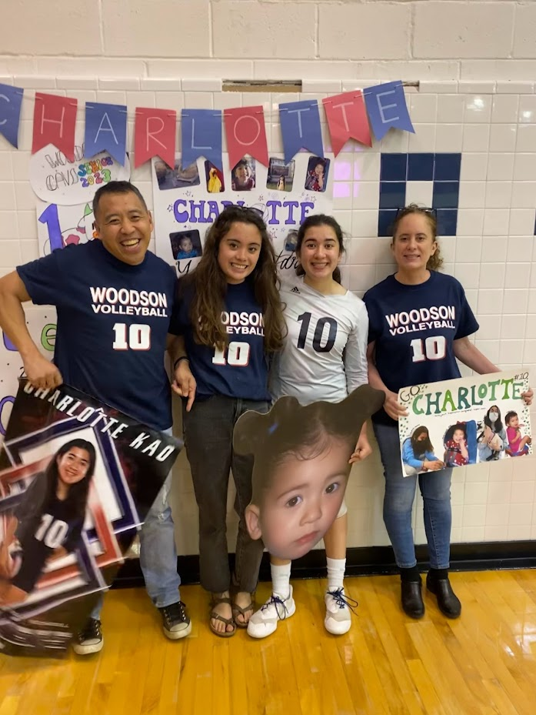

COACH TIM KAO Varsity Head Coach

Slide 4






Coach Kao’s Coaching Journey

Slide 5
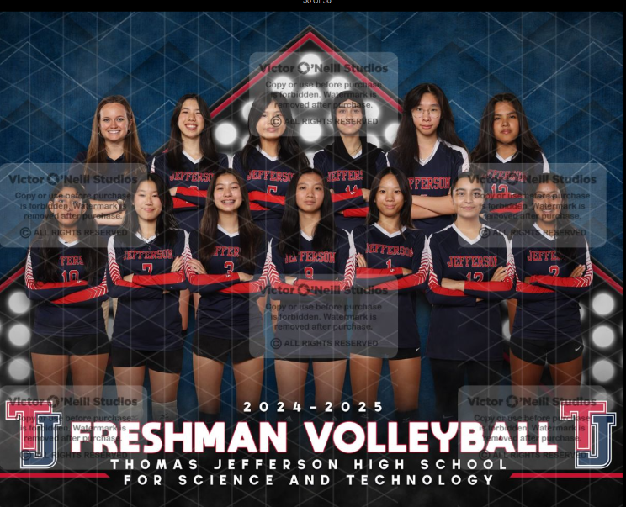
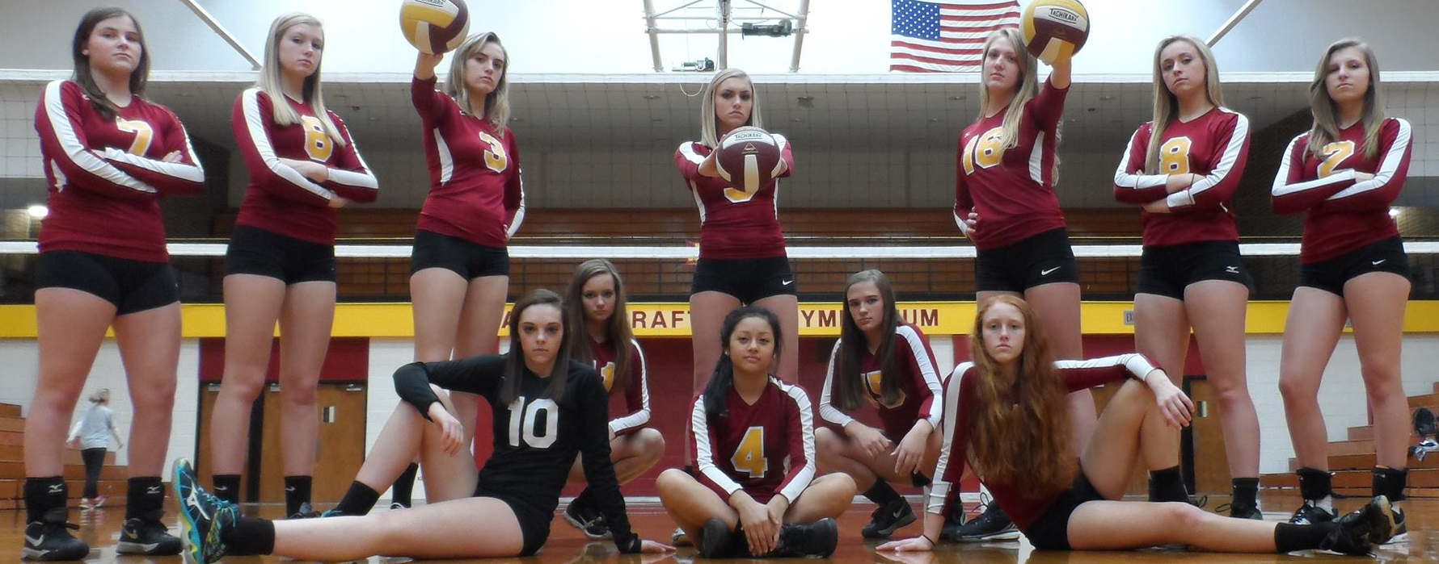

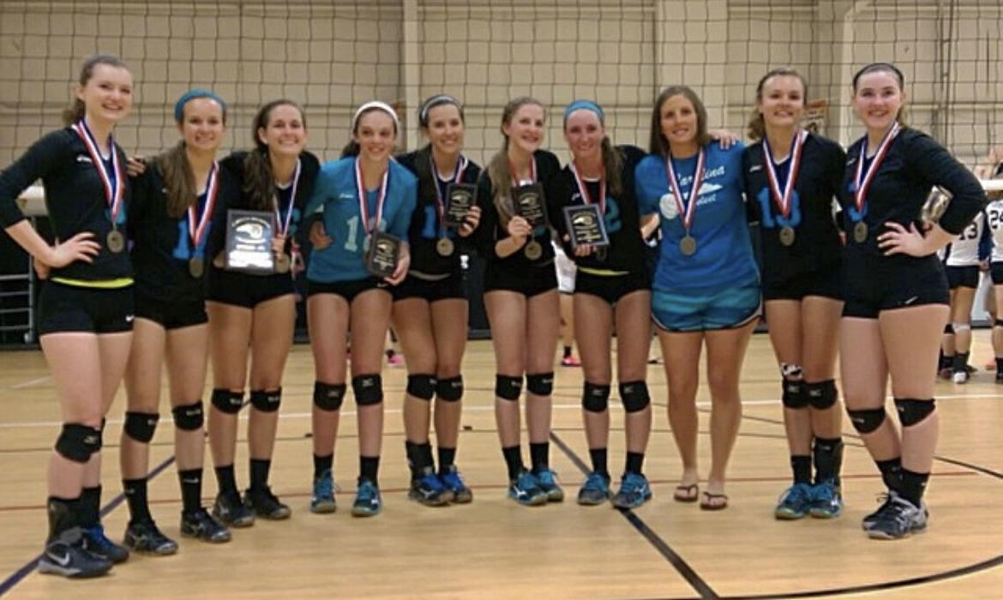
Coach Ashley Craft
JV Head Coach

Slide 6



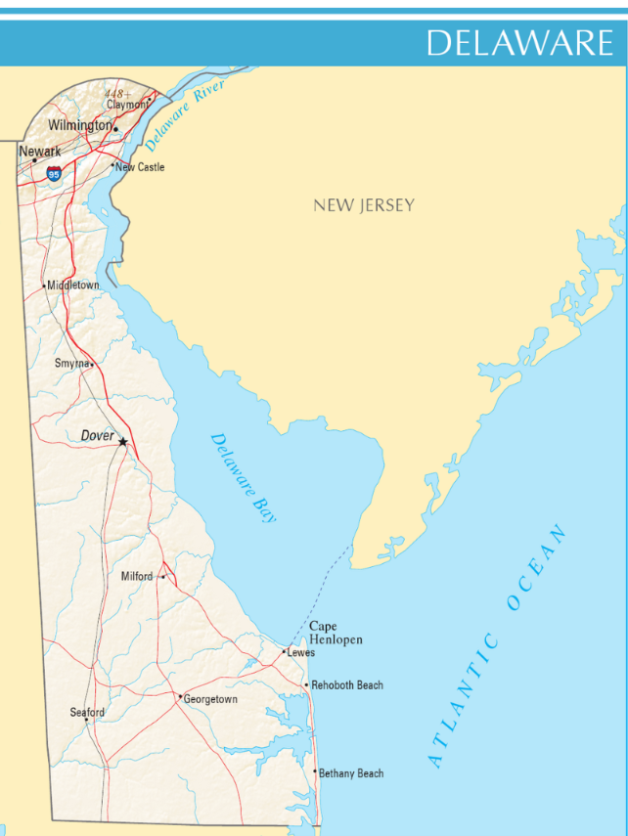
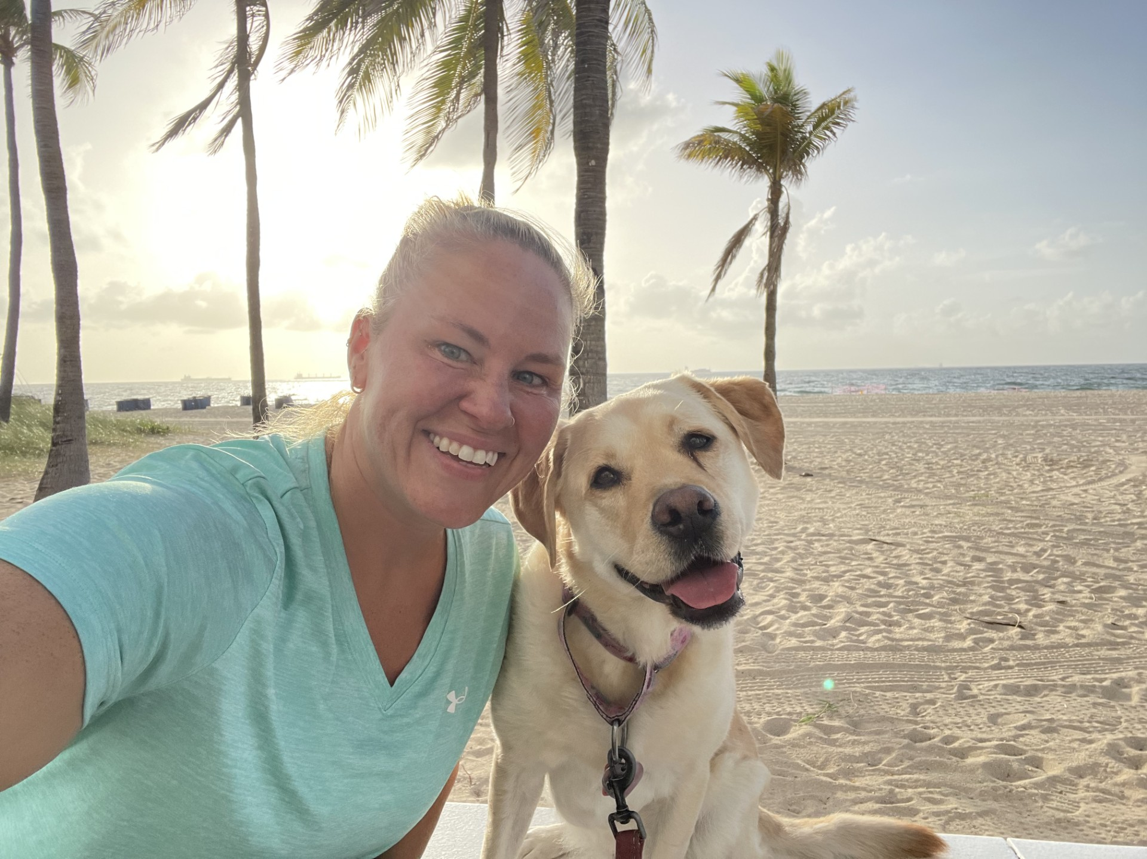

Coach Jennifer Johnson
JV Assistant Coach

Slide 7
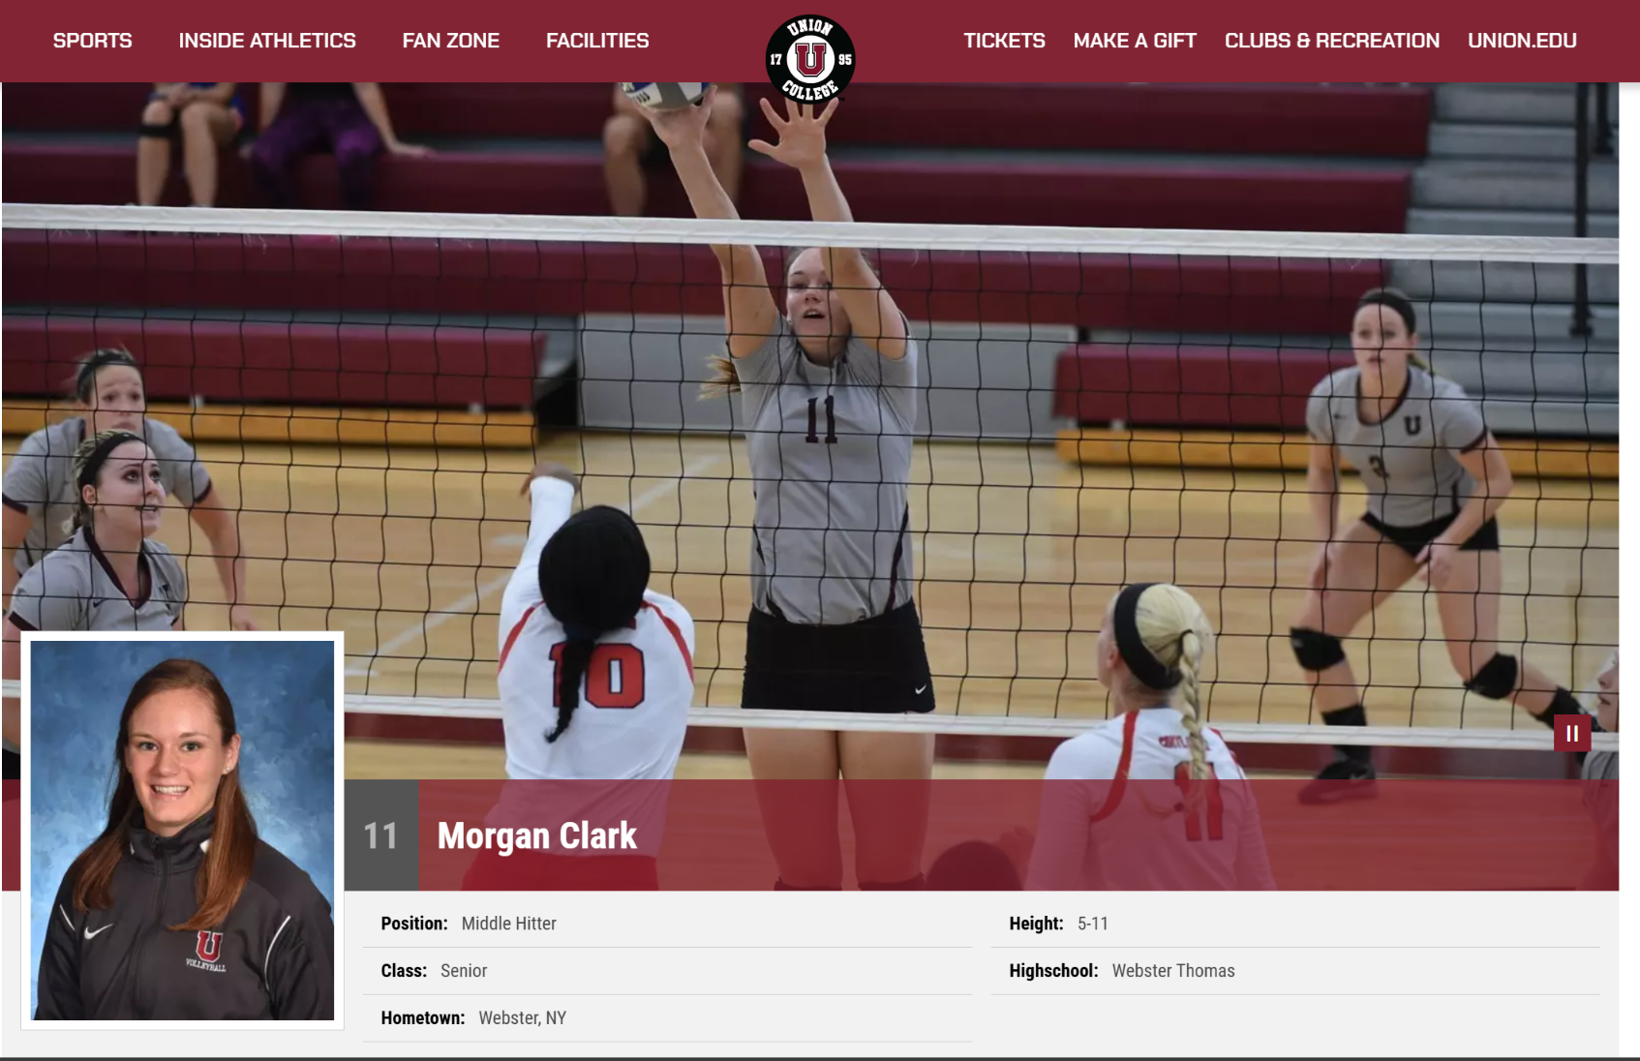
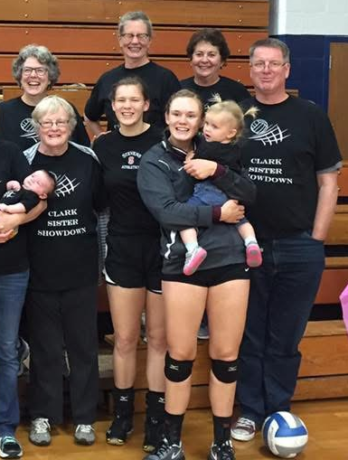


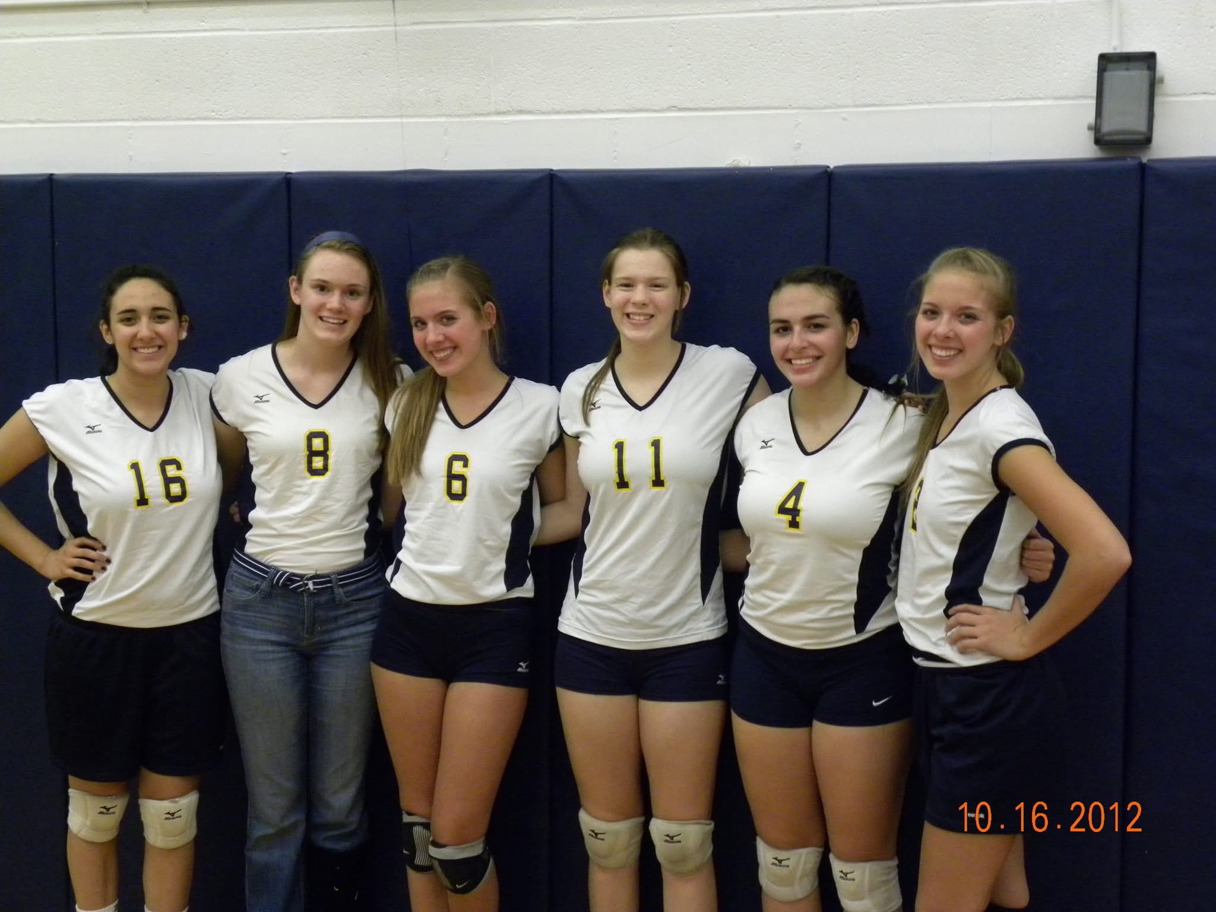
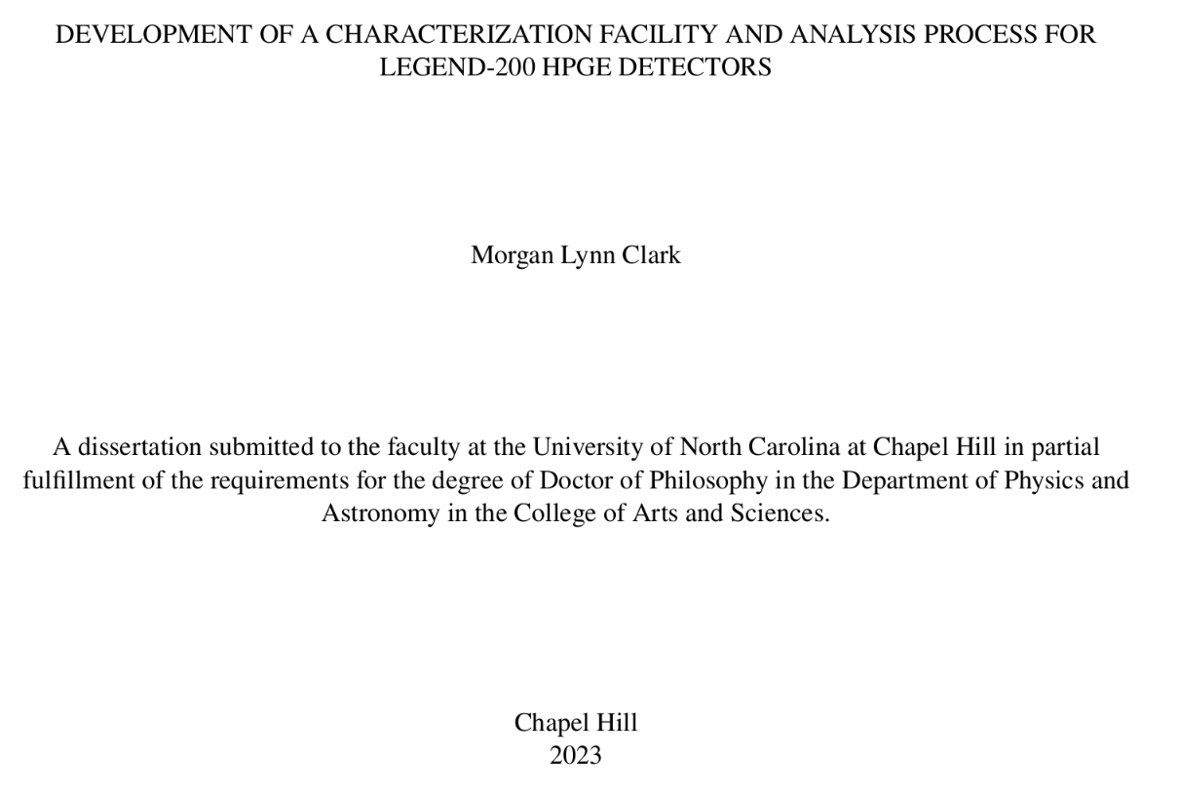

Coach Morgan Vineyard
Freshman Head Coach

Slide 8
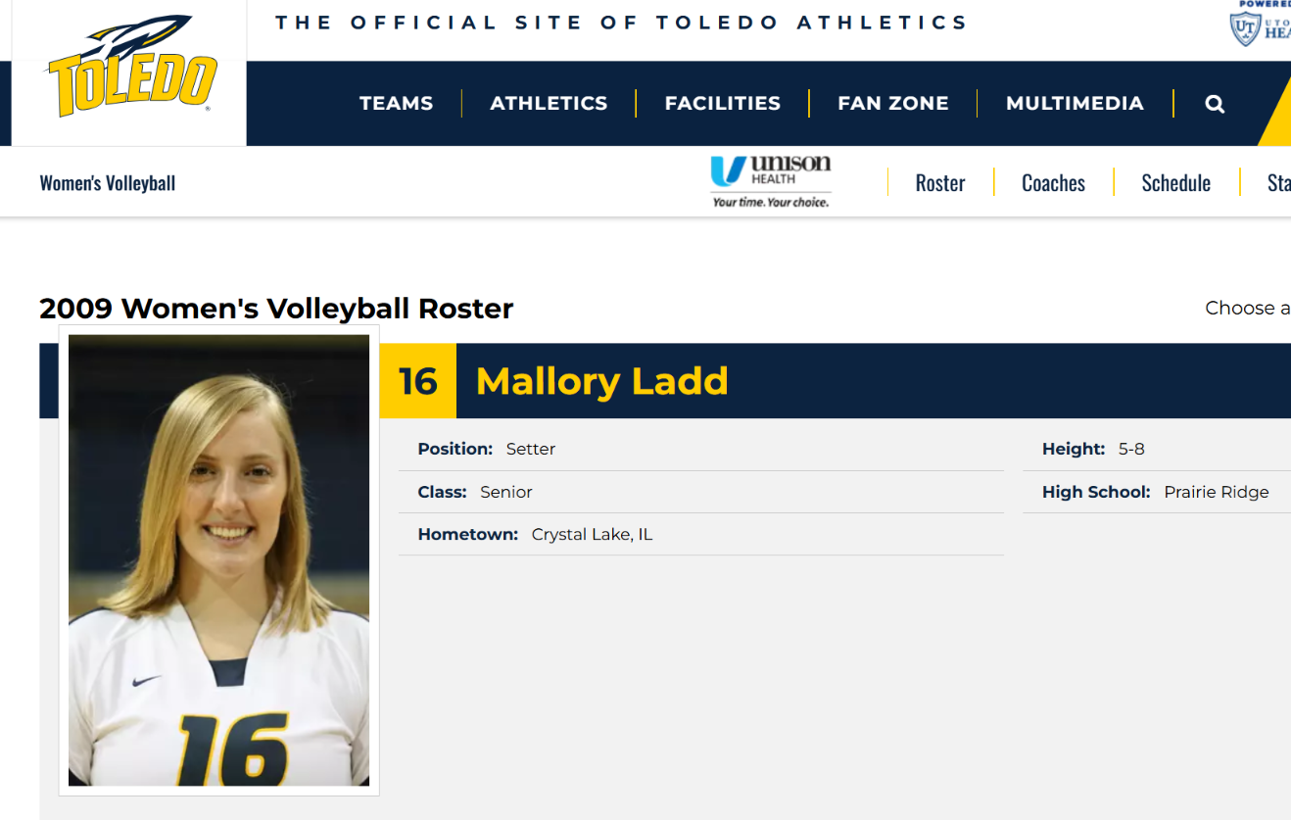


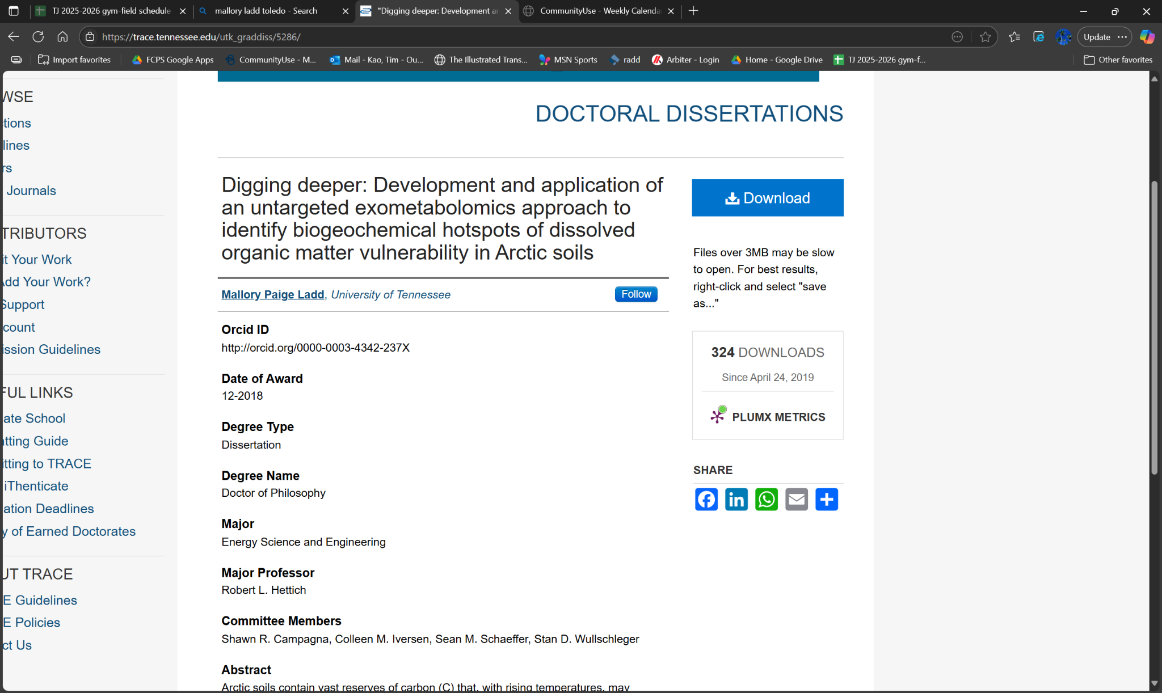

Coach Mallory Ladd
Setting Coach

Slide 9
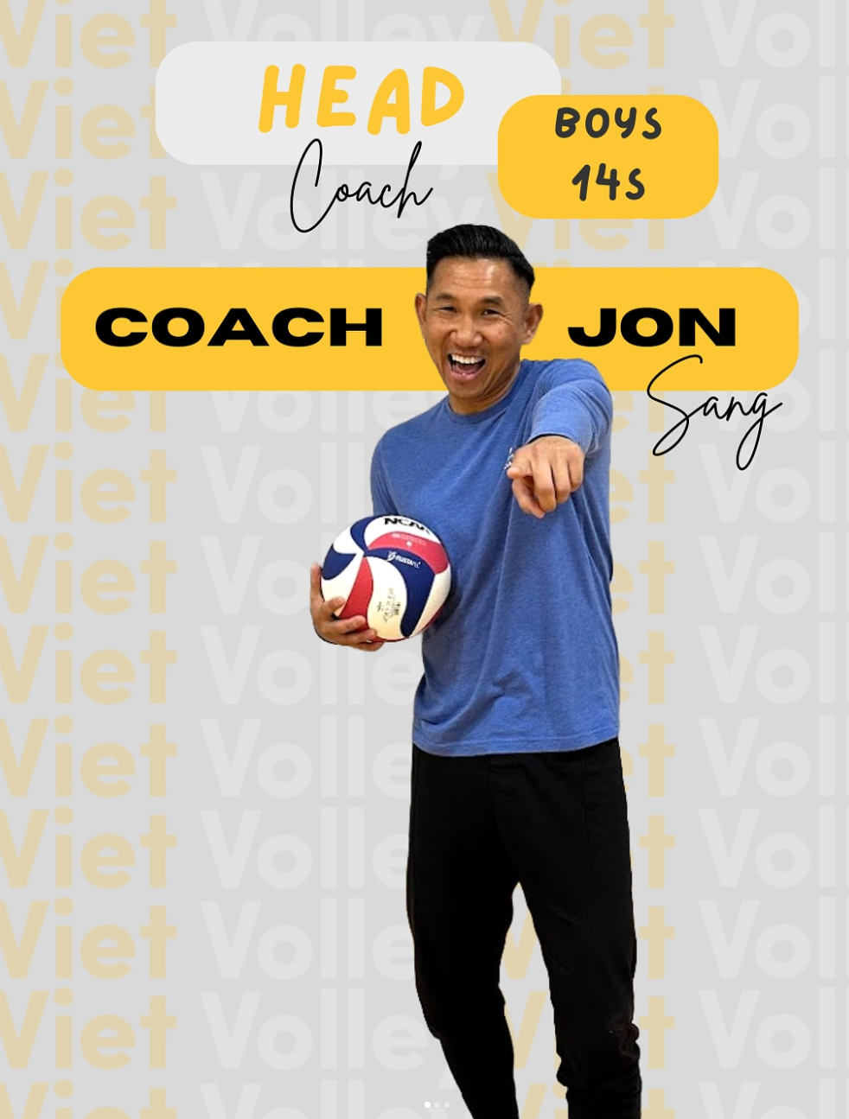



Coach Jon Sang
Positional Coach

Slide 10
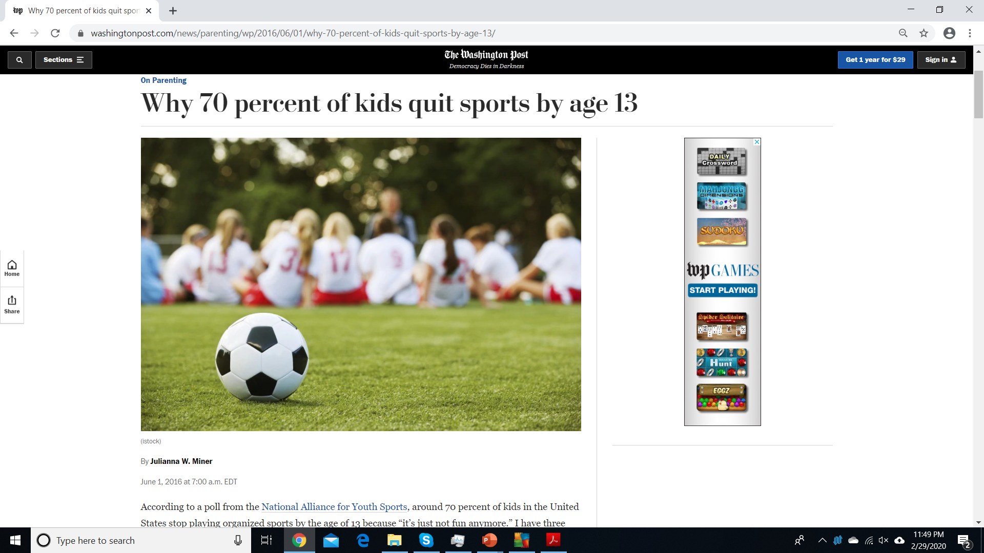
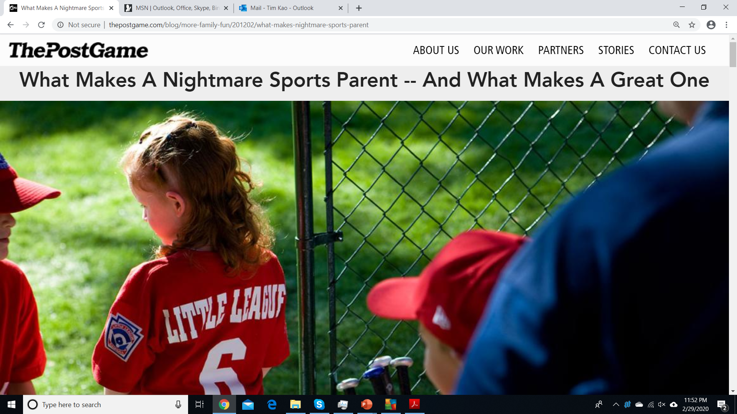
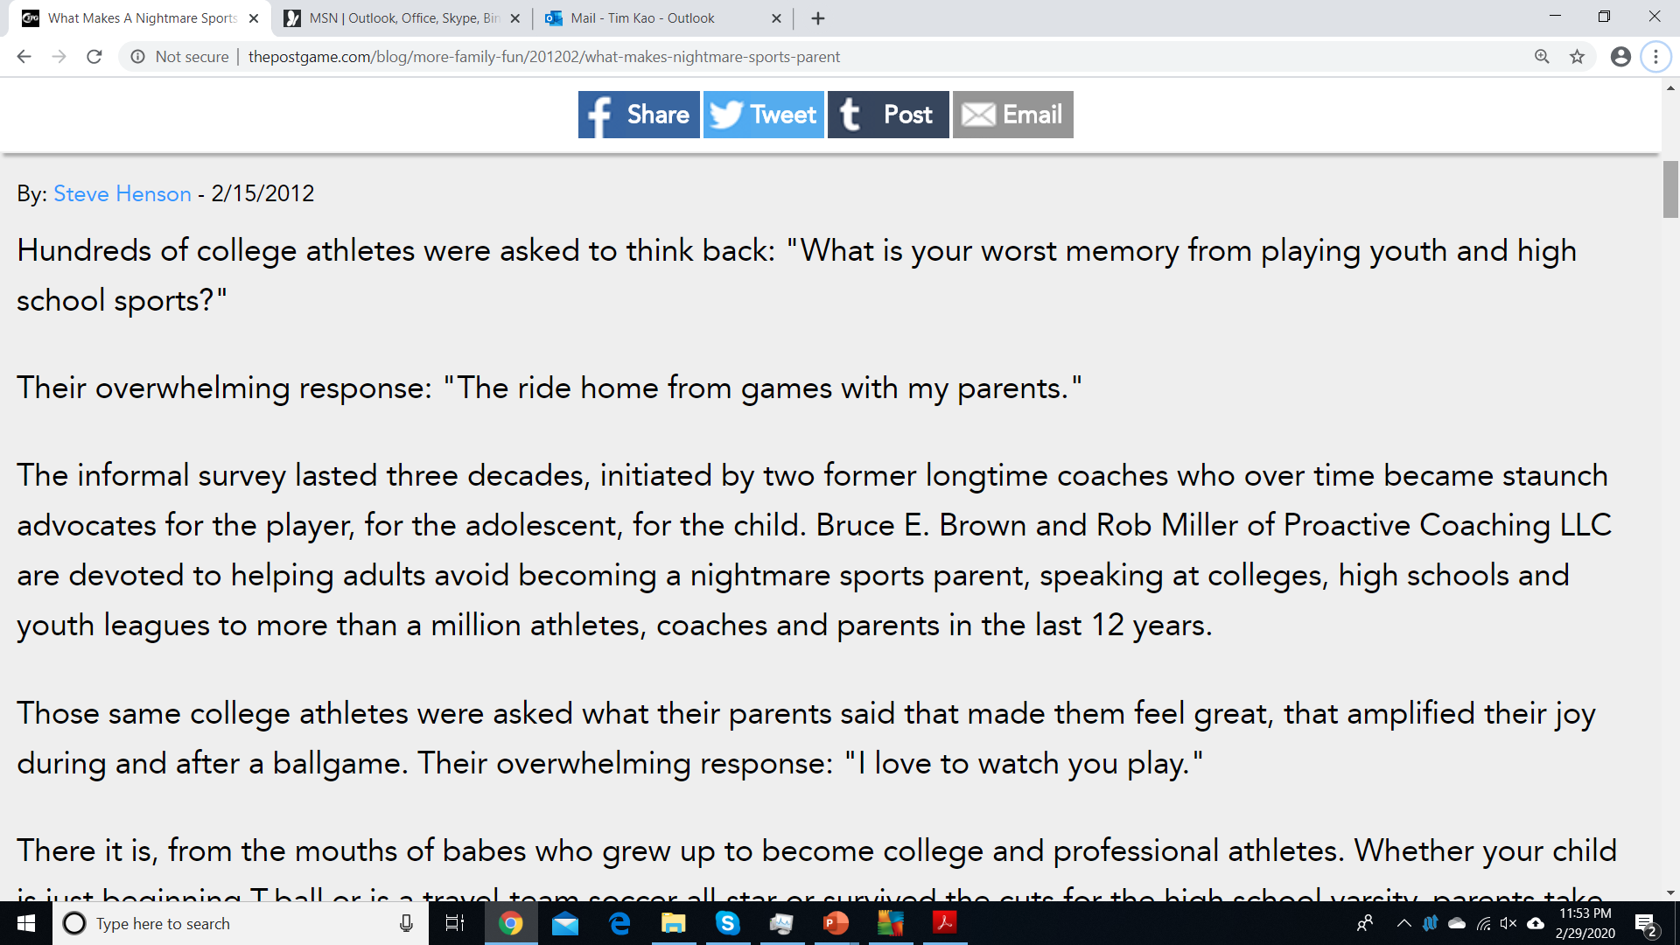

Slide 11
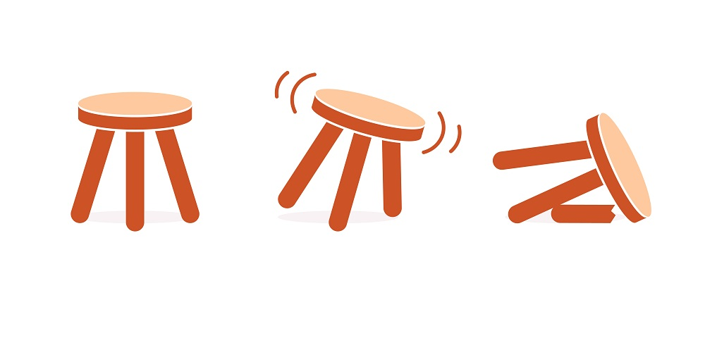
Coach Parent Player Partnership
We should all want the same thing… but priorities can be different
Unique roles – all are important (staying in our lane)
Let the players _____
Coaches ______
Refs ________
Parents?
Parent
Player
Coach
“Gould, Chung, Smith, and White’s (2006) study cited problems with parents as one of the most frequent issues high school coaches had to contend with.
Also, prior research indicated difficult parents as a reason coaches would discontinue coaching.”
How to Effectively Manage Coach, Parent, and Player Relationships – The Sport Journal
“I love to watch you coach”
Gould, D., Chung, Y, Smith, P. & White, J. (2006). Future directions in coaching life skills: Understanding high school coaches’ views and needs. Athletic Insight, 8(3), 28-38.

Slide 12
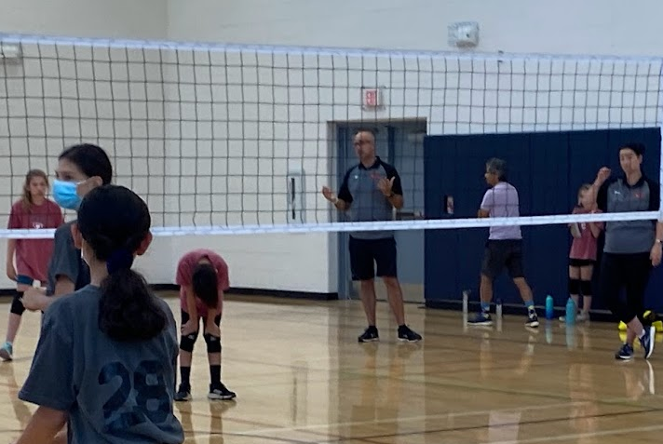

USAV Goals for Junior Volleyball
Teach volleyball skills
Help kids to have fun
Teach teamwork
Build friendships
Improve communication skills
Help participants understand winning
Learn a sport for a lifetime
Foster emotional, psychological growth and development

Slide 13

Communicating with Coaches
Be Curious… Not Judgmental
Athletes should have discussion with coach first
Parents or coaches should request a private meeting
Scheduled when there is availability for coaches and parents (not before or after games)
Focus on issues affecting your child only (not rumors or comparisons)
Collaborate on a plan going forward

Slide 14
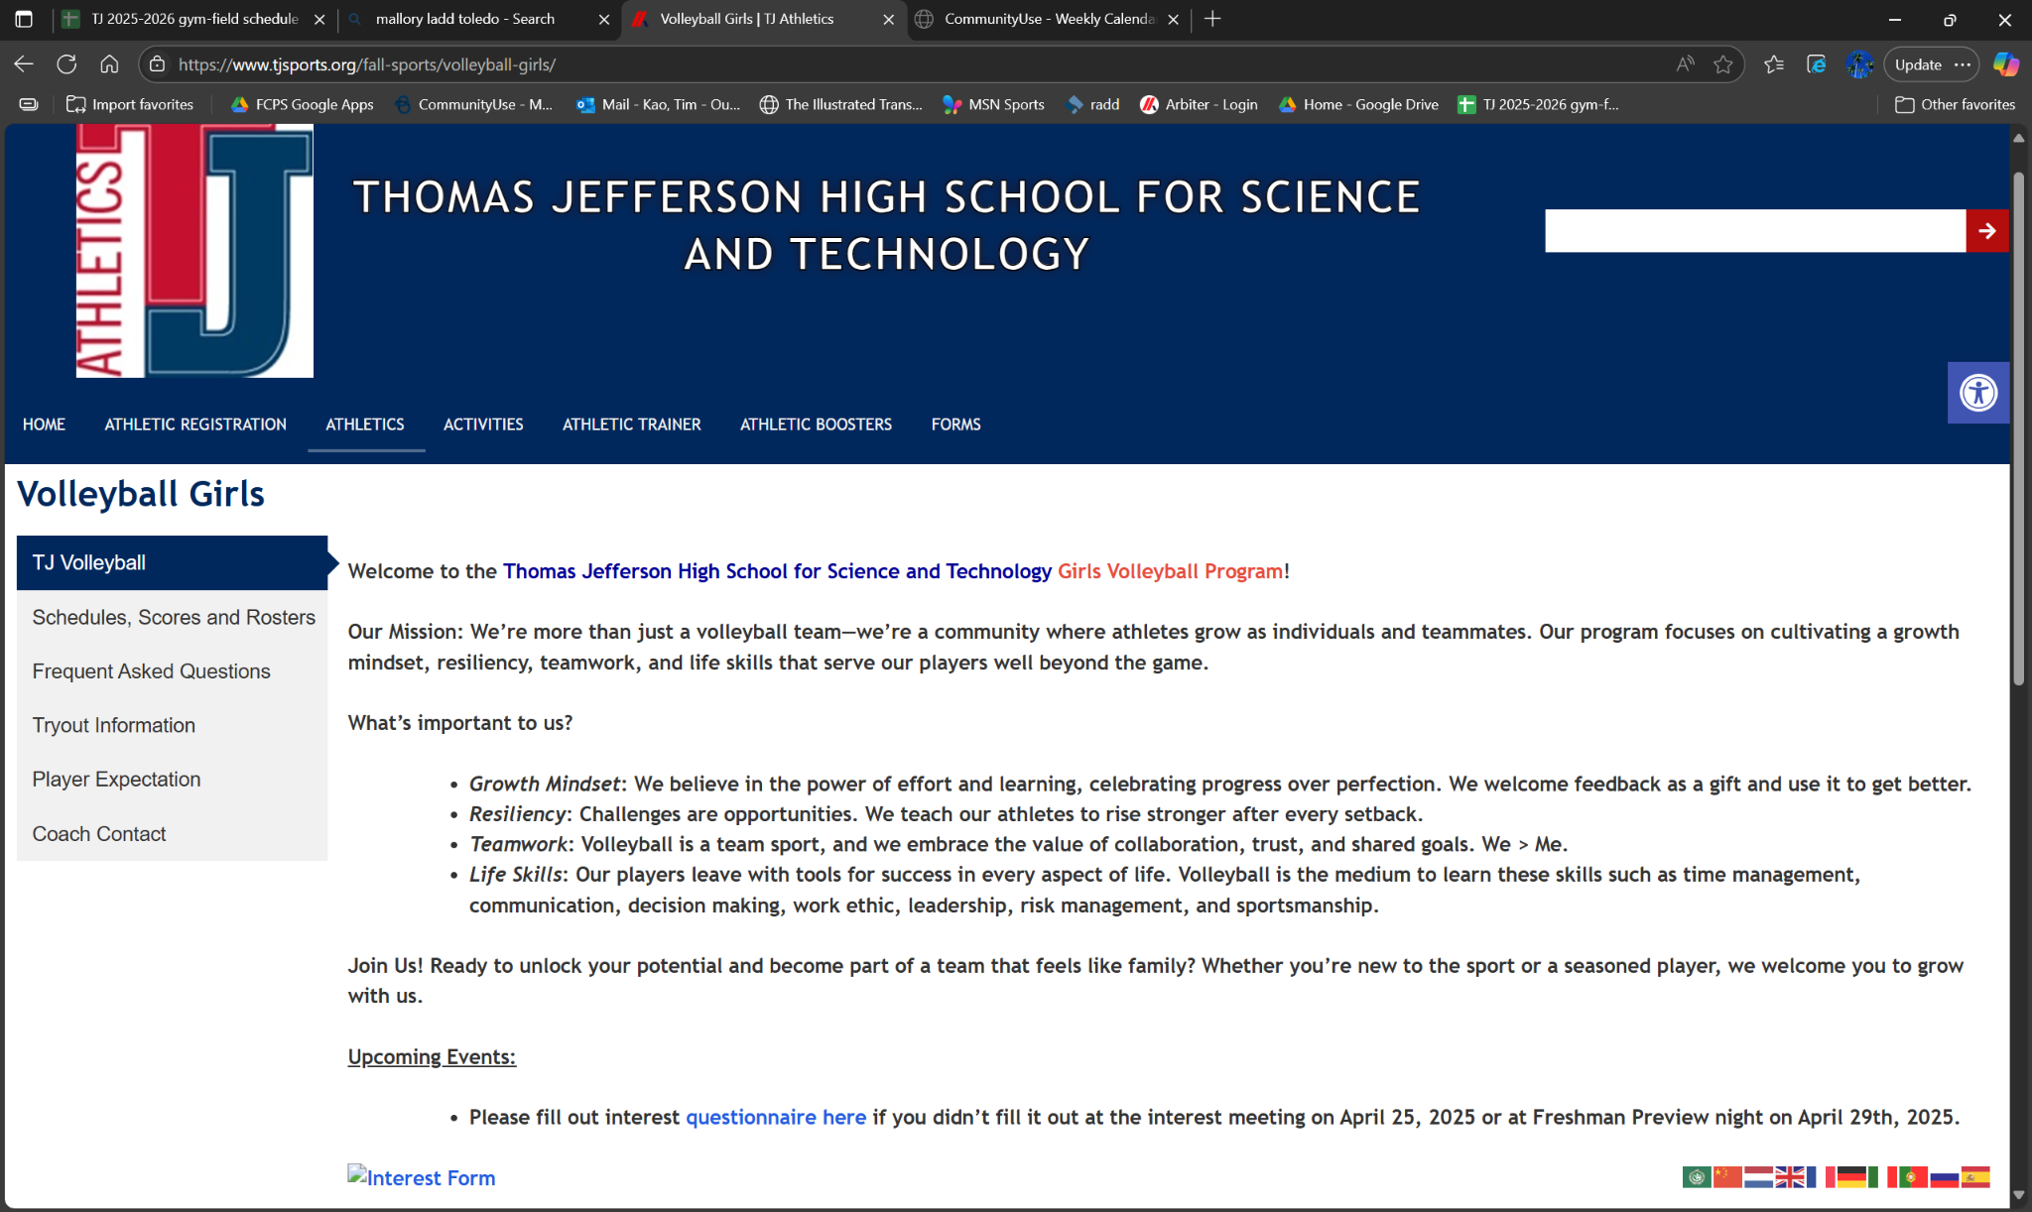
Volleyball website

Slide 15

OUR MISSION
We’re more than just a volleyball team—we’re a community where athletes grow as individuals and teammates. Our program focuses on cultivating a growth mindset, fostering resiliency, teamwork and developing life skills that serve our players well beyond the game.
What's important to us?
Growth Mindset: We believe in the power of effort and learning, celebrating progress over perfection. We welcome feedback as a gift and use it to get better.
Resiliency: Challenges are opportunities. We teach our athletes to rise stronger after every setback.
Teamwork: Volleyball is a team sport, and we embrace the value of collaboration, trust, and shared goals. We > Me.
Life Skills: Our players leave with tools for success in every aspect of life. Volleyball is the medium to learn these skills such as time management, communication, decision making, work ethic, leadership, risk management, and sportsmanship.

Slide 16
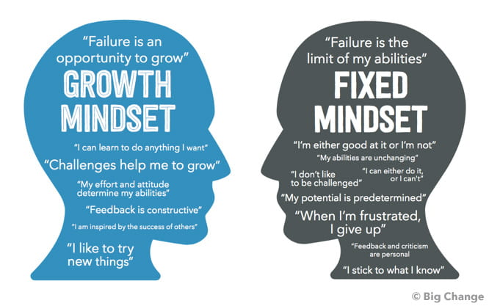

Slide 17
KEY DATES
Meet the coaches night (Today!)
Team bonding (this week?)
Season Opener 19 August home vs West Springfield
Dig Pink 6 October (Monday vs Hayfield)
Senior Night 23 October (last home game vs. Annandale)
Post season awards banquet

Slide 18
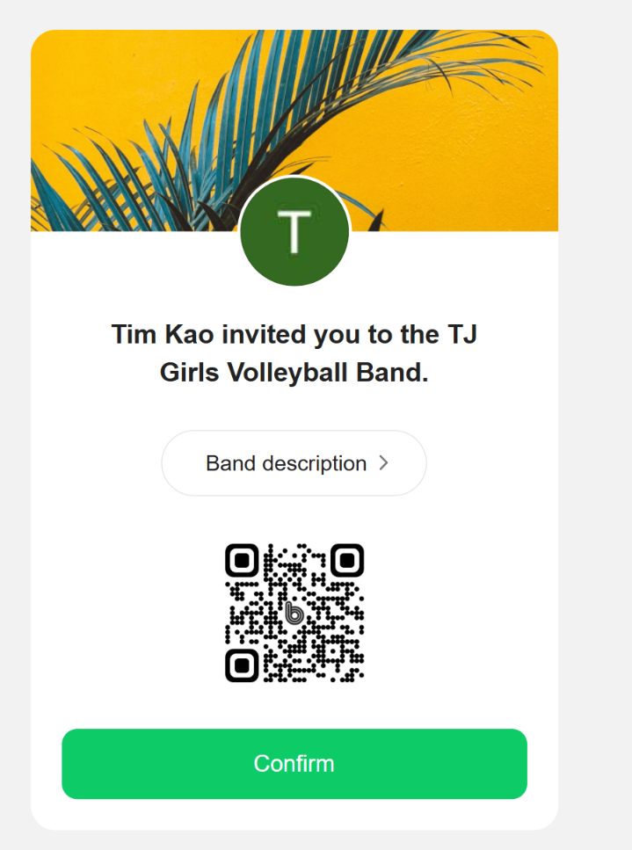
ADMIN
Carpool info/ buses for games
SWAG/Spirit wear
Booster club rep
INSTAGRAM / Website
HUDL/STATS
Weekly Coaches emails
BAND communication app
https://band.us/n/aeaeA2Z0F525w

Slide 19



Slide 20

I. TEAM PHILOSOPHY AND VALUES:
Commitment & Unity: There is zero-tolerance for gossip, inappropriate social media posts, and other negative communication about teammates as it is toxic to team.
Growth Mindset: We recognize feedback is a gift. We strive each day to be a little better as players and individuals.
Positive Attitude: Celebrate your teammates successes as much (if not more) than you celebrate your own.
Respect: We treat coaches, teammates, opponents, officials, and the game itself with respect by listening, using respectful language, and accepting decisions gracefully.

Slide 21

II. PRACTICE EXPECTATIONS:
Attendance: Volleyball is not an individual sport and requires consistent attendance at practice to develop as a team. Notify the coaching staff in advance if you will be absent. Absences from matches and practices will affect playing time in future matches.
Punctuality: Tardiness disrupts the team's flow and demonstrates a lack of respect for everyone's time. Ensure your pick-up time after practice/games does not exceed 10 minutes after the last volleyball game/practice ends.
Effort and Intensity: We want to train harder and smarter than every team in the district. Bring consistent effort and intensity to every drill.

Slide 22
Playing Time
Earned, Not Entitled: Our coaches will do their best to provide opportunities for play to all players. However, playing time is earned through consistent effort, skill development, positive attitude, adherence to team rules, and performance in practice and games. Volleyball is not a timed sport and as such there is no concept for equal playing time. Other factors affecting playing time include positional needs and strategic matchups.
Understand Roles: Each player has a valuable role on the team, whether it's as a starter, key substitute, or supportive teammate on the bench. Understand and embrace your role, contributing positively in any way you can. Regardless of playing time, focus on supporting the team and contributing to our overall success. Maintain a positive attitude on the bench and be ready to contribute when called upon.
Communication with Coaches: If you have concerns about your playing time, schedule a private meeting with the coach to discuss it respectfully before or after practice not during, before, or immediately after games.

Slide 23
Off the court
• Student-Athlete First: You are a student first and an athlete second – this is TJ after all. Plan your time effectively to ensure you can fulfill your academic and volleyball commitments. Communicate with coaches about academic conflicts in advance.
• Seek Support: Utilize available academic resources such as tutoring, study groups, and teacher office hours when needed. Your academic performance reflects on the team's reputation. Strive for excellence in the classroom. If you are struggling academically, communicate with the coaching staff. We want to support your academic success.
• Substance Abuse: The use of illegal drugs, alcohol, and tobacco is strictly prohibited.
• Respectful Conduct: Treat all individuals with respect, including teammates, coaches, opponents, officials, school staff, and community members. Avoid gossip, negativity, and disrespectful language. Your behavior in school, at home, and in the community reflects on the entire program.

Slide 24
VI. Communication Protocol:
• Player-Coach Communication: Players should feel comfortable communicating with coaches about volleyball-related matters, academic concerns, or personal issues that may affect their participation. Report any injuries or physical discomfort to the coaching staff and trainers immediately. Do not play through significant pain.
• Team Communication: Team information (schedules, changes, announcements) will be communicated through email and other communication apps. Check these regularly.
• Parent Communication: Individual player concerns should generally be addressed directly by the player with the coach first. If that communication does not resolve the concern sufficiently, then parents may request a meeting with coaches to further discuss issues. Leave the coaching to the coaching staff.

