Slide 1
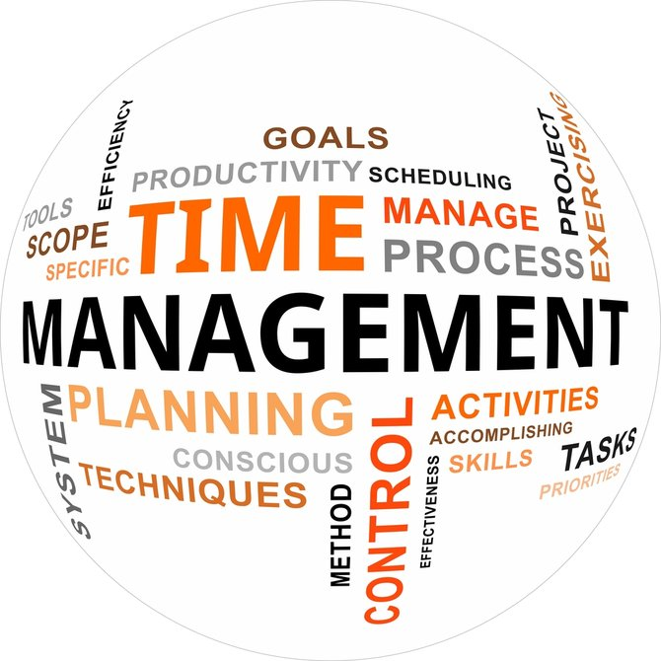
Time Management:
Strategies For Managing Your Workday
Nathan Priest - Gray-New Gloucester High School Geoff Godo - Mt. Ararat High School
MIAAA Fall Conference
November 12, 2024

Slide 2
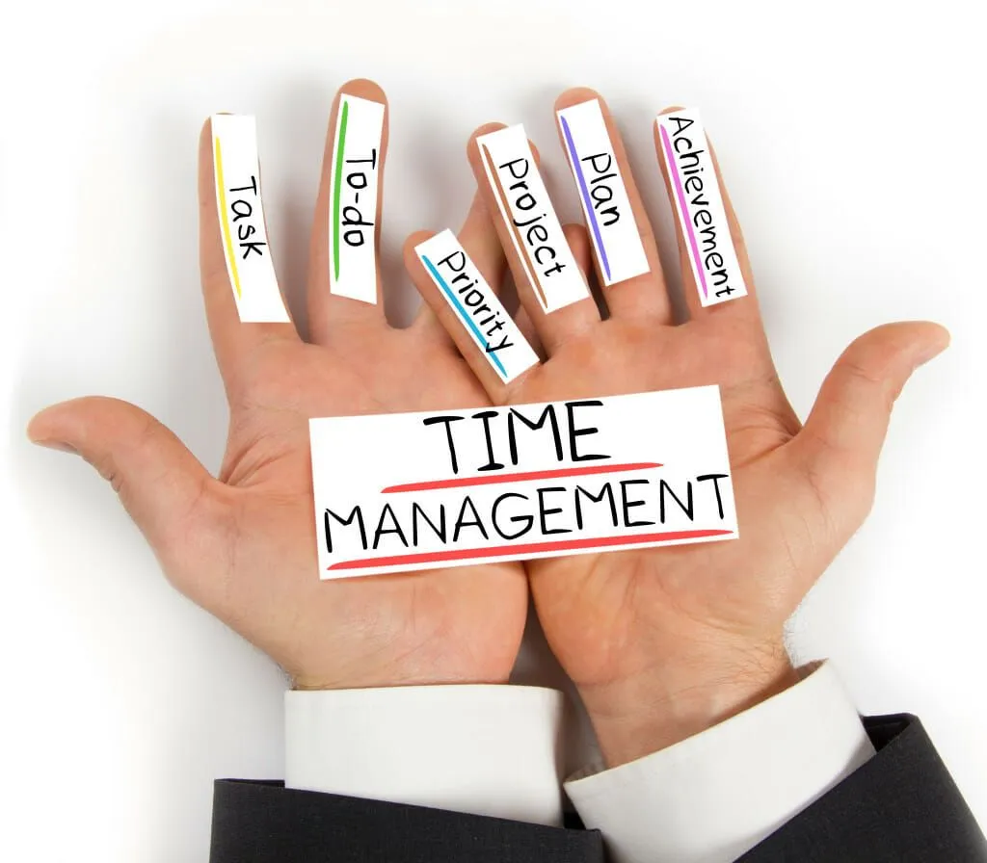
Benefits of Good Time Management
Increased productivity
Decreased stress
Clear goals
Better decision-making
Improved quality of work
Improved self-discipline
More time for work and you
Better mental health

Slide 3
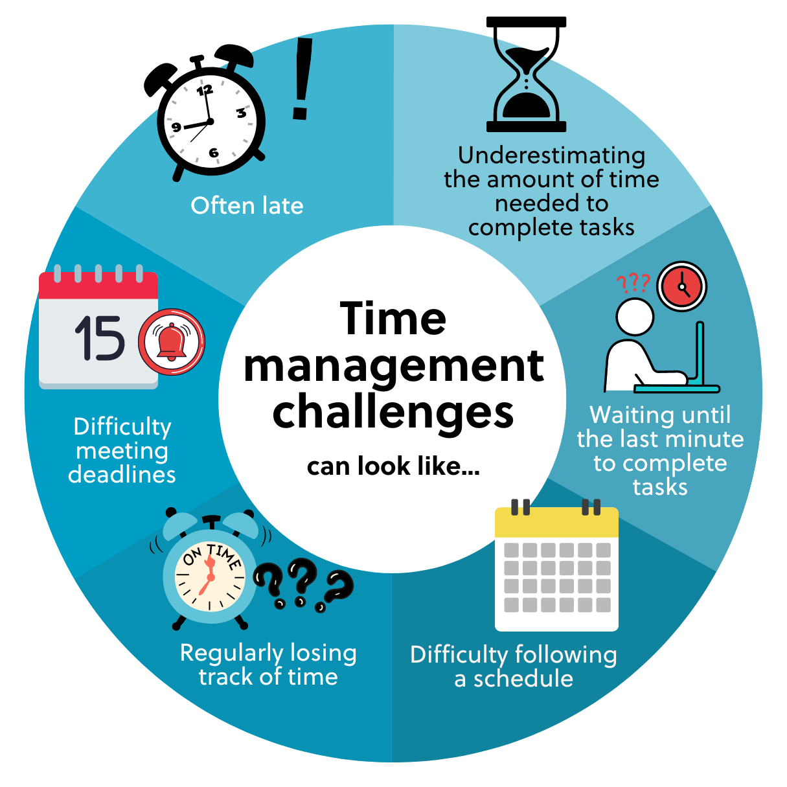
Implications of Poor Time Management
Poor workflow & quality of work
Wasted time
Missing deadlines
Loss of control
-Leads to uncertainty of next task
Loss of sleep and increased anxiety
Poor reputation
Poor work-life balance

Slide 4
HOW DO YOU WORK BEST
YOU KNOW YOURSELF & YOUR STRENGTHS
Notes:
You know yourself and how you prefer to get your work done
Handwrite everything or computer? Morning Person or Night Person? Do you start your workday and check emails at home before you come in or do you do so when you arrive at school?
If the way you do things fits you and your personality, then continue with that approach Do you find that you are utilizing your time productively and thoroughly? There are things you can do, within your own preferred structure, that can help you work more efficiently “Work smarter, not harder” - This should be unique to you, so find your system and approach and refine it Change if you want to, but make sure any change fits your style

Slide 5
Understanding How and When YOU Work Best
Determine the Best Times For Concentrated, Deep-Thought Tasks Anticipate & Plan ‘AD’ Work Around School Duties & Other Set Responsibilities
Create Routine Meetings Duties Map out your day as much as possible to maximize productivity
Time of Day or Week? Home or Office? Multitasking - Be Careful! (Why?) Focus on Task at Hand and Complete It
Notes:
I work best in the morning
CONCENTRATED DEEP TASKS - Creating Budget - Time Consuming, Requires Focused Time and Energy….During the School Day? Before or After School? Weekend?
Routine - Daily Tasks right away…check schedule, check weather, confirm officials & buses, pay bills on Monday’s (know how others in your school district work - Business Office check requests by Tuesday’s, checks go out on Wednesday’s)
Be aware of and plan around standard meetings - Weekly Staff/Admin Meetings Duties - Hallway, Lunch, Parking Lot, Before or After School Are you an early bird or a night owl? (Better be BOTH to do our job) Are certain tasks better to complete for you in the office or at home?

Slide 6
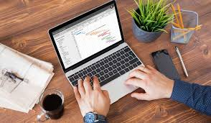
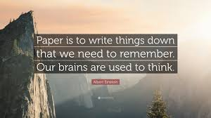
DOCUMENT AS MUCH AS YOU CAN
Declutter & organize your thoughts
A written goal/task is more likely to get done! Keep a record of the past, but also use old information
COPY & PASTE Use & Reuse Information
Ease your working memory
Simplify complex tasks
Notes:
My Weekly Update - Copy & Paste
Standard Operating Procedures - Detailed Workplace Instructions
Using similar documents for different events - MPA Events
Organize your work in a way that fits you best

Slide 7
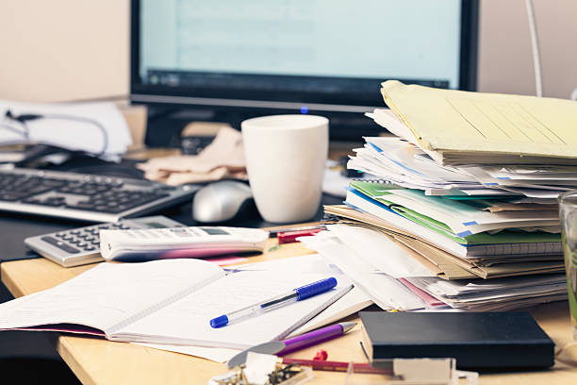
Workspace Organization
What does your workspace look like?
Do you have a clean space or do you have
piles of paperwork? Or somewhere inbetween?
What do you have within arms reach?
Notepad, Jostens/daily planner, schedules, etc.
Organization can save time and reduce stress
Throw out what you don’t need
Minimize what you have, maximize the space you’re working with
Fewer distractions clears your mind and improves focus
Fewer work minutes are lost when you know where things are
Creates a more professional office environment

Slide 8
Benefits of a Tidy Workplace
Regular cleaning can decrease sick days by up to 80%, according to a University of Arizona study
According to Harvard Business Review, cluttered home space can lead to procrastination and poor eating habits - this can lead to work habits
Participants with messy desks were perceived to be less conscientious, more neurotic, and less agreeable
Clear some space - consider going electronic with your files
File retrieval is easier
Less clutter, reduction of filing cabinet/floor space
Collaboration
Increased security
Higher productivity
Schedules/Jostens

Slide 9
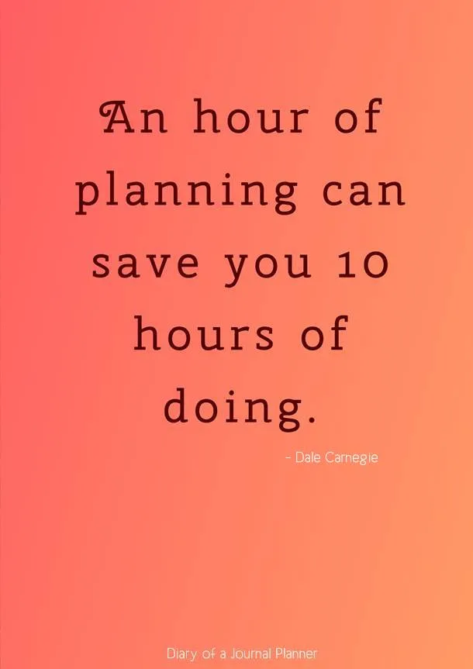
Duty to PLAN.
Organizing
Anticipating
Protecting
Administering
Supervising Evaluating
Reflecting
Adapting
Wouldn’t you rather be over-prepared?
Notes:
Legal Responsibility to PLAN

Slide 10
To-Do Lists & Prioritization
WE ARE PLANNERS! Organize Your Day By Creating a To-Do List - either beginning or end of day
Google Tasks Phone Other Apps - Todoist, Canva Good ‘ole “Legal Pad List” Post-It Notes Then…Prioritize Your List - HOW URGENT AND IMPORTANT IS THIS?
Cross Things Off When You Finish - FEELS GOOD!

Slide 12
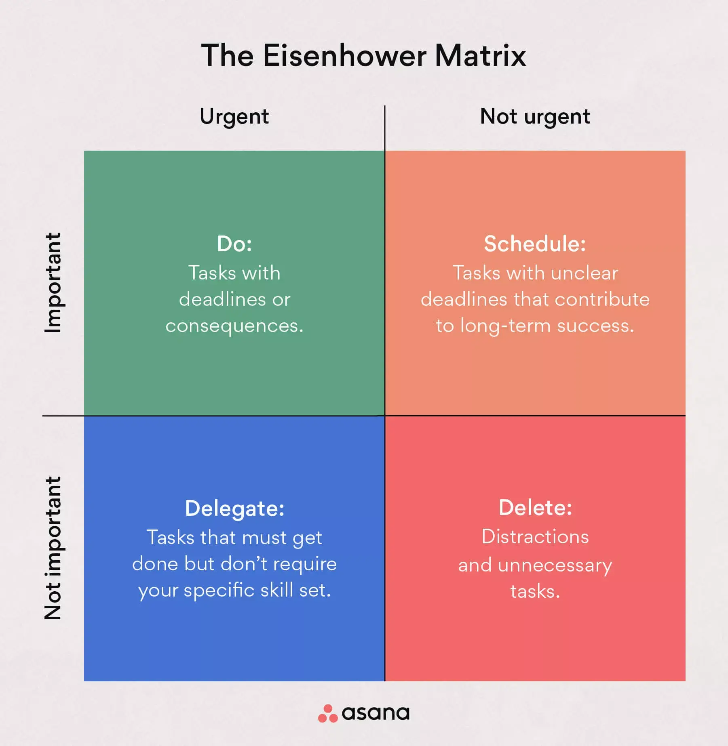
https://asana.com/resources/eisenhower-matrix
Notes:
Do: Weekly Update Schedule Email, Finish Budget Outline for Pre-Budget Planning with Supt., Check that Officials Are Scheduled
Schedule: Signup for MIAAA Spring Conference, Schedule Hall of Honors Committee Meeting, Walk Through Cafeteria…Chat with Students Delegate: Updating Winter Coaches Directory for the Athletic Website, Updating Scoreboard Message Board Slides, Picking Up Awards
Delete: Individual Team Facebook Gossip, Sorting Desktop Icons on My Laptop, Removing Old Coach Files

Slide 13
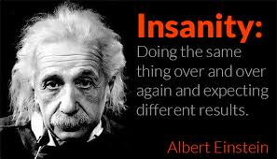
The Importance of Routines
What does your routine(s) look like?
Arrive at school at a certain time, emails, return phone calls, meetings, check-ins, etc.?
Daily routines will look different day-to-day
Systematic habits have far-reaching benefits
Lead to consistent results
Save time - you become more efficient
Reduce stress & anxiety
Lead to better mental health
Allows you to control decisions
Lead to consistent results and better work performance
Einstein’s definition of “insanity”

Slide 14
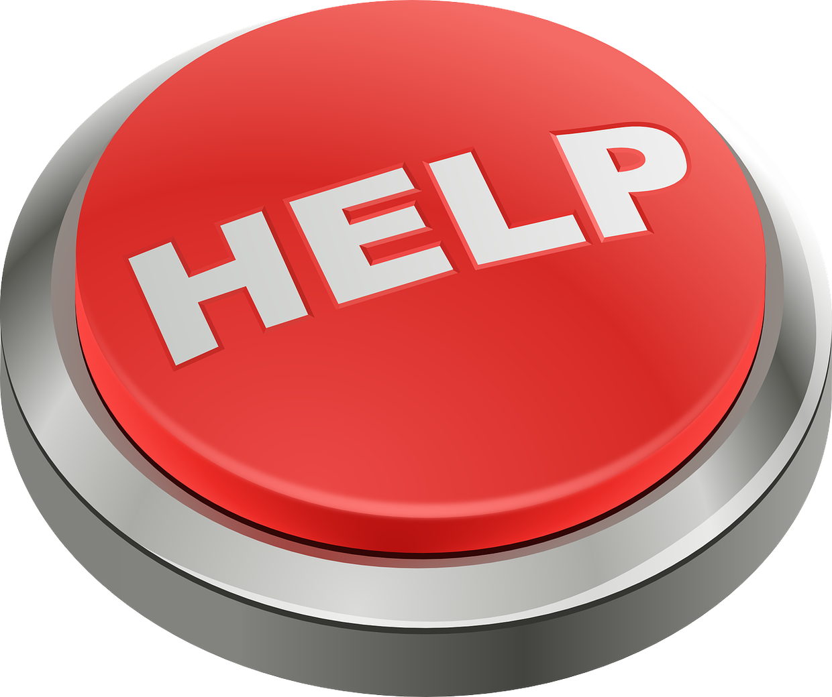
It’s OK to Ask Others For Help
You are one person - you can’t do it all!
Identify those at your school that can and will help you with tasks to save time
Other Staff Coaches / Administrators Students AD Colleagues -Don’t reinvent wheels
Take the help you can get and run with it
Anticipate and proactively ASK for help
Notes:
Opening School Meeting - Soliciting Help From Staff & Hiring for Paid Positions
Emails for Additional Admin Support For Big Games
Communicate with Student Council / Captain’s Council about Getting Students More Involved in Athletic Events Beg, Borrow and Steal from Other AD’s Try to accept help when available BIG EVENTS - Go find assistance (MPA Events, Parking Volunteers, Boosters, etc.)

Slide 15
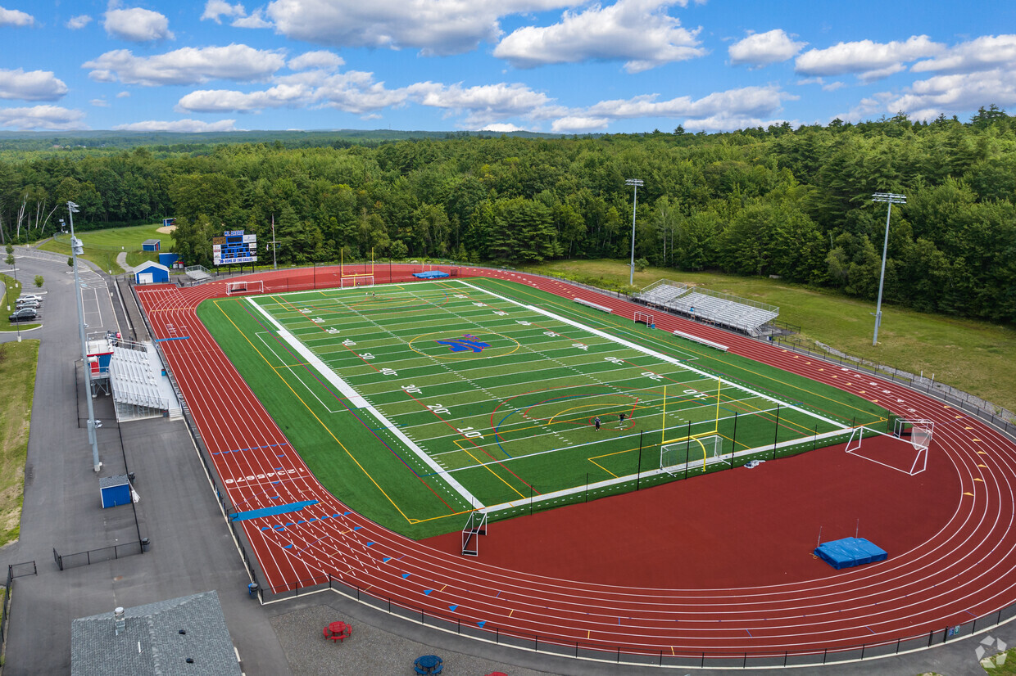
Delegate Responsibilities to Others
Save time by having others do the work
Pregame Field / Gym Setup Postgame Bleacher Cleanup Administrative Assistance -End of Season Awards Game Admin Support Help - MTA Staff
What do you really need your hands in and what can be “shopped out” to others?
Communicate your expectations to see that jobs still get done to your satisfaction

Slide 16
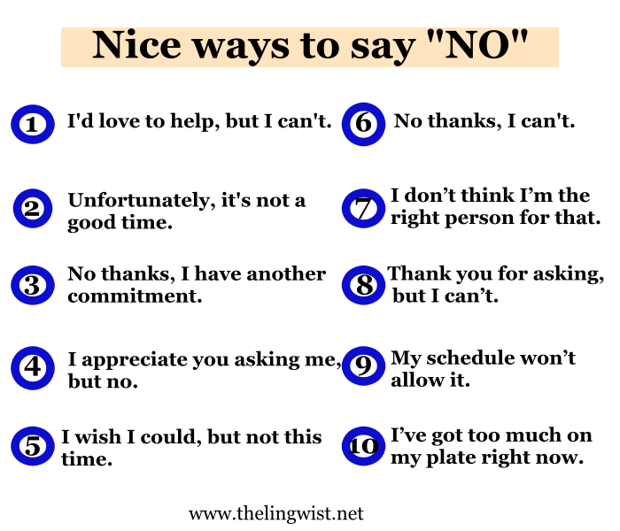
Notes:
Not only is it OK for you to say no, it is imperative that you DO from time to time…
Don’t overwhelm yourself - know your limits
How does this request relate to your other priorities? Attending Booster Meetings - During seasons (I try to submit a written summary/notes if possible) Professional Day Meetings - Some sessions I skip out on, due to events
Invitations to Sport Team Banquets - Off School Time
Asked to Assist With Supervision of School Dances/Prom - No Thanks.

Slide 17
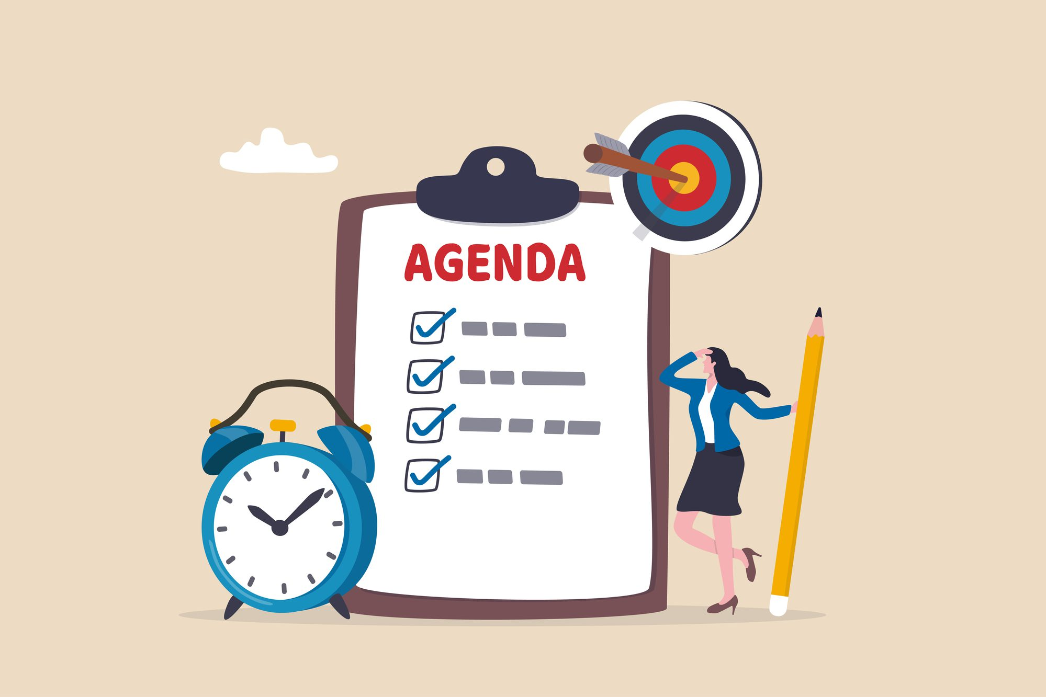
Meeting Structure
Meetings need to stay focused
Have a plan and purpose
Send the agenda out ahead of time
Stick to the agenda
Include a start and end time
Put time limit on agenda items
Be clear about this at the start of the meeting
Honor the time limits
Have a running timer - assign someone
Be flexible when needed
End with action items

Slide 18
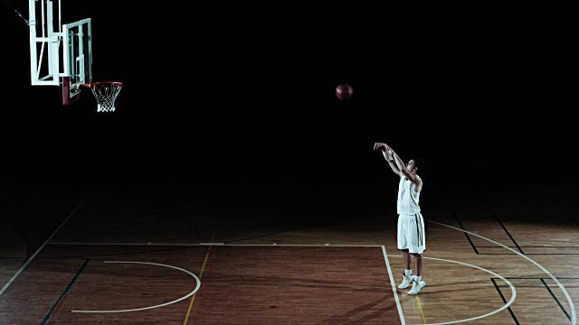
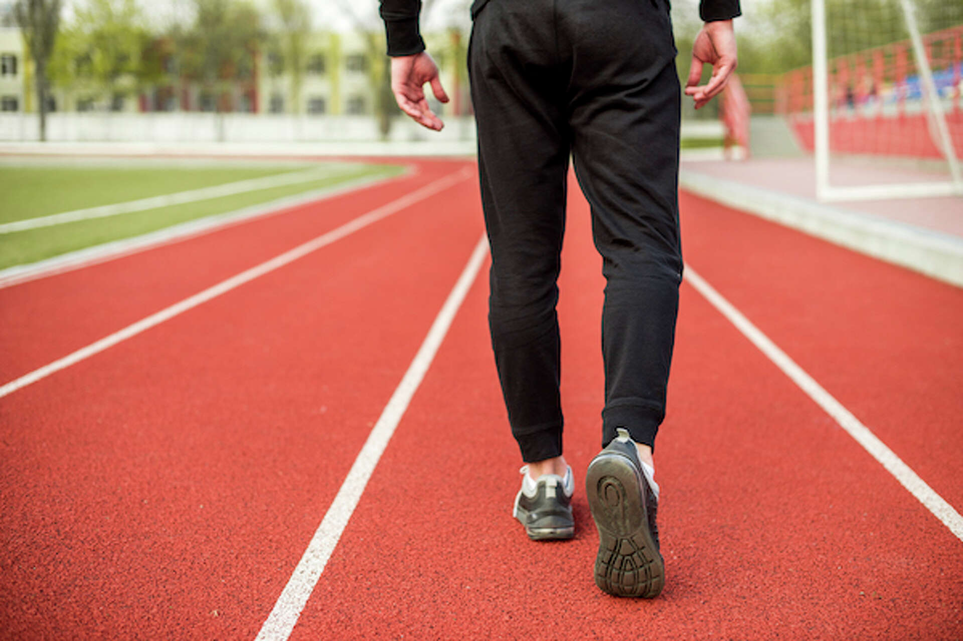
Time For YOU Is Just As Important as Your Work
You are a valuable human resource to your school…Your personal time is valuable too! Do you work better when you are physically or mentally exhausted? Carve out time in your schedule for yourself
Block off your schedule Adjust your daily work time Disconnect from communication Share your need for personal time Exercise / Engage in physical activity Take time off - (everybody else does!) Family & Friends are the most important

Slide 20
Questions / Thoughts From Others?
Nathan Priest - npriest@sad15.org
Geoff Godo - godog@link75.org
THANK YOU ALL AND ENJOY THE CONFERENCE!

