Slide 1
MIAAA FALL
CONFERENCE 2024
Presenters: Alex McCormack & Cameron Archer

Slide 2
Discussion Topics:
*Hiring Process
*Conducting Interviews
*Evaluating Coaches
*Skill Development
*Middle School Philosophies

Slide 3
Key Factors In The Hiring Process
District Hiring Expectations:
Job descriptions and qualifications
Importance of networking in the hiring process
Include varsity coaches
Utilize numerous communication channels
Skills and Qualifications:
Leadership qualities
Experience working with professionals
Knowledge of compliance and regulations
Athletic Experiences and Exposure

Slide 4
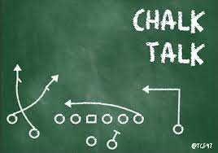
Key Factors In The Hiring Process (Cont.)
Evaluation of Candidates
Evaluation Criteria:
Interviews and reference checks
Assessment of cultural fit with the institution
Onboarding New Coaches
Best Practices:
Importance of mentorship
Providing resources for success
Certification requirements

Slide 5
Conducting Effective Interviews
Include Varsity/HS coaches or school administrators
Confidentiality statement
Punctuality & Professionalism
Include scenario-based questions
Seek alignment with the mission of the school or institution

Slide 6
Essential Pieces to the Puzzle
Athletic Administration
Coaches
Parents
Players
What do we stand for? Provide all parties with a comprehensive overview of the athletic mission of the school.
Policies & Procedures: All athletic policy and procedure documents should be readily available to all parties.
Communication: Ensure critical season details are shared with parents and players in a timely manner.
Clear Expectations: Players should fully understand what is expected of the student athlete, including academic requirements, behavior, and the goals of the team.
Education Sessions: Host workshops to educate parents about the coaching philosophy and the importance of development over competition.
Positive Communication: Encourage parents to focus on their child’s development rather than just game outcomes, reinforcing the coach's message.
Academics First: Student-athletes must understand academics are paramount to their success.
Accountability: Student-athletes are representing their school and their programs on various levels.

Slide 7
Basics 101
First & Foremost:
Someone who can create a Positive Environment
Encourage Teamwork: Promote collaboration and teamwork through group activities and team-building exercises on and off the athletic surface.
Celebrate Hard Work: Recognize effort and improvement in practices and games; not solely outcomes. Positive reinforcement, tone, and approach can make or break a player and a team.

Slide 8
Collaboration, Programming, Education
Collaborate with Other Coaches: Share ideas and resources with other coaches who prioritize foundational knowledge and skill development. Create a network of support and encouragement.
Mentorship Programs: Establish mentorship opportunities where experienced coaches can guide newer coaches in fostering a development-centered environment. Build a programmatic approach.
Continued Education: Encourage coaches to pursue training focused on youth development, emphasizing positive coaching techniques and age-appropriate strategies.
Acknowledgement of Philosophy: Organize workshops that reinforce the philosophy of development over immediate winning, helping coaches internalize and implement these values through a feeder system mindset.

Slide 9
Evaluating Coaches
Clear expectations of the coach
Consistent feedback throughout the season
Emphasis on Skill Development vs Wins/Loses
Proper Documentation
Season Debrief Meetings
Discussion about Off-season Expectations

Slide 10
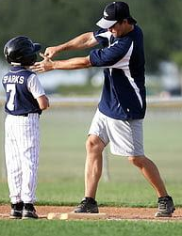
What does Effective Skill Development look like?
Middle School Athletics should:
Focus on skill acquisition and development
Constructive, individualized feedback (Progress vs Perfection)
Introduction of age appropriate functional strength and conditioning
Meaningful, but NOT equal playing time
Fundamentals and technique to ease the transition from MS to HS
Winning should never be the primary focus

Slide 11
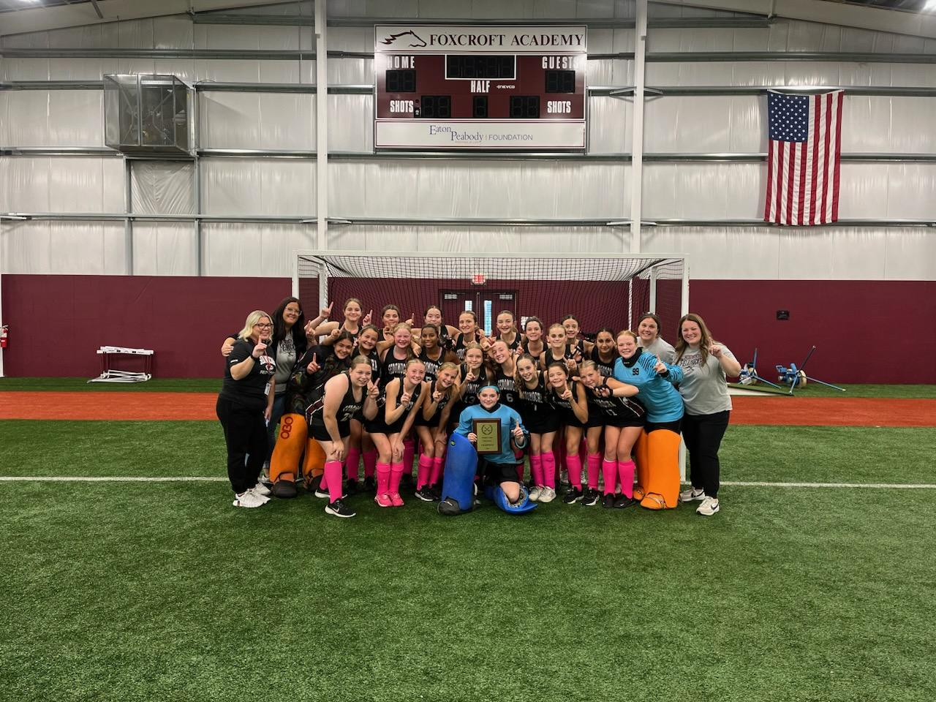
Middle School Coaching Philosophy Essentials:
Emphasize Skill Development
Focus on Fundamentals: Prioritize teaching basic skills and foundational concepts. Incorporate drills that promote skill acquisition and understanding of the sport that are transferable to game situations.
Progressive Learning: Create a developmental approach that builds skills gradually, allowing athletes to master each level before moving on.
Set Developmental Goals
Individual Goals: Encourage athletes to set personal development goals, such as improving specific skills or increasing participation. Goals must be attainable and measurable.
Team Goals: Shift team objectives from winning championships to improving overall team cohesion and performance from day to day, week to week.

Slide 12
Discussion Activity…
Mock Resume Review:
You are hiring for a new Middle School Basketball Coach…
Upon review of six resumes, which would you choose to interview?
What qualities made you choose these candidates?
What “red flags” did you find amongst the resumes?

Slide 13
Additional Questions?
Thank You!

