Slide 1
Maine High Schools
&
Community Engagement
The Role of Student Athletes Building Stronger Communities
Dennis Walton, CMAA, Biddeford High School
Notes:
1, Gary leaves the topics broad which is great because it allows you to take whatever approach you would like.
2. Presentation Title: Community Engagement - I choose the word engagement because when I think of engagement I think of it as two ways.

Slide 2
All high schools have some level of community engagement
Opening Statement
This presentation is not an attempt to educate athletic administrators how to begin to engage with their community.
You might get a few good ideas…but!
Encourage Schools to Build an Engagement “portfolio.”
Encourage Schools to Promote Engagement.
Encourage Schools to Celebrate Engagement.
The Stakeholders are watching!

Slide 3
Today’s Topics & Goals
Why Community Engagement Matters.
The Influence of Education Based Athletics.
Factors that Might Impact the Level or Success of Community Engagement.
Benefits of Community Engagement on Student Athletes & Schools.
Benefits of Community Engagement on our Communities.
Examples of Community Engagement.
Conclusion - Call to Action!

Slide 4
Why Community Engagement Matters!
Education Based High School Athletics
“The other half of Education” NFHS
Emphasizes the value of community involvement as a crucial aspect of student development & school culture.
Building Character & Leadership Skills.
Creates a Sense of Responsibility towards Community.
Fosters School Spirit.
Encourages Volunteerism.
Strengthens Community ties.
Develops Positive Role Models.
Notes:
A big component of “Education Based Athletics” centers around an emphasis on community involvement.

Slide 5
Why Community Engagement Matters!
Education Based High School Athletics
Start your portfolio by identifying where the principles of Education Based Athletics are located within your athletic program.
Athletic Department Mission Statement / Vision
The mission of the athletic department at Biddeford High School is to provide athletic programs that help develop the whole child through education and competition, to stimulate a lasting attitude of discipline, sportsmanship, integrity, leadership and social responsibility. To provide a rigorous athletic program which complements and supports a challenging academic program by teaching student-athletes to persevere, to work well with others, and to test themselves. Biddeford High School strives to build competitive athletic programs that act as an enduring source of pride for the student population, student-athletes, alumni and members of the Biddeford Community.
Notes:
Does you Mission Statement reflect the values embedded in Education Based Athletics?

Slide 6
Why Community Engagement Matters!
Education Based High School Athletics
Coaches Handbook (Volunteer Requirement)
Code of Conduct
Represent themselves, their school and their community in a positive manner at all times; this includes on social media platforms.
Demonstrate civility by modeling behavior that exemplifies appropriate respect and concern for others.
Demonstrate social responsibility towards their team, school and community.
Proclaim Who We Are…We Are Who We Say We Are!
Notes:
Code of Conduct?

Slide 7
All high schools have some level of community engagement
What are some factors that may impact the level of engagement?
Which Factors Can You Control?
Leadership (vision & values - priorities)
Cultural Relevance & Social Factors.
School Systems (MSAD, School Union, Public vs. Private)
Resource Availability.
Parent & Alumni Involvement.
Notes:
Poor Leadership will often result in poor community engagement - this all levels and both sides!
What are the cultural dynamics of your school distinct? Community?
Socio Economic makeup? Are you made up of a few towns? Private?
Does you district have adequate funding for both the city and the school. Lack of funding a barrier?
Established groups? Alumni initiatives?

Slide 8
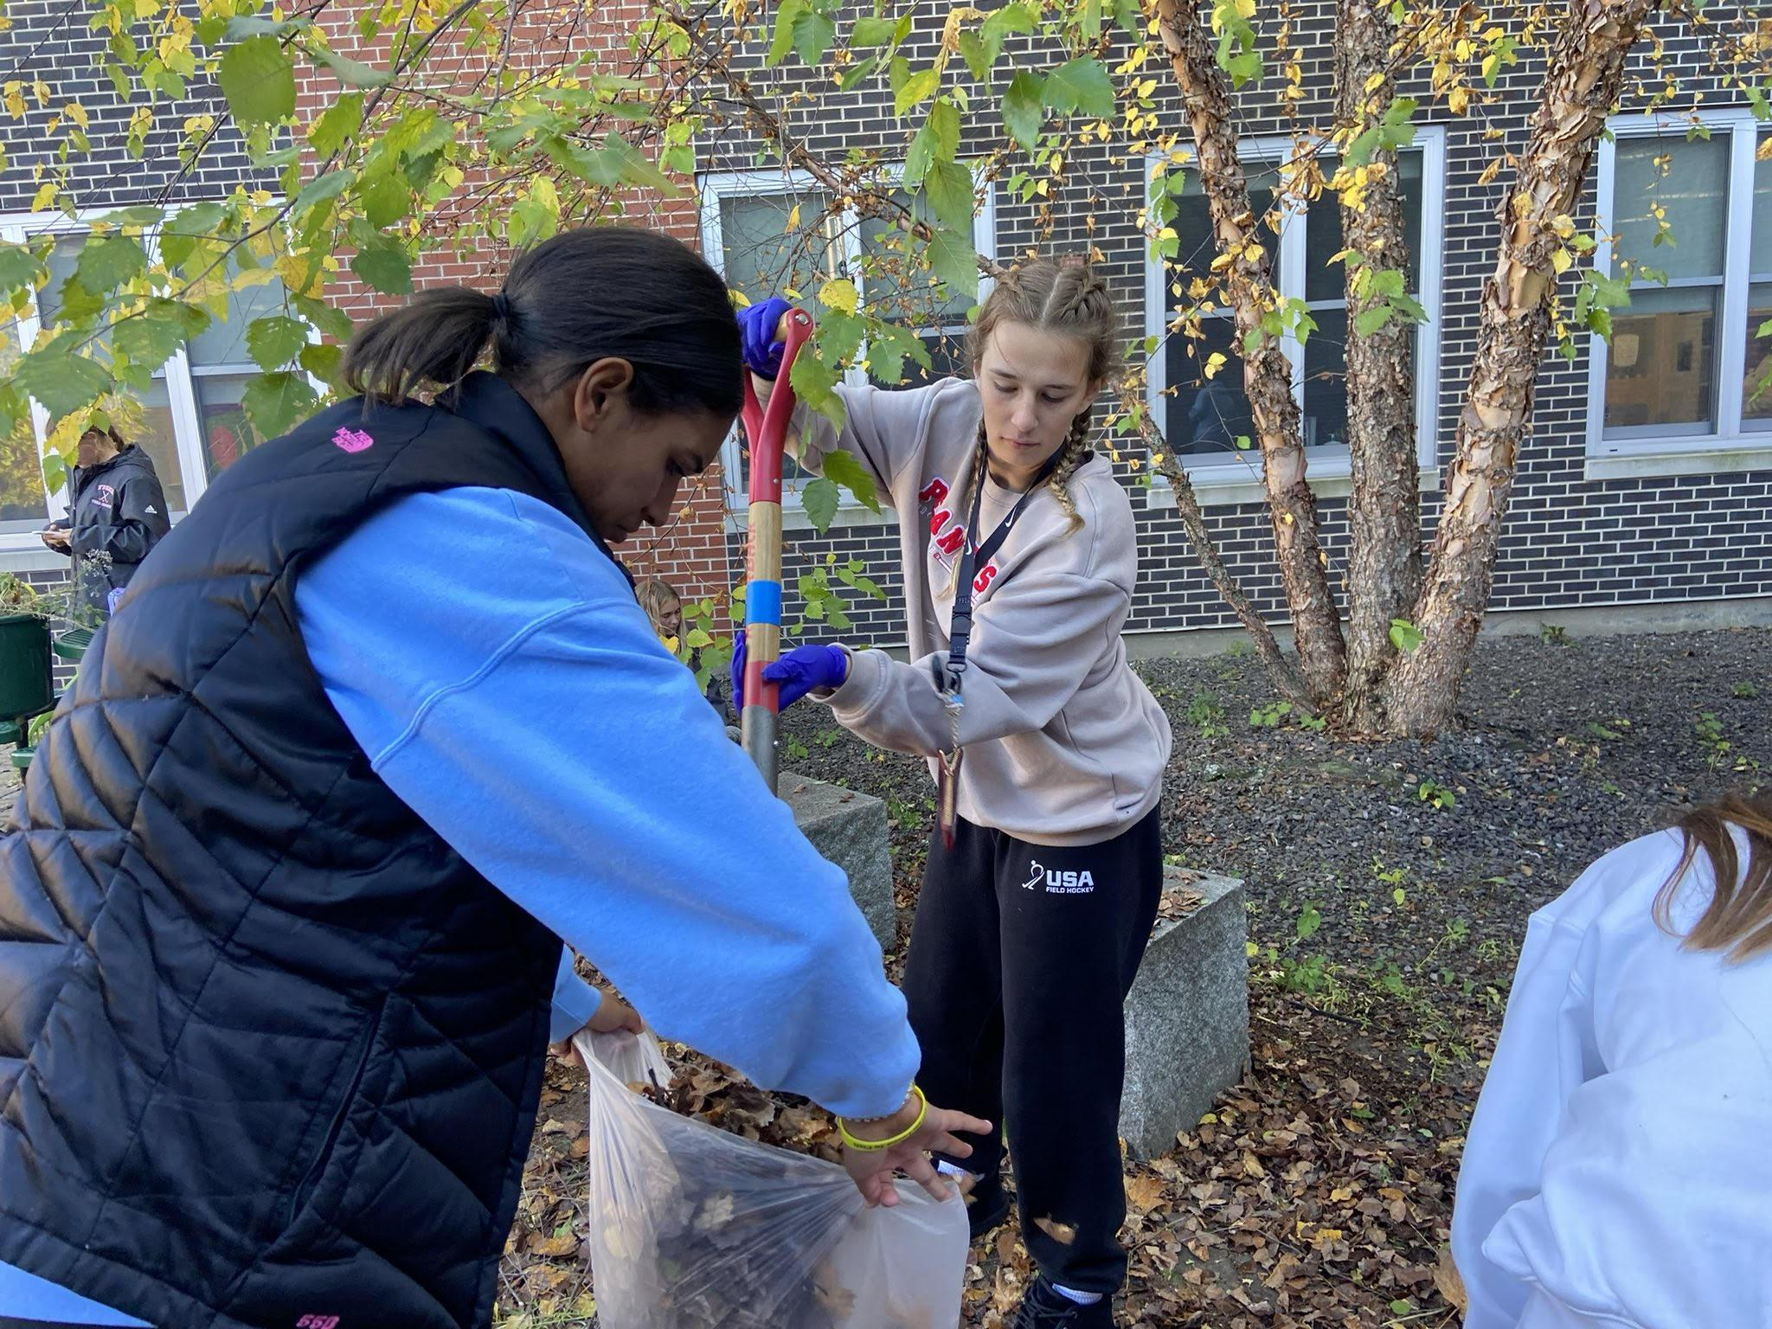
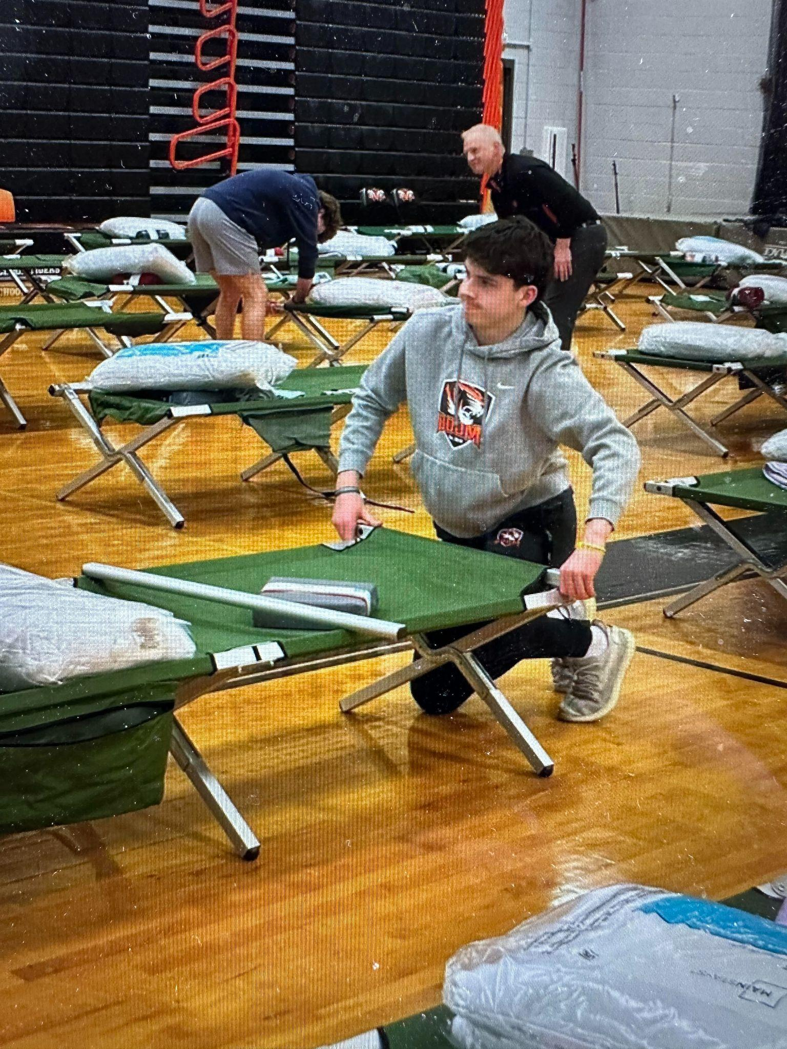
Benefits for Student Athletes
Personal Growth & Self Reflection.
Increased Visibility.
Increased Empathy & Social Awareness.
Networking & Community Connections.
Team Building - Camaraderie & Teamwork.
College Applications.
Local Resources. (Sponsorships/Contractors)
Courtyard cleanup
CMP setup
Notes:
All of the values of Education Based Athletics & Character Building

Slide 9
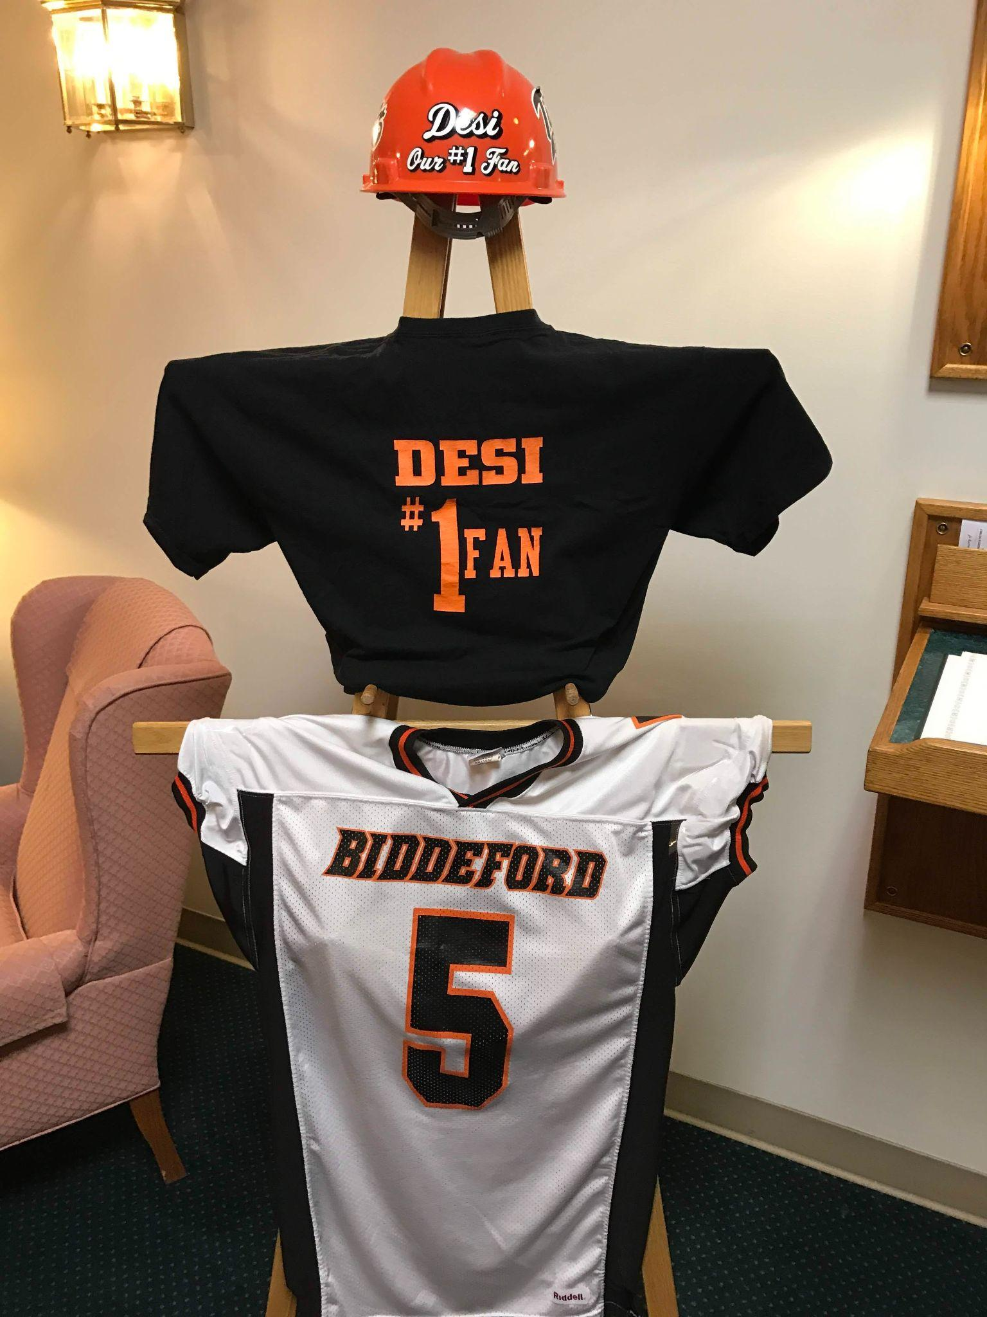
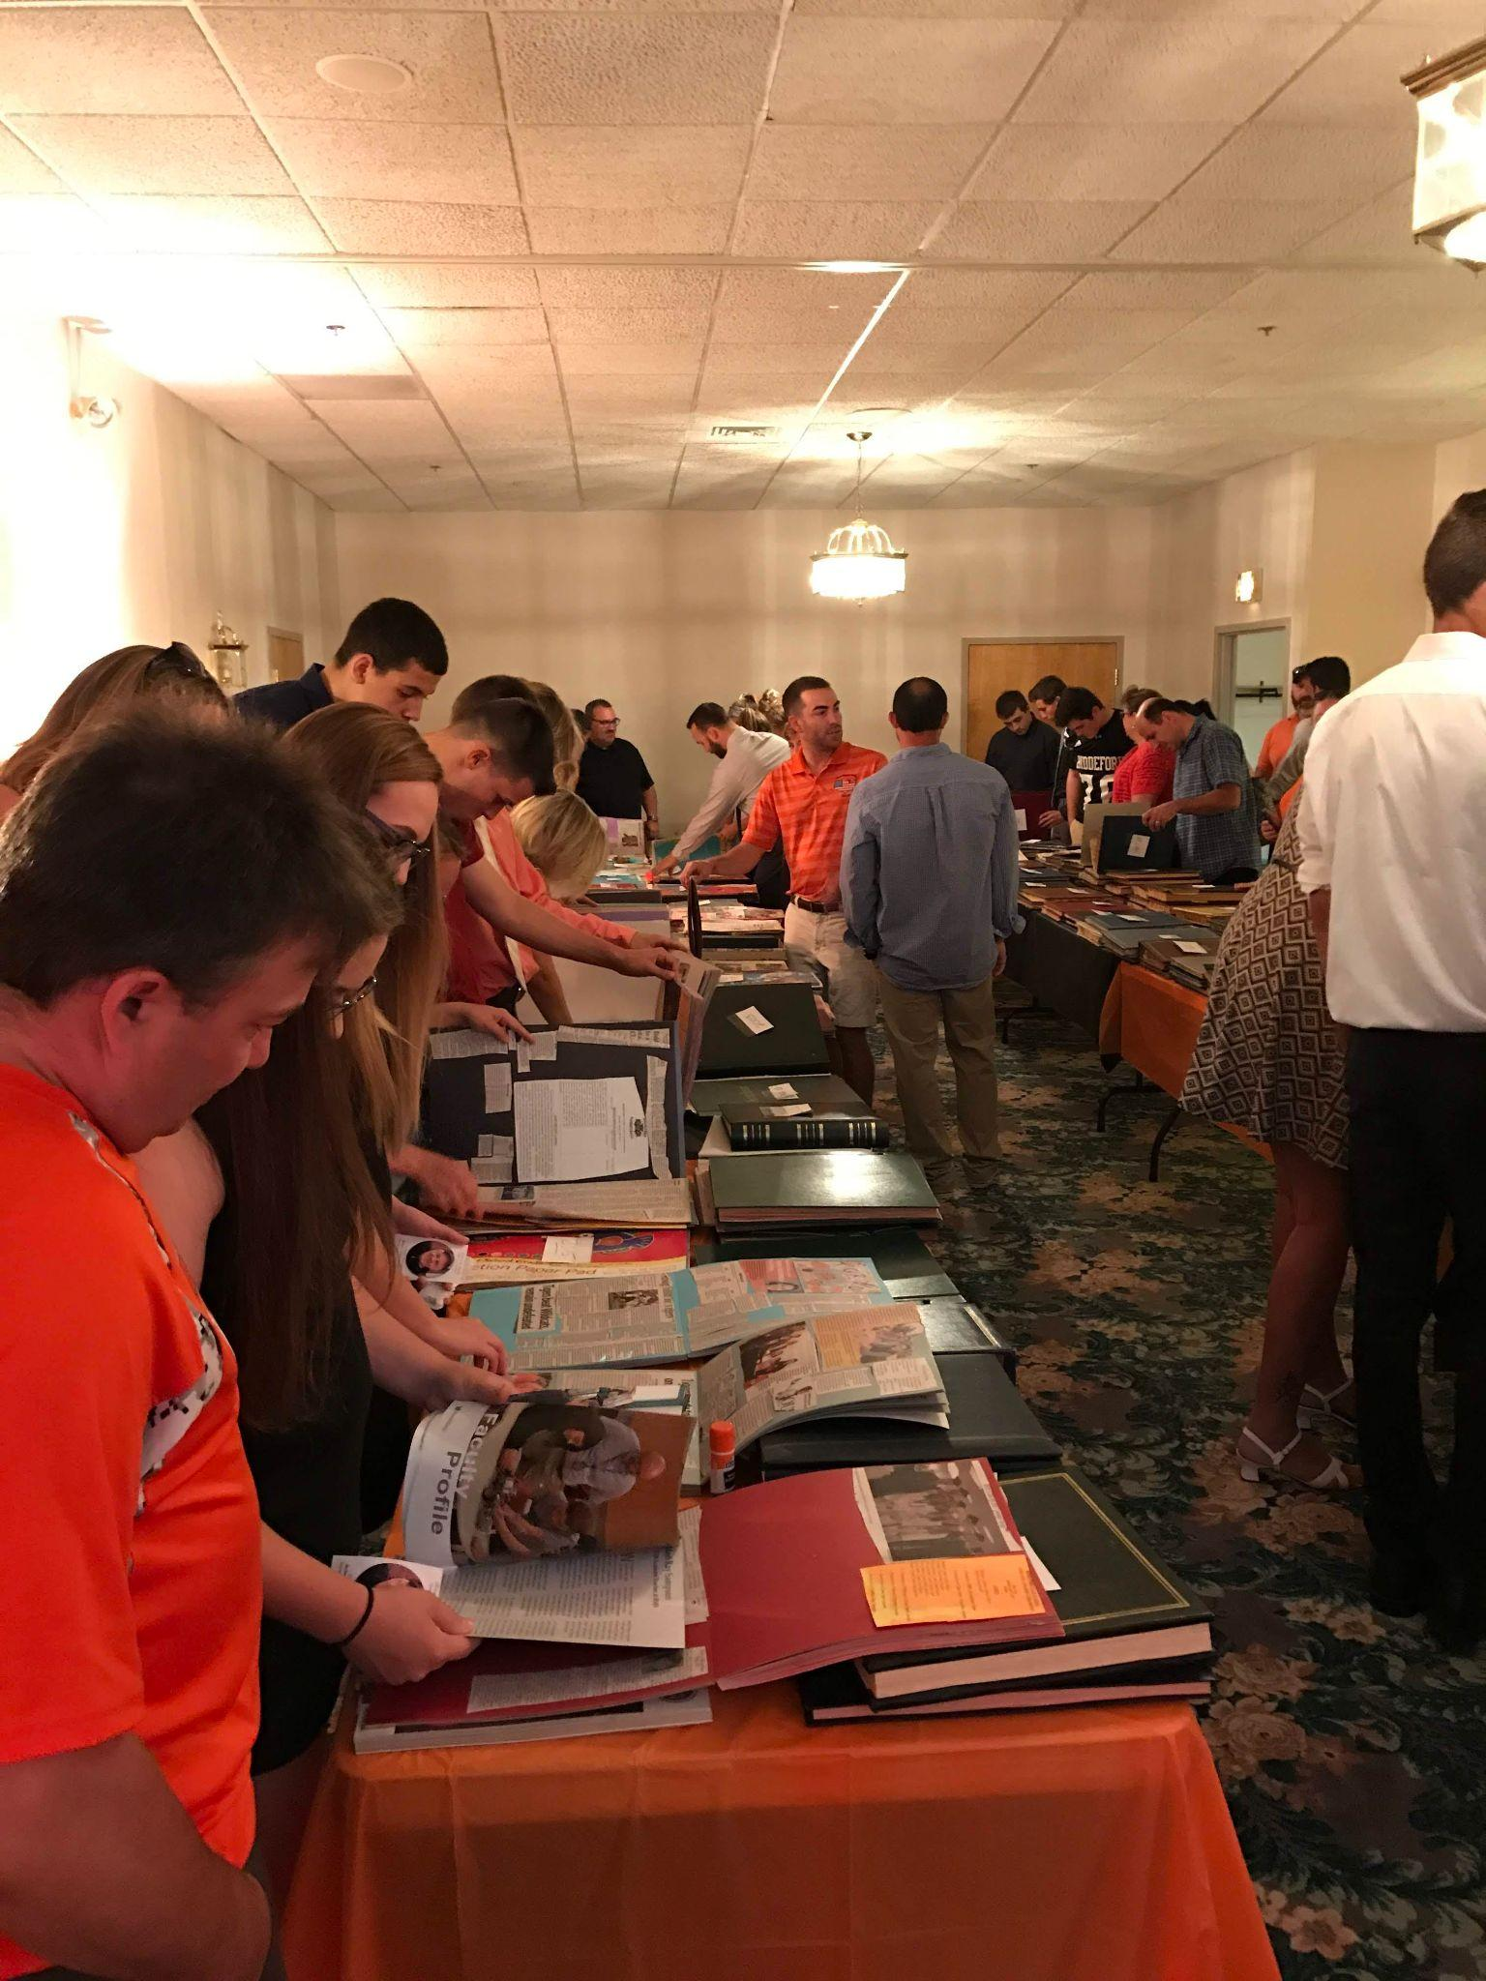
Benefits for Our Community
Our Schools are the Epicenter of our Community.
Identity & Pride. (Enduring Source of Pride!)
Social Gatherings & Events.
Local History, Tradition & Social Events.
Shared Resources.
Investment in our future Workforce.
Support System for Families.
Community Service.
Robert “Desi” Desjardins
Notes:
Community Engagement can be a benefit to not only the school and our student athletes, the community benefits in many ways.

Slide 10
Community Engagement Examples
Community Resources
Shared Facilities (Both Ways)
School Assistance Programs
Director of Community Outreach & Development.
Biddeford Educational Foundation. (50K Annually)
Backpack Program & Tiger Boutique. (Food & Clothing)
Community Resources - Business’ & Contractors
Funding (Sponsorships, Partnerships)
Work on Facilities

Slide 11
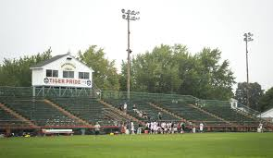
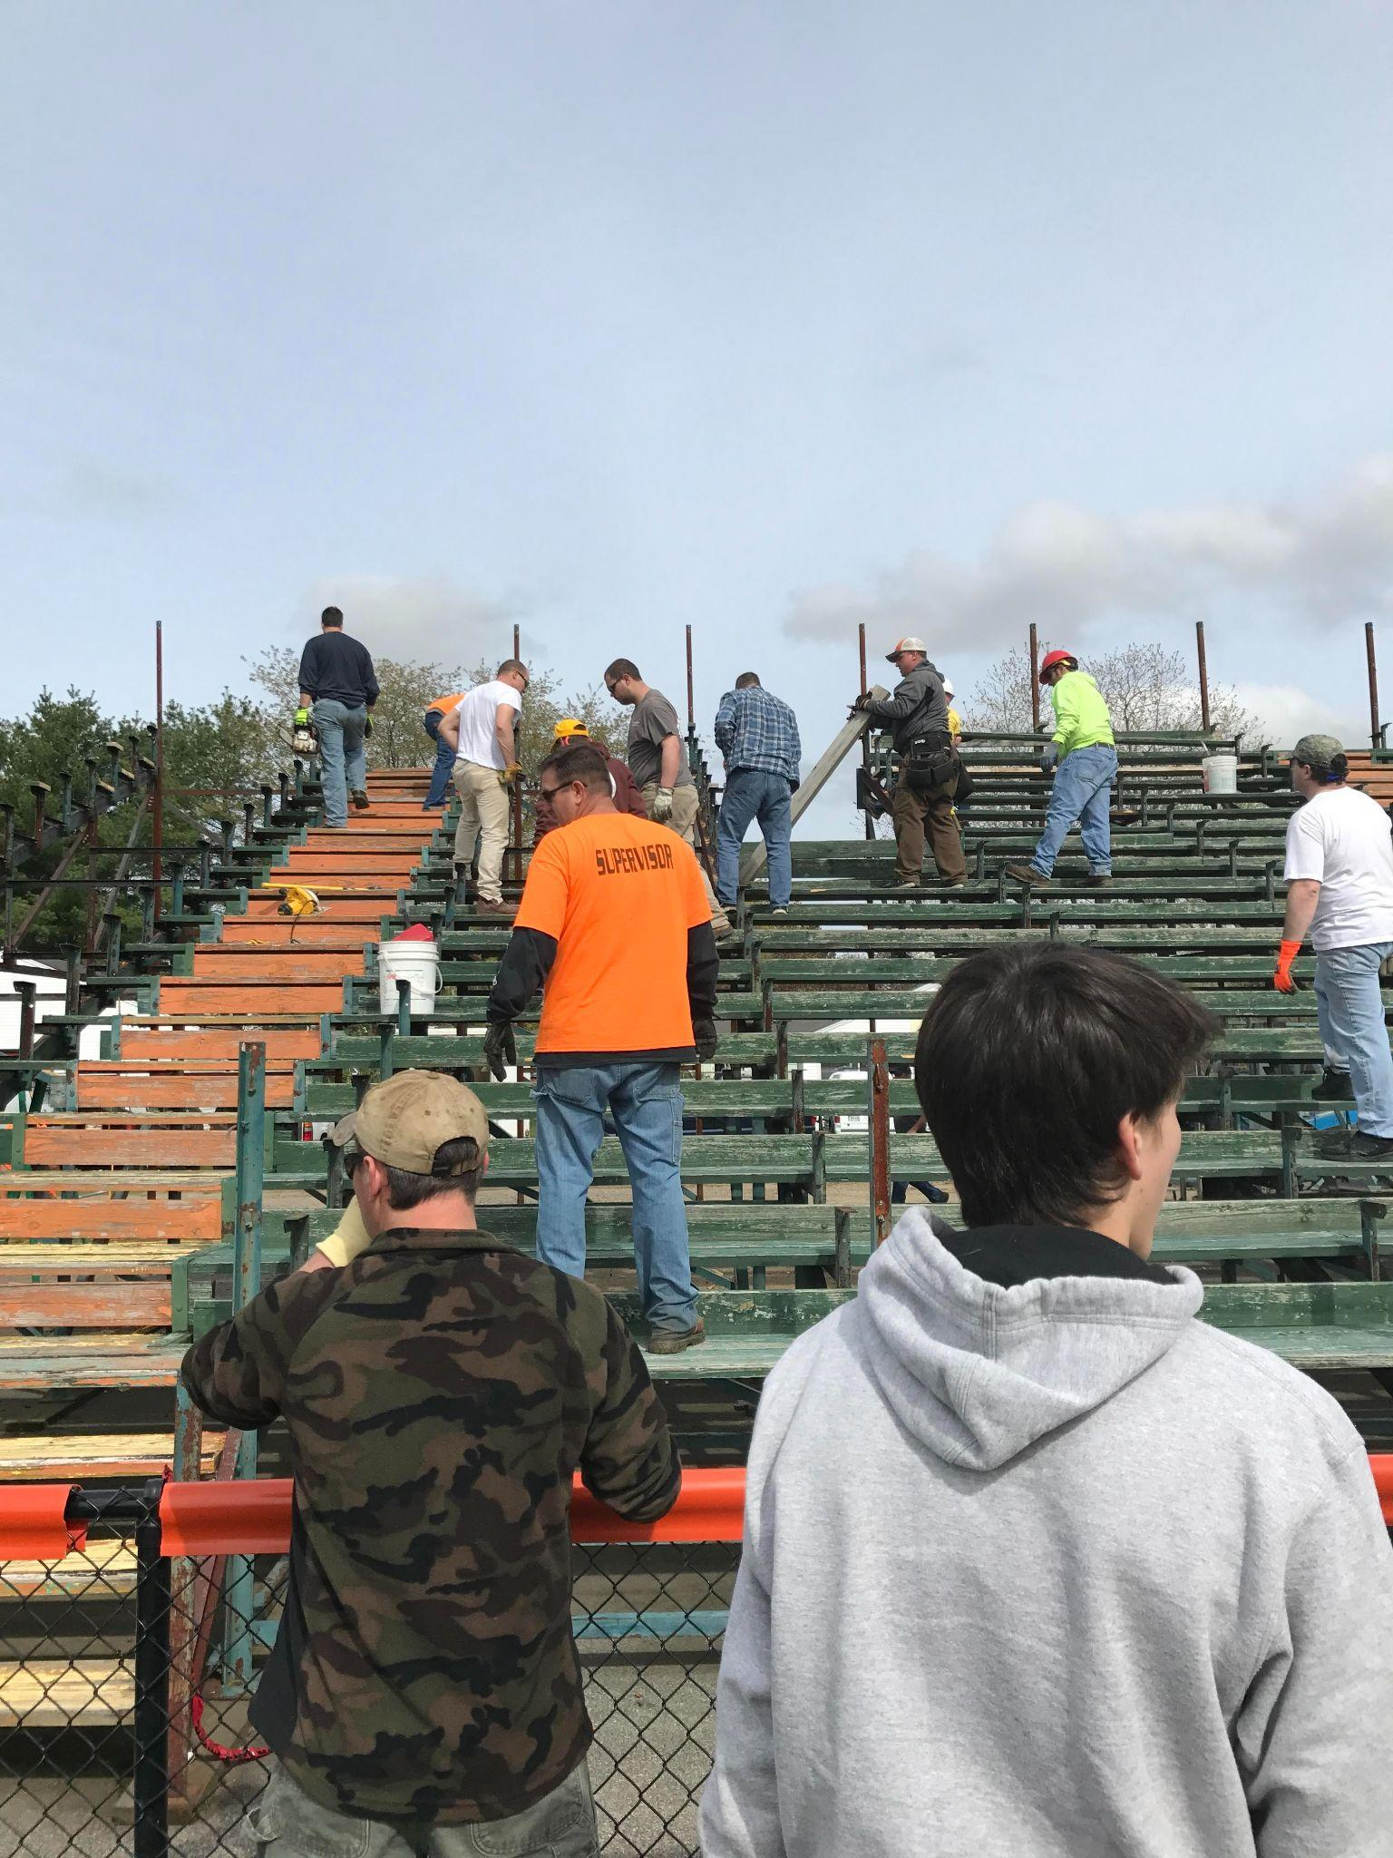
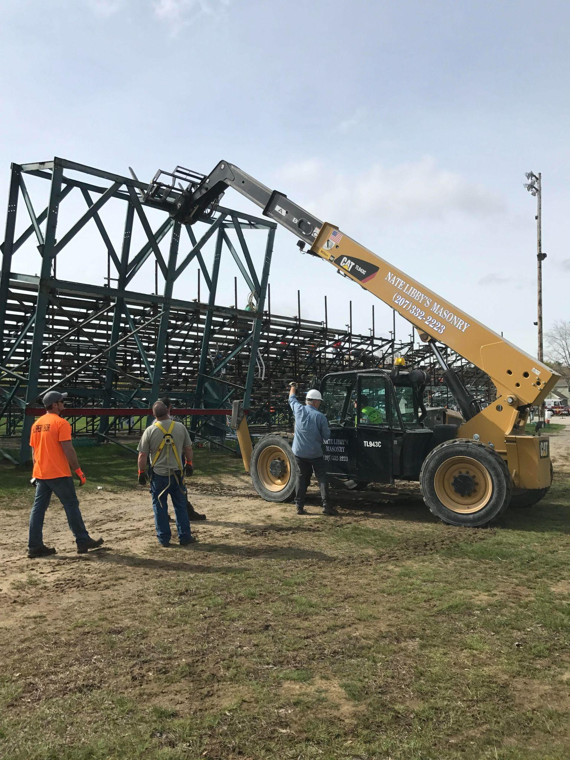
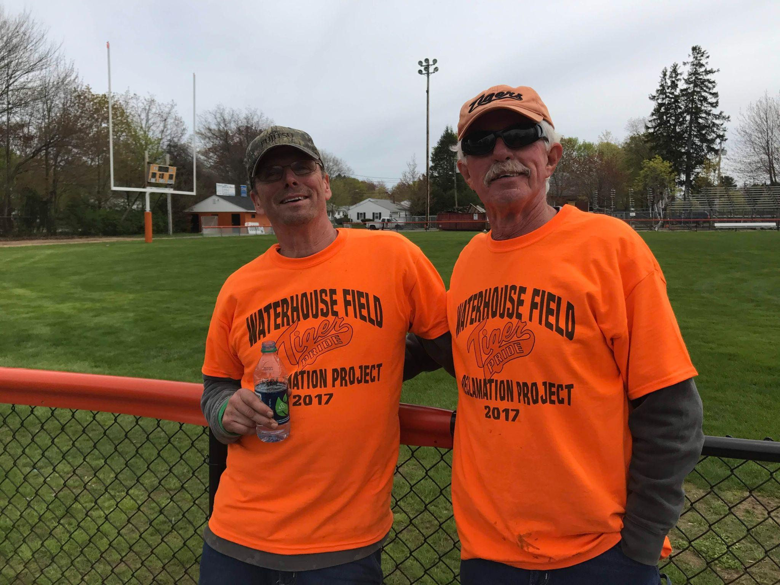
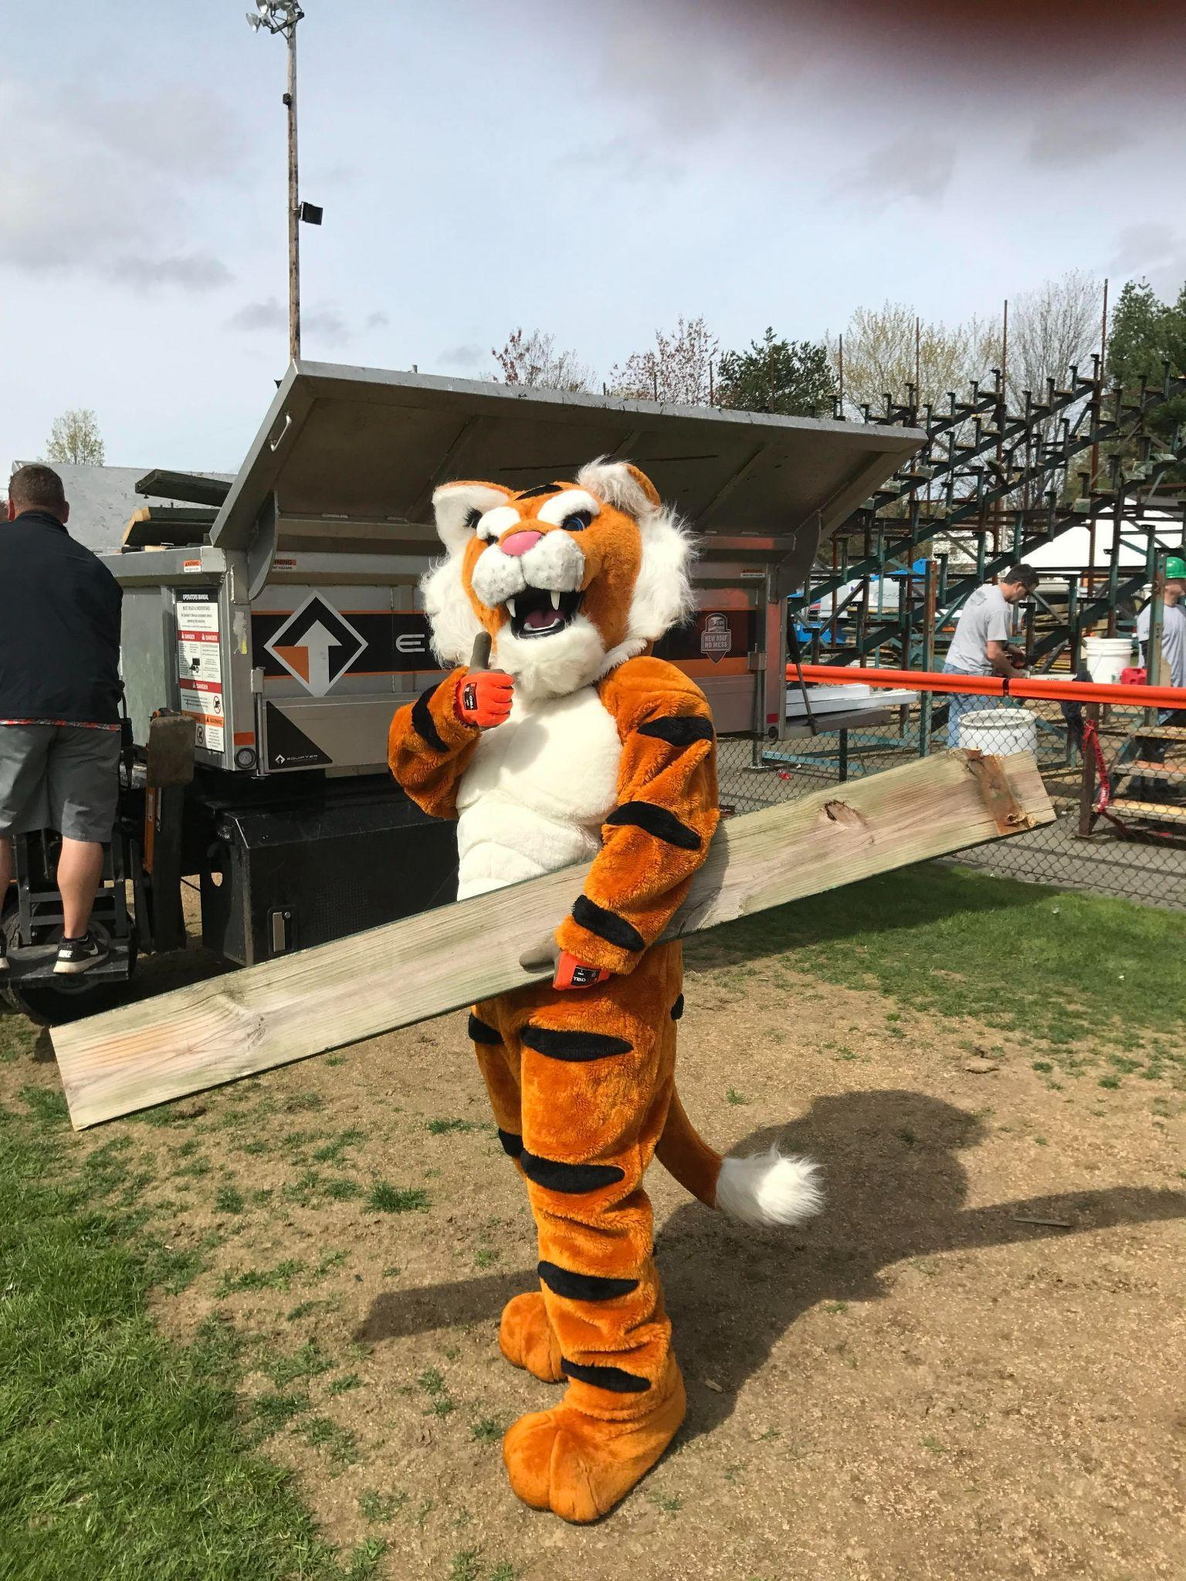
Community Engagement Examples
Community Resources… Waterhouse Field Renovation
May 2017
5,000+ Seats
350 Volunteers

Slide 12
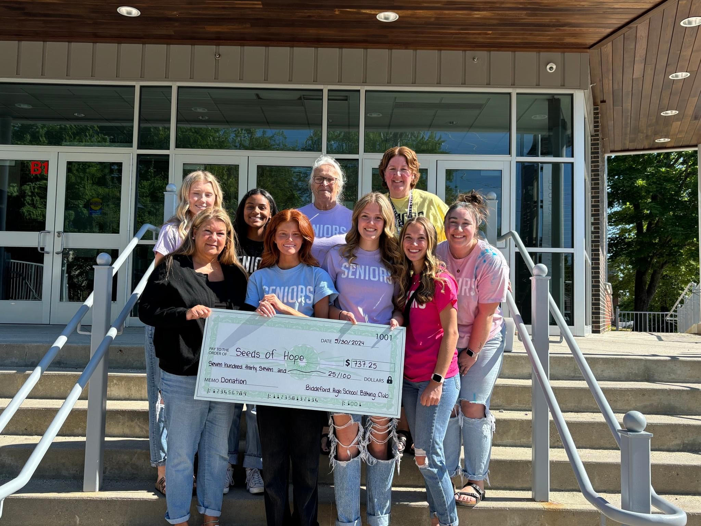
Community Engagement Examples
School & Community Events
Tributes & Memorials
Scholarships, Drives, Causes
Outreach Efforts (Local Organizations, Non Profits)
Community Event Participation (Parades, Festivals, Events)
Notes:
Tributes to Community Members at games * Established Memorials for Community Members * Community Ceremonies
Athletics raising funds for causes * Raising money for Scholarships * Drives (food, coats, turkey, presents)
Athletes participating in Community Events

Slide 13
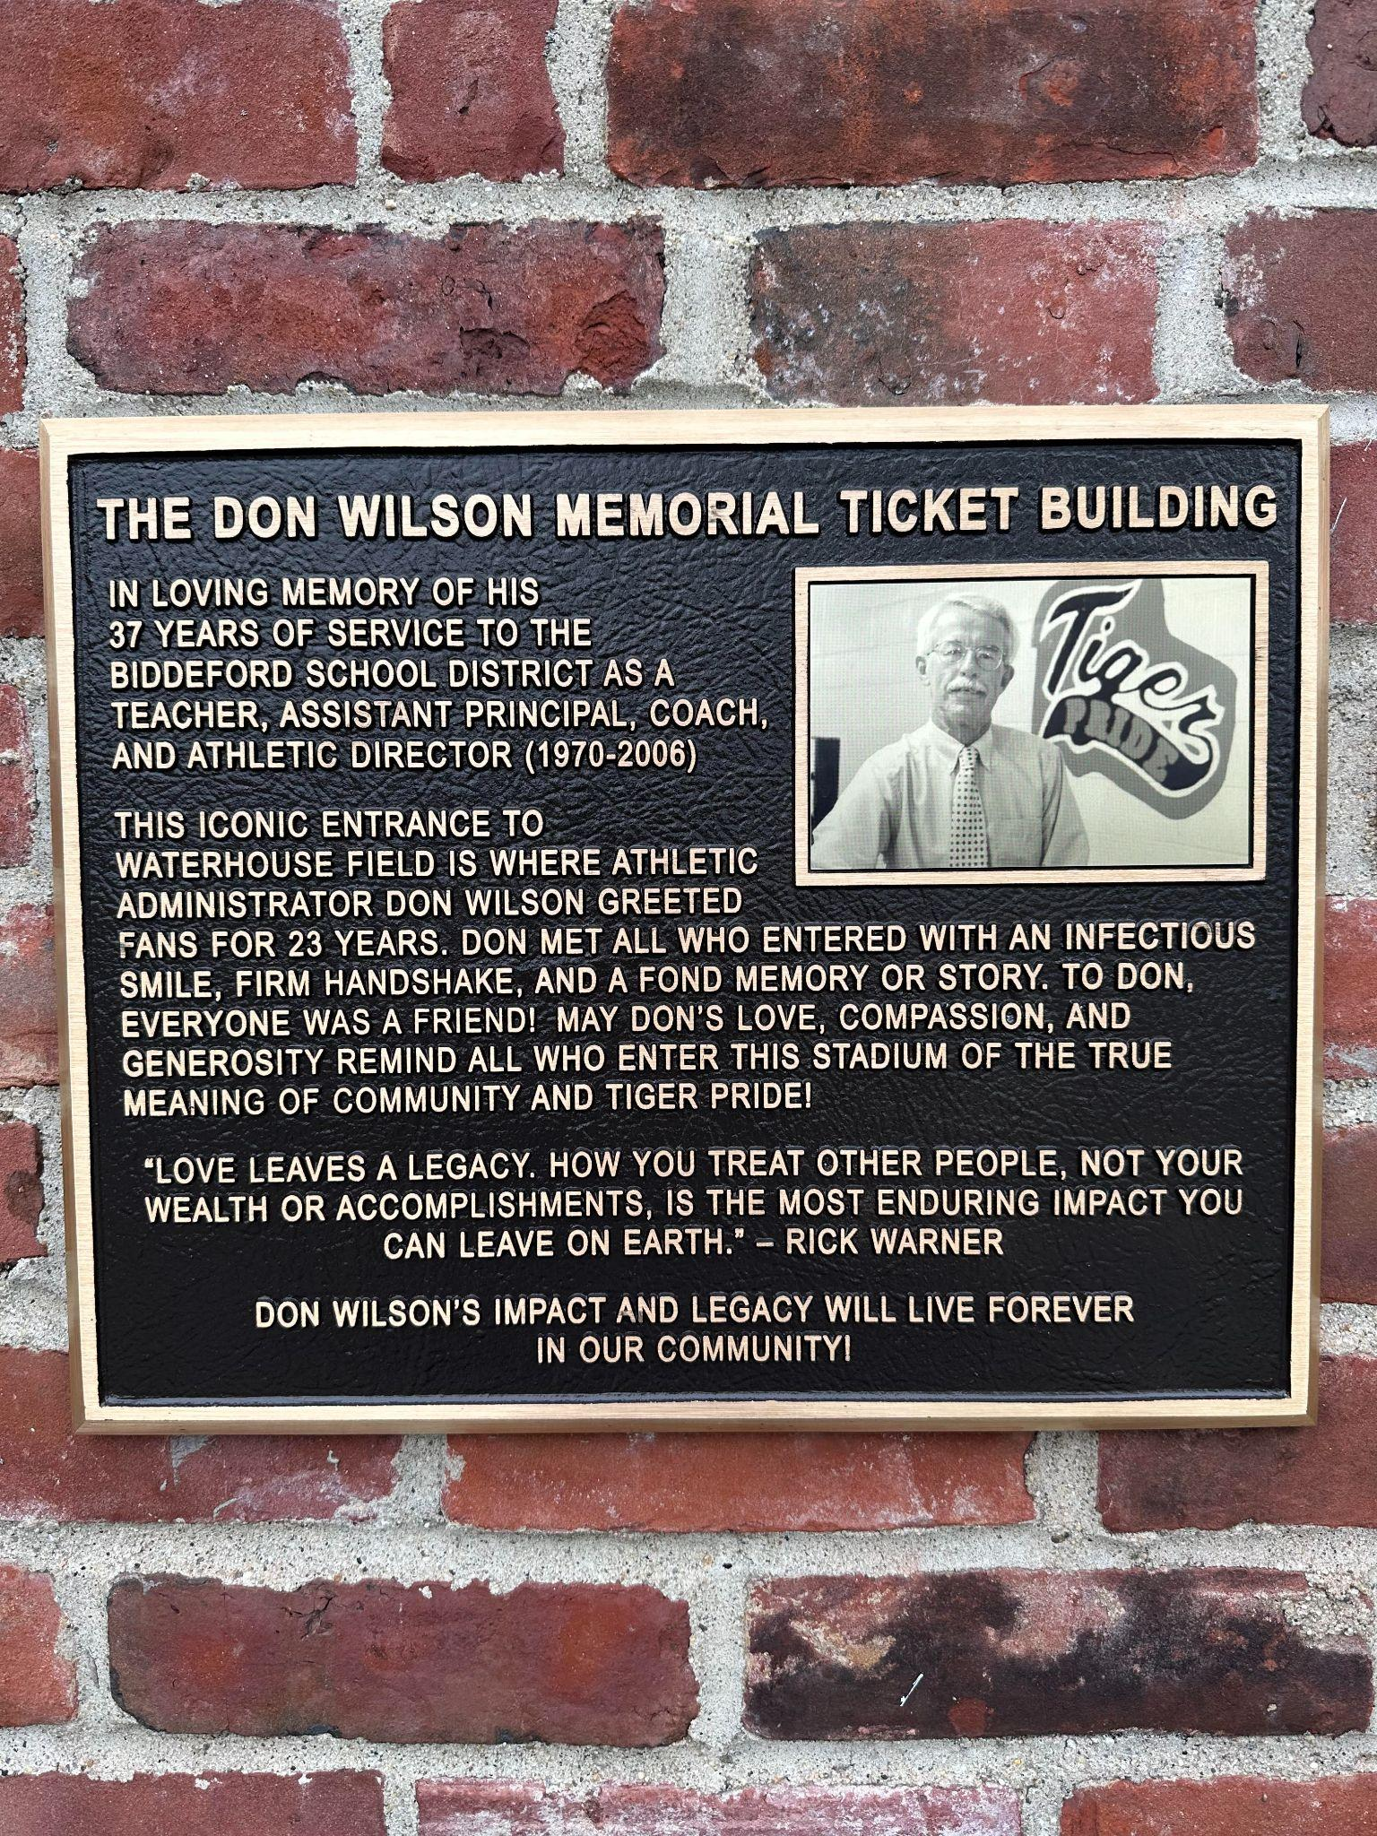
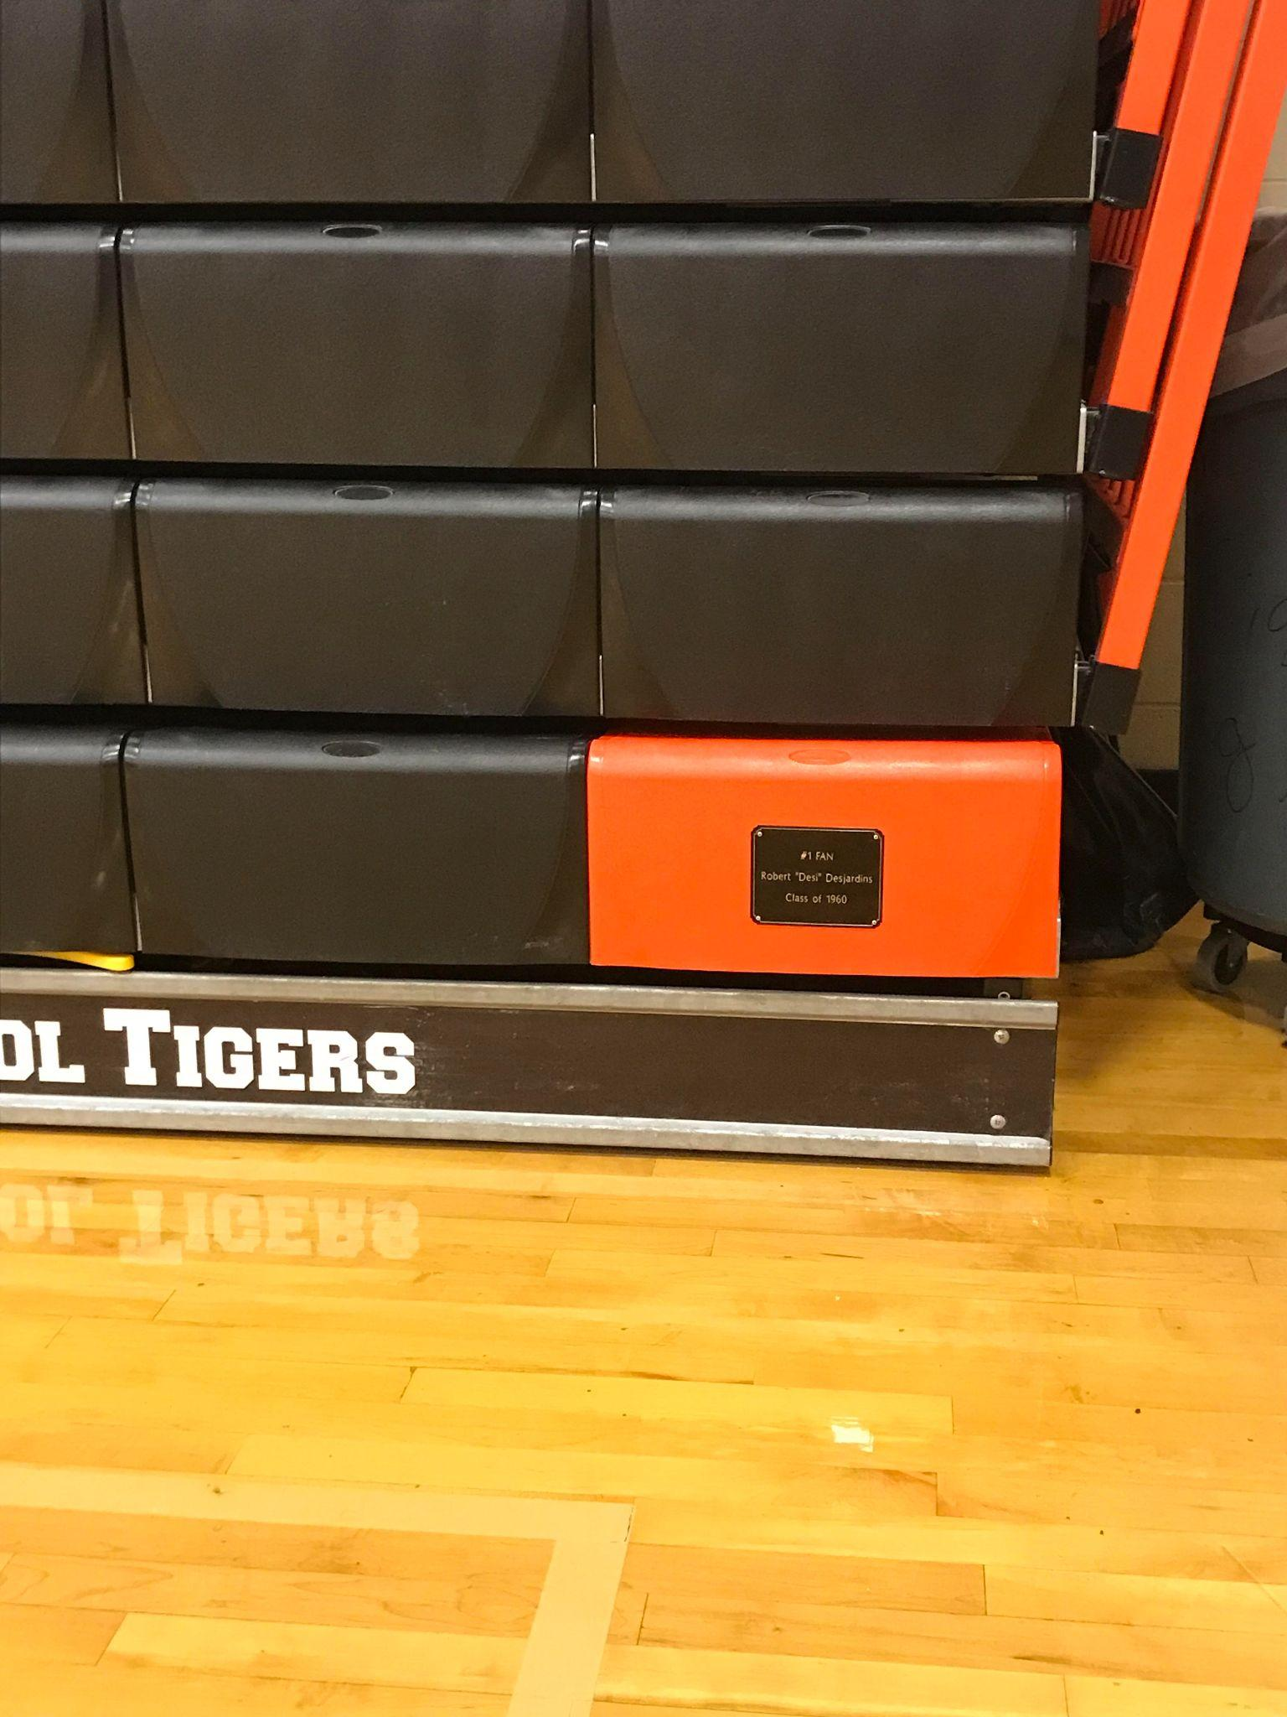
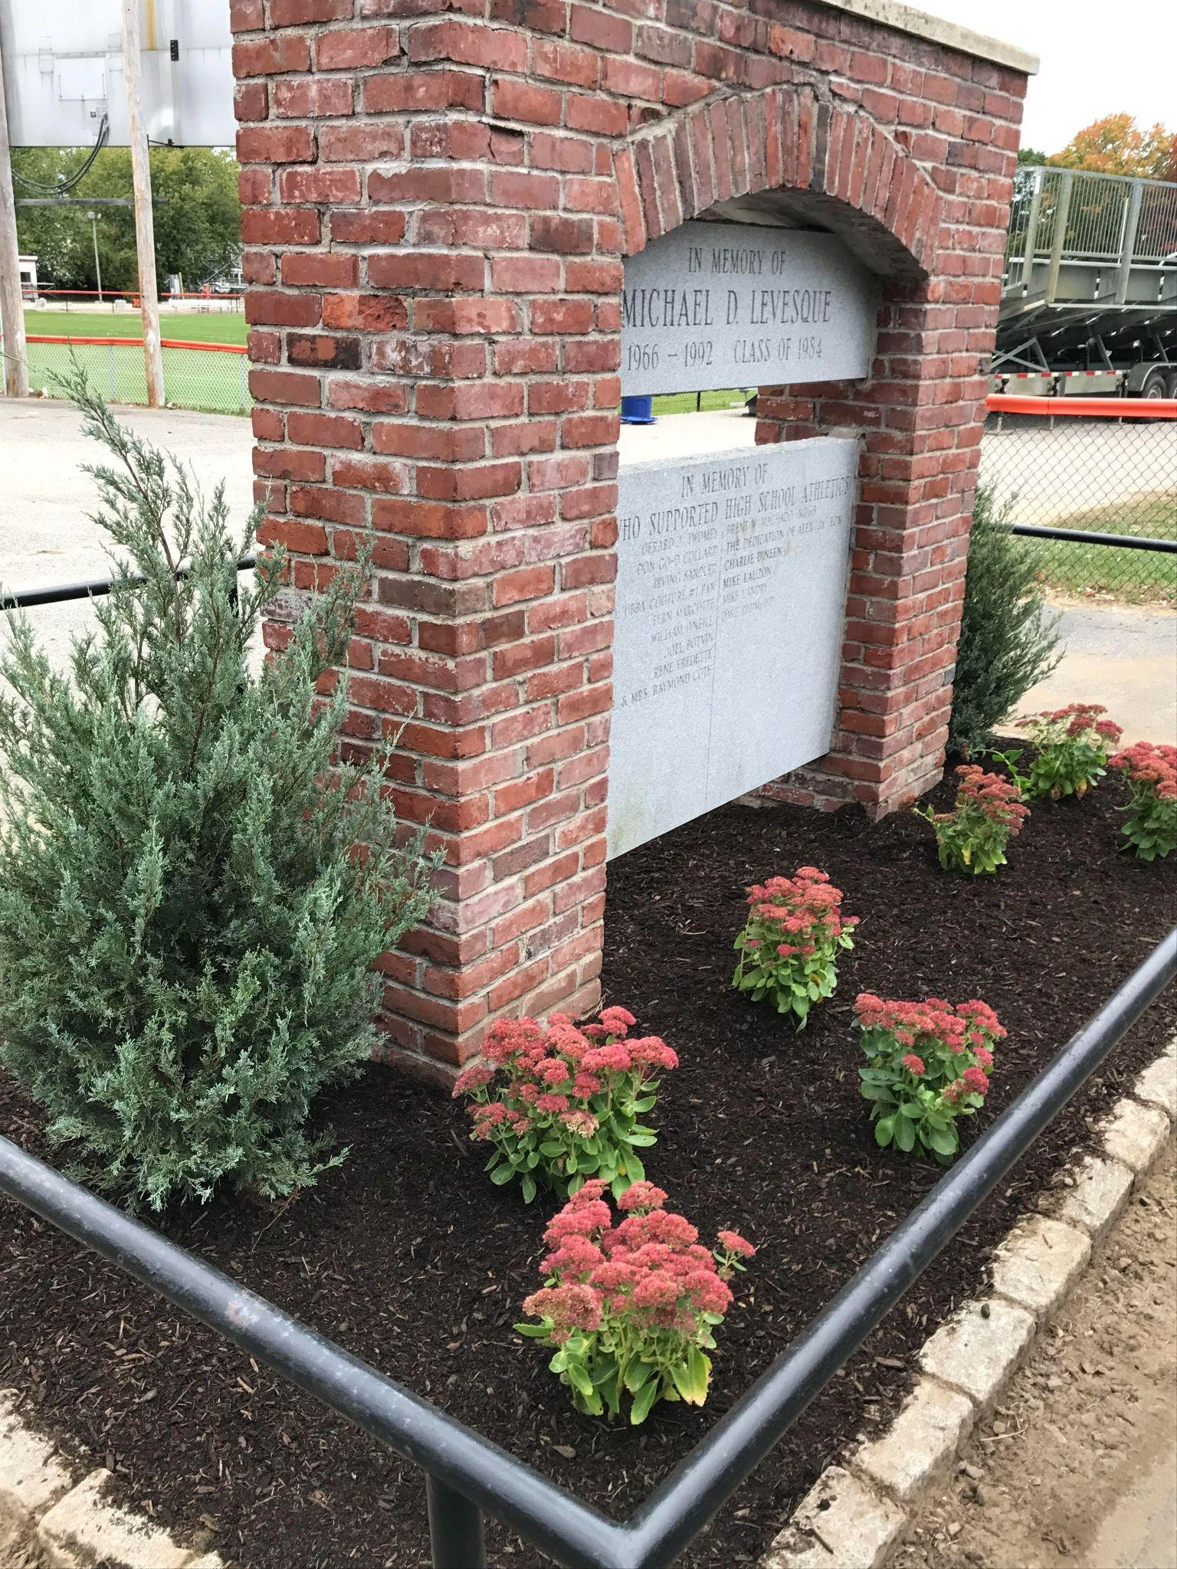
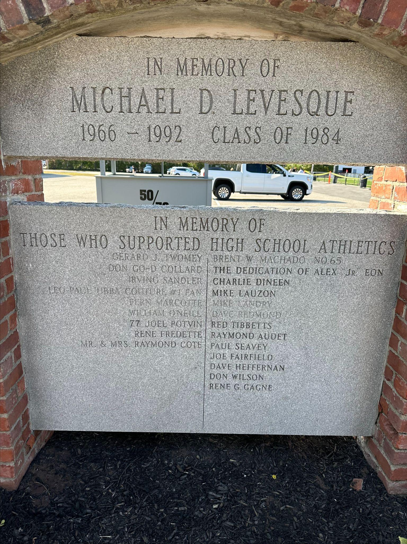
Community Engagement Examples
Tributes & Memorials
Don Wilson Memorial
Ticketbooth
#1 Fan
“Desi”
Mike Levesque Memorial ‘84
Memorialized
Notes:
Tributes to Community Members at games * Established Memorials for Community Members * Community Ceremonies
Athletics raising funds for causes * Raising money for Scholarships * Drives (food, coats, turkey, presents)
Athletes participating in Community Events

Slide 14
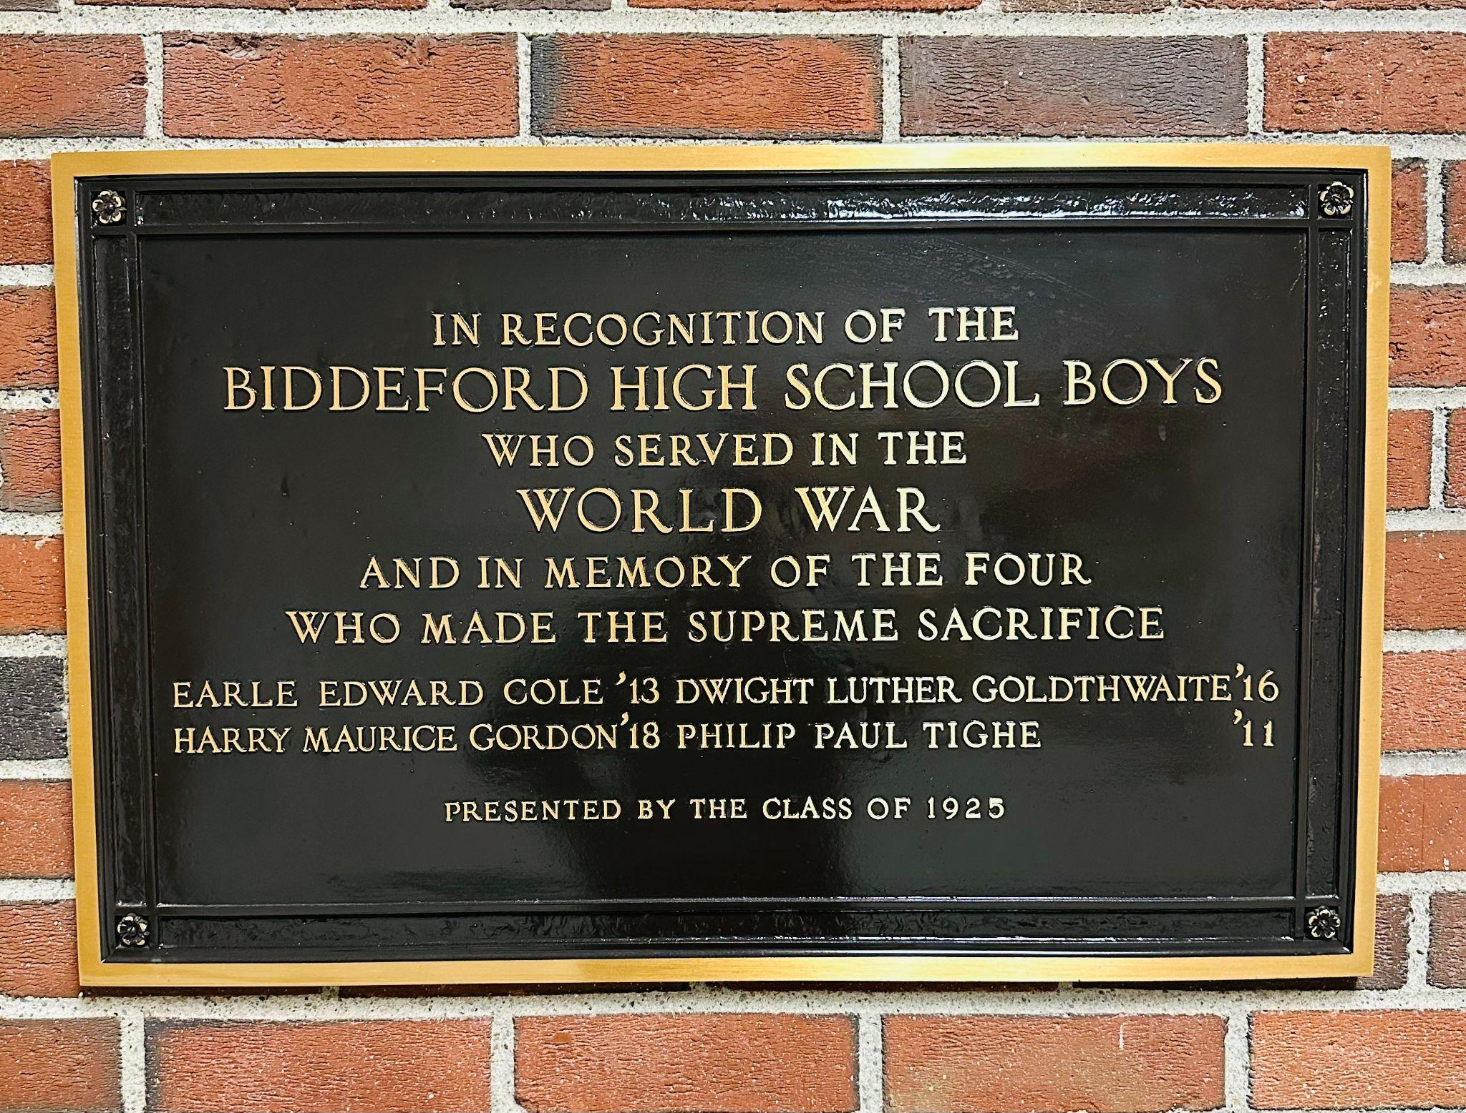
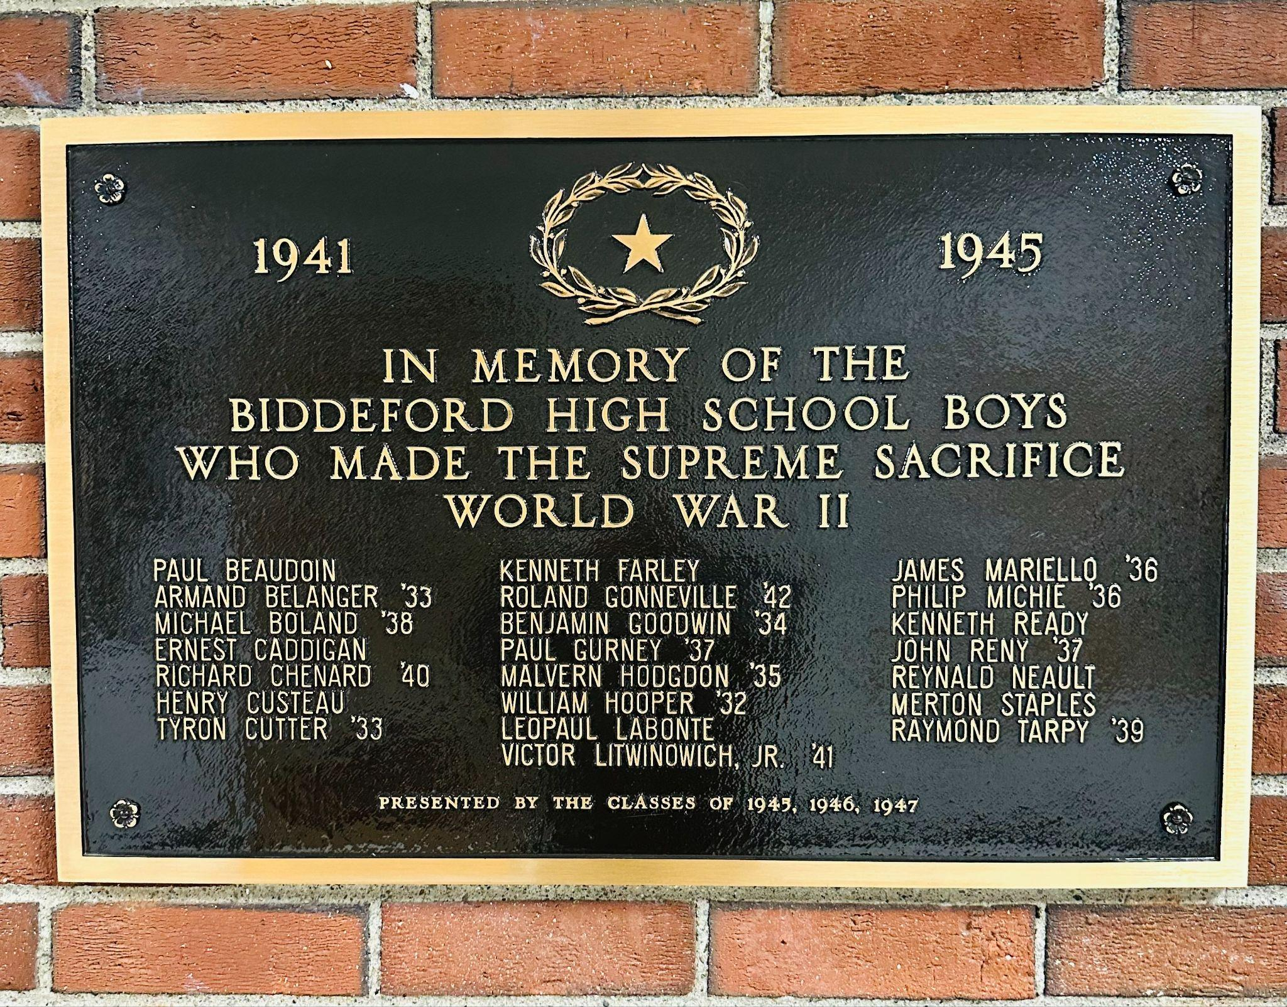
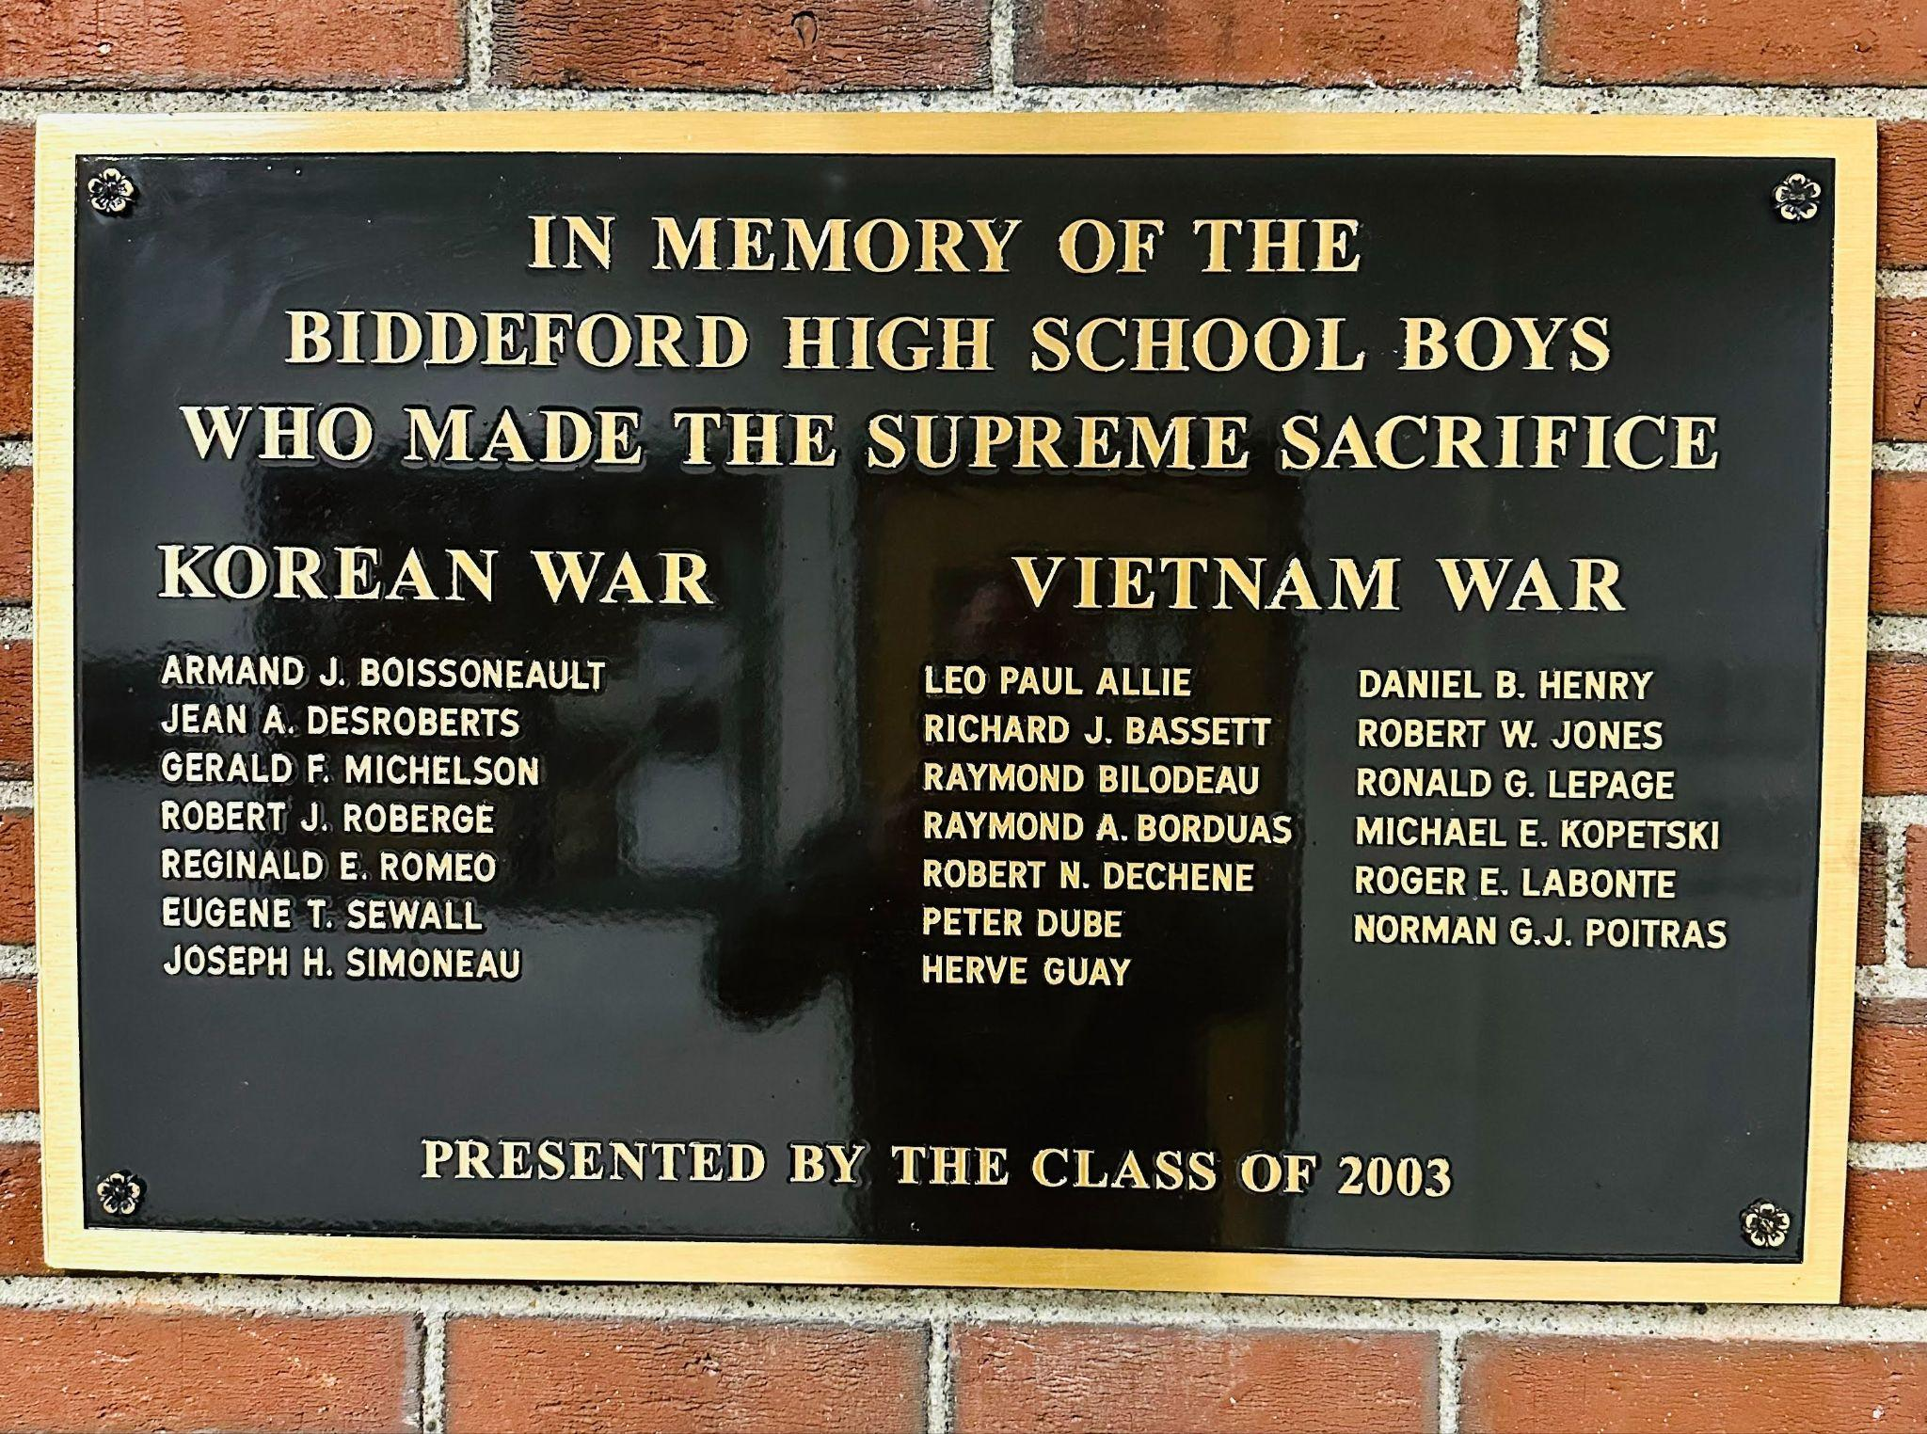
Community Engagement Examples
Tributes & Memorials
Biddeford High School
Veterans Memorial
Notes:
Tributes to Community Members at games * Established Memorials for Community Members * Community Ceremonies
Athletics raising funds for causes * Raising money for Scholarships * Drives (food, coats, turkey, presents)
Athletes participating in Community Events

Slide 15
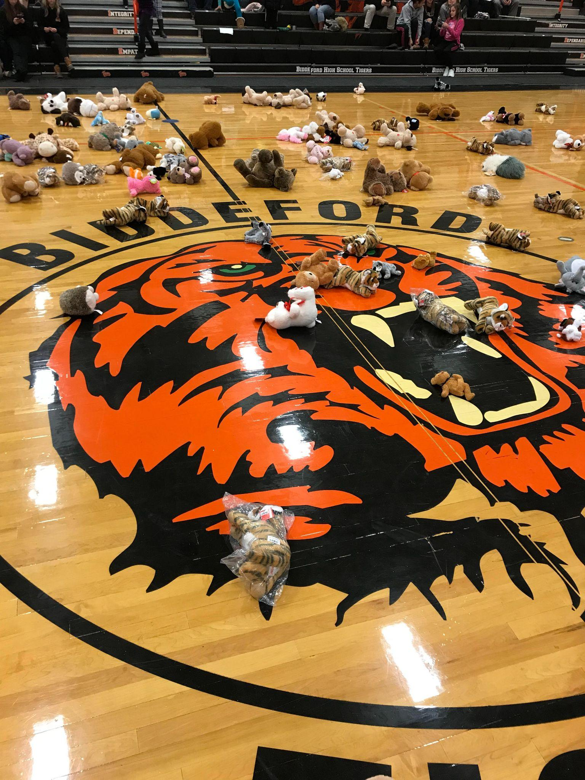
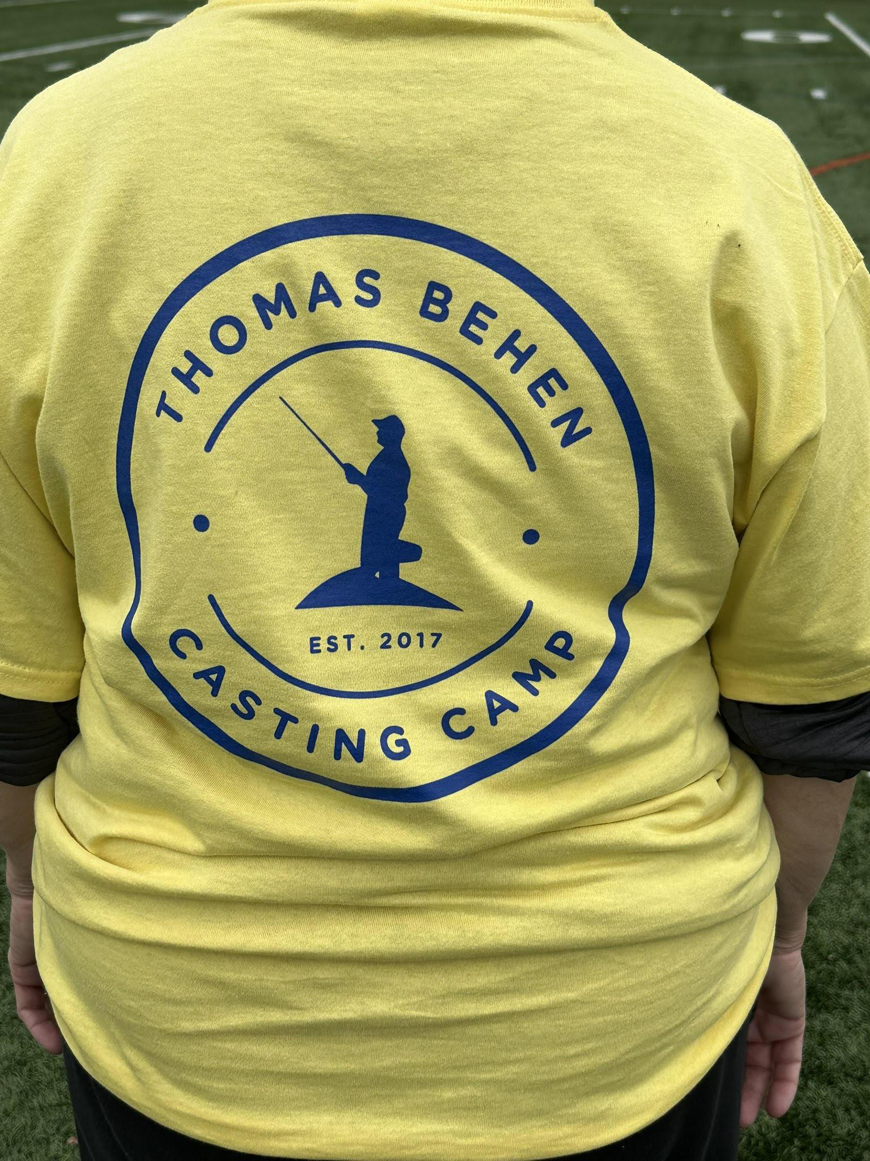
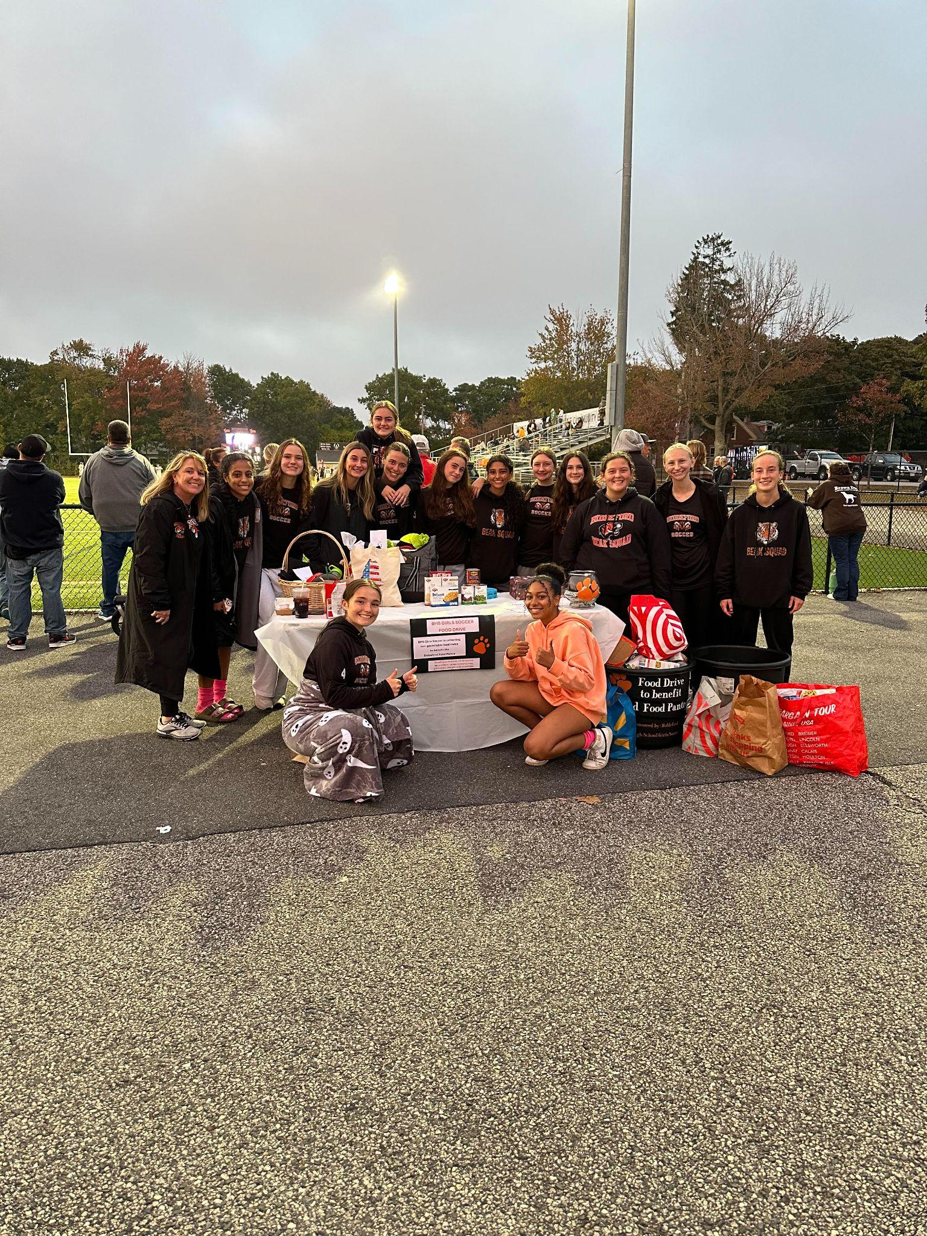
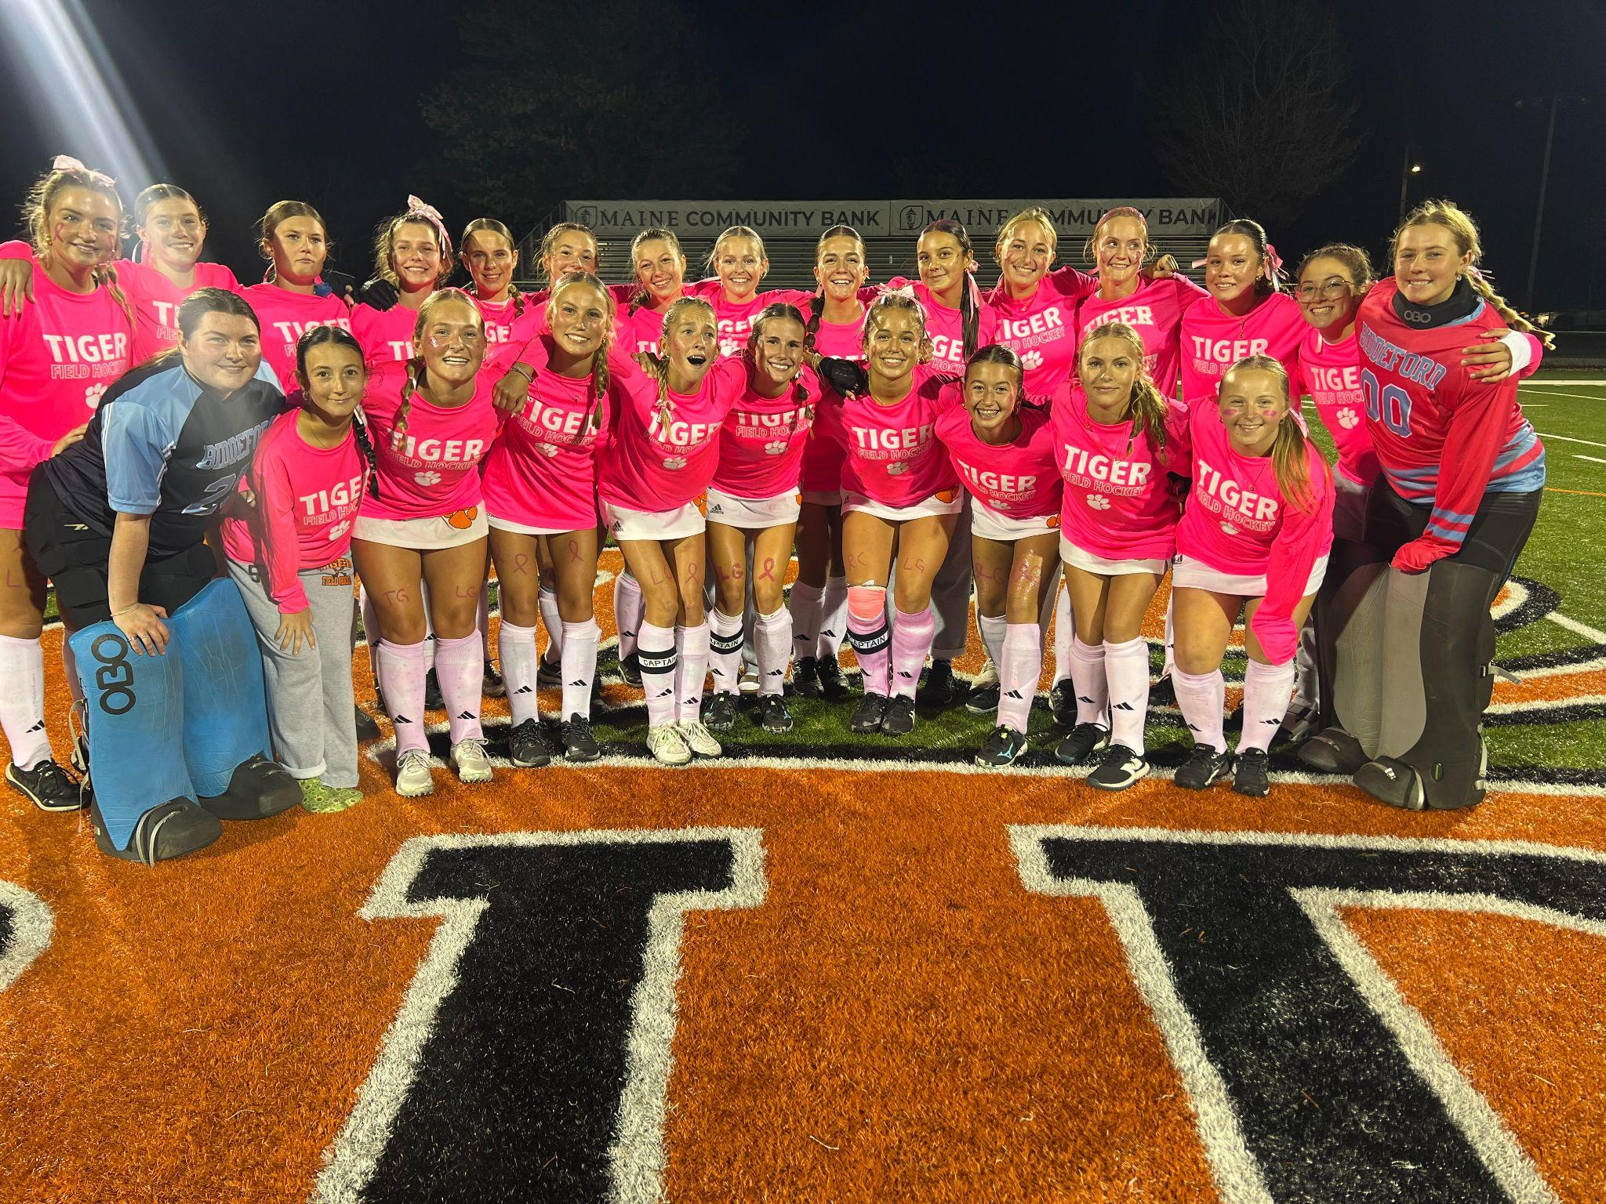
Community Engagement Examples
Scholarship, Drives, Causes
)
Stick it to Cancer
American Cancer Society
Teddy Bear Toss
Thomas Behen Scholarship Fund
Food Drive
Biddeford Food Pantry

Slide 16
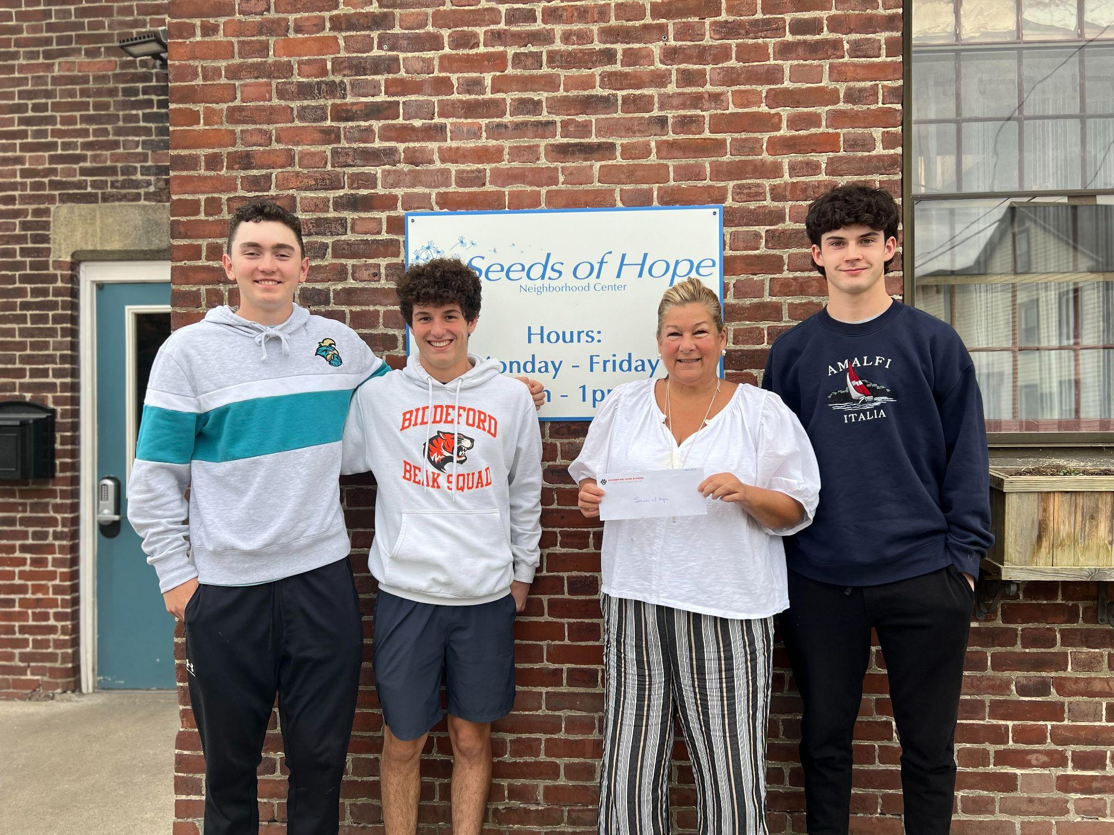
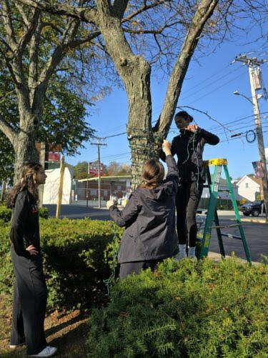
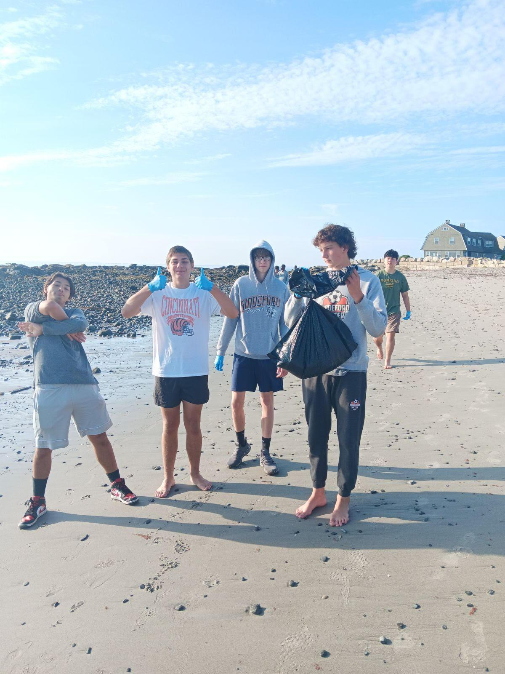
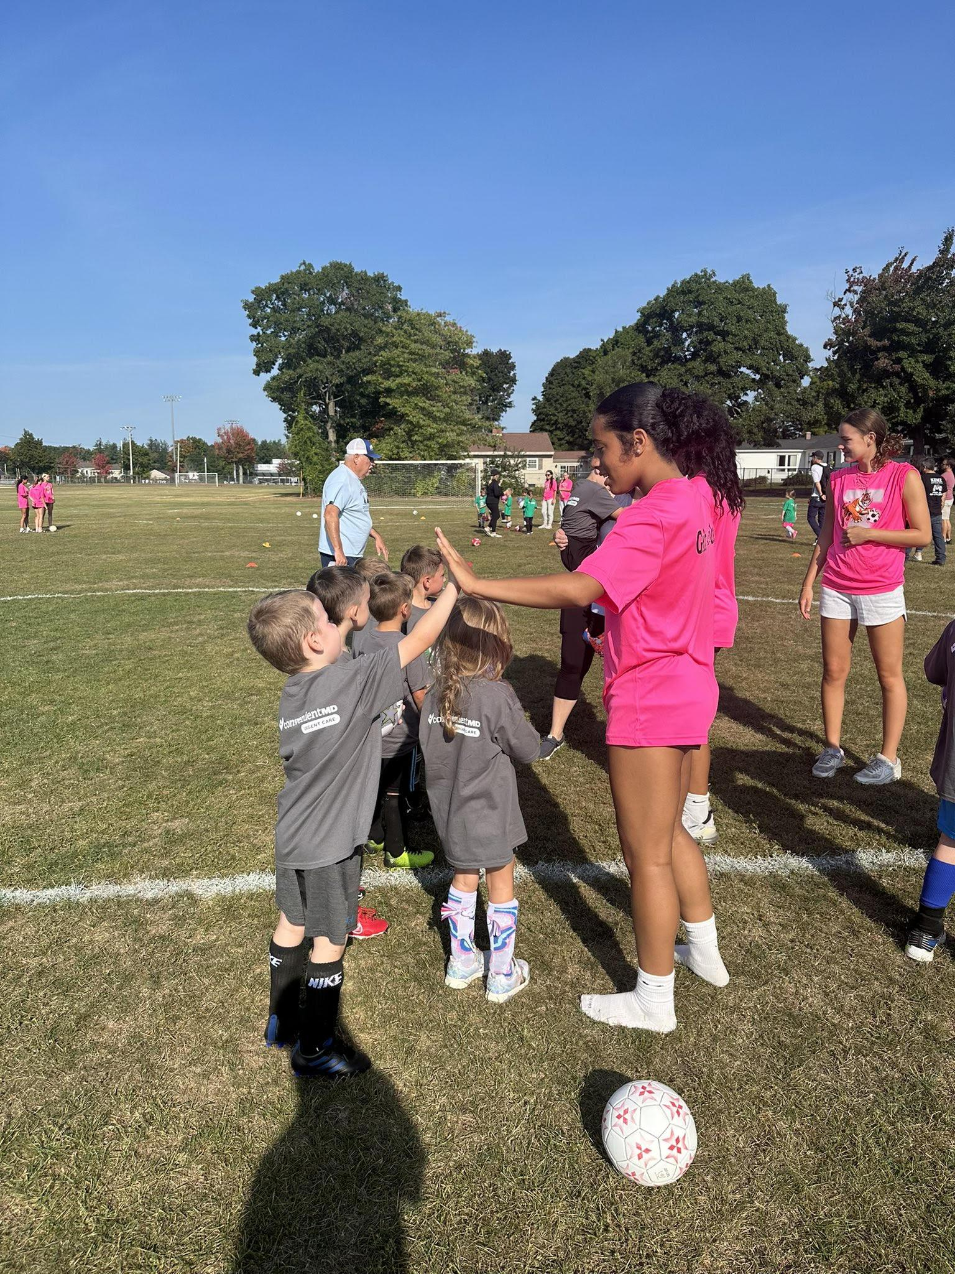
Community Engagement Examples
Outreach Efforts (Local Organizations, Non Profits)
Thomas Behen Scholarship Fund
Seeds of Hope
Heart of Biddeford
Holiday Lights
Beach Cleanup
Parks & Recreation
Kinder Soccer

Slide 17
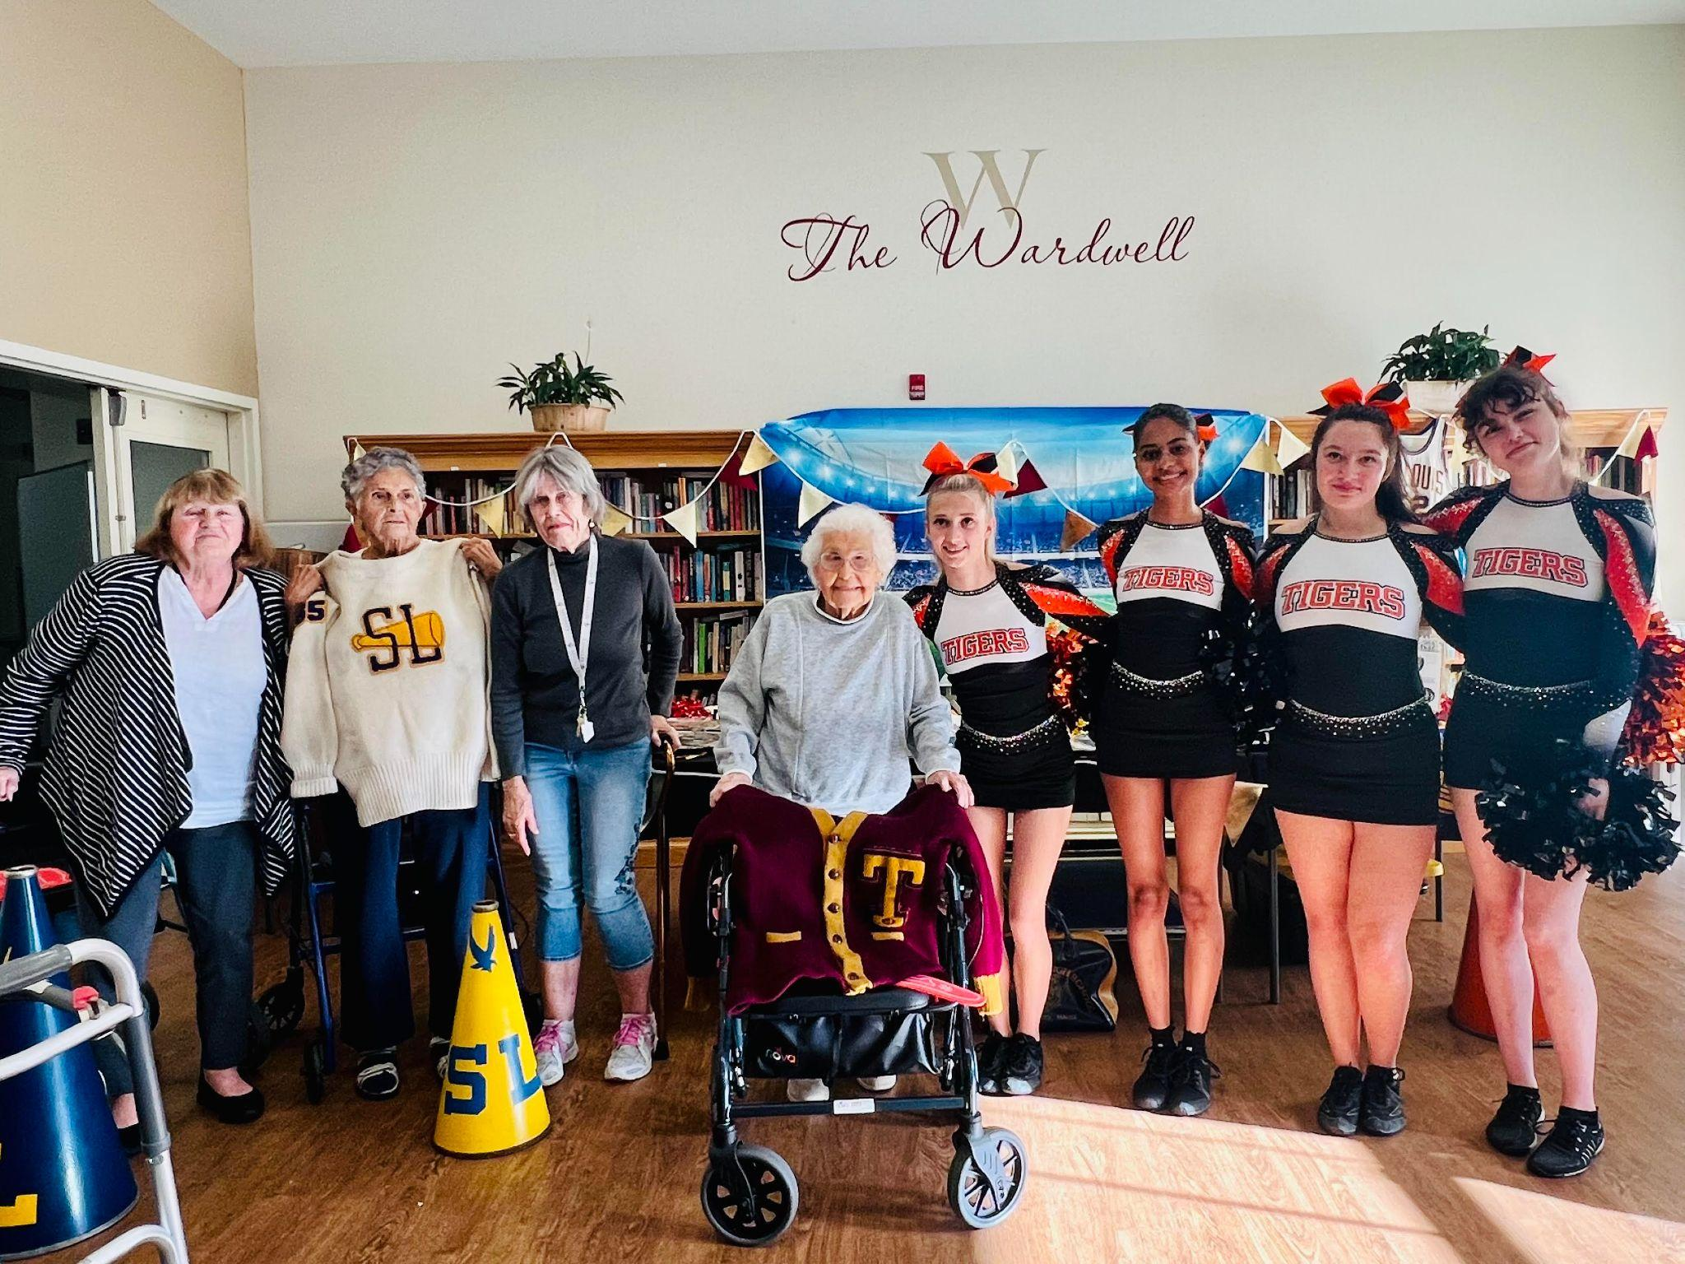
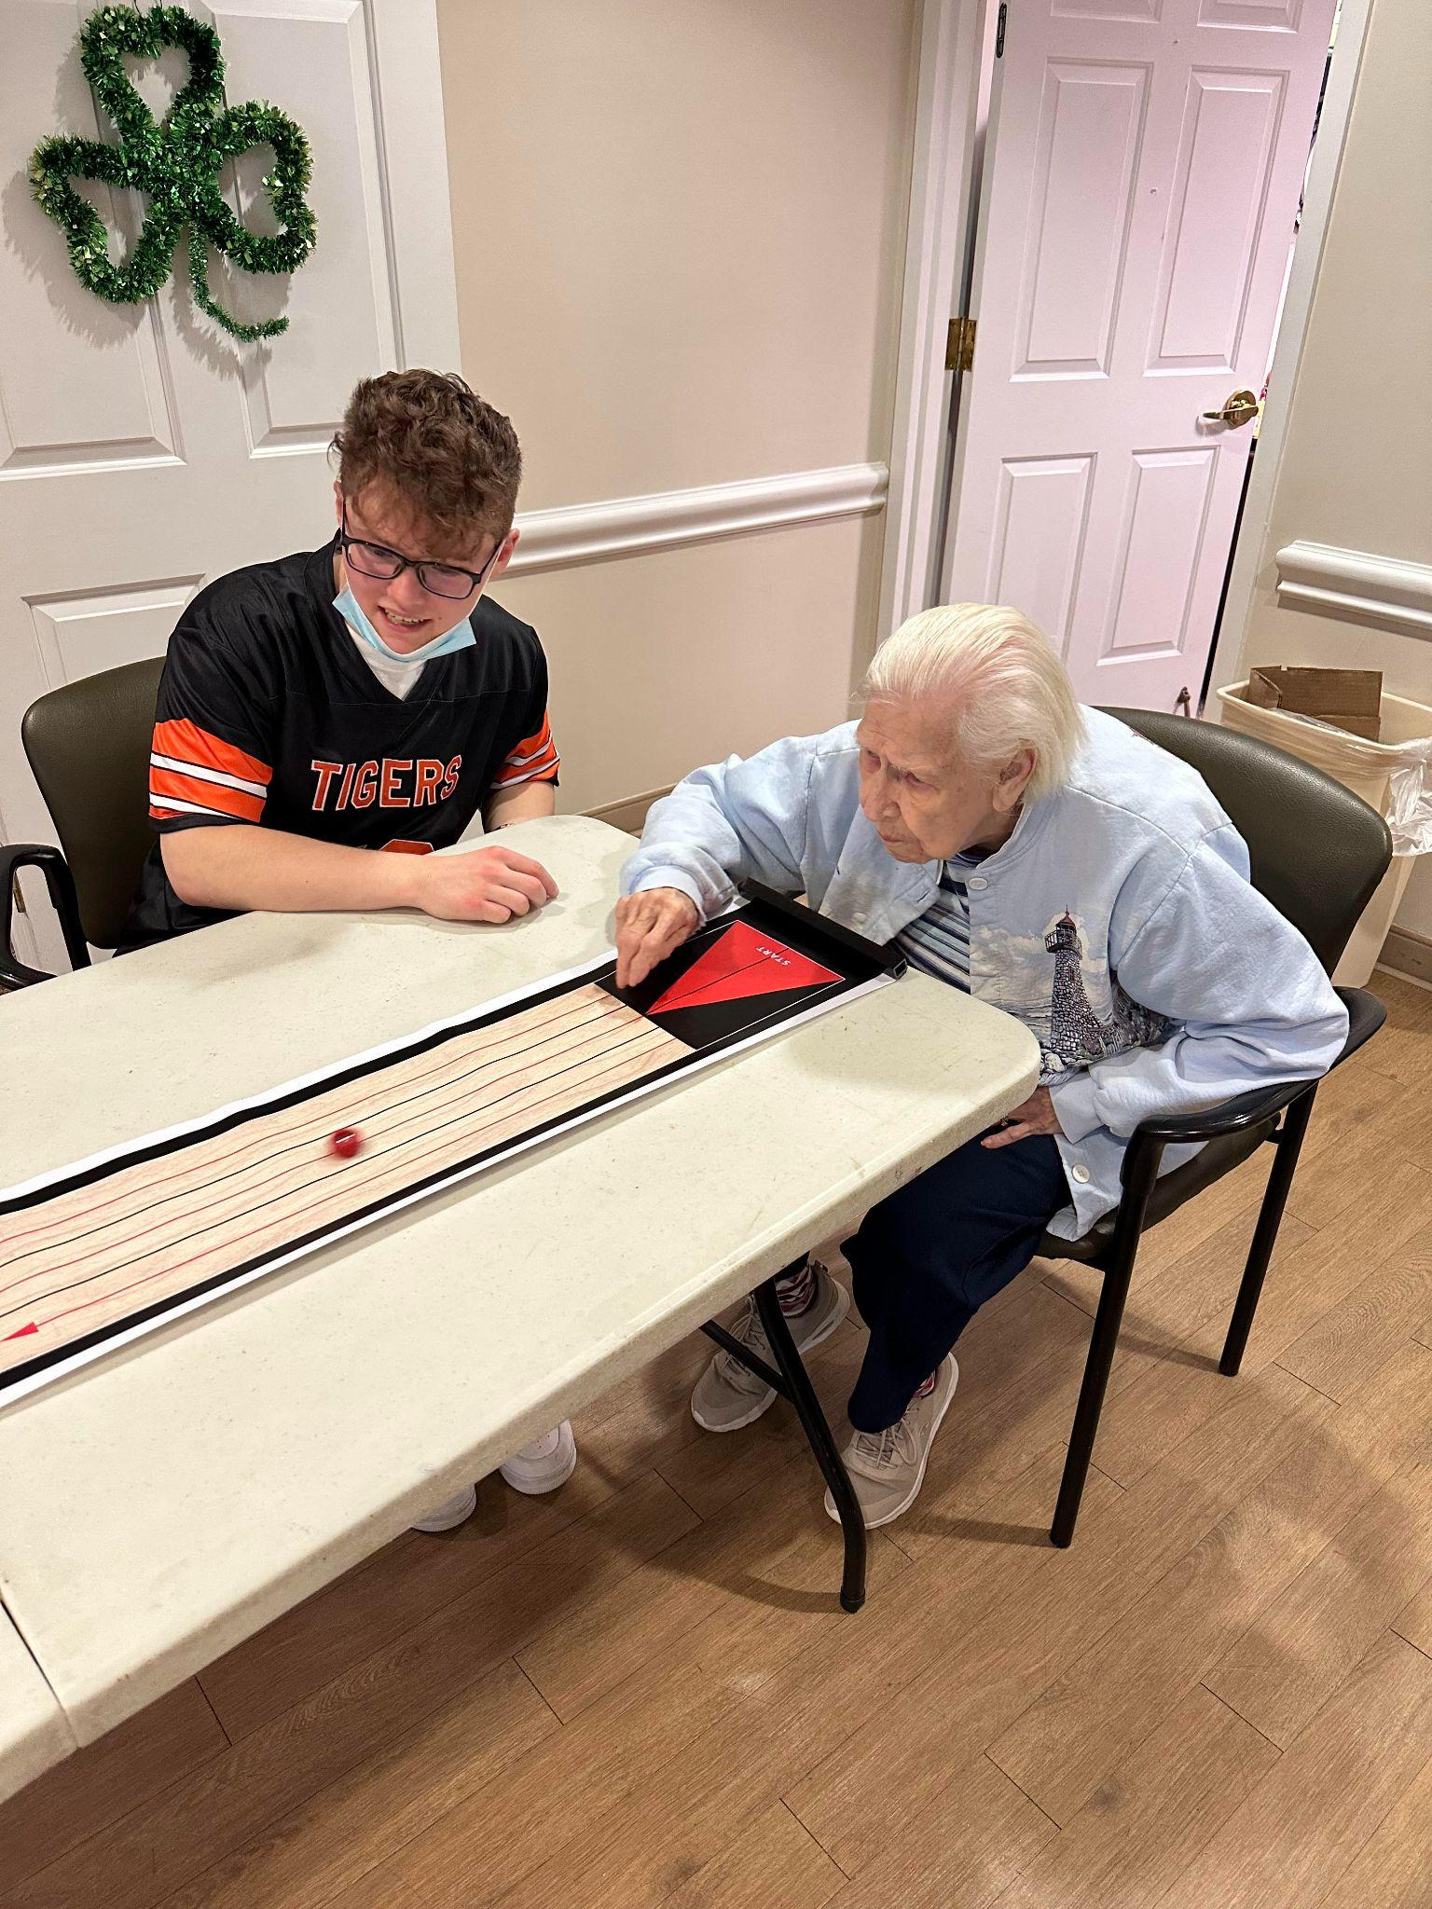
Community Engagement Examples
Community Event Participation (Parades, Festivals, Events)
La Kermesse Parade
Biddeford Winterfest
Biddeford River Jam
5K Road Races
National Assisted Living Week

Slide 18
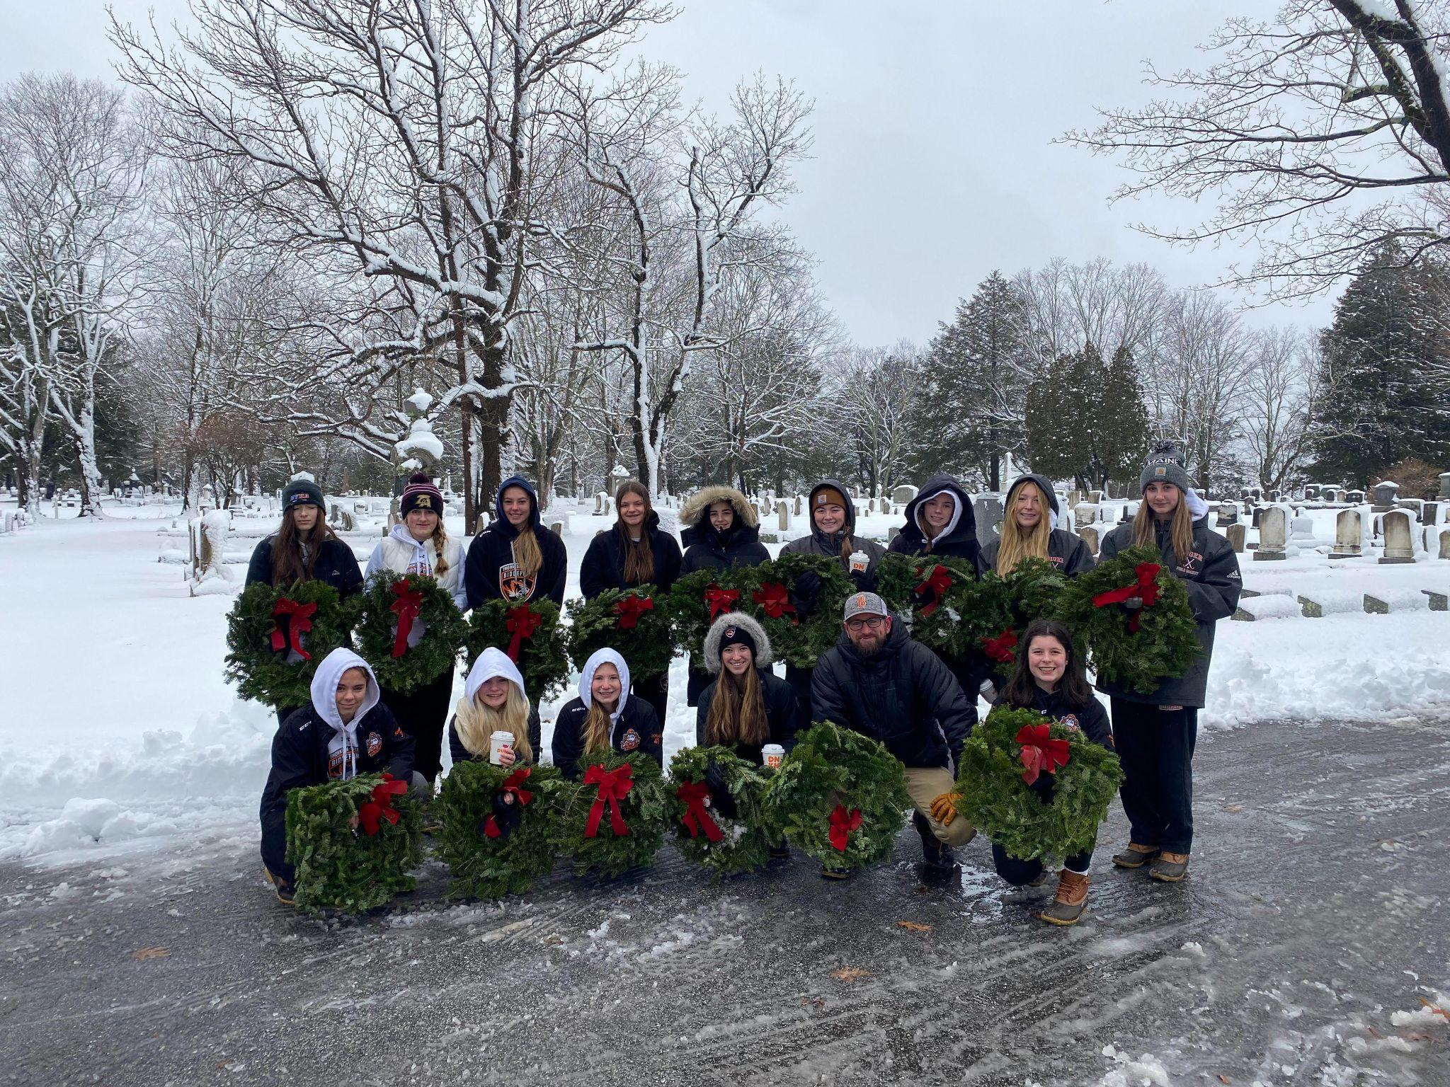
Community Engagement Examples
Community Service Initiatives
Perhaps one of the most common forms of community engagement.
Some schools require community service.
Common Local Opportunities…
City Department
Parks & Recreation
Local Youth Organizations (win-win)
Local Organizations
Wreaths Across America

Slide 19
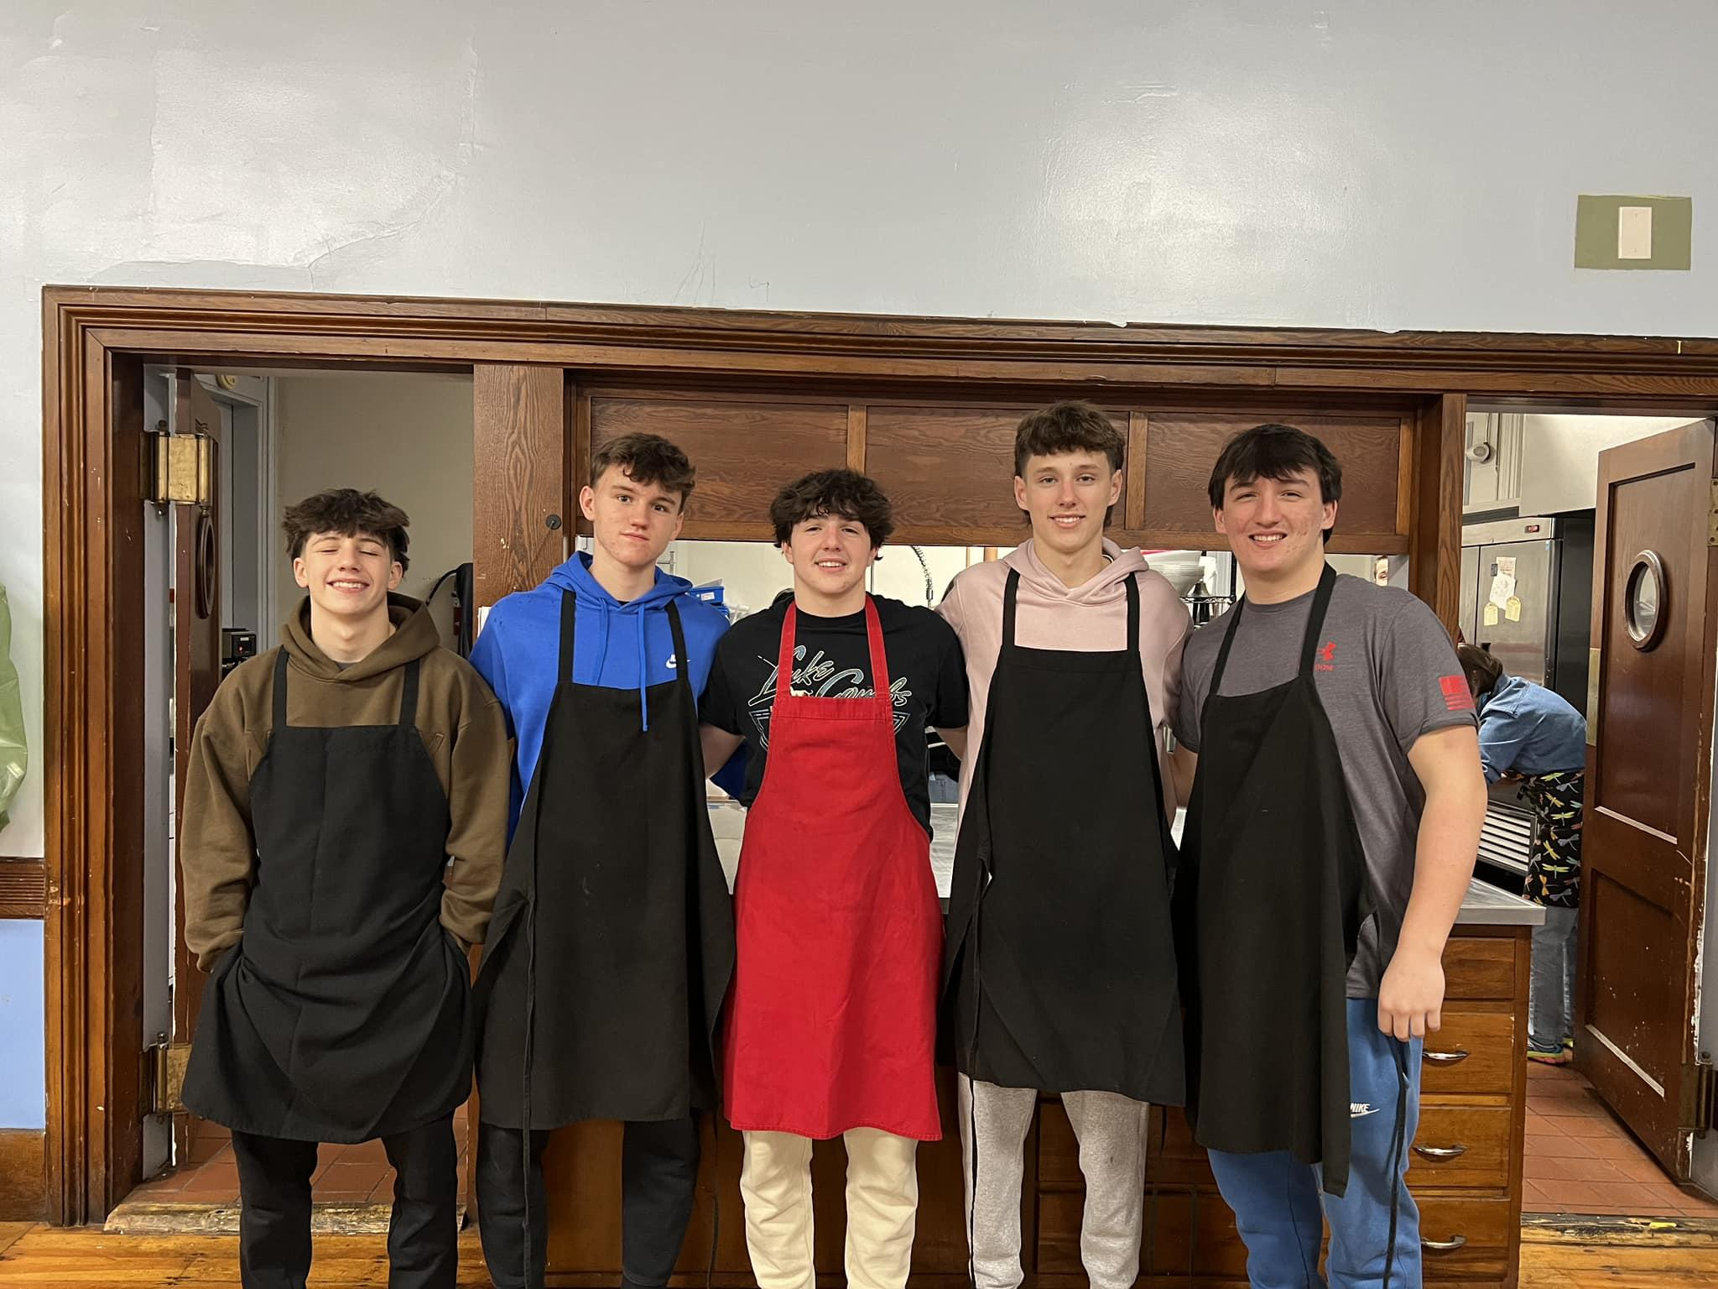
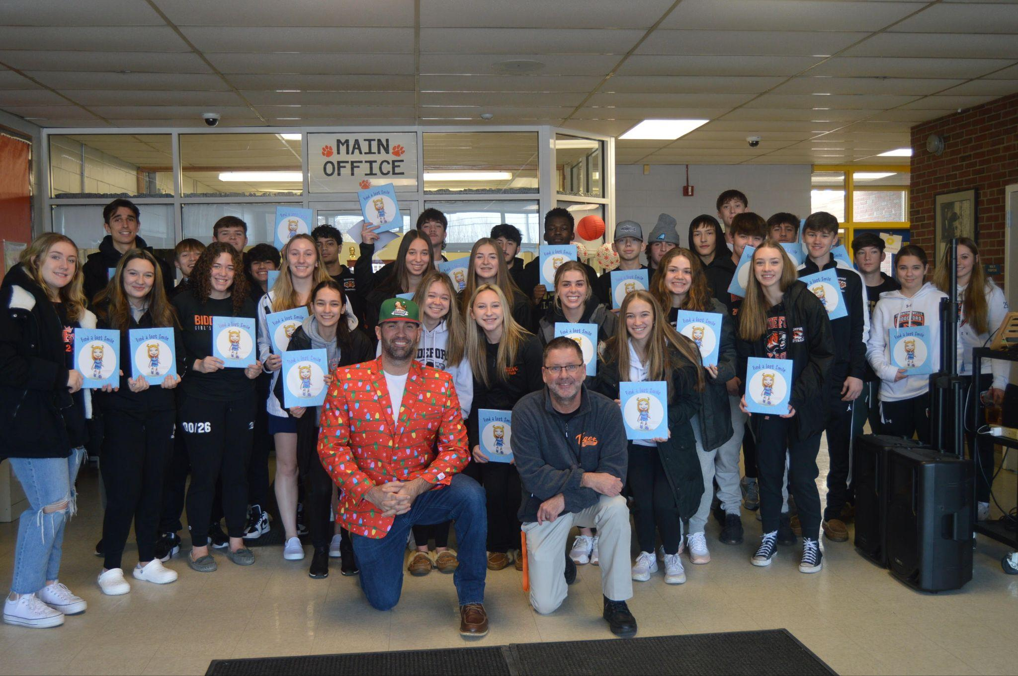
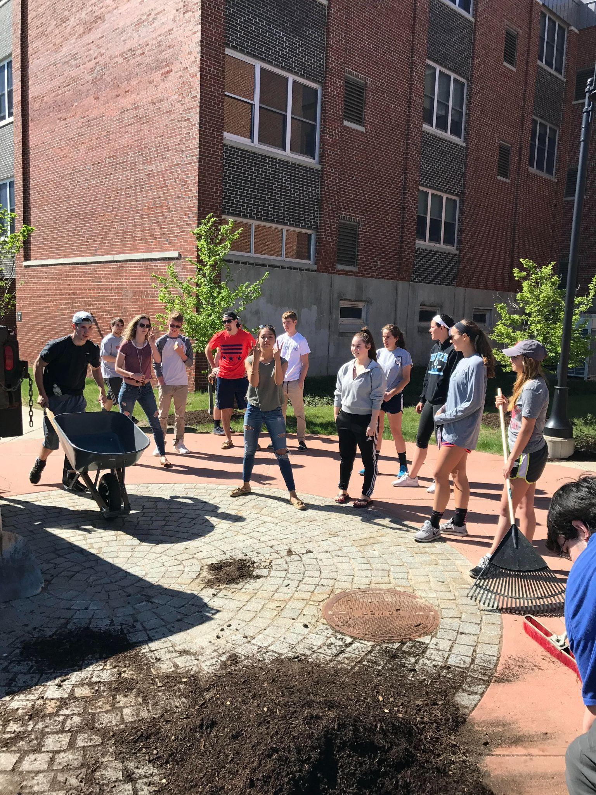
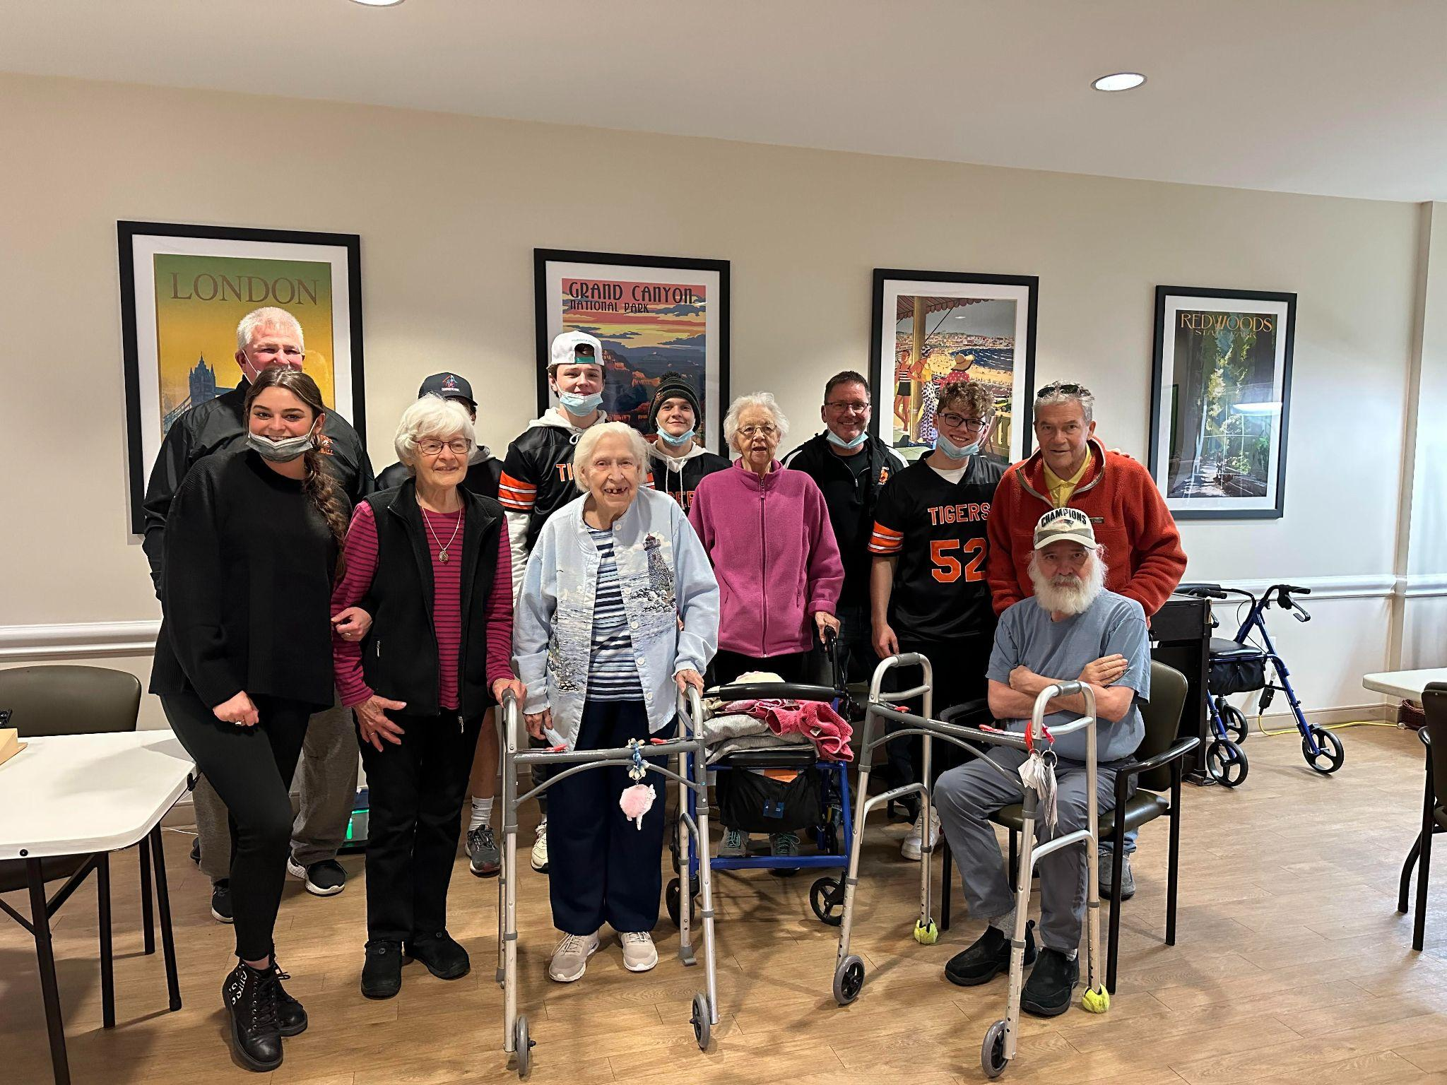
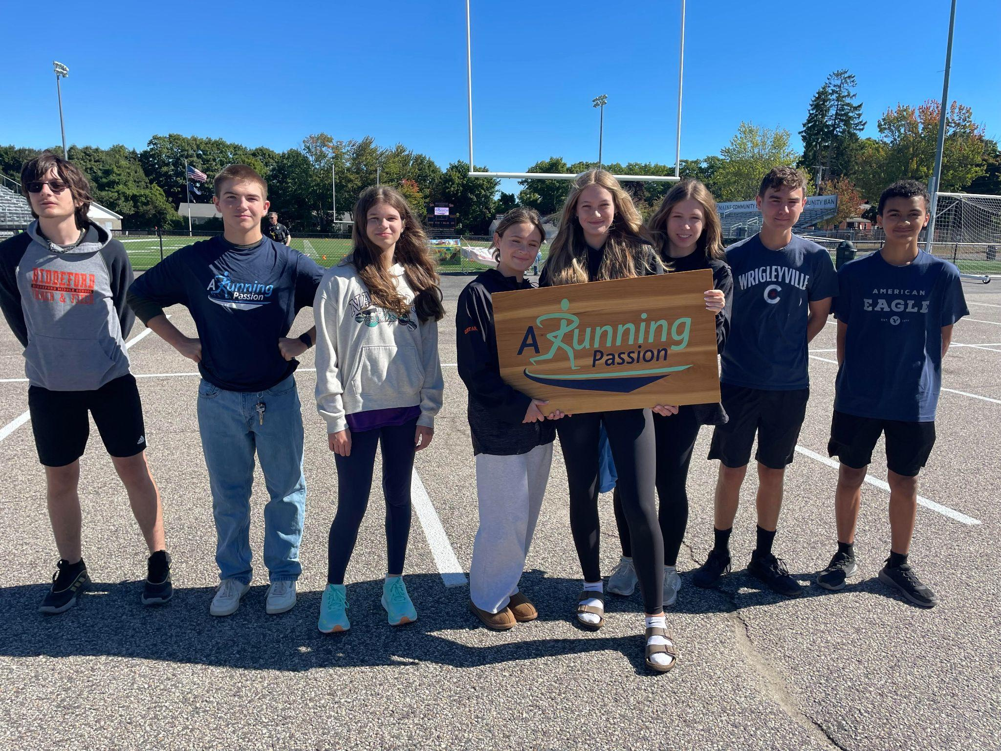
Community Engagement Examples
Community Service Initiatives
Basketball - Soup Kitchen
JFK Book Giveaway
Graduation Cleanup
Football - Assisted Living
CC -Running Passion

Slide 20
Community Engagement
Promotion & Recognition Initiatives
Social Media Promotion.
Newsletters / Press Releases / Publications.
Awards Ceremonies.
Character Award (PRIDE)
Joe Fairfield - Volunteer Award
Hall of Honor / Hall of Fame Ceremony

Slide 21
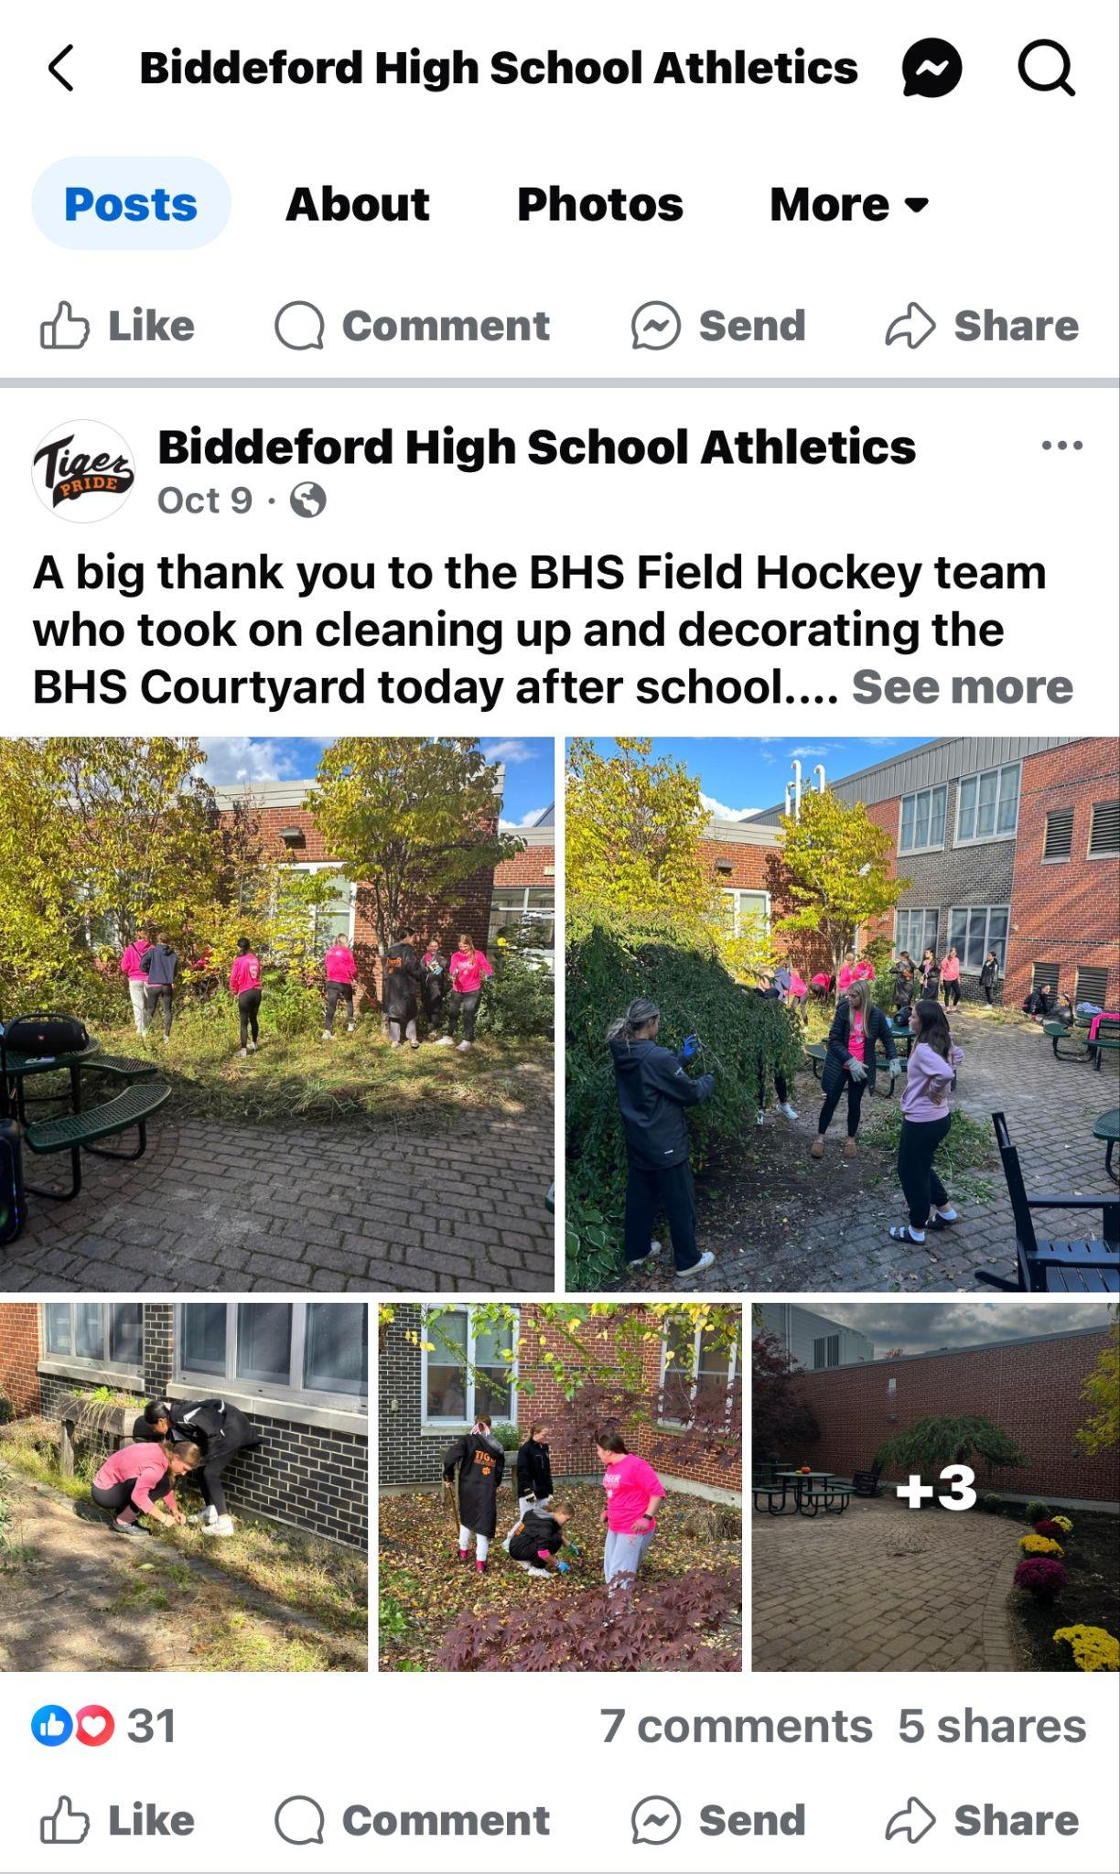
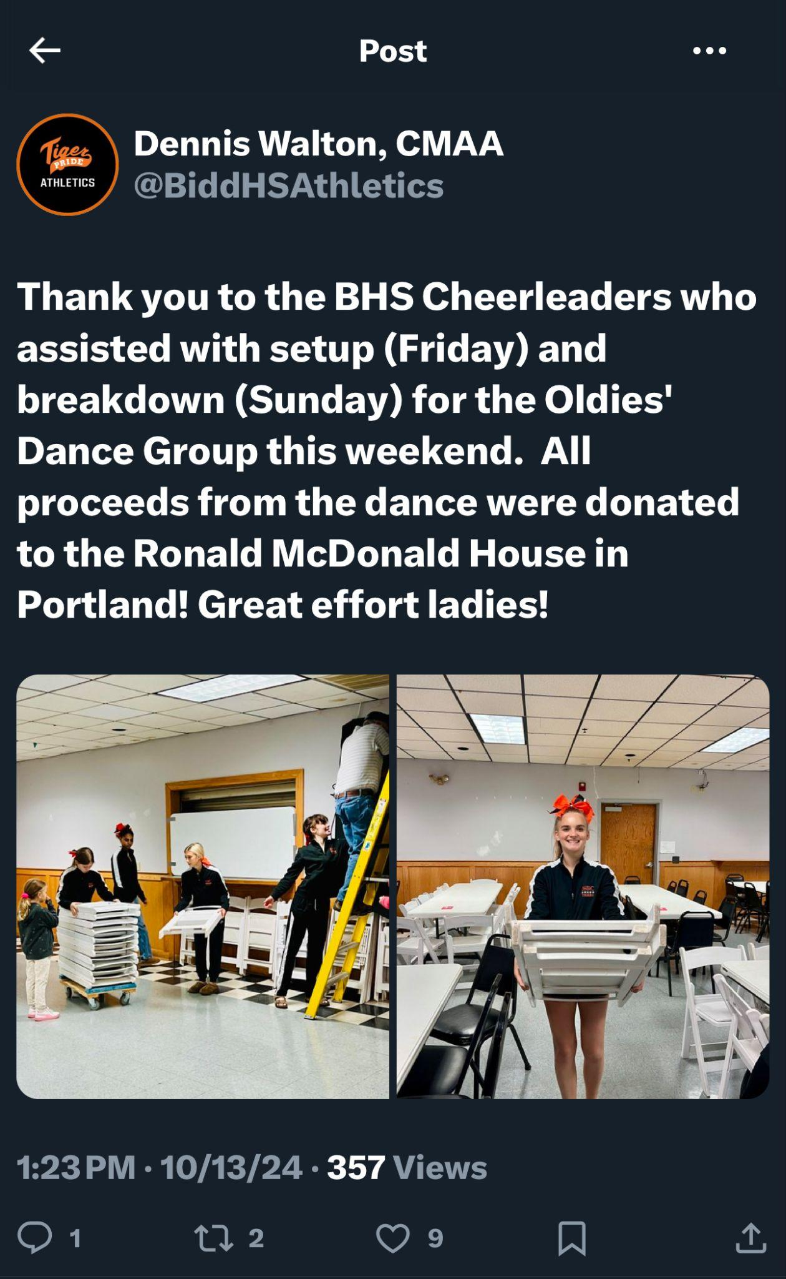
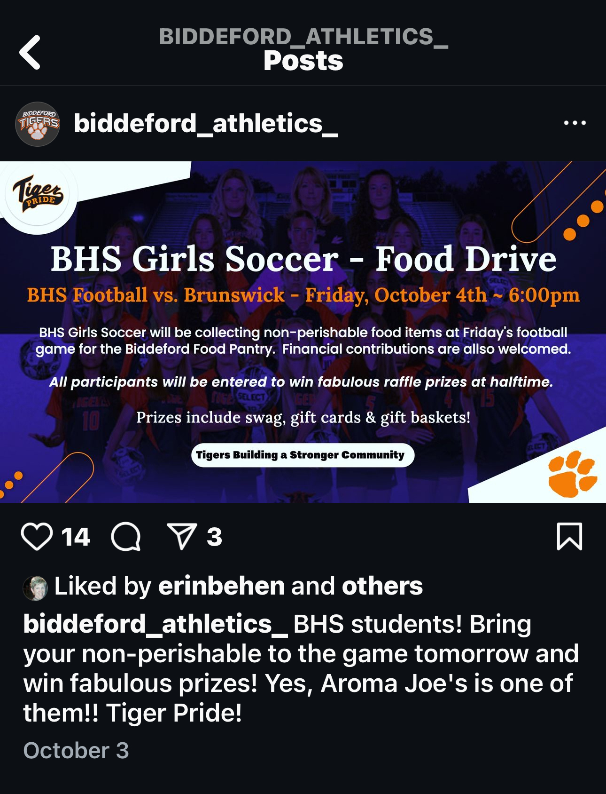
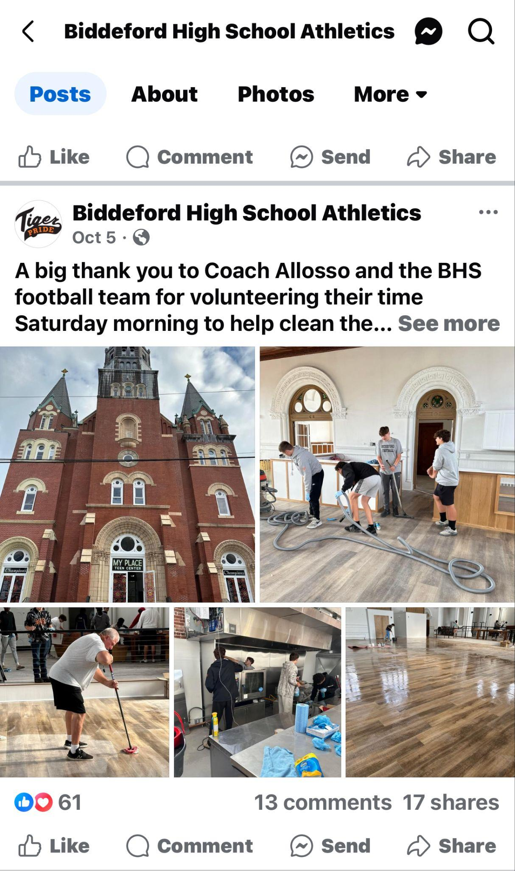
Community Engagement
Social Media Promotion
Facebook
Courtyard
Instagram
Food Drive
Oldies Dance Group
Facebook - Teen Center

Slide 22
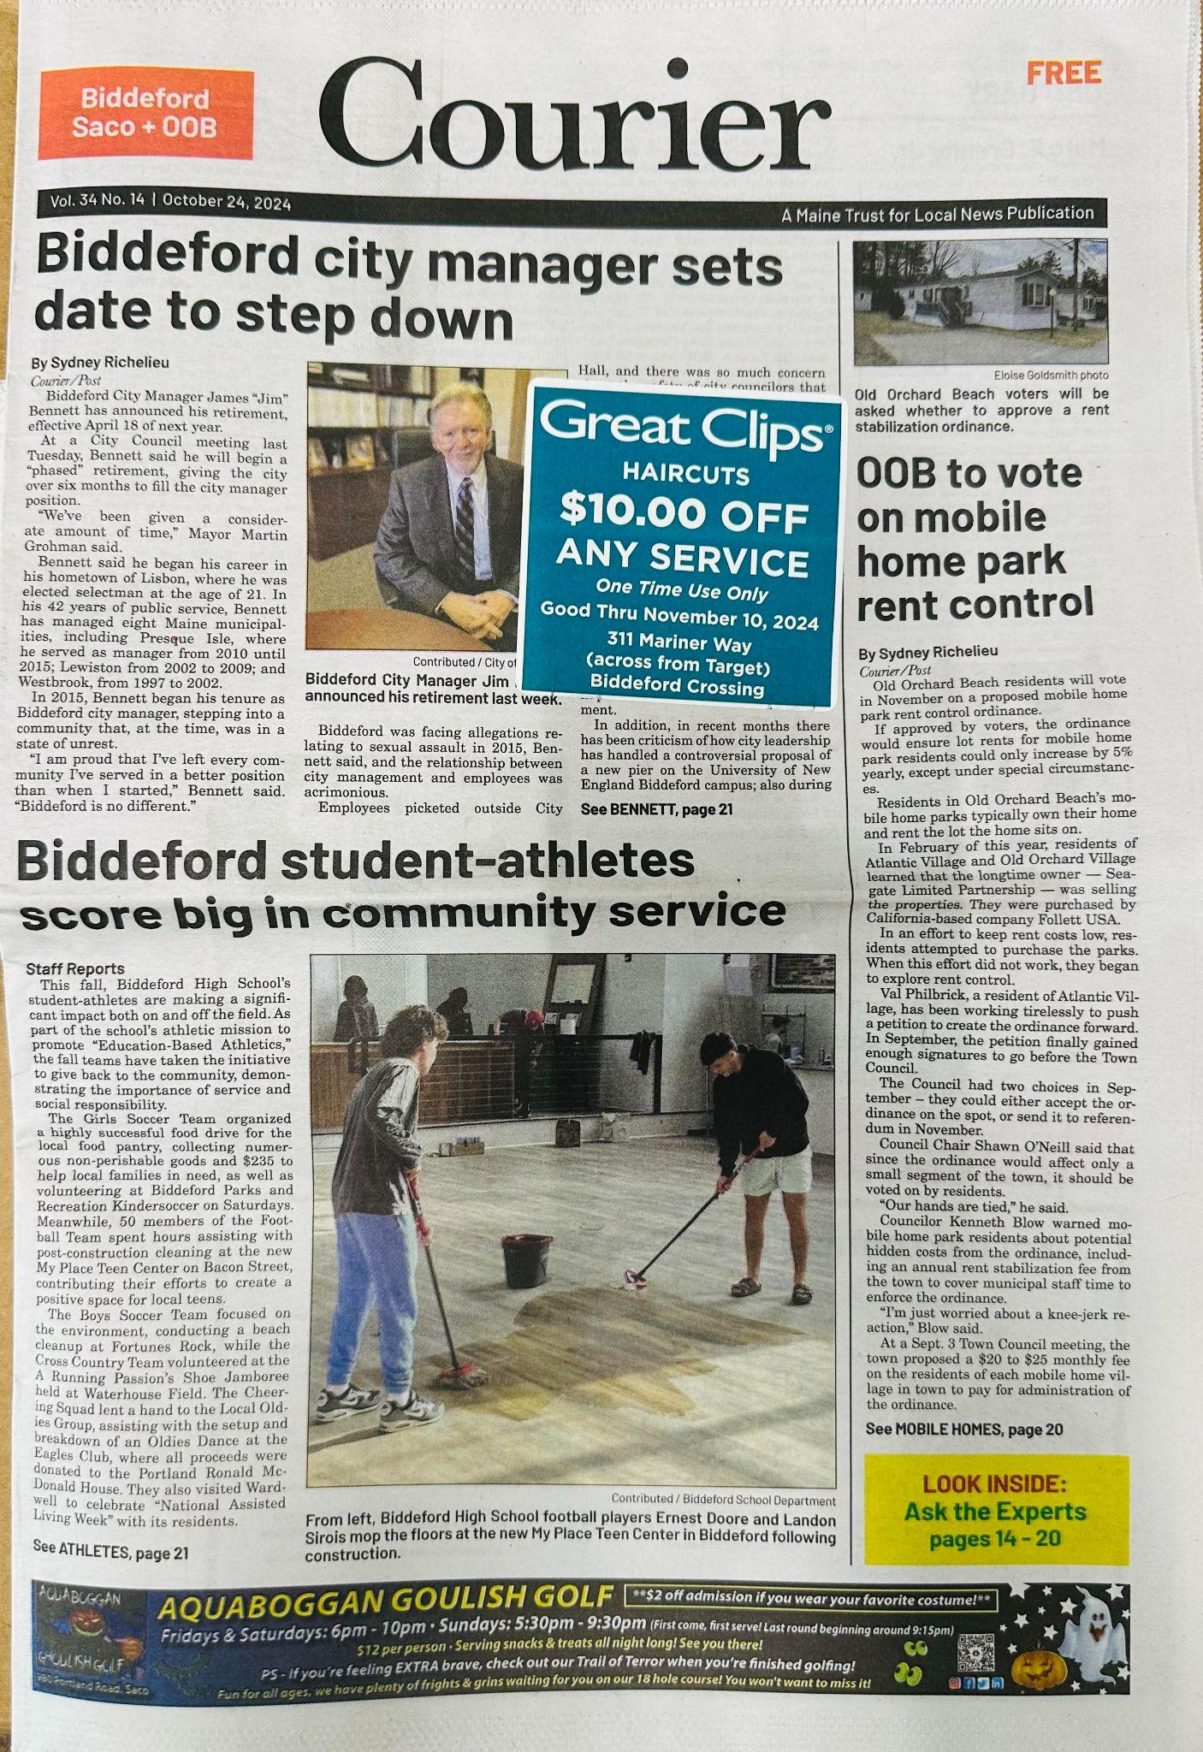
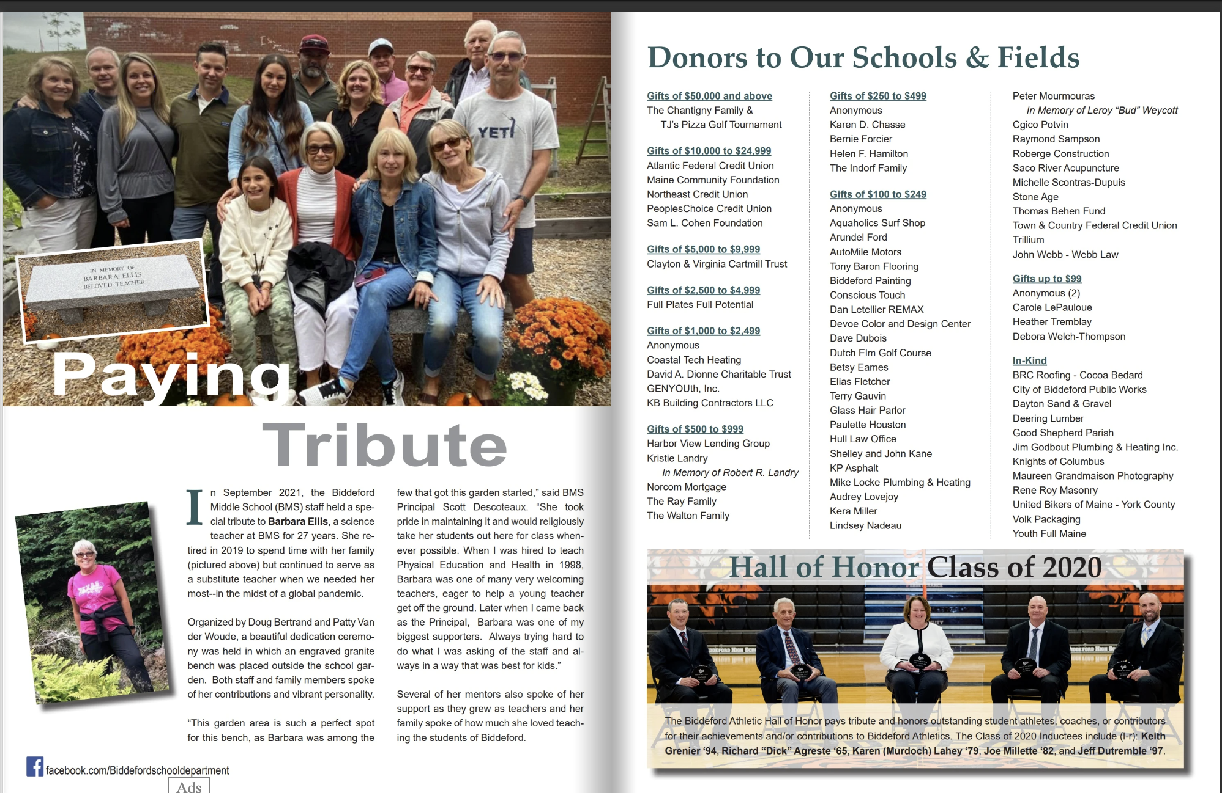
Community Engagement
Newsletters / Press Releases (Director of Communications)
.
Newsletter - SMORES
The Bridge Publications
Press Release

Slide 23
Community Engagement
Ceremonies & Awards
All Sports
Awards Ceremony
Volunteer Award
Character Awards

Slide 24
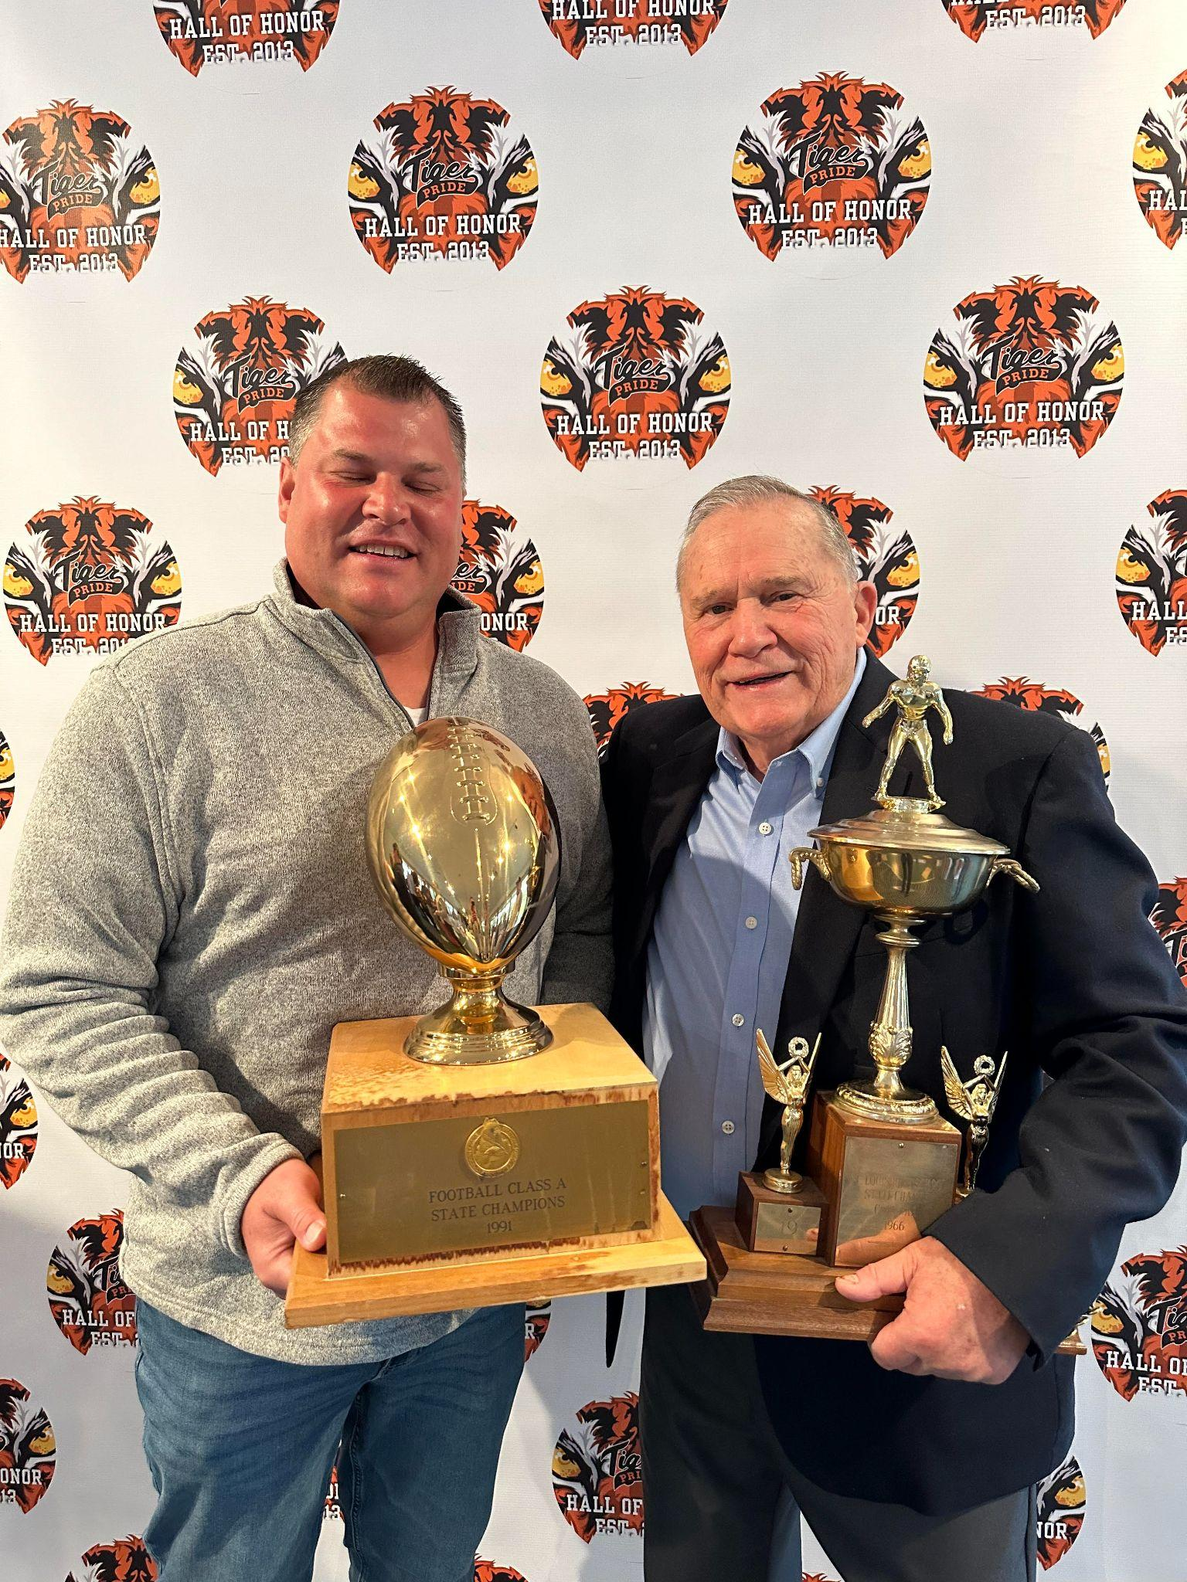
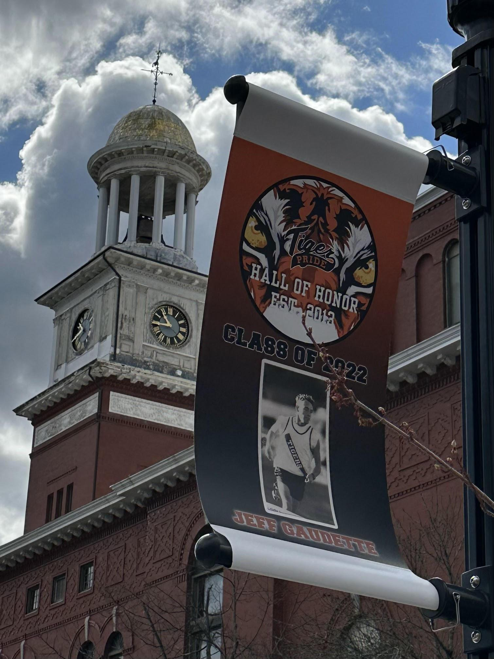
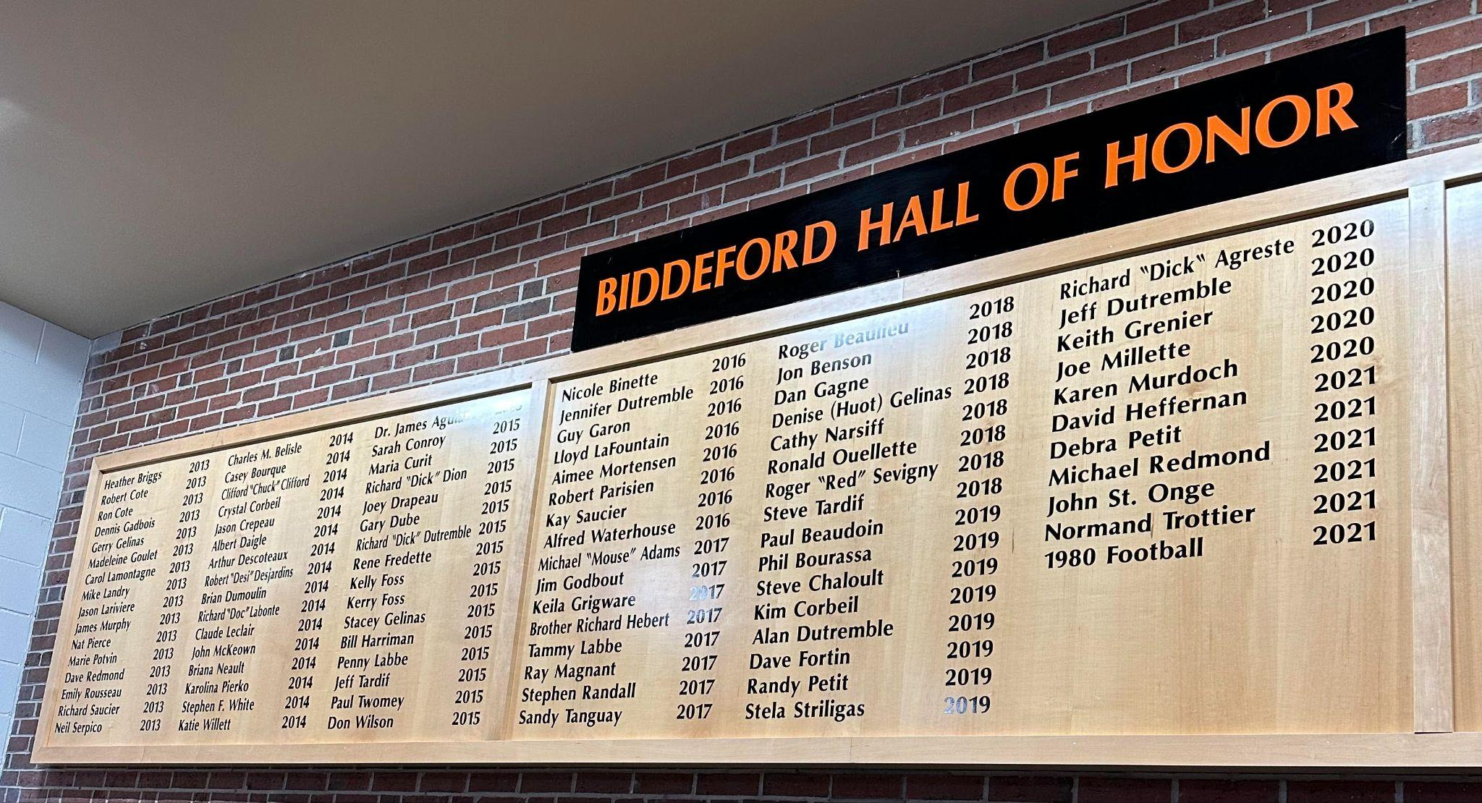
Community Engagement
Promotion and Recognition Initiatives
Hall of Honor /Hall of Fame Ceremony
A TRUE Community Event.
Homecoming
Community Support
Partnerships
In-Kind Donations
Promotions
Chris & Ron Cote
91’ & 66’
The Wall
Downtown Banners

Slide 25
Notes:
This can be used if we run out of time. It’s about 5 minutes. If we don’t get to it no worries. I thought we could use it as a way of “promoting” our community engagement.

Slide 26
Maine
The floor is open!
Please share your school’s initiatives & successes!

Slide 27
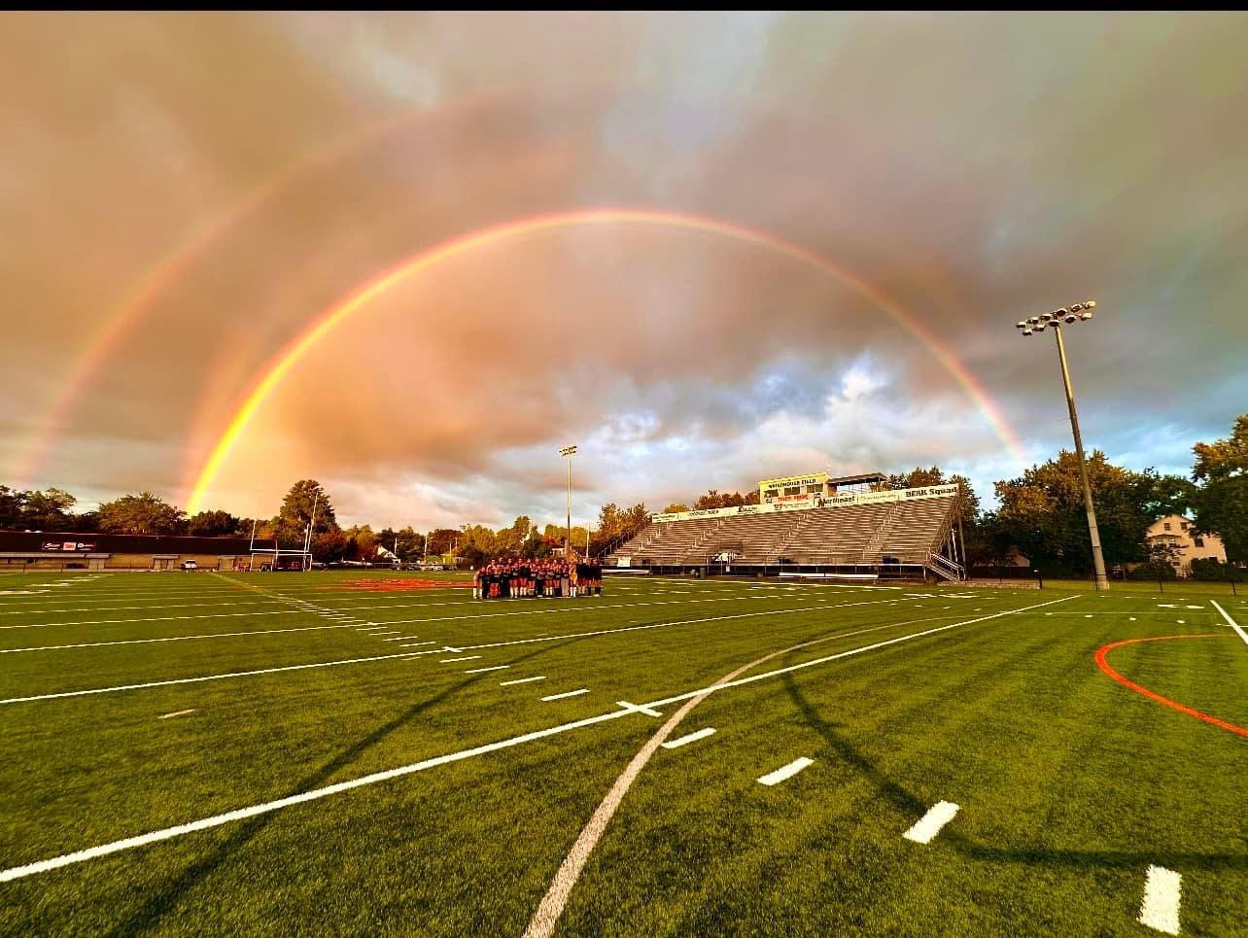
“Alone we can do so little: Together, we can do so much!”
2024
2024
Waterhouse Field
Notes:
This can be used if we run out of time. It’s about 5 minutes. If we don’t get to it no worries. I thought we could use it as a way of “promoting” our community engagement.

Slide 28
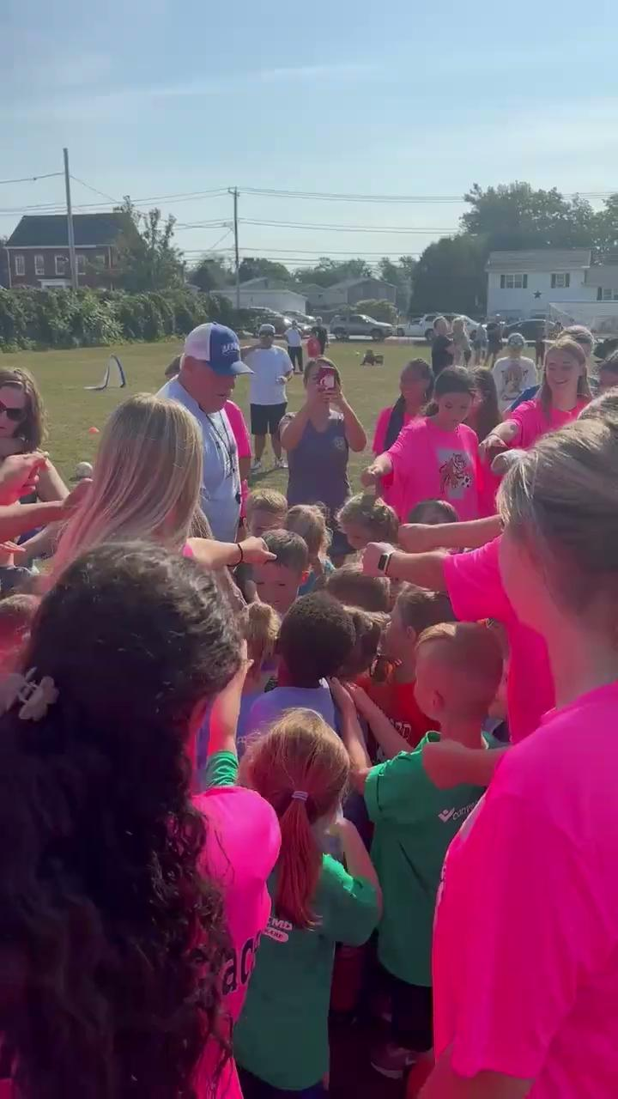
“Alone we can do so little: Together, we can do so much!”
2024
2024
Parks & Recreation - Girls Soccer
Notes:
This can be used if we run out of time. It’s about 5 minutes. If we don’t get to it no worries. I thought we could use it as a way of “promoting” our community engagement.

