Slide 1
Women’s Sport Hype:
How the “big-stage” can help us
here at home
Billie L’Heureux, George Stevens Academy
Kelsy Ross (RAA, CAA), North Yarmouth Academy
Notes:
Each year this session is offered at the MIAAA Fall Conference
Historical knowledge
ME is leading the way in female athletic AD representation
The evolution of this session…
…creating awareness for our females in HS athletics in an effort to strengthen the experience

Slide 2
Preseason: HS AD’s v Low Participation #’s
The Game Plan.
What’s the plan today?
Goals for this conversation:
Create a clearer picture of HS athletic participation #’s
Reflect on your specific community participation #’s
Outline an action plan to strengthen and growth those #’s
Notes:
The GAME PLAN
Get your “Coach of the Coaches” AD hat on to form a game plan
Game Day model today features High School Athletic Directors v Low participation #’s
The Plan?
We’re going to use national trends and recommendations alongside recent professional/collegiate women sport success to outline our own HS success here in the 207
Introductions
Face with a name
Create community and connections
Know your TEAM importance - lean on each other
Goals
Walk away from the session with some ideas and action plans

Slide 3
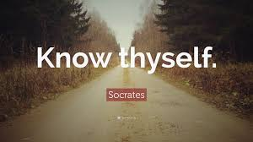
Your roster.
Two minute drill:
In your community…
What athletic programs are successful?
What athletic programs struggle?
WHY?
Notes:
“Know thyself” Socrates mindset today
NYA example:
Small, private school
We do not recruit
I need to KEEP kids at NYA from the MS to the US levels
We need to work backwards to accomplish a goal

Slide 4
Scouting Report.
What’s actually going on out there?
National trends
Maine trends
Local trends
Notes:
National Trends
Project Play
https://projectplay.org/state-of-play-2024-introduction
Annual report on youth sport PARTICIPATION trends:
Highlight MAINE #’s online
HS S/A’s = 64.0% of males and 52.6% of females reporting participation in 2011 compared to just 55.7% of males and 48.1% of females reporting participation in 2023
HS 55.7% of males and 48.1% of females reported past-year participation in organized sports
Highlight Recommendations on Page #21
Tucker Center for Research on Girls and Women in Sport (MN)
2022 “DisruptHERS: Driving a New Model for Women’s Sport” study
https://tuckercenter.umn.edu/tuckercenter/library/docs/research/Lough-et-al_2022-March-8_DisruptHERS-Driving-a-new-model-for-womens-sport.pdf
Female athletes/programs were best promoted through meaningful activism, social engagement, athlete and fan social media
Maine Trends:
Conference feedback:
Loss of JV and FT’s in BOTH girls and boys sports
Sport specific declines (i.e. field hockey, softball)
Sport increases in volleyball
Team co-op growth
Local Trends:
Group report out!

Slide 5
Scouting Report (cont’d)
Where are we seeing successful female participation?
Women’s National Basketball Association (WNBA)
Summer Olympics 2024
Notes:
We don’t need to reinvent the wheel here!
We’re living in time of incredible growth of female sport attention
Two areas we’re going to explore today are…
And to get us started, I’ll turn things over to Billie…

Slide 6
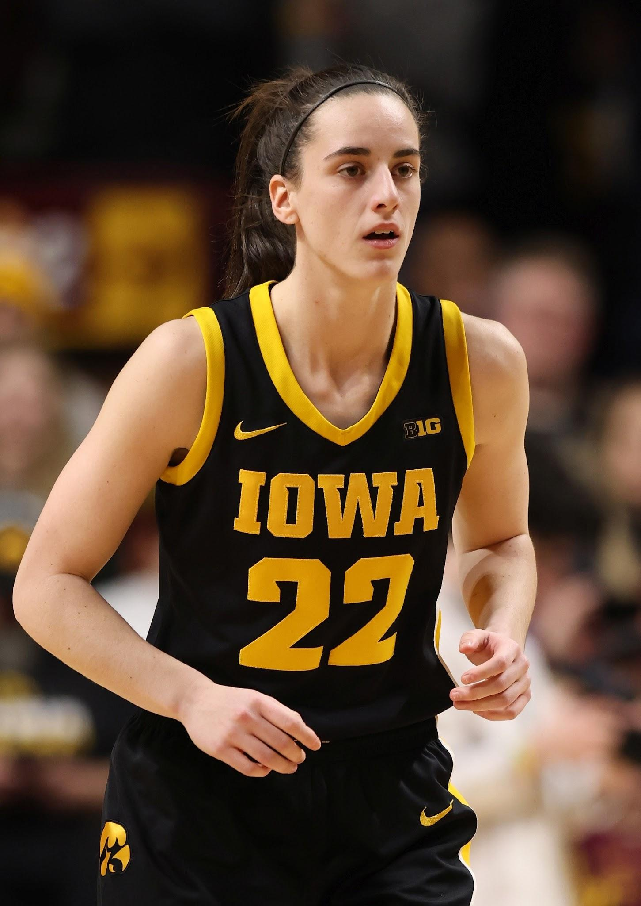
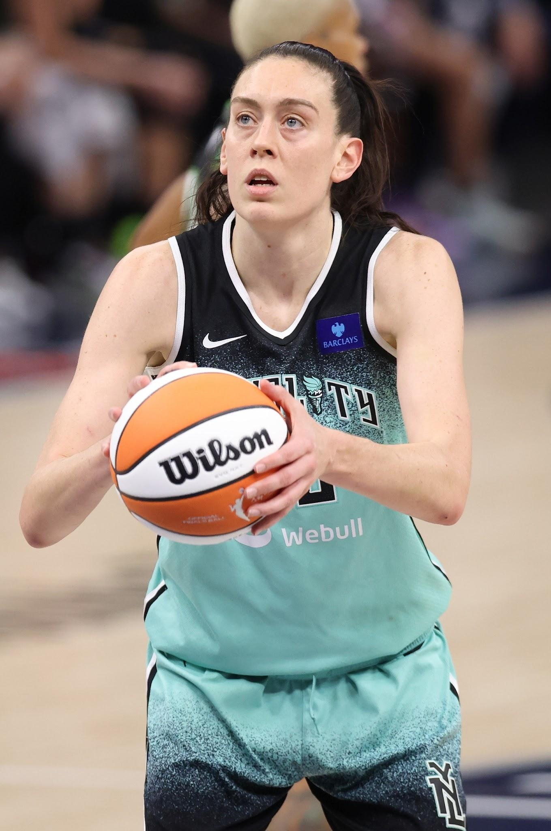
WNBA
Popularity
Viewing Data
Celebrity Endorsements

Slide 7
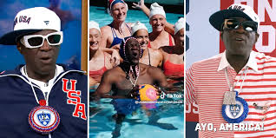
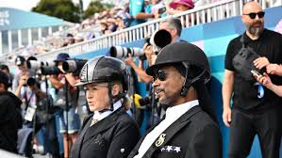
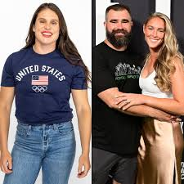
Summer Olympics, 2024
Participation # facts
Viewing data
Celebrity endorsements
Notes:
Participation #’s:
An estimated 10,500 athletes participated in the 2024 Paris Olympics. The 2024 Games was the first to have an equal number of male and female participants, IOC (site: ESPN)
In 2018, the IOC approved a Gender Equality Review Project, aiming to “push gender equity globally”, ESPN
Viewing data:
Up 82% from the Tokoyo Olympics, Nielsen and Adobe
USWNT (soccer) gold medal game v Germany had 9M viewers, the most EVER for a gold medal game, The Daily Tarheel
US Gymnastics Team finals drew 13M viewers, more than ANY 2024 NBA final games, The Daily Tarheel
Celebrity endorsements
Flava Flav, Women’s Water Polo, Gold Medal
Snoop and Martha, polo
The Kelce’s, Women’s Rugby

Slide 8
Practice plan.
What can we do to be successful?
Notes:
(BIllie)

Slide 9
Ideas from the WNBA:
Focus on storylines and personalities
Engage in the community
Fan experience
Media Coverage
Persistent stereotypes and bias
Lack of diverse role models
Notes:
(Billie)

Slide 10
Ideas from the Summer Olympics:
Promote early
Find a spokesperson
Use storylines to connect with the community
Make the experience special
Notes:
Promote early
NETFLIX USWNT soccer documentary example
Look ahead: highlight a big regular season game IN the preseason; SAVE-the-DATE
Find a spokesperson
A student, manager, teacher, local community member, ALUMNI, someone with connection
NYA ie VB manager, Paxton; JV BICE senior and EC President, Jack; recently, Emily and Ella of GSOC with fun game announcements with Sully, DOS
Local business partnerships for endorsements (i.e. Greely HS GBB Tourney Time Bfast with the Fowlers at Stones)
Storylines
Use social media!
DisruptHER examples
Highlight your coaches
Reach out to media with storylines
Special experiences
Olympics are every four year
HS is four years
Find ways to get excited for each season
Create traditions (i.e. Olympic ring tattoo :) )

Slide 11
Practice Plan: yours (cont’d)!
Two minute drill:
What can you and your community do to:
Maintain your successful athletic programs?
Support and grow those that are struggling?
Notes:
(Billie)

Slide 12
GAME DAY.
Every day, is game day as an Athletic Director.
Do your research.
Find your people.
Have fun.

