Slide 1
CALEDONIA ATHLETIC DEPARTMENT
ONLINE PARENT/STUDENT
PRE-SEASON MEETING

Slide 2
PURPOSE OF MEETING
To provide information from the athletic department for the athletic season ahead.
Communicate expectations for our student athletes – both the school and team level.
Provide information that may help avoid conflicts, problems, or questions that may arise during the upcoming season.
We are a Educational Based program. Our goal is to teach our participants to be better individuals and teammates.

Slide 3
CALEDONIA ACTIVITIES DEPARTMENT STAFF
Scott Sorenson
Activities Director
507-725-3316
EXT. 3154
scott_sorenson@cps.k12.mn.us
Sara Tessmer
AD Assistant
507-725-3316
EXT. 2012
sara_tessmer@cps.k12.mn.us

Slide 4
FALL VARSITY/HEAD COACHING STAFF
Football Carl Fruechte
Soccer – Girls Chris Jandt
Soccer – Boys Jay Marschall
Volleyball - Girls Scott Koepke

Slide 5
WINTER HEAD COACHES
Basketball-Boys Brad King
Basketball-Girls Scott Sorenson
Gymnastics Savana Becker
Wrestling Shay Mahoney

Slide 6
SPRING HEAD COACHES
Baseball Shawn Bauer
Golf-Girls Robert Sobczak
Golf-Boys Scott Sorenson
Softball Chad Augedahl
Track-Boys Reese Wait
Track-Girls Mitchell Bechtel

Slide 7
CALEDONIA ATHLETIC DEPARTMENT MISSION
The primary mission of the Caledonia Athletic Department is to provide an opportunity of involvement and/or participation for every student athletically, whether it is a competitive sport, recreational activity, or management/support opportunity. In doing this, serious attention will be devoted individually to the physical, mental, social, and emotional dimensions with outcomes including student growth in all dimensions and their preparation to make a serious contribution to his/her family and community.
Athletics are a part of the total educational program and should emphasize the “student first” philosophy.
We are not a “win at all cost” program but realize the importance that the expectation of success can play in creating a competitive environment.
Being an athlete at Caledonia Middle/High School, is a privilege and not a right. Athletes will:
Be held to high academic standards.
Display exemplary behavior on and off the field/court.
Face adversity, but that is OK.
We encourage multi-sport participation among our student athletes and will emphasize working together to better the entire athletic program

Slide 8
PLAYING TIME POLICY
Most problems that occur revolve around this issue. Here is the policy adopted by the Caledonia Area School Board.
Junior High: All players in good standing will be given the opportunity to play in each contest. There is no equal playing time.
9th Grade: All players in good standing may be given the opportunity to play, but is not guaranteed in each contest.
Junior Varsity: All players in good standing may be given the opportunity to play, but is not guaranteed in each contest.
New Three Rivers Rule: B-Squad is now JV and Juniors or lower can play on that team.
Varsity: All players in good standing may be given the opportunity to play, but is not guaranteed in each contest.
Coaches will decide playing time at all levels based on what is best for the team. This is not open for discussion.

Slide 9
ELIGIBILITY
Academic Policy:
Student must pass all classes.
A fail at the end of a ”Term” will result in them being academically ineligible.
Semester fails are not academically ineligible.
Fail to pass a class will result in the student being academically ineligible for a number of contests. (Listed in the Student Handbook).
Grades are checked at the end of each term to determine eligibility.
If a student is ineligible they are then on Academic Probation for the following Term. They will then be checked every three weeks thereafter.
A student must serve the suspension in their next activity.
For instance if a student fails term 2 and all they are involved in is football, they will serve that suspension the following Fall.
Ineligible athletes must:
Attend all practices and games. However they may not dress for the game, and must be seated with the team.
A player must be eligible to be ineligible.
Any student in violation will be notified and will become ineligible for competition immediately.

Slide 10
In-Season/Out of Season Activities
Caledonia Coaches and Athletic Department encourages a complete focus on the activity that is in-season. Playing other activities out of season is disrespectful to the coaches and members of the in-season team.
Parents and players need to respect in-season activities and not step on their toes. In-season should be a priority.
It is a MSHSL Violation to be part of club teams of the same sport during the MSHSL season. This disqualifies the student from postseason play.
MANY studies have proven, participation in the same sport all year increases sport-specific related injuries and limits the growth of the whole athlete.

Slide 11
STUDENT ATTENDANCE & BEHAVIOR
Athletes must be in attendance all day to practice or compete.
Parents calling in does not excuse a student, they will be ineligible.
Exceptions are excused absences which include:
Medically documented appointments
Funeral visitation
Court appointment
College visits – scheduled through the guidance department
Military examinations
Religious holidays with administrative approval
School sponsored activities such as field trips, athletic participation, etc.
Any student who receives a suspension of any type as a result of a violation of the MSHSL Code of Conduct can not play in the contest during the length of that suspension unless otherwise indicated by the Athletic Office.
Behavior in class and hallways will be monitored. Disrespectful behavior will result in loss of playing privileges.

Slide 12
SUBSTANCE USE
This continues to be a problem:
Substance use affects performance. Hand eye coordination suffers, players become slower, they lack endurance to perform.
When students start using, we lose them, it changes their ambitions, attitude, value system and goals. They lose interest in activities that require extra work.
We care about these kids so much that we are not worried about losing them for a game, we are worried about losing them mentally for life. Their brains are still developing and these chemicals interfere with that growth.
Please help us educate our players. We all need to work together.
MSHSL prohibits the use of mind altering chemicals such as drugs and alcohol (E-Cigs & Vaping are included in this). Vaping is widespread even in our middle school students.

Slide 13
Signs of Substance Use and/or Abuse
Don’t Be Naive...Even “Good” kids are exposed to the pressures of substance use and abuse!
Here is a link for parents to read to give them more insight on what they should be looking for when they are concerned their may be substance abuse:
Hazelden Betty Ford Foundation Publication Link: “Early Warning Signs of Teenage Substance Use”
https://www.hazeldenbettyford.org/articles/warning-signs-teen-substance-use

Slide 14
ATHLETE/PARENT/COACH COMMUNICATION
At Caledonia Middle/High school we have adopted a Chain of Communication when it comes to issues that arise with athletes and their activity. This chain must be followed as we have found success resolving issues at the lowest level when it is followed.
Athlete
Athlete should approach the coach 1st regarding an issue.
Parent
Start with encouraging your student to have a discussion with the coach. Parents should not reach out to the coach until after the student has met with the coach.
Set up a meeting with the coach by setting up an appointment.
Do not confront a coach prior to, during, or after a practice or contest.
If not satisfied, set up an appointment with the Activities Director.
Misinformation, misinterpretation and rumors are one of the biggest challenges we face.

Slide 15
Chain Of Communication
*Chain of Communication must be followed when questions or issues arise.
Step One: The Athlete should meet with the Coach.
Step Two: The Athlete, Parent and Coach should schedule a meeting.
Step Three: The Athlete, Parent, Coach should schedule a meeting with the Athletic Director.
*Do not contact the Principal, Superintendent or School Board Member as they will send you back to the level in which the Chain of Communication was not followed.

Slide 16
RECRUITING
We WILL help with the recruiting of student athletes, however, the initial process must begin with the athletes and parents:
Identify schools
Be realistic as to college level
NCAA Clearinghouse: Division 1 & 2 www.eligibilitycenter.org
NAIA Eligibility Center: www.playnaia.org
Academics are important always, but especially starting freshman year for those that want to participate in college.
College coaches will look at your grades & behavior 9-12.

Slide 17
BOOSTER CLUB
CALEDONIA ATHLETIC BOOSTER CLUBS
CHECK WITH THE HEAD COACH OF THE ACTIVITY YOUR STUDENT IS INVOLVED WITH. WE NEED EVERYONE TO GET INVOLVED AT THIS LEVEL TO HELP MAKE EACH STUDENTS PARTICIPATION A SUCCESS.
BOOSTER CLUBS ARE HUGE IN RAISING FUNDS FOR ITEMS THE SCHOOL SIMPLY CANNOT AFFORD.

Slide 18
FORMS AND DOCUMENTS
Athletic Physical Packet 2023-24- Must be completed before the student athlete is allowed to practice/participate.
MSHSL Physical Examination Form.
Concussion Acknowledgement Form.
MSHSL Eligibility Form & Activity Fee Paid.
Emergency Health Contact Form.
Complete online Parent training AND online assessment, before we will allow them to play in events.
ALL FORMS ARE AVAILABLE ON THE CALEDONIA HIGH SCHOOL WEBSITE! www.cps.k12.mn.us

Slide 19
ATHLETIC TRAINER
Notes from our contracted trainer from Gundersen Lutheran
*We have been assigned a new athletic trainer, her name is Janelle Currie her email is janelle_currie@cps.k12.mn.us
Coaches: Will obey all of the restrictions our trainer has for an athlete. In the past our trainer has been a great communicator and keeps coaches/players informed.
Players, listen to and do as the trainer asks, they are trying to get you back into competition as fast as they can, but wants you healthy.
IMPACT (Concussion) Testing (ONLY 7th,9th, and 11th grade)
Football: August 3rd at 9am & August 10th at 9am
Volleyball: Dates have not been set at this time.
Soccer:
Girls soccer: August 16th at 3pm
Boys soccer: August 16th at 4:30pm
*Make up date/Time: August 24th at 3:00pm
Helmet Checks
Monday Wednesday
Symptoms of concussion – the athlete will be removed from contest/practice. Must get a release from a physician on the official release form. This is a Minnesota State Law.

Slide 20
ATHLETIC TRAINER HOURS & CARE
Hours & Care
Mondays/Tuesdays/Thursdays @ 3:00-5:30, Wednesdays @ 2:30-5:30, Fridays @ 3:00-5:30.
Coverage for all HOME soccer and football games.
Coverage for all HOME playoff games.
Injury Evaluation/Treatment/Rehabilitation for all athletes.
Parent will get a phone call or note depending on the injury that occurred.
Contact me anytime with questions or concerns and I can put you in touch with the athletic trainer, Janelle Currie.

Slide 21
ATHLETIC TRAINER CONCUSSIONS
Concussions
All concussions will be needing an MD visit for clearance.
The athlete will go through a return to play protocol once they are symptom-free and pass the ImPact test.
The time it takes to come back from a concussion varies.
During the time that they are symptomatic, rest will be advised, and they may even be ran through some activity guided by the ATC depending on the athlete’s status.
Return to Learn-form.

Slide 22
ATHELTIC TRAINER: HYGENE; EQUIPMENT; WATER
Proper Hygiene: Avoid skin conditions and spreading germs!
Regularly wash uniforms and practice gear.
Shower and wash their hands following practices or games.
Do not share equipment (towels, razors, mouthguards, etc.)
Equipment Check-out
Return ace wraps, braces, crutches, etc.
Sara and I work hard to help remind them, but parents can help.! 😊
Water: Please make sure they always have a water bottle with them at practices and games, especially during warmer days.
Carry it with them in school too!
They should stop at the water fountains throughout the school day.
Sleep
Maintaining a good sleep schedule is crucial to student/athlete development and success..

Slide 23
ATHLETIC TRAINER: INHALERS, EPIPEN'S, MEDICAL CONDITIONS ETC.
Please have these present at every practice and game and let me or your coach know its location.
Parents: Please fill out the medical conditions section as in depth as you can. If there is any question with whether it’s a concern, write it down anyway.
Emergency Action Plans
Every venue has a prepared plan for how to direct EMS to the scene.
Plans are in emergency contact folders.

Slide 24
EMERGENCY PROCEDURES
Lightning strike – 30 minutes from last strike; time will restart with each new occurrence.
Bleachers must also be exited and players will be moved inside.
Severe weather– Coaches will keep athletes and will only release to parents.
We want to make sure that everyone is safe and accounted for.
Weather Related School Closing –Contests and practices will most likely be canceled. But in the event that the weather/roads improve, events. contests and/or practice may occur with the approval of the Superintendent, Activities Director and transportation company. Typically that decision will be made around noon.
Weather Related Early Dismissal – Everything cancelled, unless
If the contest is a MSHSL postseason event, they may still go on as scheduled.

Slide 25
ADMISSION AND SEASON PASSES
Caledonia High School (Set by the conference)
Adult $6.00
Sr. Citizen(65 and older) Free
Students $4.00
Season Pass
All home events during Fall, Winter or Spring Seasons. Exception: MSHSL sponsored tournament events.
Student= $80 Adult= $100 Family= $250
Senior Citizen (65 & Older)= Free
*Please take a photo of the pass to present to the ticket gate.
*We are moving to online registration and payment, but that is not set up completely at this time.

Slide 26
SCHEDULE UPDATES
It is the goal of the Caledonia Athletic Department to get you accurate updated information as soon as possible.
Schedules are always changing and we will send those changes out in various ways:
Schoology updates
”Notify Me” Email Alerts
Remind Text Alerts
Caledonia Athletics Twitter Page
Caledonia School Website
If you see a problem let me know ASAP.

Slide 27
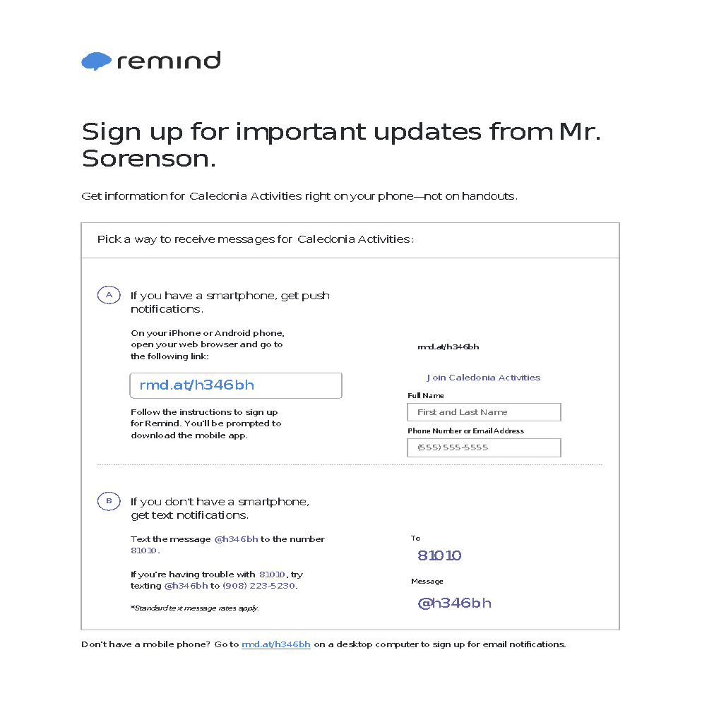
CALEDONIA ACTIVITIES TEXT ALERTS

Slide 28
GENERAL INFORMATION
Social Media (Facebook, Twitter, etc…)
A great tool when used correctly.
Please be aware of the possible dangers and consequences as a student and athlete. Parents monitor your students!!!
Recruiters are watching.
Sportsmanship / Behavior
A class level of behavior and sportsmanship should be displayed towards officials, workers, athletes, fans, and opponents at all times.
There is a huge shortage of people wanting to officiate games. Stop yelling at them from the stands, they are watching all players, you usually are watching things around your player.
Expected of both our student athletes and their support group
Guests at away contests
Be Respectful and Polite! I will be alerted to bad behavior, which could include you being suspended from attending more games.
Leave the area you use cleaner than when you arrived.

Slide 29
GENERAL INFORMATION 2
Last day to join the team?
To be eligible for postseason MSHSL competition the student must join by the fourth Monday or 22 calendar days from the start of the season.
Transfer information?
Whatever school the students attends at the start of the their 9th grade year matters. Any transfer after that will require a residence change to the new school district.
Without a residence change the student is ineligible for varsity competition for a period of one calendar year. They can play at the lower levels, just not varsity unless conference rules prohibit them.
Quitting the team?
Students who quit the team will not receive a refund and all suspensions served during the time they were a participant are no longer considered served.
For instance if a player goes out and serves a two game suspension for grades, and then quits the team, the suspension does not count and they will need to serve it in the next activity they are a participant.

Slide 30
General Information 3
Students who receive a MSHSL Chemical or Behavior violation during the season of play will not be eligible for postseason All-Conference or State Awards.
Students serving a suspension, must complete the full season for the time suspended to count. For instance if a student sits out for a suspension and then quits the team, the time they sat out will not count and they will need to serve a suspension in the next activity.

Slide 31
PARENT BEHAVIOR DO’S AND DON’TS
Do:
Cheer for your team, all members.
Support and accept your athletes role on the team.
Get all fees & form turned in on time.
Join and support your athletes booster clubs.
Tell them how much you enjoy them being a part of the activity.
Don’t:
Talk negatively about other players and/or coaches around your son or daughter. They hear you and lose respect for those individuals which affects how well they perform and playing time in a negative way.
Argue with the coach in front of student.
Believe everything your athlete tells you.
Live through your child and expect their role to be what you want.
Coach or direct from the stands.
Yell at or complain about officials, opponents or spectators during the contests.

Slide 32
FACILITIES USE
All facilities can be used by students, but there needs to be supervision. Coming in to the building and using the weight room, gym, MPR etc. without supervision is prohibited.
Take pride in the facilities, our staff is doing several upgrades and when stuff is not used correctly it costs taxpayer dollars to repair.
Please clean up after yourself when attending games or using our facilities.

Slide 33
CALEDONIA SCHOOL GROUNDS
We have made huge improvements to our facilities/grounds and they look better than they ever have and we want to keep them looking great. Please respect some of the following rules that some feel do not apply to them:
No pets allowed at any time on school grounds, unless registered service animals.
Do not drive vehicles on the grass or walking paths around the school (paved or unpaved) unless given permission by Administration.
Do not move barriers or drive around them when they are set.
Park in designated areas only. Do not park on the grass.
Smoking, tobacco use and electronic vaping devices are PROHIBITED on school grounds.

Slide 34
CLOSING
In closing, thank you for viewing this slideshow. Information in this presentation will help make the 2023-24 athletic/activities season a success.
Understand that being part of the team alone is what makes our student athletes successful. Playing time and wins do not define us. Being part of something bigger than ourselves does.
Trust the process: Athletes will be challenged, they will fail. They may come home happy, sad, upset and crying.
They will have good days and bad, understand that is all part of the process and their growth. Embrace it!
If you have any questions or concerns, please don’t hesitate to stop me or drop me a line.

Slide 35
Complete the Online Parent Assessment
One Parent will need to complete the assessment by clicking on the link provided. This needs to be completed before a student will be allowed to participate in events in their chosen activity.
Make sure to list all names of students you are completing the assessment for.
One parent needs to complete only once for all school year.
One parent needs to complete and this registers for all students in which the parent is the parent, court appointed guardian or Athletic Department approved guardian.
Assessment Link: https://forms.gle/DBEWK6dg4ZLqVbf19

