Slide 1
World’s Best Workforce 2021-2022 Report
Lester Prairie Public Schools
School Board Annual Public Meeting
November 21, 2022

Slide 2
World’s
Best
Workforce
Annual
Report: A Look Back to Look Forward
Strategies
Goals
Equity
Increased Student Success
Notes:
WBWF is an annual report.
In a nutshell, it is legislation that directs districts to report on the goals, strategies, and equity initiatives in place that ensure progress toward increased student performance.
So, in other words, what are the ways that we
support and improve teaching and learning
Ensure equity
and equip students w/21st century skills………with the ultimate goal of creating the world’s best quality workforce.

Slide 3
WBWF Timeline
Fall
1. Public Meeting
2. Annual Report posted on district website
Dec. 15, 2022
Submit summary report to MDE
Throughout year
Continue to monitor, review, and plan for next year’s plan
Notes:
Iterative or revolving improvement process

Slide 4
Minnesota Statute 120B.11
World’s Best Workforce means striving to:
Have all students meet school readiness goals
Have all third-grade students achieve grade-level literacy
Close the achievement gap among all groups
Have all students graduate from high school
Have all students attain college & career readiness

Slide 5
Lester Prairie 2021-22: 471 students
Notes:
438 in 2017-18
469 in 2018-19 (86 Hispanic)
478 in 2019-20 (88 Hispanic)
486 in 2020-21 (93 Hispanic)
Hispanic, Black, and 2 or more races are growing across the state = White population is decreasing; down 2% since 18-19 (approx. 17,600 students of a total of 883,203)

Slide 6
Lester Prairie 2021-22: 471 students
Notes:
Last year, our Compensatory Revenue was $142,007. Not all because of our numbers – the calculation rates are also decreasing. Now it’s down almost $200 per student.
Currently in 2020-21 – 102 ($93,538 Compensatory Revenue).
Next year projection – 79. ($56,019)
2021-22 = 109 FRP

Slide 7
WBWF Goal #1 School Readiness
Kindergarten Ready
Purpose of school readiness program= prepare children to enter kindergarten (MN Statute 124D.15)
Local definition: Lester Prairie School District defines school readiness as children having the academic, social, emotional, and behavioral skills necessary to be successful in kindergarten and beyond.
Notes:
Kindergarten Ready
Data collected from multiple key sources including _______.

Slide 8
SMART Goal #1: Kindergarten Readiness
Child received early childhood screening (MN Statute 121A.17)
In 2021-22, Lester Prairie School District had 100% of children screened before entering kindergarten. (85% - Goal Not Met)
100% complete as of 10/25/22
Child is at least 5 years of age by September 1 of the child’s enrollment year (MN Statute 120A.20)
In 2021-22, Lester Prairie School District had 100% of children begin kindergarten at age 5 or older. (100% Goal Met)
Child has received medically acceptable immunizations (MN Statute 121A.15)
In 2021-22, Lester Prairie School District had 100% of children fully immunized at kindergarten entry. (85% - Goal Not Met)

Slide 9
WBWF Goal #2: All Third Grade Students Achieve Grade-Level Literacy
“Literacy is the cornerstone of all learning and reading well by third grade is one of the many developmental milestones in a child’s education” (MDE).
The Read Well by Third Grade Legislation (120B.12) requires districts to develop a literacy plan with the goal of having all students proficient in reading by the end of third grade. The Literacy Plan is updated annually.
Grade level literacy is crucial because in 4th grade, learning to read shifts to reading to learn.
Notes:
The entire Literacy Plan (as a link) is included in our WBWF plan.

Slide 10
SMART Goal #2: All Third Grade Students Achieve Grade-Level Literacy
MCA III – Grade 3 READING
 | Percent Proficient
 | Grade 3 | State
2016-17 | 47.1% | 57.0%
2017-18 | 62.5% | 56.2%
2018-19 | 59.3% | 55.0%
2019-20 | Results not available due to COVID
2020-21 | 48% | 48.2%
2021-22 | 37.2% | 48.7%
MCA SMART Goal: The reading proficiency percentage of all third-grade students enrolled in the Lester Prairie School District will increase from 48% to 65% as measured by the Reading MCA-IIIs in the spring of 2022.
Results: Results indicated 37.2% in 2022 = Goal NOT met

Slide 11
WBWF #3: Achievement Gap Closure
READING:
The percentage of all Hispanic students in grades 3-8 and 10 in Lester Prairie Public Schools who earn Does Not Meet (D) and Partially Meets (P) the standards on the Reading MCA III will decrease from 56% to 45% in 2022.
Results: Results indicated 68.7% D and P in 2022 = Goal NOT met

Slide 12
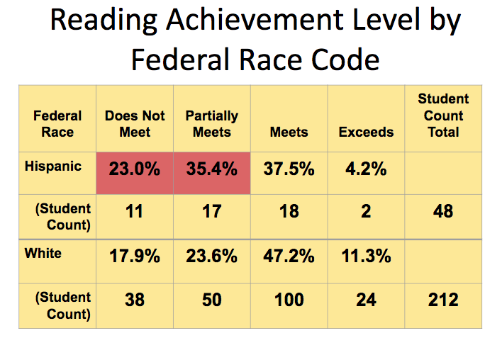
Data from 2022 Reading MCAs
Federal Race | Does Not Meet | Partially Meets |  | Meets and Exceeds | Student Count Total
Hispanic | 41.8% | 26.9% | 68.7% | 31.3%
#Count | 28 | 18 |  | 21 | 67
White | 25.3% | 23.7% | 49% | 51%
#Count | 50 | 47 |  | 101 | 198
GAP = 19.7%

Slide 13
Data from 2021 Reading MCAs
Federal Race | Does Not Meet | Partially Meets |  | Meets and Exceeds | Student Count Total
Hispanic | 33% | 25% | 58% | 42%
#Count | 16 | 12 |  | 20 | 48
White | 20% | 31% | 51% | 49%
#Count | 37 | 57 |  | 89 | 183
GAP=7%
Notes:
58 Hispanics DNM and PM
51 White DNM and PM (up from 41.5)
GAP = 7

Slide 14
WBWF #3: Achievement Gap Closure
READING - FRP:
The percentage of all FRP students in grades 3-8 and 10 in Lester Prairie Public Schools who earn Does Not Meet (D) and Partially Meets (P) the standards on the Reading MCA III will decrease from 60.2% to 45% in 2022.
Results: Results indicated 68.8% D and P = Goal NOT met.

Slide 15
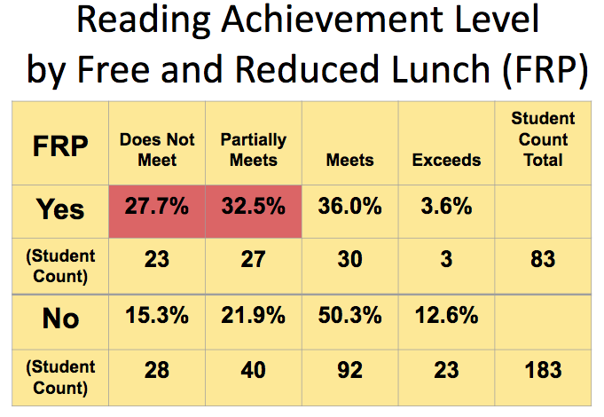
Data from 2022 Reading MCAs
FRP | Does Not Meet | Partially Meets | Meets and Exceeds | Student Count Total
YES | 42.6% | 26.2% | 31.2%
#Count | 26 | 16 | 19 | 61
NO | 26.4% | 23.6% | 50%
#Count | 56 | 50 | 106 | 212
Notes:
68.8 FRP students DNM and PM
50% NON-FRP student DNM and PM

Slide 16
Data from 2021 Reading MCAs
FRP | Does Not Meet | Partially Meets | Meets and Exceeds | Student Count Total
YES | 32% | 31% | 37%
#Count | 20 | 19 | 23 | 62
NO | 23% | 30% | 47%
#Count | 41 | 53 | 85 | 179
Notes:
63% FRP students DNM and PM (up from 60.2%)
53% NON-FRP student DNM and PM (up from 37.2%)

Slide 17
WBWF Goal #3: Achievement Gap Closure
MATH - Hispanic:
The percentage of all Hispanic students in grades 3-8 and 11 in Lester Prairie Public Schools who earn Does Not Meet (D) and Partially Meets (P) the standards on the Math MCA III will decrease from 68% to 45% in 2022.
Results: Results indicated 73.2% D and P = Goal Not met.

Slide 18
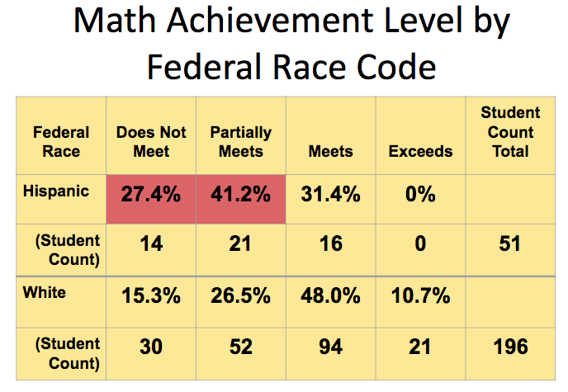
Data from 2022 Math MCAs
Federal Race | Does Not Meet | Partially Meets |  | Meet and Exceeds | Student Count Total
Hispanic | 33.9% | 39.3% | 73.2% | 26.8%
#Count | 19 | 22 |  | 15 | 56
White | 19.9% | 26.3% | 46.2% | 53.8%
#Count | 37 | 49 |  | 100 | 186

Slide 19
Data from 2021 Math MCAs
Federal Race | Does Not Meet | Partially Meets |  | Meet and Exceeds | Student Count Total
Hispanic | 39% | 47% | 86% | 14%
#Count | 19 | 23 |  | 7 | 49
White | 26% | 31% | 57% | 43%
#Count | 49 | 57 |  | 79 | 185
Notes:
86 Hispanic DNM and PM
57 White DNM and PM

Slide 20
WBWF Goal #3: Achievement Gap Closure
MATH - FRP:
The percentage of all FRP students in grades 3-8 and 11 in Lester Prairie Public Schools who earn Does Not Meet (D) and Partially Meets (P) the standards on the Math MCA III will decrease from 61% to 45% in 2022.
Results: Results indicated 73.6% D and P = Goal NOT met.

Slide 21
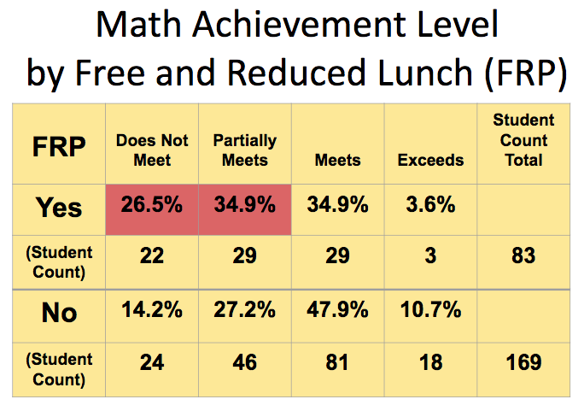
Data from 2022 Math MCAs
FRP | Does Not Meet | Partially Meets | Meets and Exceeds | Student Count Total
YES | 37.7% | 35.9% | 26.4%
#Count | 20 | 19 | 14 | 53
NO | 19.4% | 28% | 52.6%
#Count | 38 | 55 | 103 | 146
Notes:
73.6% FRP students DNM and PM
47.4% Non-FRP students DNM and PM

Slide 22
Data from 2021 Math MCAs
FRP | Does Not Meet | Partially Meets | Meets and Exceeds | Student Count Total
YES | 35% | 47% | 18%
#Count | 16 | 21 | 8 | 45
NO | 22% | 32% | 46%
#Count | 28 | 40 | 58 | 126
Notes:
82% FRP students DNM and PM
54% NonFRP students DNM and PM

Slide 23
Goal Area #4: College and Career Readiness
ACT | LP 2022 | State 2022 | LP 2021 | State 2021
# Students Tested | 19 | 69% | 39 | 48,017
English | 18.7 | 19.7 | 18.7 | 20.15
Mathematics | 19.6 | 20.7 | 21.7** | 21.51
Reading | 19.6 | 21.7 | 19.3 | 21.87
Science | 20.5 | 21.4 | 21.1 | 21.7
Composite | 19.8 | 21.0 | 20.3 | 21.6
ACT SMART Goal: The composite ACT score for Lester Prairie students will meet or exceed the state average composite score for the 2023 graduation year students.
Results: Goal Not Met

Slide 24
CCR = Choice Ready
All 7-12 meet with counselor to determine college and career path plans of action
Career component built into the Social 10 class
Career Exploration event at Ridgewater College
Work Study Class and Personal Finance Class
Career Portfolio Binders in Google Drive during 10th grade
Multi-year binders that include career/non4yr college/workforce plan, Career Research Plan, Resume, Cover Letter, Course Progression, Exploratory Research, etc.
100% seniors completed

Slide 25
Goal Area #5: All Students Graduate from High School
Grad Year | LP Count | LP %
2015 | 32 | 100%
2016 | 22 | 88%
2017 | 30 | 96.8%
2018 | 31 | 91.2%
2019 | 27 | 93.1%
2020 | 27 | 96%
2021 | 44 | 97%
2022* | 32 | 100%
State goal: 90% graduation rate with no student group below 85%.
LP Results: MET state goal
*Because graduation data lags behind one year, 2022 data is UNOFFICIAL for this report.
The Dropout Rule
If a student drops out after less than half an academic year at a high school, they will be counted as a dropout in the graduation rate of whichever high school they have attended for the most time.
Notes:
According to the Minnesota Department of Education, 70 percent of jobs in Minnesota will require some form of postsecondary education by the year 2020. As such, the state goal is to reach a 90 percent graduation rate by the year 2020 with no student group below 85 percent.
*Because graduation data lags behind one year, 2022 data is UNOFFICIAL for this report.
The Dropout Rule
If a student drops out after less than half an academic year at a high school, they will be counted as a dropout in the graduation rate of whichever high school they have attended for the most time.

Slide 26
Data and Strategies
These were the 4 questions we needed to answer for each goal area. LOTS of focus on data, data literacy, and data utilization
What data have you used to identify needs in this goal area? How is this data disaggregated by student groups?
What strategies are in place to support this goal area?
How well are you implementing your strategies?
How do you know whether it is or is not helping you make progress toward your goal?

Slide 27
WBWF Strategies for Continued Improvement:
Data Literacy/Data Utilization
Data Team: participated in a District Data Dig this past fall; presented to staff and School Board; facilitate literacy/utilization through working with teacher teams throughout the year
PLC teams = formal biweekly monitoring of academic and behavioral data
Student Success Teams: Student Support, EL, SPED, Reach & Gen Ed Teachers using Multi-Tiered System of Supports model, math support JH/SH
Comprehensive Assessment System with multiple indicators
Data Sources: 5 Categories of Data
Notes:
Comprehensive model of data-based decision making that includes social and emotional supports in addition to academic and behavior

Slide 28
Multi-Tiered System of Supports: Whole Child: Academics, Behavior, & Social/Emotional Wellness
Notes:
Framework for providing targeted support for all learners – whether advanced or struggling
Focused on the whole child: academic, behavioral, social and emotional wellness
Tier 1 = ALL students
Tier 2 = small group instruction
Tier 3 = individualized targeted interventions

Slide 29
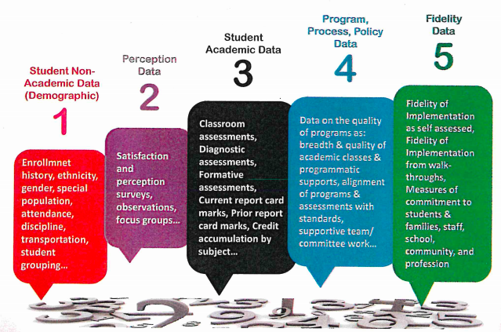
5 Categories of Data
Notes:
Best practice means we are examining and utilizing 5 categories of data
1=Synergy SIS
2=staff surveys, community surveys and focus meetings
3 =MCA, ACCESS, STAR, ACT, Graduation
4=Curriculum Maps, WBWF
5= TDE: walk throughs, observations

Slide 30
Curriculum and Instruction
Students - Process for assessing/evaluating student progress toward meeting state & local standards
PLC Teams, Data “Dig” & staff presentation, Testing Windows, Multi-Tiered System of Supports, Student Support Team
Teachers & Principals - System to evaluate the effectiveness of curriculum & instruction
Curriculum Maps & Standards Alignment, PLC teams, Mentoring Program, Teacher/Principal Evaluations
District - District practices around high-quality instruction and rigorous curriculum that integrate a collaborative professional culture and technology
PLCs, collaborative professional culture, End-of-Year survey by classroom teachers
MTSS, EL, SPED, REACH, general PD & North Collaborative opportunities
technology committee and 1:1 devices

Slide 31
Teacher Equity
WBWF requires districts to publicly report data on an annual basis related to equitable teacher distribution including data on access for low-income students, students of color, and American Indian Students to effective, experienced, and in-field teachers.
Currently, district data indicates 69% experienced, tenured teachers and 31% probationary teachers. This year we have a variance and two out-of-field for SPED, an out-of-field for EL; an out of field for HS science (filled with a JH license), and the rest of the teaching positions are staffed with in-field teachers. This data is typical for districts of our size in our geographical region.
What strategies has the district initiated to improve student equitable access to experienced, in-field, and effective teachers?
We will continue to develop our staff with high-quality professional development and mentoring.
We will continue to make hiring decisions that are based on need and aim for top talent.
We will continue to distribute staff across the district so that all students have equitable access to effective teachers, support staff, and administration who will help them reach their potential.

Slide 32
Teacher Diversity
WBWF also requires districts and charters to examine student access to licensed teachers who reflect the racial and ethnic diversity of students.
Which racial and ethnic student groups are present in your district that are not yet represented in your licensed teacher staff?
Student diversity is 21%: 19% Hispanic and the remaining 2% include American Indian and 2 or More Races.
We have one licensed teacher who is Asian. The remaining staff members employed by the school district are Caucasian.
The district continues to recruit teachers of color by attending career fairs and advertising broadly.

Slide 33
World’s Best Workforce Comments and Questions?

