Slide 1

Welcome Student Success Teams

Slide 2


Equipping Student Success Teams to Support the MTSS Problem Solving Process September 21, 2023

Slide 3
Presented by:
Christi Sickel - Assistant Director of Special Education
Chris Hautala- CEIS Coordinator

Slide 4

Introductions and Welcome
Please share:
Name
School District/school
Role on Student Success Team
Notes:
Katie

Slide 5

Overview
Topics covered:
Introductions & Welcome
Overview of MTSS
Student success teams
Updated forms
Case studies
MTSS Student support Team guide
Parent referral
Next steps
Notes:
Katie

Slide 6
SCHOOLS have to be ready for kids.
Kids DON’T NEED to be ready for school.
Minnesota Department of Education
Notes:
tina

Slide 7
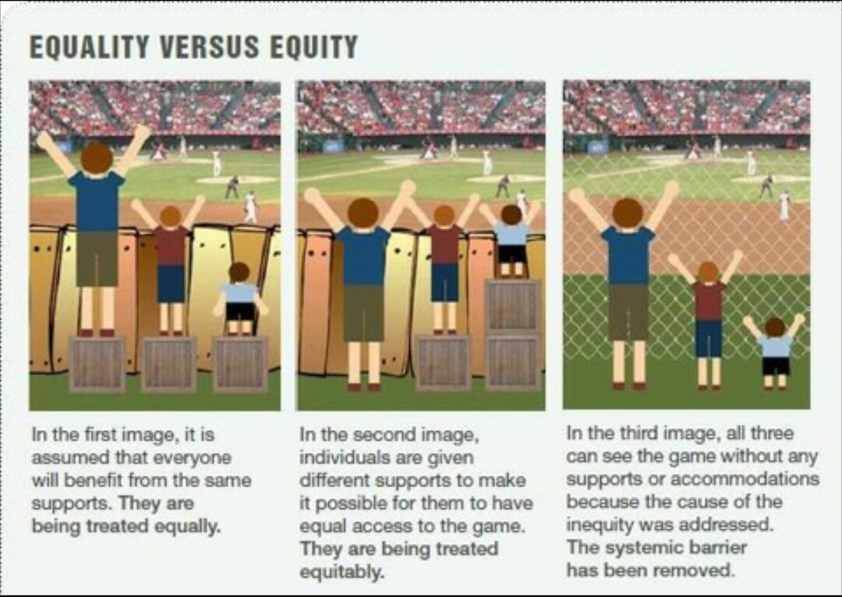
Notes:
Chris

Slide 8
Multi-Tiered Systems of Supports (MTSS) is a systematic,
continuous-improvement framework in which data-based problem solving and decision-making is practiced across all levels of the educational system for supporting all students. This includes students receiving special education
services.
The MTSS paradigm shift focuses on all students, identifies what help each student needs, and is intentional in design and redesign of services and supports matched to the needs of each student.

Slide 9
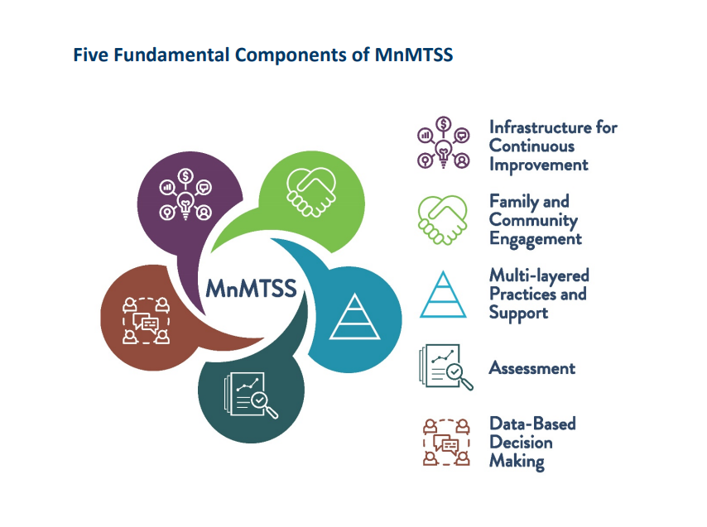
Notes:
Comprehensive Center Network Region 10 Wisconson Minnesota Handbook

Slide 10
The MTSS framework consists of five fundamental components that work together for successful implementation:
1. An infrastructure that provides a system in which people can work
effectively and efficiently.
2. Family and community engagement that promotes authentic collaboration
to support common values and equitable outcomes
3. Multi-Layered practices and supports that match intensity of services to
level of student need.
4. Assessment tools with which to accurately and reliably collect
information that aids decision making.
5. Data-based decision-making practices that consider the unique experiences
of every population and drive continual improvement.

Slide 11
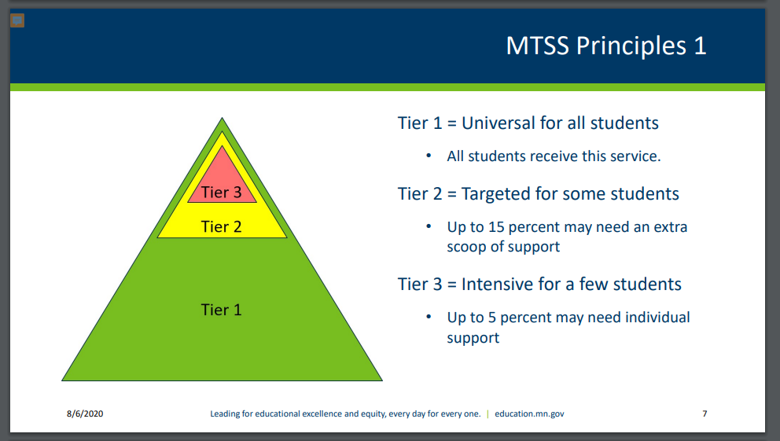

Slide 12
There are three tiers of support in an MTSS model.
Tier 1 includes universal, high-quality classroom-wide instruction and
support for all students. This is best practice with differentiated
instruction in place.
Districts should aim to have 80-90% of students in Tier 1.
Tier 2 provides targeted support through group interventions based on a
similar need to address a student’s gap in skills.
Districts should aim to have 5-15% of students in Tier 2.
Tier 3 involves intensive, individualized interventions with frequent
progress monitoring. Districts should aim to have 1-5% of students
in Tier 3.

Slide 13

The goal is to improve outcomes for students using:
1. Data for decision making.
2. Evidenced-based practices for student outcomes.
3. Systems which adults need in order to support implementation efforts.
4. Fidelity and consistency to adequately measure outcomes.

Slide 14
According to the MDE MTSS guidebook:
MTSS is a “team sport.” Successful implementation of MnMTSS requires well-functioning teaming across and within the school district, school and intra-school levels. This guidebook is intended to help district and school-based teams implement the expectations found within the MnMTSS framework and unleash the collective wisdom and expertise of educators and stakeholders. Successful teaming leads to good decisions, effective support of educators and ultimately positive student outcomes.

Slide 15
Starting with Intentionality
Your Student Success Team
Who are the key people who will be present at these meetings?
Members of the Student Success Team (SST) may include: Principal/Assistant Principal/Dean of Students
Interventionist
Social Worker
Mental Health Practitioner
School Counselor
General Education Teacher(s)
Special Education Teacher
Others as needed (Cultural Liaison, Itinerant Staff, Nurse, etc.)
What are each of their roles?
Who owns broader SST communications?
Notes:
Some of you may have this in place. Others, may want to use these questions to guide setting up your teams.
You set the stage, hold the expectations, as well as support these processes, I (we) are here to provide another layer of support to you in this work.
BAck to school inservice should included the SST expectations, Dates/times of meetings, and members of the team.
You will receive a survey later this week that needs to be completed/submitted by Friday, September 8th.

Slide 16
What does SST need to do?
Student Success Teams must:
Appoint a Chair to oversee SST meetings
Schedule SST meetings on a regular basis
Develop a system for tracking students who are receiving interventions
Consult with their School Psychologist with questions regarding intervention questions

Slide 17
Collaborate
Meeting dates/times
Team members
Communication
Meeting Structure
Tracking Students
Notes:
Who are core team members? Who are sometimes members? Structure of meetings? Communication with team members/school talk about school wide data versus student specific.how to get a student on the agenda for sst. Principals leading/supporting the work not doing it.

Slide 18
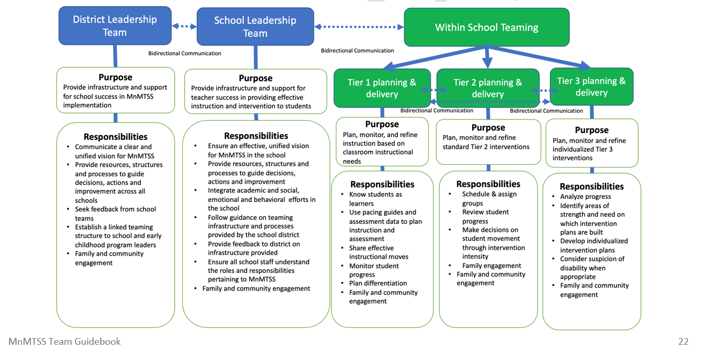
This includes:
Notes:
District Leadership: Communicate a clear and unified vision for MTSS.
School Leadership: Ensure all school staff understand the roles and responsibilities pertaining to MTSS
Tier I: All students in the classroom
Tier II: Small groups of students provided interventions
Tier III: Individualized supports/interventions: may still be classroom level, Title I, 504, or possible Sped referral/services
Communication, data, family, whole child

Slide 19
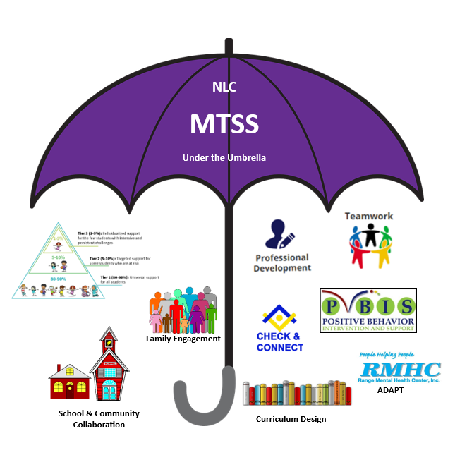

Notes:
Sample-can send template if Districts would like to create their own.

Slide 20
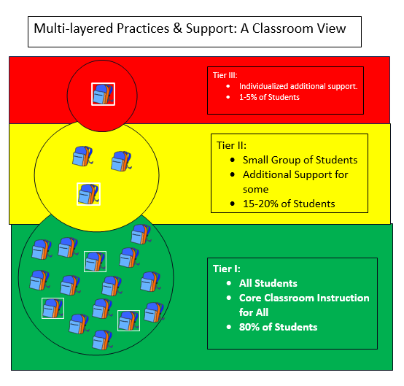
Notes:
Snowman analogy: needs base. Build on it to create the structure. Top can’t be too heavy.

Slide 21
Same Process - Updated Forms
Part 1: Team Discussion
Part 2: Intervention data
Part 3: team data Review
Part 4: Referral for special education evaluation –
The team will only complete Part 4 after a decision to move to a special education evaluation has been made.

Slide 22
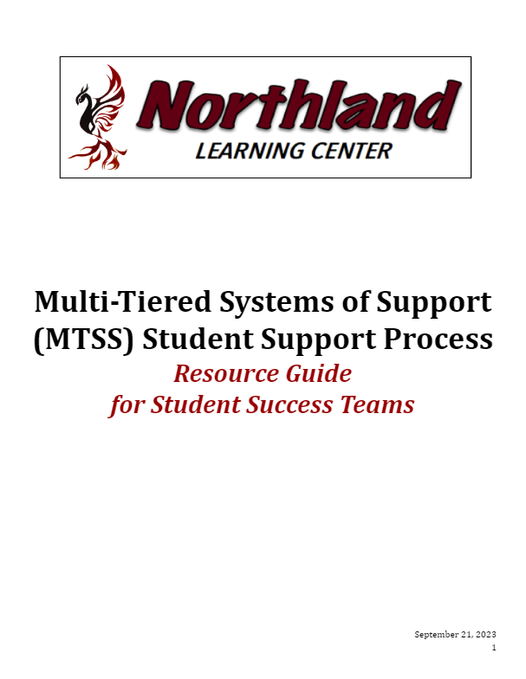
MTSS Student Support Team Process
Resource Guide for Student Success Teams
Notes:
We have created a Resource Guide for your SST members. It walks you through the whole process of your SST.

Slide 23
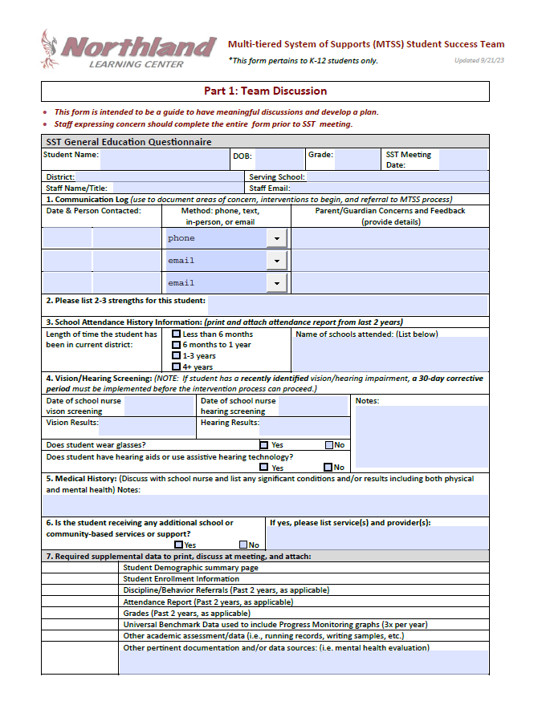
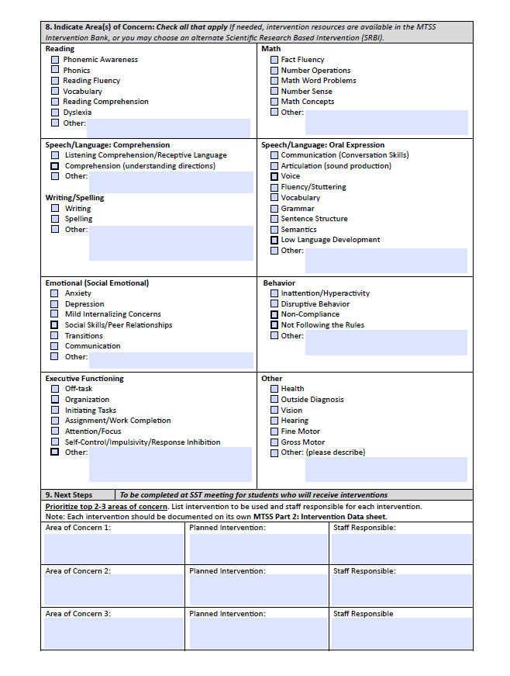

Slide 24
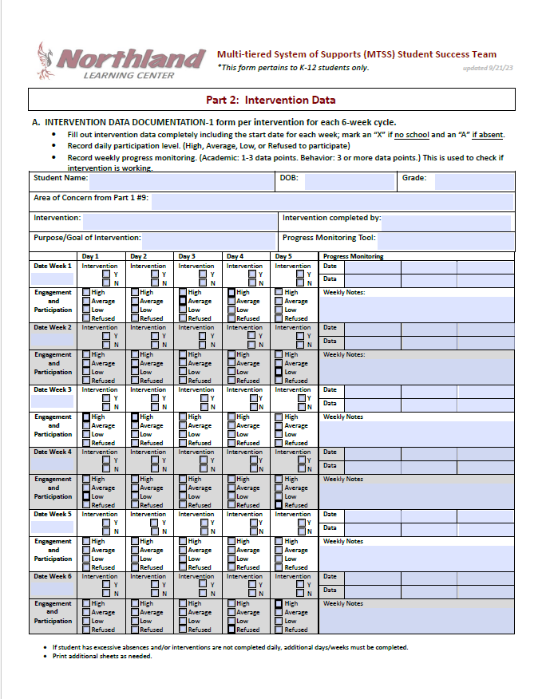

Slide 25
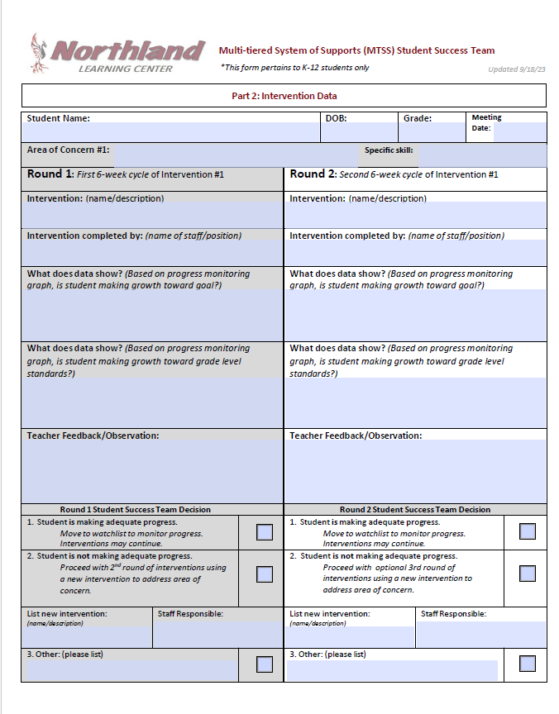
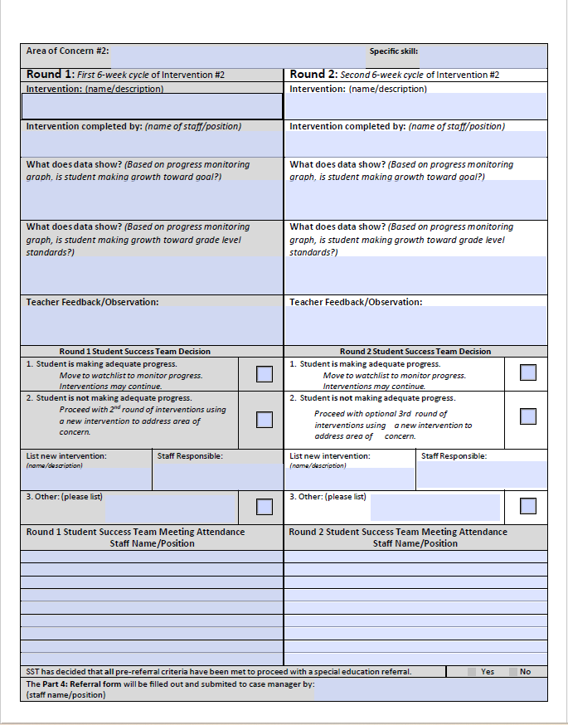

Slide 26
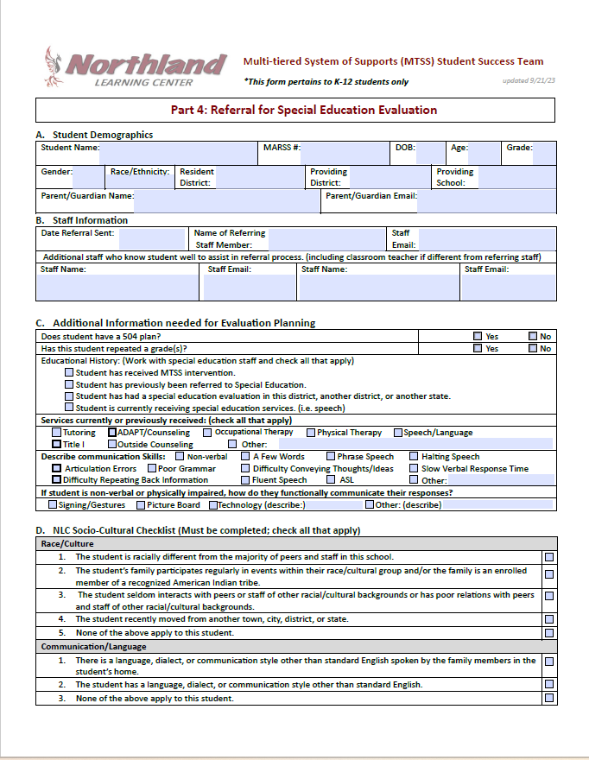
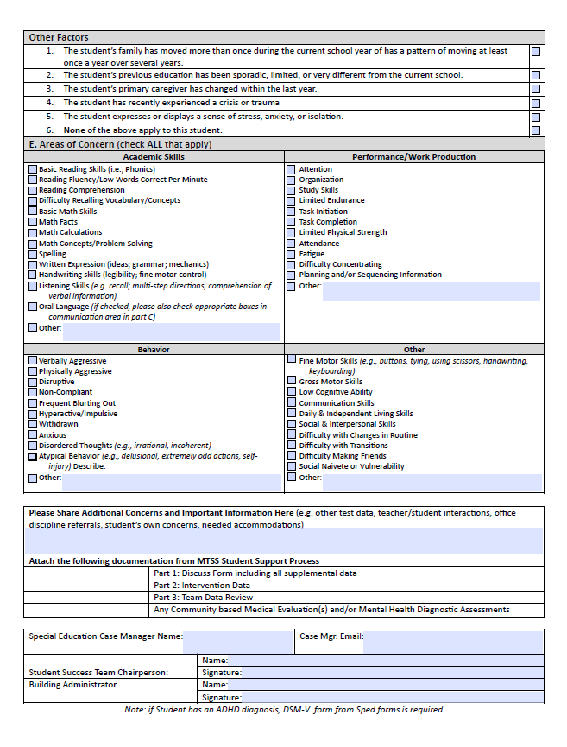

Slide 27

Take a BREAK

Slide 28
Case Studies
What would you do?
Notes:
Tina

Slide 29
Elementary Case Study
The following case study is an example using a fictitious elementary student. MTSS Part 1: Team Discussion, Part 2: Intervention Data, and Part 3: Team Data Review. These forms provide a framework for districts to follow when following the MTSS process for student interventions. As always, please reach out to your School Psychologist or Coordinator/Assistant Director with any questions.
Background Information:
Sam is a 9-year-old 3rd grader at Example Elementary. His teacher Mrs. Example has concerns about his reading. He has difficulty completing assignments and reads at a much slower pace than his peers. His teacher said he gives good effort but tends to shut down and will not complete reading assignments when things get too hard. Therefore his grades are suffering, and she is concerned that he will struggle to be successful in her class. Mrs. Exampleton is seeking out support from the Student Success Team to address these concerns.

Slide 30
His teacher provided the following information:
Benchmarks:
Fall STAR Reading 543
Winter STAR Reading 563
These scores are considered not meeting grade-level standards.
Grades:
Reading: U
Spelling: U
Math: S
Music: S
Gym: S
Library/Media: S
Interventions/Accommodations/Modifications that have been implemented:
Given lower-level reading materials to read that are differentiated from his peers.
Skill Deficits Identified:
Reading Fluency
Task Completion

Slide 31
High School Case Study
The following case study is an example using a fictitious elementary student. MTSS Part 1: Team Discussion, Part 2: Intervention Data, and Part 3: Team Data Review. These forms provide a framework for districts to follow when following the MTSS process for student interventions. As always, please reach out to your School Psychologist or Coordinator/Assistant Director with any questions.
Background Information:
Robby is a 16-year-old 10th grader at Sample High School. His teacher has concerns related to withdrawal, participation, task initiation, and work completion. He is currently failing most of his classes due to missing assignments. During English, he does not participate in classroom discussion, rarely communicates with his peers, often puts his head down, fidgets with his materials or his phone, or looks around the room during independent work time, and rarely turns in completed work. His other teachers have expressed similar concerns, but reported that he appears to have a small group of friends who he regularly interacts with in school. His parents have concerns regarding anxiety and his ability to concentrate and complete homework assignments on his own. He is seeing a therapist outside of the school and has diagnoses of Generalized Anxiety Disorder and Attention Deficit Hyperactivity Disorder, Inattentive Type. His parents have voiced their concerns to his English teacher, and he agreed that the Student Success Team should be consulted to address current concerns.

Slide 32
His teacher provided the following information:
Robby has missed 5 days of school (excused absences) and does not have any office discipline referrals. He passed the vision and hearing screening. Benchmarks (6th Grade – MCA Scores)
Reading - 651
Mathematics - 660
These scores meet the grade-level standards.
Grades: Percentage of Missing Assignments:
English – F 85%
American History – F 97%
Health – C 25%
Art – A 0%
Physical Science – F 89%
Geometry – F 79%
The following accommodations/modifications have been utilized by his teachers:
Robby will be given additional time to complete his classroom assignments.
His assignments will be modified to contain fewer items.
Robby will be allowed to take tests in a quiet room with fewer distractions.

Slide 33

MTSS Student Support Team Process Guide

Slide 34
Parent Request For Special Education Evaluation
Parent Requests - Administrative Led
Process for Parent Request for Special Education Evaluation
NEW! Admin Use:
Updated Parent Eval Request Form Letter
Guide for Admin Response to Parent Eval Request Form Letter
Referrals in Kindergarten
Academic referrals must be based on Minnesota Standards, not boxed curriculum
Kindergarten students must follow MTSS/Pre-Referral Intervention Process
Notes:
Updated links and form need to be done
Chris and Christi

Slide 35

What are your team’s next steps?

Slide 36
Questions & Save the Date
Student Success Team Train the Trainer - Phoenix Room at the NLC & Virtual
Each SST should send teams or 2-3 members (1 Administrator, SST Lead/Chair, 1 SST member)
Tuesday, Nov. 28 - Interventions & Progress Monitoring/Data Collection
8:30-11:30 Elementary
12:00-3:00 High School
Thursday, Jan. 25 - The Whole Child
8:30-11:30 Elementary
12:00-3:00 High School
Notes:
Train the Trainer Model-We are here to support your teams through this process
Surveys will be used to gather/share feedback.
Communication
In person schedule/supports

