Slide 1
Retiree HRA
Understanding Your Retirement Benefit

Slide 2
Retiree HRA 101
Interest-bearing account in your name
Employer deposits money
Money invested in a fixed annuity, currently guaranteeing a 1.65% interest rate through 2024*
Use for medical expenses and premiums to offset your out-of-pocket costs
Guarantees are subject to the claims paying ability of American United Life Insurance Company.
* American United Life Insurance Company’s unallocated group Fixed Annuity. Not FDIC insured. Based on the claims-paying ability of the investment provider.

Slide 3
Your Plan Details
Fill in details here.

Slide 4
Why Use an HRA?
Contributions are not taxed.
Distributions are not taxed.
Interest is not taxed.

Slide 5
HRA: Your Rainy Day Fund
If you need it, it’s there
If you don’t need it, it rolls over every year
And grows tax-free
Expenses do not expire—you can submit expenses that were incurred after you retired or separated from service at any time

Slide 6
Eligible Medical Expenses
Physician visits
Prescription medication
Dental Care
Nursing home care
Eye care
Co-pays or deductibles
Medical insurance premiums
Etc.

Slide 7
Qualifying Insurance Premiums
Health, Dental, Vision, and Long-Term Care Insurance
Medicare Part B, Part C, and Part D and Medicare Supplements
Individual Policies on and off the Exchange
Employer-Sponsored Group Health Coverage (as long as not paid with pre-tax payroll deductions)

Slide 8
Who Can Benefit from Your HRA?
Individuals who qualify for reimbursement:
You
Your spouse
Qualifying dependents
Surviving spouse and qualifying dependents
Beneficiary(s)
Funds first made available to surviving spouse and surviving qualifying dependents tax-free for the reimbursement of eligible medical expenses/premiums. If there is no surviving spouse and no surviving eligible dependents, the funds made available to beneficiary.
Reimbursements are taxable to the beneficiary
Can elect a beneficiary online through the participant portal

Slide 9
Claim Submission Options
ONLINE
APP
CARD
MAIL
Submit claim securely online through the MidAmerica Journey Participant Portal
Submit claim securely through the Journey mobile app
Pay for claims at the point of sale with the Journey Benefits Card
Mail claim form to:
PO Box 24927 Lakeland, FL 33802

Slide 10
Accessing Your Online Account Logging into MidAmerica Journey for the First Time
Go to www.myMidAmericaJourney.com.
Select Create Your New Username and Password.
Enter your identifying details, establish your security questions and choose a username and password.

Slide 11
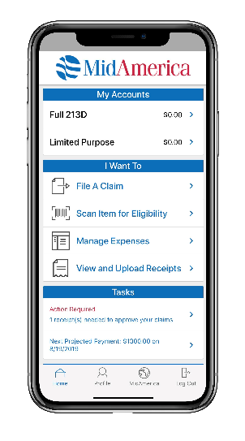
MidAmerica Journey Portal Resources
24/7 Account Access
Online Claims Submission
Debit Card Management
Journey mobile app
Manage personal information and communication options (Manage direct deposit, sign up for text and email communications)

Slide 12
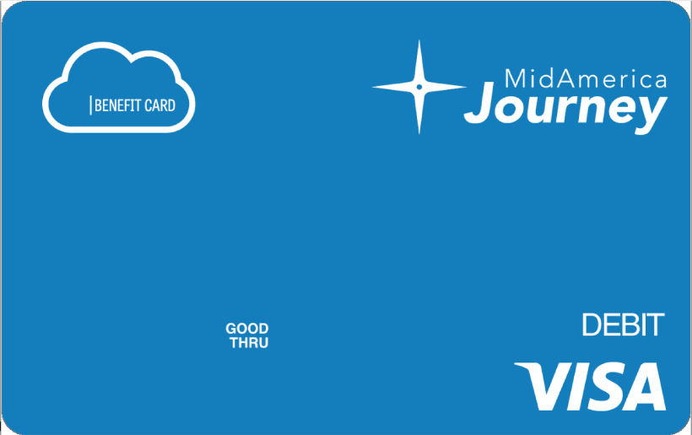
Debit Card: Documentation
Eliminates need for claim forms and out-of-pocket payments at the point-of-sale
Can be used anywhere from a doctor’s office to a local pharmacy for eligible medical expenses
Supporting documentation may still be required to substantiate debit card purchases/adjudicate a claim
Balances and transactions accessible via MidAmerica Journey or via the Journey mobile app

Slide 13
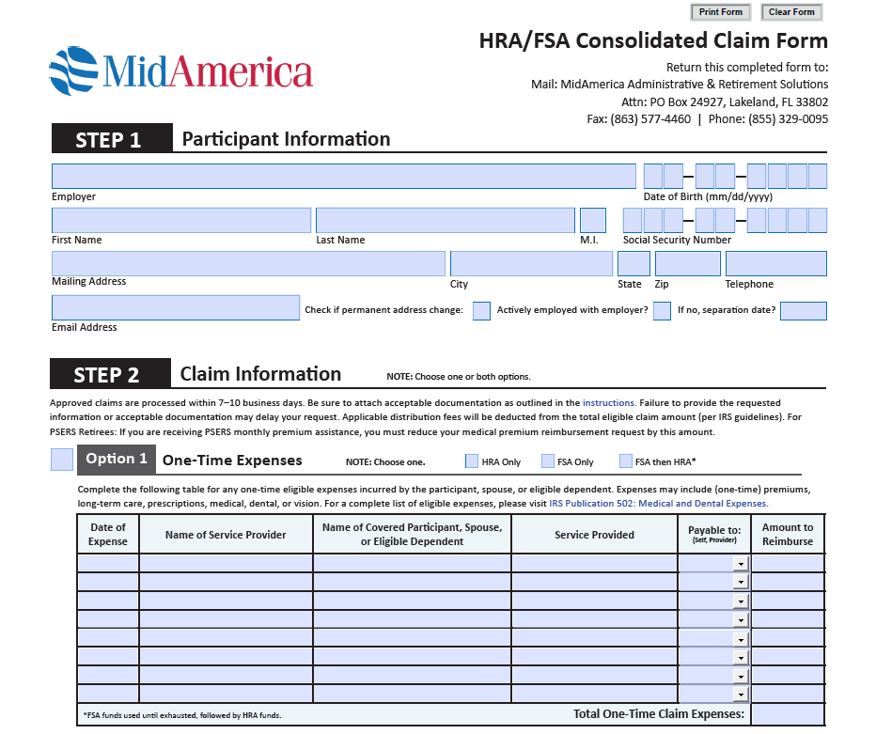
Submitting Paper Claims
Claim Form
Include receipts or other documentation
Mail or fax
10 business days for reimbursement
$5 fee for each reimbursement request not submitted through the Journey portal or Journey mobile app

Slide 14
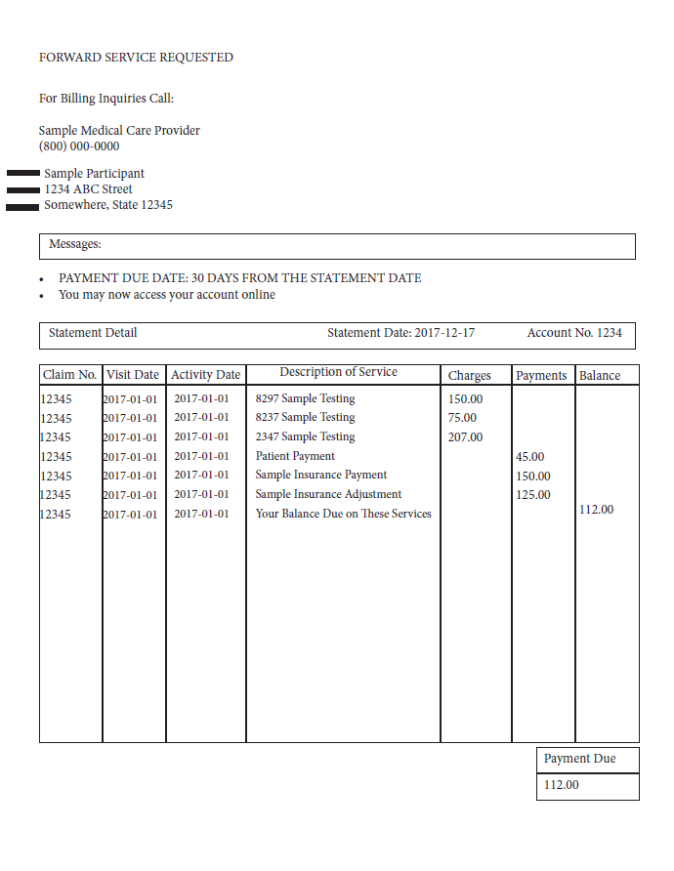
Documentation: Good vs. Bad
Good!
Itemized statement (left), Explanation of Benefits (EOB), Co-Pay receipts, or invoices if no insurance
Contains date of service, type of service, service amount and participant name*
*identifying details have been removed from example.

Slide 15
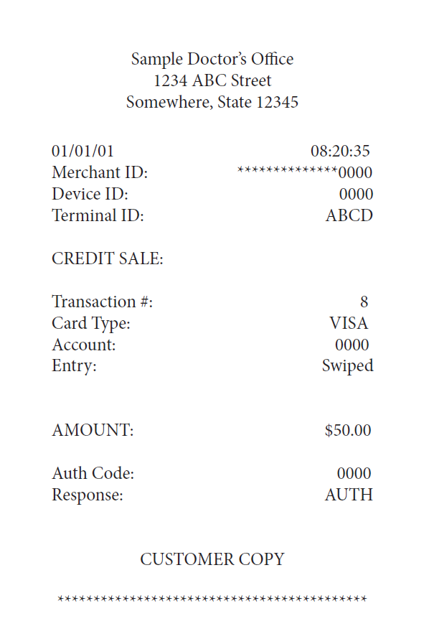
Documentation: Good vs. Bad
Bad
Only includes total amount paid
Doesn’t include breakdown of services
*identifying details have been removed from example.

Slide 16
Documentation: Premiums
Premium Notice from your insurance company that includes:
Type of Premium
Premium Amount
Effective Date of Coverage
Name of insured—you, your spouse, or another qualifying dependent
Insurance Premiums must be due or incurred before reimbursement. Exception is Long-Term Care premiums—these must be paid before reimbursement and proof of payment must be included with supporting documentation.
Recurring premium reimbursements remain in effect for the earlier of 12 months or when your premium changes*
*New claim form or online submission with required documentation must be submitted to renew recurring claim after 12 months

Slide 17
Recurring Premium Claim Process
Step One – decide how to pay your insurance premiums directly to providers/employer in retirement
Automatic payments from your personal checking or savings account?
Step Two – set up Recurring Premium Claim with MidAmerica
Set up Recurring Premium Claim online at www.myMidAmericaJourney.com, through the MidAmerica Journey mobile app, or complete a paper claim form. Supporting documentation is required when using any method and supporting documentation is critical!
Once you set up your recurring premium claim, MidAmerica will send you a monthly payment each month for up to the next 12 months
Monthly payments will be sent to you one month in advance
MidAmerica can send funds to you via direct deposit to the same checking/savings account you use to pay your insurance premiums as outlined in Step One
Step Three – After 12-months, payments will cease until you submit a new Recurring Premium Claim and supporting documentation!

Slide 18
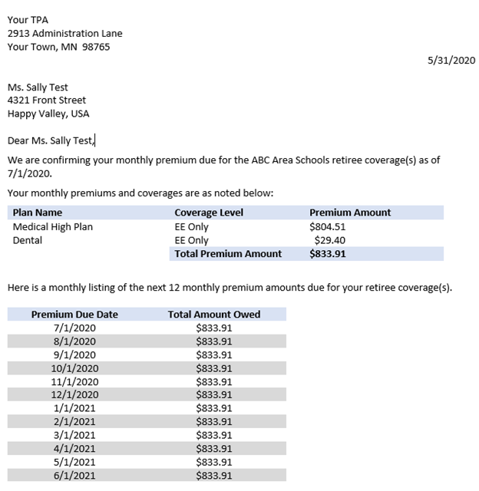
Documentation Example Premium Notice
Provided by Retiree Billing/COBRA TPA
Contains:
Coverage period
Name of covered individual
Premium amount
Coverage type
Name of insurance provider
*Identifying details have been removed from example.

Slide 19
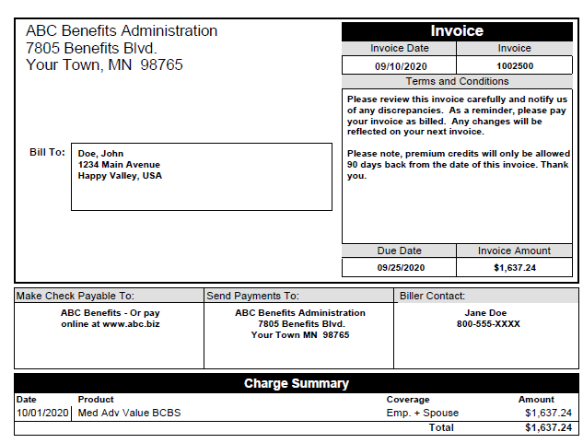
Documentation Example Premium Invoice
Provided by insurance provider
Contains:
Coverage period
Name of covered individual
Premium amount
Coverage type
Name of insurance provider
*Identifying details have been removed from example.

Slide 20
Questions?

Slide 21
Customer Service Hours:
Monday through Friday, 8:30 a.m. – 6 p.m. ET
Online Inquiry through myMidAmerica.com
healthaccountservices@myMidAmerica.com
Send All Forms To:
U.S. BENCOR/MidAmerica Attn: HRA Dept. PO Box 24927 Lakeland, FL 33802-0149
Fax: (863) 577-4460
Call (855) 329-0095
21

Slide 22
All group variable annuity contracts are issued by American United Life Insurance Company®, a OneAmerica® company (AUL), One American Square, Indianapolis, IN 46206-0368, (800) 249-6269. Registered group variable annuity contracts are distributed by OneAmerica Securities, Inc., Member FINRA, SIPC, a Registered Investment Advisor, 433 N. Capitol Ave., Indianapolis, IN 46204, (877) 285-3863.
U.S. BENCOR/MidAmerica and National Insurance Services are not affiliates of AUL or OneAmerica Securities and are not OneAmerica companies.
Neither AUL, OneAmerica Securities, Inc., nor their representatives provide tax or legal advice. For answers to your specific questions, please consult a qualified attorney or tax advisor.
22

