Slide 1
Special Pay Plan
Understanding Your Retirement Benefit

Slide 2
Special Pay 101
Type of 403(b) account
Fixed annuity investment, not subject to market risk. Credited rate is guaranteed not to fall below 1.65% through 2024*
Employer deposits money for unused sick leave, unused vacation pay, separation of service pay, or other retirement incentive pay
Guarantees are subject to the claims paying ability of American United Life Insurance Company.
* American United Life Insurance Company’s unallocated group Fixed Annuity. Not FDIC insured. Based on the claims-paying ability of the investment provider.

Slide 3
Your Plan Details
Fill in details here.

Slide 4
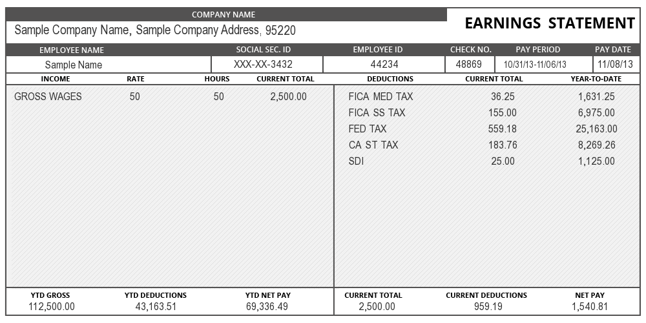
Why Use a Special Pay Plan?
Problem
Too many taxes.
Solution
Eliminate 7.65% FICA tax.

Slide 5
Plan Is Tax-Deferred
Tax-Deferred Means:
Tax bracket may be lower after retirement
Withdrawal later may mean less income tax

Slide 6
How Tax-Deferment Works
25%
Tax Bracket
15%
Tax Bracket
Paycheck
Unused sick leave, vacation pay, or other retirement incentive | $10,000
FICA Tax | -$765
Income Tax | -$2,500
Total | $6,735
Special Pay Plan
Unused sick leave, vacation pay, or other retirement incentive | $10,000
FICA Tax | -$0
Income Tax | -$1,500
Total | $8,500

Slide 7
When Is a Good Time To Withdraw?
SPP funds are a taxable distribution. This means:
Use funds that have already been taxed first
Time withdrawals when your tax bracket is lower
Compare rates

Slide 8
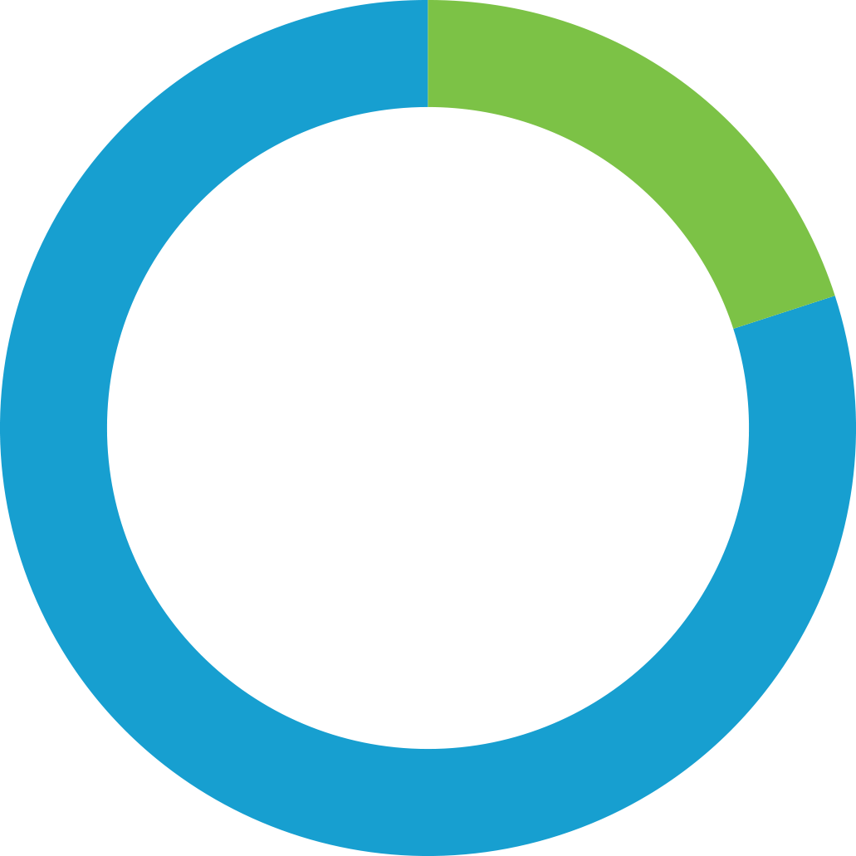
Is Tax Withheld When I Withdraw?
No FICA tax…ever
Mandatory 20% will be withheld for federal tax
When you file taxes in April, your final tax rate will be determined
State taxes may be withheld
80% | 20%
80%

Slide 9
Your Funds Are Liquid
Must be at least 59½ to take distribution without 10% early distribution penalty
No 10% early distribution penalty if you are at least 55 when you retire or separate from service (and remain separated)
Request funds by completing U.S. BENCOR/ MidAmerica's Retirement Plan Transaction Form
Time frame 7-10 business days
No surrender fees

Slide 10
Substitute and Part-Time Work
The IRS does not consider you retired if:
You return to work between age 55 and 59½…
And you work more than 20% of your pre-retirement schedule for this specific district
What this means:
You should not withdraw funds during the time you are working
If you do withdraw funds, you will receive 10% early distribution penalty

Slide 11
Online Account Access
Go to www.myMidAmerica.com
Select Account Access, then Participant Login
If logging in for the first time, click New User in the top-left corner of the login title. Enter your Social Security Number (no dashes), Birthdate, and Zip Code, then click Next. You’ll be asked to re-enter your Birthdate and Zip Code and click Next on the Request Credentials tile. You can now select your security questions, set up your login credentials, and enter your contact information.
If you have logged in before, simply enter your established credentials
11

Slide 12
Designating a Beneficiary – Online
Designating a Beneficiary is a secure online form
Log into your account at www.myMidAmerica.com. Once logged in, select the settings icon located in the upper right-hand corner of the screen. Note: This is a small gear icon . Next, select Beneficiaries. From here you can enter your beneficiary information.
12

Slide 13
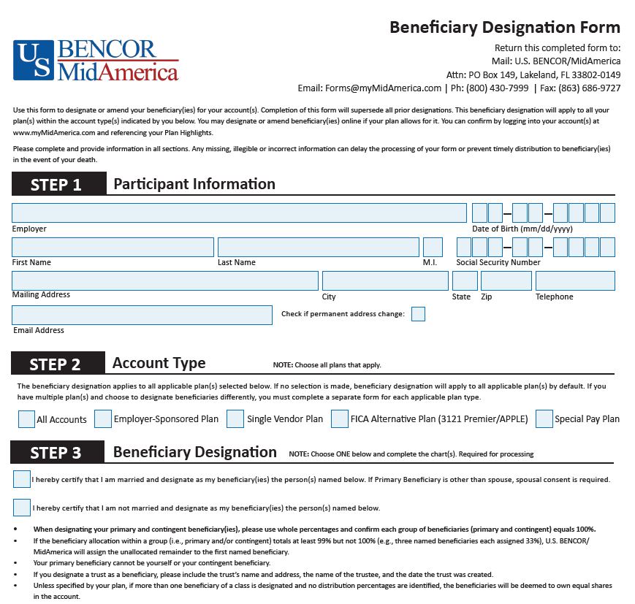
Designating a Beneficiary – Download
Complete the Beneficiary Designation Form
To download the Beneficiary Designation Form, visit www.myMidAmerica.com and select Forms & Reports from the blue header, then Forms
You can also request the form by calling 800.430.7999
Email, mail, or fax to U.S. BENCOR/MidAmerica
13

Slide 14
Requesting Distributions – Online
Effortless Distribution is a secure online request form
Easily submit and process your distributions quicker
Log into your account at www.myMidAmerica.com. Once logged in, select Request a Distribution from the Transactions dropdown menu. First time user? Set up your account by selecting New User from the login screen.
14

Slide 15
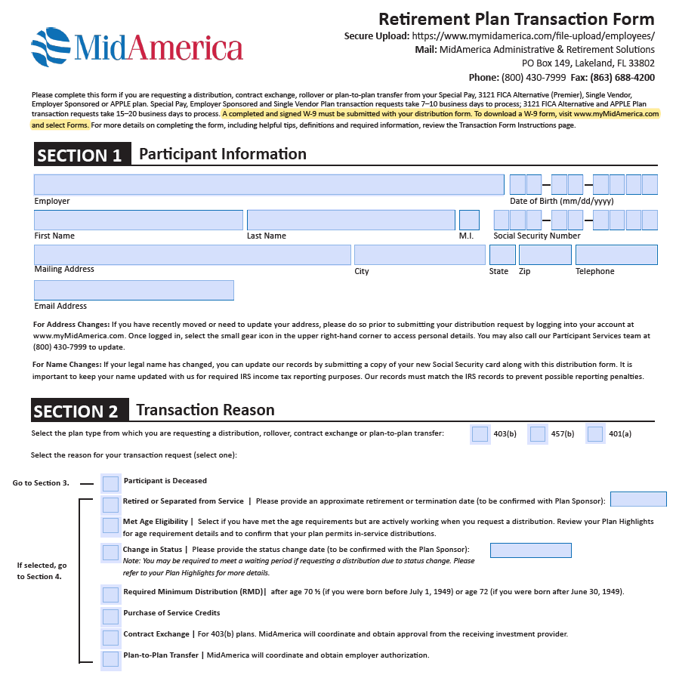
Requesting Distributions - Download
Complete the Retirement Plan Transaction Form
To download the Retirement Plan Transaction Form, visit www.myMidAmerica.com and select Forms
Secure upload, mail, or fax to U.S. BENCOR/MidAmerica

Slide 16
Questions?

Slide 17
Customer Service Hours:
Monday through Friday, 8:30 a.m. – 6 p.m. ET
Online Inquiry through myMidAmerica.com
accountservices@myMidAmerica.com
Send All Forms To:
U.S. BENCOR/MidAmerica Attn: SP Admin. PO Box 149 Lakeland, FL 33802-0149
Fax: (863) 688-4200
Call (855) 329-0097
17

Slide 18
All group variable annuity contracts are issued by American United Life Insurance Company®, a OneAmerica® company (AUL), One American Square, Indianapolis, IN 46206-0368, (800) 249-6269. Registered group variable annuity contracts are distributed by OneAmerica Securities, Inc., Member FINRA, SIPC, a Registered Investment Advisor, 433 N. Capitol Ave., Indianapolis, IN 46204, (877) 285-3863.
U.S. BENCOR/MidAmerica and National Insurance Services are not affiliates of AUL or OneAmerica Securities and are not OneAmerica companies.
Neither AUL, OneAmerica Securities, Inc., nor their representatives provide tax or legal advice. For answers to your specific questions, please consult a qualified attorney or tax advisor.
18

