Slide 1

Red Wing Public Schools, ISD 256
Public Hearing for Taxes Payable in 2026
December 15, 2025
Presented By:
Christopher Muhvich,
DIRECTOR OF FINANCE AND OPERATIONS

Slide 2

Truth in Taxation Law
Minnesota’s Truth in Taxation Law requires that cities, counties and school districts follow certain steps before adopting a tax levy for the following year.
  The law requires a mailed notice to each property owner in the county, which describes the tax levies proposed by the city, county and school district and what percent increase (decrease) such a levy would mean in dollars.
  School districts are required to hold a single meeting in which the public is allowed to speak, and the budget and levy is discussed. This meeting may be part of a regularly scheduled meeting but must occur after 6:00 P.M.
  The meeting date and location must be provided at the same time or prior to certifying the proposed property tax levy. The meeting date must be between November 25th and December 29th.
  You are here tonight as part of the school district’s public meeting process.

Slide 3

Requirements of the Truth in Taxation Public Meeting
  Discuss proposed property tax levy for taxes payable 2026.
  Provide and discuss information on the current budget (2025-2026).
  Public must be given a reasonable amount of time to comment on the proposed property tax levy and budget and to ask questions. - Minnesota Statute 275.065

Slide 4

Points to Remember
Revenue formulas are se
Revenue formulas are set by the State Legislature except for voter approved referendums.
Local Levy and State Aid mix are set by the State Legislature.
An increase in local taxes does not necessarily mean an increase in revenues for the school district. - Minnesota Statute 275.065

Slide 5
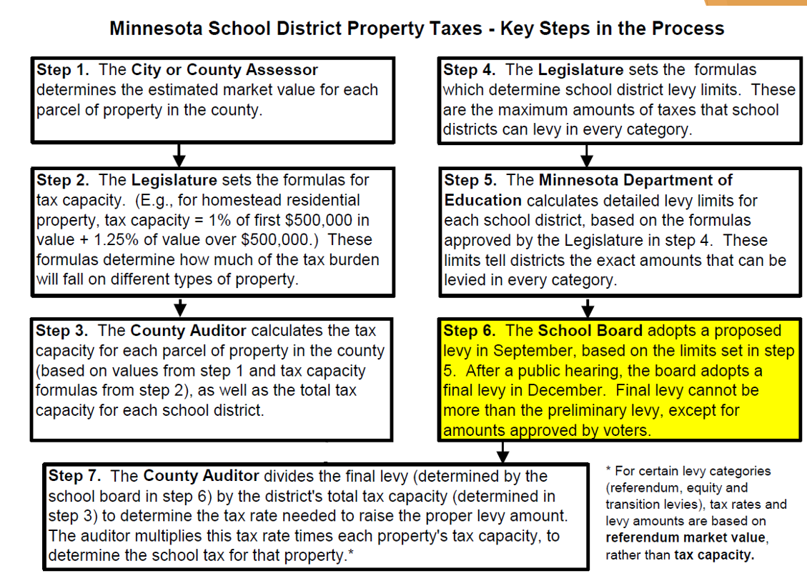
Key Steps

Slide 6
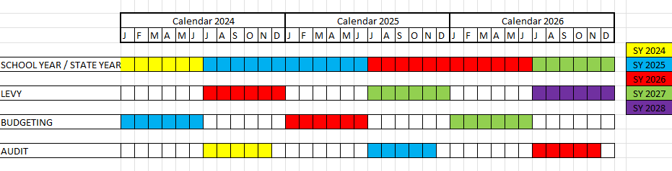
Levy Cycles

Slide 7
Red Wing Public Schools
  School District Budget
  Current School Year
  2025-2026

Slide 8

Fund Accounting Overview
All school districts’ budgets are divided into separate funds, as required by law.
For our District, there are four funds:
GENERAL FUND (Fund 01)
  Revenue is based on student enrollment
  The local referendum levy is part of the General Fund
  Provides for classroom instruction, instructional supplies and equipment, and other educational activities
  Special Education, and State / Federal Mandated Programs
  Extra-curricular Activities / Student Activities
  Pupil Transportation
  Facilities Operation and Maintenance
  Capital Expenditures and Improvements
  Health and Safety Code Compliance

Slide 9

Fund Accounting Overview
2. FOOD SERVICE (Fund 02)
  School Breakfast and Lunch Program
3. COMMUNITY SERVICE (Fund 04)
  Levy is based on adult population in the District
  Early childhood levy is based on the number of children under 5 years of age
  Provides for enrichment programs for any age level that are not part of the K-12 education program
  Early Childhood Family Education
  School Readiness
  Adult Basic Education
4. DEBT SERVICE (Fund 07)
  Based on annual debt retirement schedules for the district’s outstanding bonded indebtedness. Annual levy is for the payment of principal and interest on bonds as due. Current debt is a result of the voter approved Bond Issue for ________.

Slide 10
Red Wing Public Schools

Slide 11
Red Wing Public Schools
General Fund Revenue Budget
Where Do Our School Revenues Come From?

Slide 12
Red Wing Public Schools

Slide 13
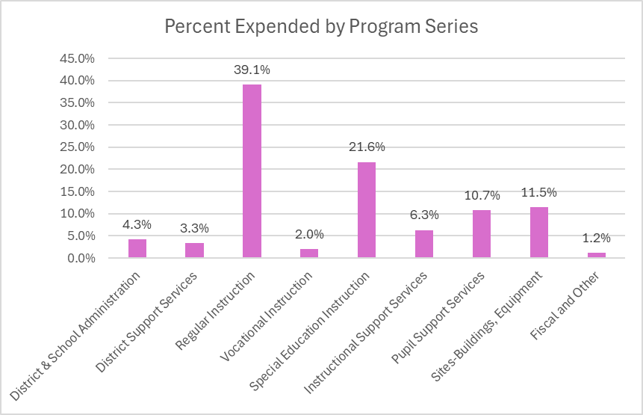
Red Wing Public Schools
HOW ARE GENERAL FUND DOLLARS SPENT?
Expenses incurred in the operation of the district are paid from the General Fund. The following schedule relates how the dollars allocated to the General Fund are spent:

Slide 14
Red Wing Public Schools
General Fund Expenditure Budget
What Do Our Expenditures Pay For?

Slide 15

Components of the Projected General Fund Balance at June 30, 2026
Red Wing Public Schools

Slide 16

Red Wing Public Schools
School District Levy
The current levy is 2025 Payable 2026
This levy will be certified in 2025
This levy will be collected in 2026
This levy will be recognized as revenue in Fiscal Year 2027
Authority for School Levies
A School District Tax Levy must be either:
Set by State Formula
OR
Voter Approved

Slide 17
Red Wing Public Schools
Factors Impacting Tax Change
Issues Driven by Legislative Decisions:
    Change in sales ratio (impacting ANTC)
    Change in tax capacity rate structure
    Laws mandating code compliance (Health & Safety and Buildings)
Issues Determined by District Voters:
    Voter approved building bond issue
    Voter approved excess levy referendum

Slide 18
Factors Impacting Tax Change
    Local Factors:
      Inflationary pressure on real estate market
      Abatements
      Property improvements not previously taxed
      Change in individual assessed market value
      Possible change in property classification (e.g. homestead to rental)
Red Wing Public Schools

Slide 19

Red Wing Public Schools
How will your 2026 school taxes be spent? Percent
General Fund
Provides additional funding for district instructional
Programs by means of the approved excess referendum.
Provides funds for operating capital expenses,
building/land lease, and Health & Safety costs: 77%
Community Education Fund
Levy for Community Education Programs: 6%
Debt Service
Levy for repayment of principal and interest on
district debt: 17%
Total Levy Before Credits: 100.0%

Slide 20
Red Wing Public Schools

Slide 21
Red Wing Public Schools

Slide 22
What are the main variables that cause property tax increases and decreases?
  Changes in market values, classification or class rates
  Change in property tax credits (e.g. change in Homestead Benefit from a credit to an exclusion)
  Voter approved referendums
  Increases or decreases in levy amounts caused by changes in state funding formulas
Red Wing Public Schools

Slide 23

Red Wing Public Schools
What are the main variables that cause property tax increases and decreases?
    The value of your property may increase or decrease
    The value of other properties may increase or decrease and change the share that your property is of the total tax base, whether your property’s value changed or not.
    School Board Actions.

Slide 24
Red Wing Public Schools
Whereas, Pursuant to Minnesota Statutes the School Board of Red Wing Public Schools, Red Wing, Minnesota, is authorized to make the following proposed tax levies for general purposes:
  Maintenance (General Fund) 7,888,154.61
      (Includes Referendum)
  Community Service 638,027.06
  Debt Service 1,693,982.62
  Total Proposed School Tax Levy $10,220,164.29
Now Therefore, Be it resolved by the School Board of Red Wing public Schools School District, Red Wing, Minnesota, that the levy to be levied in 2025 to be collected in 2026 is set at $10,220,164.29. The clerk of the Red Wing Public Schools School Board is authorized to certify the proposed levy to the County Auditor of Goodhue County, Minnesota.

